Slide 1
European union of medical specialists
The advocate of medical specialists

Slide 2
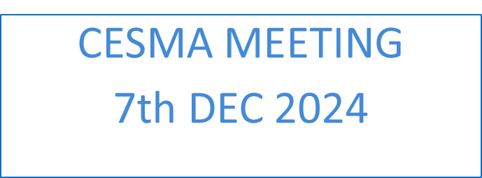
UEMS – UEMO Council meeting report
Bertrand DAVAL – DEC 2024

Slide 3
A joint Council meeting
European Medical Organisations
2 common sessions
Recognizing General Practice/Family medicine as a specialty in Europe
Physician Assistants/Associates in healthcare: the implications for standards of practice and patient safety

Slide 4
UEMS Council update – ETRs & Statements
Adoption of the European Training Requirements for:
Ophthalmology
Othopaedics & Traumatology
Plastic and Reconstructive Surgery
The competency of Rare Neurological Diseases
Endorsment of the UEMS Planetary Health position paper

Slide 5
Constitutional Matters
New Statutes and RoPs voted. Updating of the Explanatory Notes in progress
Creation of a new UEMS Section in Sports Medicine
Presentation of the Montenegrin Medical Chamber (potential new UEMS Associate Member)

Slide 6
UEMS Congress 2026

Slide 7
Get in touch with our office
Bertrand Daval, CEO  ceo@uems.eu
Amélia Donighian, Coordinator  coordination@uems.eu
Isabelle Dumaine, EU Policy & Public relations Officer  isabelle@uems.eu
EACCME®
accreditation@uems.eu
And follow us
European Union of Medical Specialists
@UEMSEurope

