Slide 1
European Examination in Core Cardiology
Experience with AI in the European Examination in Core Cardiology
Chris Plummer Clive Lawson Stephanie Thibault Danny Mathysen
Notes:
]23 April 2022 – 30min + questions

Slide 2
What is the EECC ?
test of core cardiology knowledge for independent practice
based on ESC core curriculum and UEMS cardiology ETR, guidelines and CardioMed textbook
120 MCQs (text/image/video) – BOF, short, English, random order
3-hours on-line with remote proctoring
robust governance
ESC – UEMS – independent academic analysis
transparency
best practice for high-stakes exams
international collaboration – a service to national cardiology societies

Slide 3
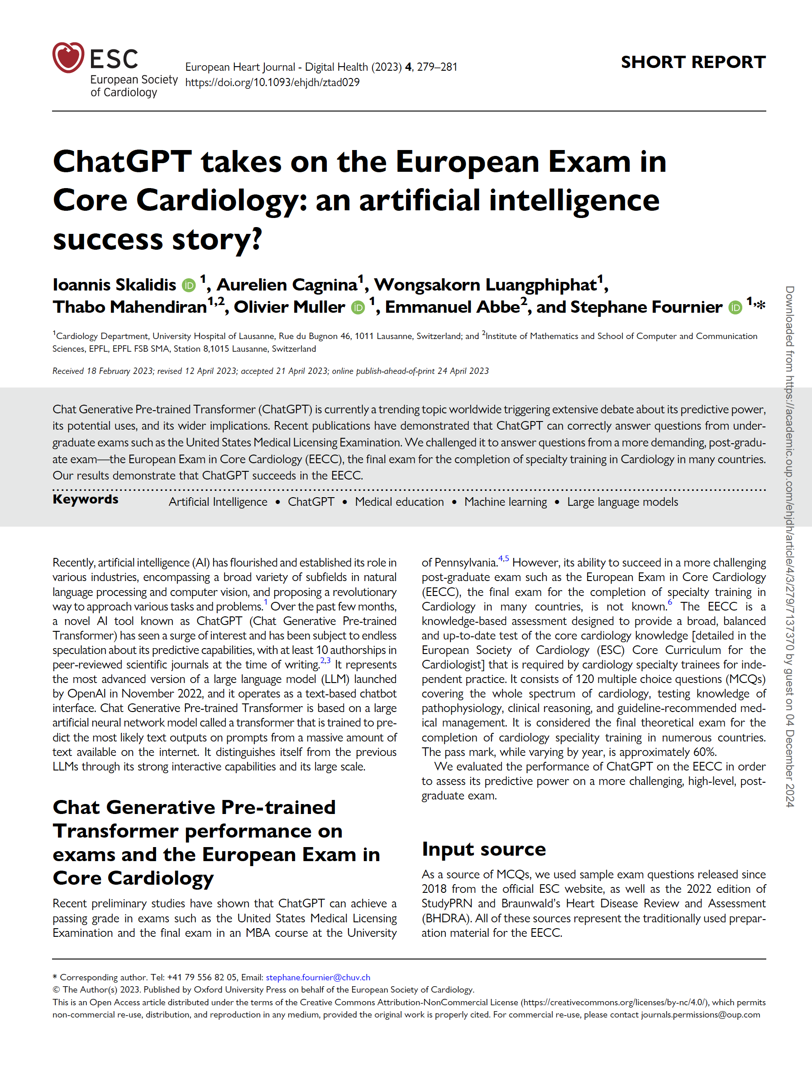
Publication – 24 April 2023
“Our results demonstrate that ChatGPT succeeds in the EECC”
ChatGPT takes on the European Exam in Core Cardiology: an artificial intelligence success story?
Ioannis Skalidis , Aurelien Cagnina, Wongsakorn Luangphiphat, Thabo Mahendiran, Olivier Muller, Emmanuel Abbe, and Stephane Fournier. European Heart Journal - Digital Health (2023) 4, 279

Slide 4
Publication – 24 April 2023
First thoughts…
Did someone cheat in the EECC? How?
How did they get hold of EECC questions?
Is our question bank compromised?
What have they done - how did they do it?
Why didn’t they contact us?
What implications does this have for the EECC?
What should we do?
Should we publish a response?
ChatGPT takes on the European Exam in Core Cardiology: an artificial intelligence success story?
Ioannis Skalidis , Aurelien Cagnina, Wongsakorn Luangphiphat, Thabo Mahendiran, Olivier Muller, Emmanuel Abbe, and Stephane Fournier. European Heart Journal - Digital Health (2023) 4, 279

Slide 5
Publication – 24 April 2023
First thoughts…
Did someone cheat in the EECC? How? No
How did they get hold of EECC questions? They didn’t
Is our question bank compromised? No
What have they done and how did they do it?
Why didn’t they contact us to collaborate?
What implications does this have for the EECC?
What should we do?
Should we publish a response?
ChatGPT takes on the European Exam in Core Cardiology: an artificial intelligence success story?
Ioannis Skalidis , Aurelien Cagnina, Wongsakorn Luangphiphat, Thabo Mahendiran, Olivier Muller, Emmanuel Abbe, and Stephane Fournier. European Heart Journal - Digital Health (2023) 4, 279

Slide 6
Methods
488 sample exam questions released since 2018 - ESC website (88) - Braunwald’s Heart Disease Review and Assessment (200) - StudyPRN 2022 (200)
Questions containing images removed - ESC website - 20 (23%) leaving 68 - Braunwald’s Heart Disease – 50 (25%) leaving 150 - StudyPRN 2022 – 56 (28%) leaving 144
ChatGPT takes on the European Exam in Core Cardiology: an artificial intelligence success story?
Ioannis Skalidis , Aurelien Cagnina, Wongsakorn Luangphiphat, Thabo Mahendiran, Olivier Muller, Emmanuel Abbe, and Stephane Fournier. European Heart Journal - Digital Health (2023) 4, 279

Slide 7
Methods
488 sample exam questions released since 2018 - ESC website (88) - Braunwald’s Heart Disease Review and Assessment (200) - StudyPRN 2022 (200)
Questions containing images removed - ESC website - 20 (23%) leaving 68 - Braunwald’s Heart Disease – 50 (25%) leaving 150 - StudyPRN 2022 – 56 (28%) leaving 144
ChatGPT takes on the European Exam in Core Cardiology: an artificial intelligence success story?
Ioannis Skalidis , Aurelien Cagnina, Wongsakorn Luangphiphat, Thabo Mahendiran, Olivier Muller, Emmanuel Abbe, and Stephane Fournier. European Heart Journal - Digital Health (2023) 4, 279

Slide 8
Methods
362 questions used as the input to ChatGPT
Responses were compared with the correct answers by the authors and classified as: - correct - indeterminate - incorrect
ChatGPT takes on the European Exam in Core Cardiology: an artificial intelligence success story?
Ioannis Skalidis , Aurelien Cagnina, Wongsakorn Luangphiphat, Thabo Mahendiran, Olivier Muller, Emmanuel Abbe, and Stephane Fournier. European Heart Journal - Digital Health (2023) 4, 279

Slide 9
Methods
362 questions used as the input to ChatGPT
Responses were compared with the correct answers by the authors and classified as: - correct - indeterminate - incorrect
ChatGPT takes on the European Exam in Core Cardiology: an artificial intelligence success story?
Ioannis Skalidis , Aurelien Cagnina, Wongsakorn Luangphiphat, Thabo Mahendiran, Olivier Muller, Emmanuel Abbe, and Stephane Fournier. European Heart Journal - Digital Health (2023) 4, 279

Slide 10
Results
source | ESC website | BHDRA | StudyPRN | TOTAL
correct | 42 (62%) | 79 (53%) | 92 (64%) | 213 (59%)
indeterminate | 4 | 11 | 7 | 22 (6%)
incorrect | 22 | 60 | 45 | 127 (35%)
images | 20 | 50 | 56 | 126
TOTAL | 88 | 200 | 200 | 488
ChatGPT takes on the European Exam in Core Cardiology: an artificial intelligence success story?
Ioannis Skalidis , Aurelien Cagnina, Wongsakorn Luangphiphat, Thabo Mahendiran, Olivier Muller, Emmanuel Abbe, and Stephane Fournier. European Heart Journal - Digital Health (2023) 4, 279

Slide 11
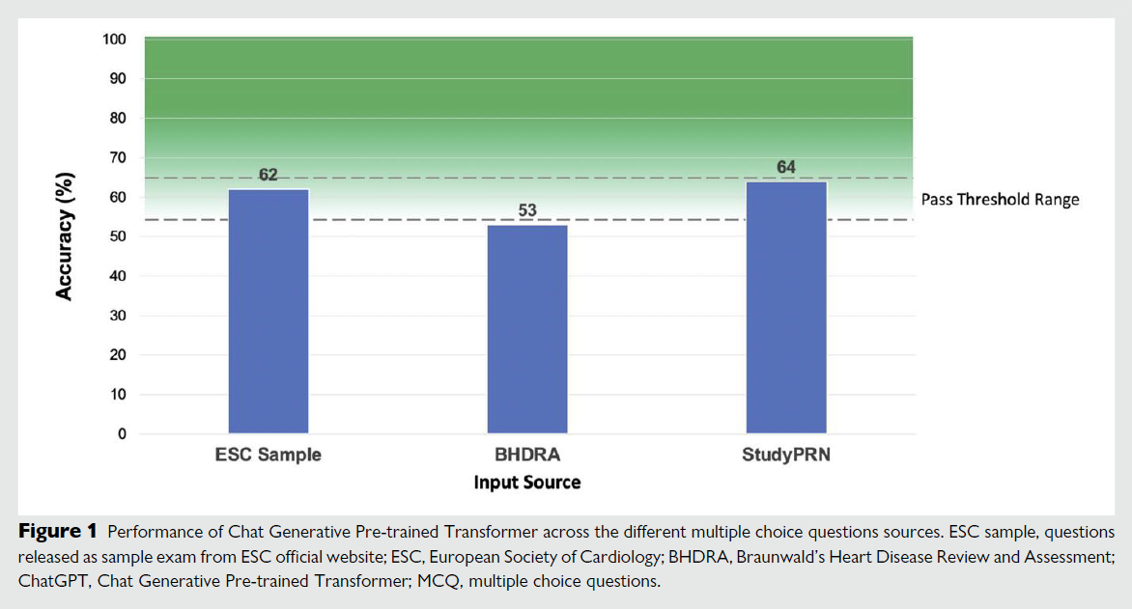
Results
ChatGPT takes on the European Exam in Core Cardiology: an artificial intelligence success story?
Ioannis Skalidis , Aurelien Cagnina, Wongsakorn Luangphiphat, Thabo Mahendiran, Olivier Muller, Emmanuel Abbe, and Stephane Fournier. European Heart Journal - Digital Health (2023) 4, 279

Slide 12
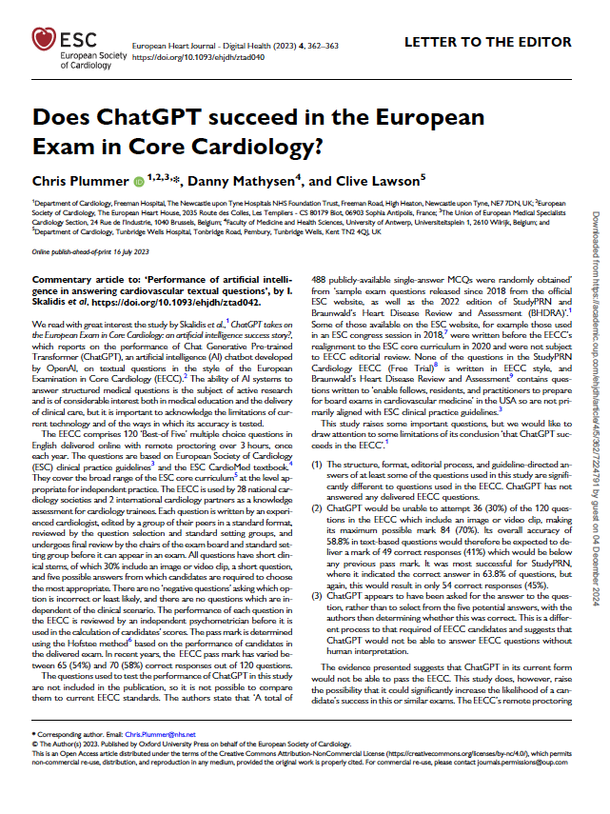
Response
“The evidence presented suggests that ChatGPT in its current form would not be able to pass the EECC”
Does ChatGPT succeed in the European Exam in Core Cardiology?
Chris Plummer, Danny Mathysen, and Clive Lawson. European Heart Journal - Digital Health (2023) 4, 362–363 https://doi.org/10.1093/ehjdh/ztad040

Slide 13
Response
Questions content tested was not representative of the EECC
It is not possible to know the content of the questions (not published) – cannot compare to EECC standards
Some questions on the ESC website since 2018 were published before the realignment of the EECC to the current Core Curriculum for the Cardiologist (Tanner et al. European Heart Journal 2020 41, 3605–3692)
BHDRA questions are written to ‘enable fellows, residents, and practitioners to prepare for board exams in cardiovascular medicine’ in the USA so are not primarily aligned with ESC clinical practice guidelines
Questions written aligned to old guidelines
Does ChatGPT succeed in the European Exam in Core Cardiology?
Chris Plummer, Danny Mathysen, and Clive Lawson. European Heart Journal - Digital Health (2023) 4, 362–363 https://doi.org/10.1093/ehjdh/ztad040

Slide 14
Response
The structure of questions tested was not consistent with the EECC
The structure, format, editorial process, and guideline-directed answers of at least some of the questions used in this study are significantly different to questions used in the EECC
None of the StudyPRN questions is written in EECC style
ChatGPT has not answered any delivered EECC questions
Does ChatGPT succeed in the European Exam in Core Cardiology?
Chris Plummer, Danny Mathysen, and Clive Lawson. European Heart Journal - Digital Health (2023) 4, 362–363 https://doi.org/10.1093/ehjdh/ztad040

Slide 15
Response
ChatGPT was unable to answer questions containing images
ChatGPT would be unable to attempt 36 (30%) of the 120 questions in the EECC which include an image or video clip, making its maximum possible mark 84 (70%)
Its overall accuracy of 58.8% in text-based questions would therefore be expected to deliver a mark of 49 correct responses (41%) which would be below any previous pass mark
It was most successful for StudyPRN, where it indicated the correct answer in 63.8% of questions, but again, this would result in only 54 correct responses (45%).
Does ChatGPT succeed in the European Exam in Core Cardiology?
Chris Plummer, Danny Mathysen, and Clive Lawson. European Heart Journal - Digital Health (2023) 4, 362–363 https://doi.org/10.1093/ehjdh/ztad040

Slide 16
Results
source | ESC website | BHDRA | StudyPRN | TOTAL
correct | 42 (62%) | 79 (53%) | 92 (64%) | 213 (59%)
indeterminate | 4 | 11 | 7 | 22 (6%)
incorrect | 22 | 60 | 45 | 127 (35%)
images | 20 | 50 | 56 | 126
TOTAL | 88 | 200 | 200 | 488
ChatGPT takes on the European Exam in Core Cardiology: an artificial intelligence success story?
Ioannis Skalidis , Aurelien Cagnina, Wongsakorn Luangphiphat, Thabo Mahendiran, Olivier Muller, Emmanuel Abbe, and Stephane Fournier. European Heart Journal - Digital Health (2023) 4, 279

Slide 17
Results
source | ESC website | BHDRA | StudyPRN | TOTAL
correct | 42 (62%) (48% of TOTAL) | 79 (53%) (40% of TOTAL) | 92 (64%) (46% of TOTAL) | 213 (59%)
indeterminate | 4 | 11 | 7 | 22 (6%)
incorrect | 22 | 60 | 45 | 127 (35%)
images | 20 | 50 | 56 | 126
TOTAL | 88 | 200 | 200 | 488
ChatGPT takes on the European Exam in Core Cardiology: an artificial intelligence success story?
Ioannis Skalidis , Aurelien Cagnina, Wongsakorn Luangphiphat, Thabo Mahendiran, Olivier Muller, Emmanuel Abbe, and Stephane Fournier. European Heart Journal - Digital Health (2023) 4, 279

Slide 18
Response
ChatGPT has not chosen a single best answer
ChatGPT appears to have been asked for the answer to the question, rather than to select from the five potential answers, with the authors then determining whether this was correct
The authors compared the ChatGPT responses to the 5 possible answers and made a judgement on whether it was - correct - indeterminate - incorrect
This is a different process to that required of EECC candidates and suggests that ChatGPT would not be able to answer EECC questions without human interpretation
Does ChatGPT succeed in the European Exam in Core Cardiology?
Chris Plummer, Danny Mathysen, and Clive Lawson. European Heart Journal - Digital Health (2023) 4, 362–363 https://doi.org/10.1093/ehjdh/ztad040

Slide 19
Response
This study raises the possibility that use of ChatGPT could significantly increase the likelihood of a candidate’s success in this or similar exams
The EECC’s remote proctoring prevents candidates from collaborating, or consulting physical or online resources, so ChatGPT would not be able assist a candidate in the EECC
It does, however, raise serious questions about the use of open book exams in the era of highly advanced large language model AI
Does ChatGPT succeed in the European Exam in Core Cardiology?
Chris Plummer, Danny Mathysen, and Clive Lawson. European Heart Journal - Digital Health (2023) 4, 362–363 https://doi.org/10.1093/ehjdh/ztad040

Slide 20
Conclusions
Why didn’t they contact us to collaborate? - should we explicitly invite researchers?
What implications does this have for the EECC? - continue current delivery methodology (closed book, on-line remote proctoring)
Should we publish a response? - yes!

Slide 21
Conclusions
Flawed methodology - difficult to test rigorously without compromising data security
Old technology - how should our exams evolve in the era of LLM AI? - clinical problem solving with routinely available clinical tools – including validated AI tools?!
Our exams will need to adapt!

Slide 22
European Examination in Core Cardiology
Experience with AI in the European Examination in Core Cardiology
Chris Plummer Clive Lawson Stephanie Thibault Danny Mathysen
Notes:
]23 April 2022 – 30min + questions

