Slide 1
AI in European Exams:
Friend or Foe ?
Chris Plummer
Notes:
23 April 2022 – 30min + questions

Slide 2
Disclosures
I am not an expert in artificial intelligence
I chair the Board of the European Examination in Core Cardiology, and I chair the European Society of Cardiology Certification, Vice President for Training of the UEMS Cardiology Section
My opinions – questions/discussion > answers

Slide 3
Agenda
Perspective – the EECC
AI in Exam preparation – advantage or disadvantage?
AI in Exam delivery – the good, the bad and the ugly…
Conclusions

Slide 4
The European Examination in Core Cardiology

Slide 5
What is the EECC ?
test of core cardiology knowledge for independent practice
based on ESC core curriculum and UEMS cardiology ETR, guidelines and CardioMed textbook
120 MCQs (text/image/video) – BOF, short, English, random order
3-hours on-line with remote proctoring
robust governance
ESC – UEMS – independent academic analysis
transparency
best practice for high-stakes exams
international collaboration – a service to national cardiology societies

Slide 6
How does it work ?
board meeting
question writing meeting
question selection meeting
120 + 30 – imaging/valvular; rhythm disorders; CAD/ACC/prevention; heart failure/other settings
candidate registration
D
J
N
F
standard setting meeting
final 120qns, pass mark criteria
O
M
S
A
introductory module
escardio.eu.crossknowledge.com
country registration
A
M
J
J
mock exam
escardio.eu.crossknowledge.com
question writing meeting (ESC)
“kick-off” NS/UEMS-cs/ESC
final review
board meeting
results → NS
EECC sitting: Tuesday 17 June 2025

Slide 7
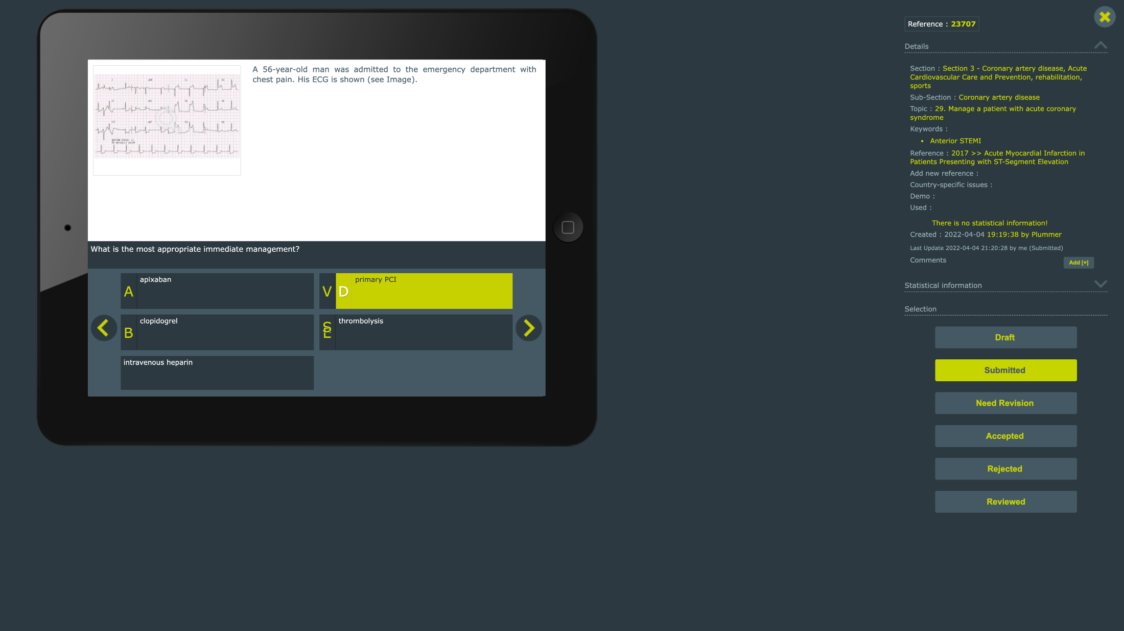
E
C

Slide 8
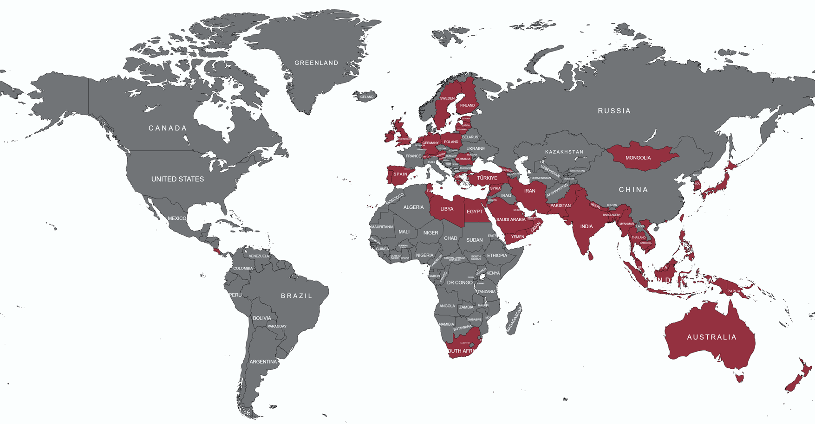

Slide 9
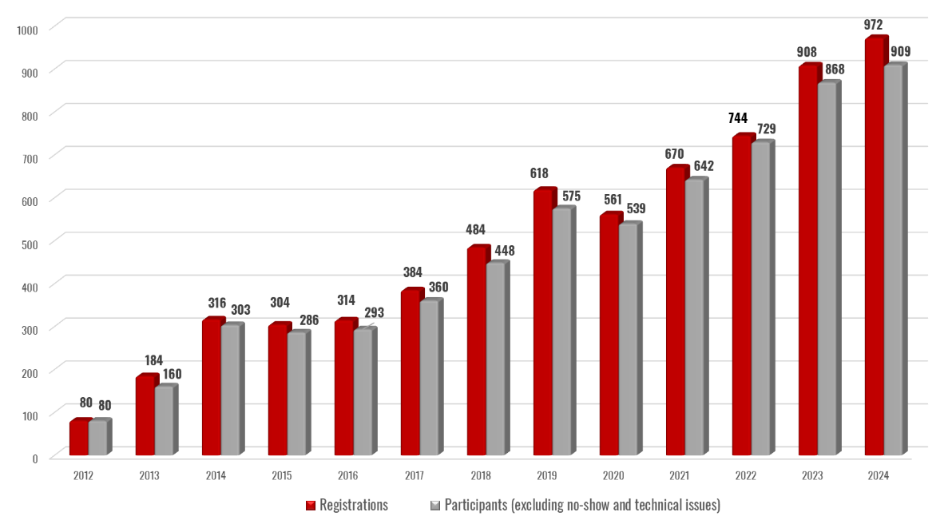
EECC 2024 – participation

Slide 10
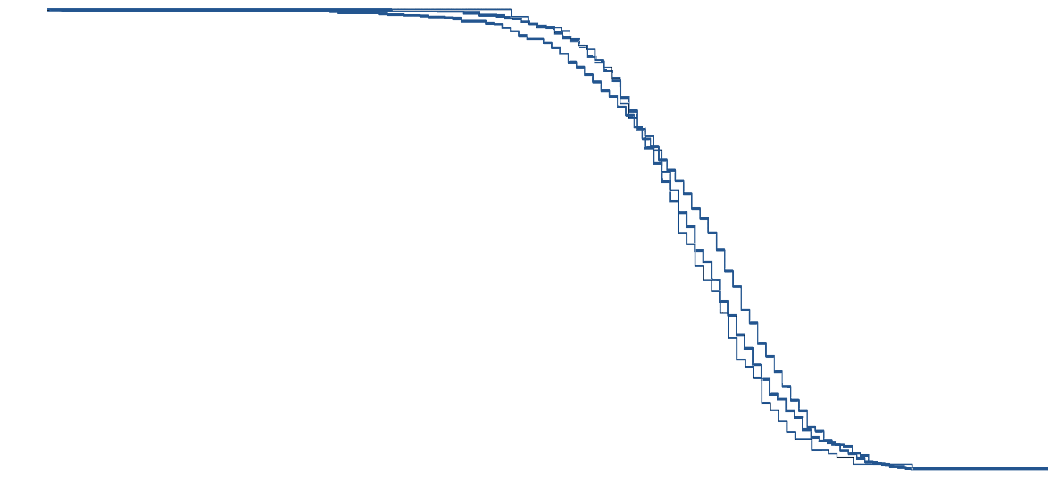
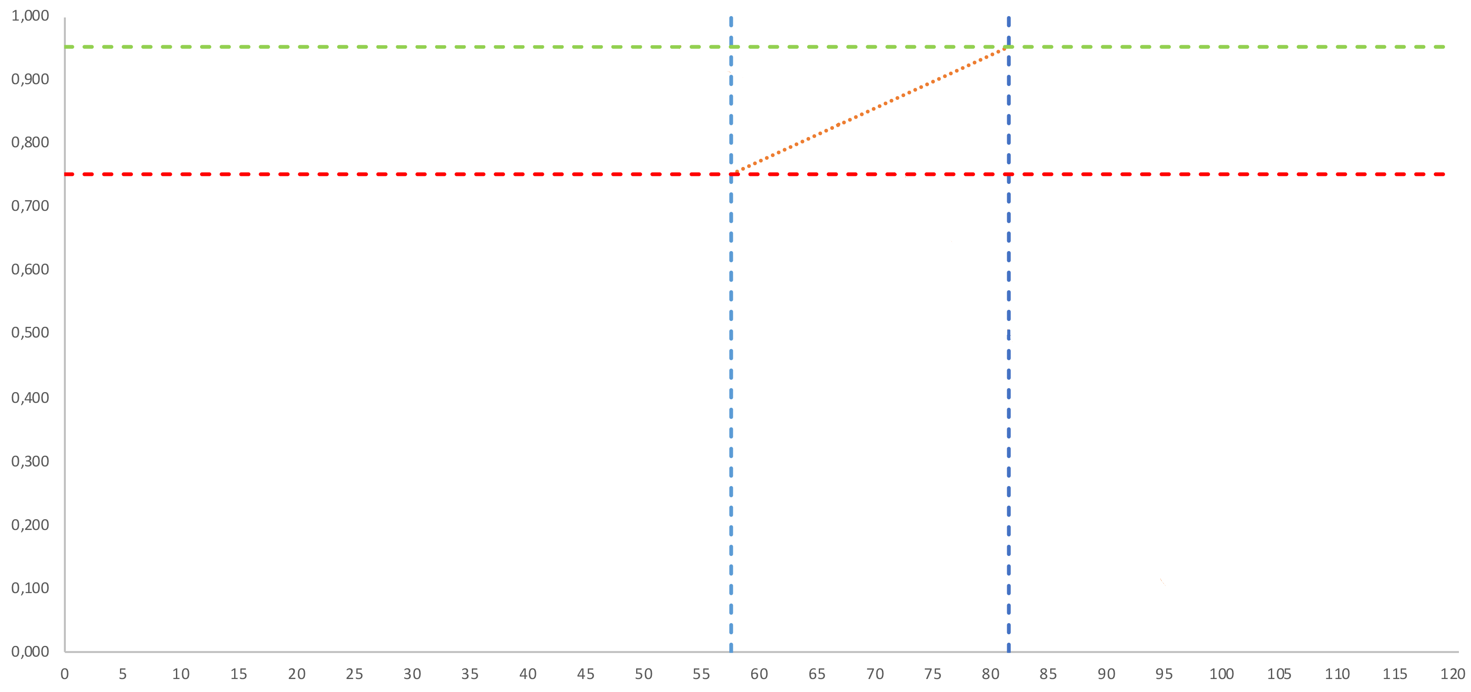
Transition to on-line delivery 2020
Candidates’ Scores
2020-23
2017-19
 | Pass mark (mean) | Pass rate (mean)
In-person | 66.7 | 80.0
On-line | 66.8 | 82.8

Slide 11
Transition to on-line delivery 2020
On-site testing limits access - physical limitations & costs
On-line preparation and delivery is feasible - participation is increased (candidates, countries 16 to 44) - no-shows and technical problems are reduced - candidate performance not affected & satisfaction increased - costs are reduced - move back to 1 in-person question writing meeting a year from 2024
Requirements - on-line exam software - excellent exam preparation and leadership teams - excellent support from ESC & UEMS

Slide 12
AI in: Exam preparation

Slide 13
Purpose of the exam
Formative or summative?
High stakes?
What knowledge is required? - test knowledge appropriate for independent practice - what do we look up in clinical practice? - what is the role of clinical decision support in EPRs? - trusted sources? - understandability/explainability/extrapolation

Slide 14
Question writing
Skill – requires practice
Requires up-to-date knowledge
Takes time ≈ 1h per question
Gets harder to start from scratch!

Slide 15
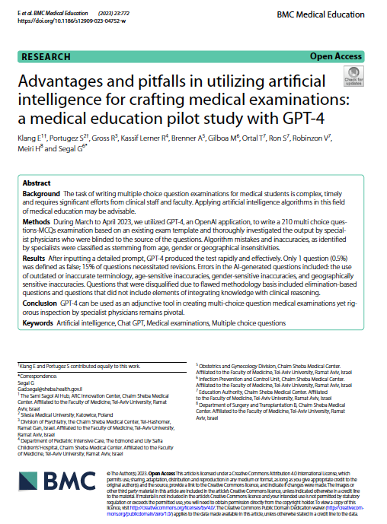
Question writing – AI opportunities
First draft questions / distractors ?
GPT-4 wrote 210 MCQs from exam template using detailed prompt
1 question (0.5%) was defined as false
15% of questions necessitated revisions
errors included: the use of outdated or inaccurate terminology, age-sensitive inaccuracies, gender-sensitive inaccuracies, and geographically sensitive inaccuracies
“GPT-4 can be used as an adjunctive tool in creating multi-choice question medical examinations yet rigorous inspection by specialist physicians remains pivotal”
Advantages and pitfalls in utilizing artificial intelligence for crafting medical examinations: a medical education pilot study with GPT‑4
Klang E, Portugez S, Gross R, Kassif Lerner R, Brenner A, Gilboa M, Ortal T, Ron S, Robinzon V, Meiri H and Segal G. BMC Medical Education (2023) 23:772

Slide 16
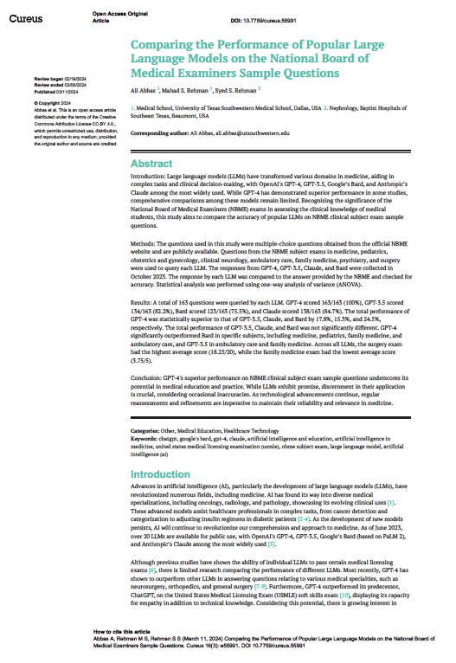
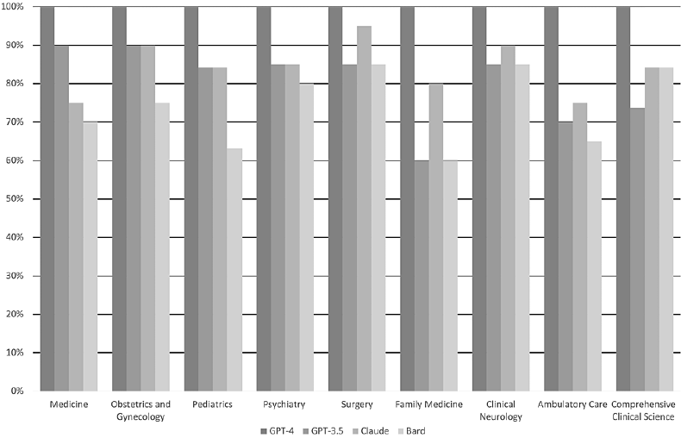
Question writing – AI opportunities
Checking answers?
Testing for ambiguity?
Guideline & literature checking?
163 MCQs from National Board of Medical Examiners
Data security?
Closed system?
Comparing the Performance of Popular Large Language Models on the National Board of Medical Examiners Sample Questions
Ali Abbas , Mahad S. Rehman , Syed S. Rehman Cureus 16(3): e55991

Slide 17
Question selection
First draft exam ?
Automated question selection is used in large exams
AI could help identify questions with specific characteristics from a question bank, and
Selection of a balanced range of topics and conditions
Data security?
Closed system?

Slide 18
Standard setting
Pre-testing / calibration
Psychometric properties of questions - difficulty - discriminating power - flaws in question or distractors
Time consuming (>$1000/question; Pugh et al. Med Teach 2016, 38:838)
Imperfect
Confidentiality (AlSaad et al. J Med Internet Res 2024;26:e59505)

Slide 19
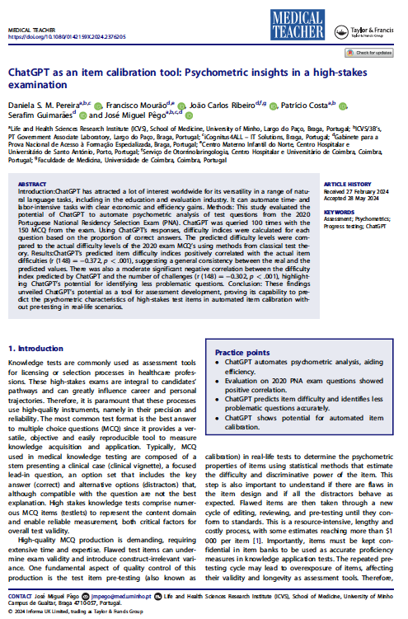
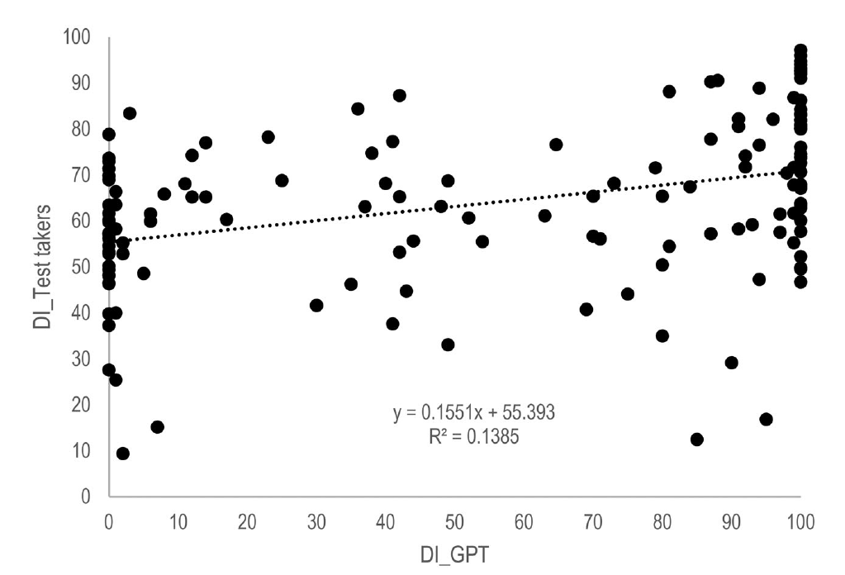
Standard setting
Potential use of AI
ChatGPT was queried 100 times with the 150 MCQ from the 2020 Portuguese National Residency Selection Exam
Difficulty indices were calculated for each question based on the proportion of correct answers
The predicted difficulty levels were compared to the actual difficulty levels of the 2020 exam MCQ’s using methods from classical test theory
ChatGPT’s predicted item difficulty indices positively correlated with the actual item difficulties (r (148) . −0.372, p < .001), suggesting a general consistency between real and predicted
ChatGPT has potential as a tool for assessment development, proving its capability to predict the psychometric characteristics of high-stakes test items in automated item calibration without pre-testing in real-life scenarios
Data security?
Closed system?
After exam sitting?
Pereira, D. S. M., Mourão, F., Ribeiro, J. C., Costa, P., Guimarães, S., & Pêgo, J. M. (2024).
ChatGPT as an item calibration tool: Psychometric insights in a high-stakes examination. Medical Teacher, 1–7. https://doi.org/10.1080/0142159X.2024.2376205

Slide 20
AI in:
Exam delivery

Slide 21
Closed Book Exams
“CBEs are essential for evaluating learners’ ability to understand and recall information as an indication of what learners know”
“CBE require more effortful retrieval from memory, which could benefit learners’ long-term retention, as compared to seemingly more passive OBEs” - no significant differences found for exam performance and testing effects
“Learners may assume OBEs are easier than CBEs, and study less for an OBE” - systematic review indicated that learners invested less time preparing for an OBE
Assessing open-book examination in medical education: The time is now
Ivry Zagury-Orlya and Steven J. Durning MEDICAL TEACHER 2021, VOL. 43, NO. 8, 972–973 https://doi.org/10.1080/0142159X.2020.1811214

Slide 22
Open Book Exams ?
“OBEs can pose questions that require higher-order cognitive skills and critical thinking, beyond rote memorization”
“The threat of not assessing learners’ knowledge could be overcome by time-pressured tests, leaving little time to look up everything or by asking “why?” questions (Schwartzstein and Roberts 2017; Fuller et al. 2020), less searchable and test reasoning”
“OBEs are more authentic to clinical practice and may allow for assessment of various transferable skills’ – in practice, we do look things up!
Assessing open-book examination in medical education: The time is now
Ivry Zagury-Orlya and Steven J. Durning MEDICAL TEACHER 2021, VOL. 43, NO. 8, 972–973 https://doi.org/10.1080/0142159X.2020.1811214

Slide 23
Open Book Exams ?
“Heighten learner awareness of the importance of aptly identifying and utilizing best available evidence in clinical decision-making, commonly referred to as evidence-based medicine”
“With the quantity of scientific information increasing exponentially, knowledge that was once acquired early in medical school may not only be forgotten but may also be irrelevant.”
“By administering online OBEs, medical students and residents may become more mindful of their duty to be self-directed learners. They could develop skills in keeping up with the constant evolutions of medical practice.”
Assessing open-book examination in medical education: The time is now
Ivry Zagury-Orlya and Steven J. Durning MEDICAL TEACHER 2021, VOL. 43, NO. 8, 972–973 https://doi.org/10.1080/0142159X.2020.1811214

Slide 24
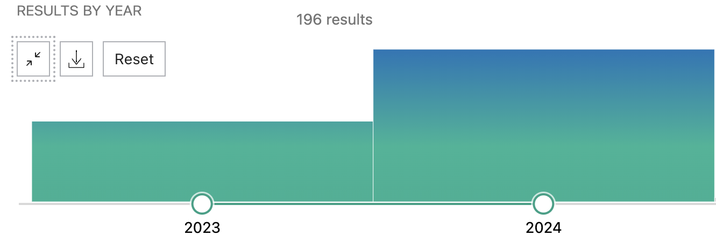
Closed vs Open Book Exams ?
Large Language Models
PubMed: exam chatGPT

Slide 25
Closed vs Open Book Exams ?
Large Language Models
Much better than chance
Some good enough to pass exams – beware of claims (see tomorrow)
We do not have exam structures or question banks designed for LLM use in open book high stakes summative exams
Strategy – on-site invigilated or remote proctoring

Slide 26
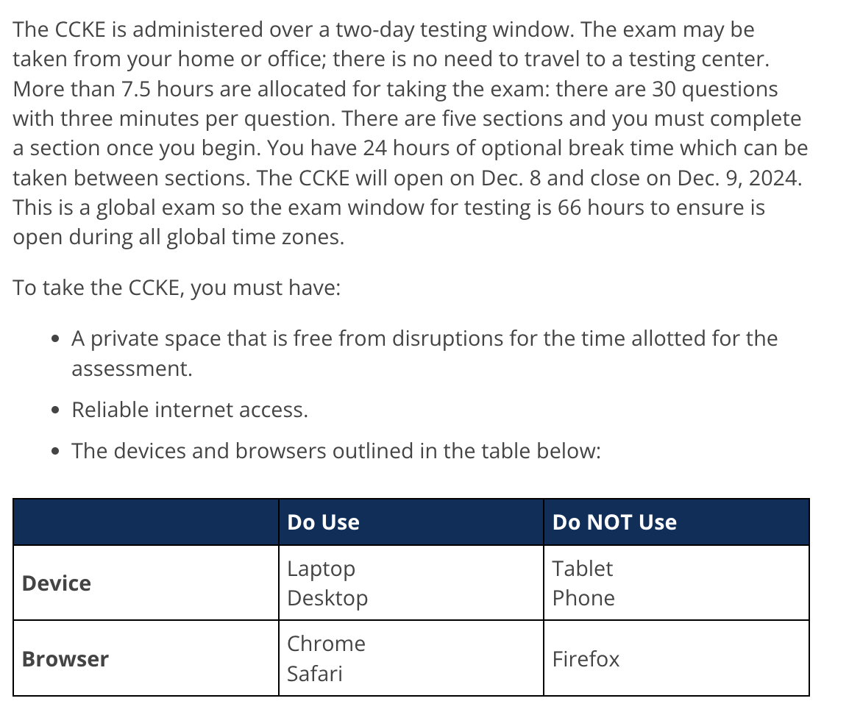
Closed vs Open Book Exams ?
OBEs still exist:

Slide 27
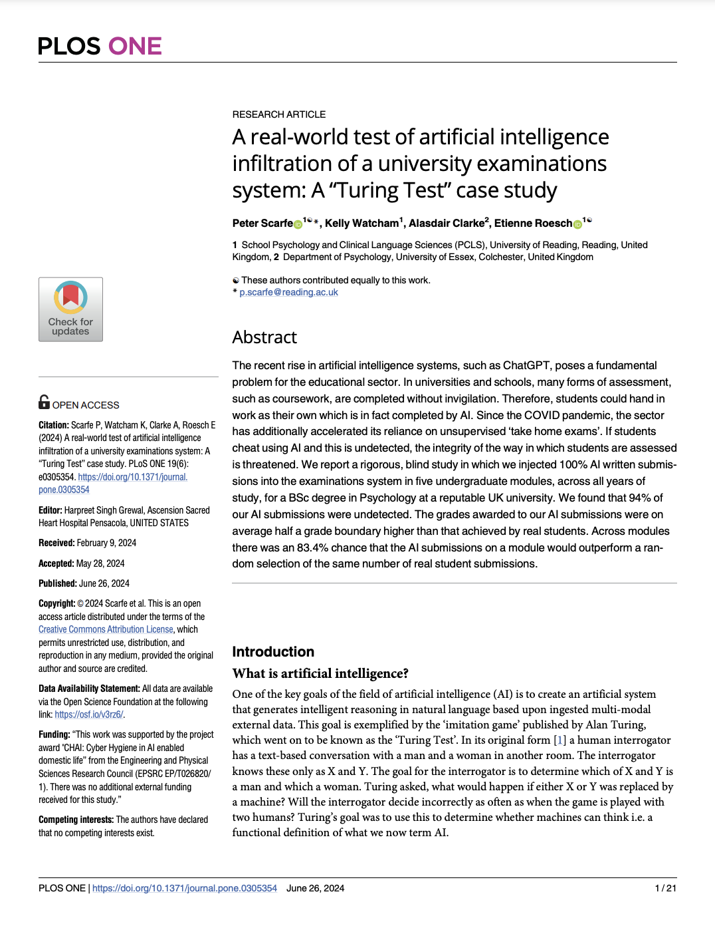
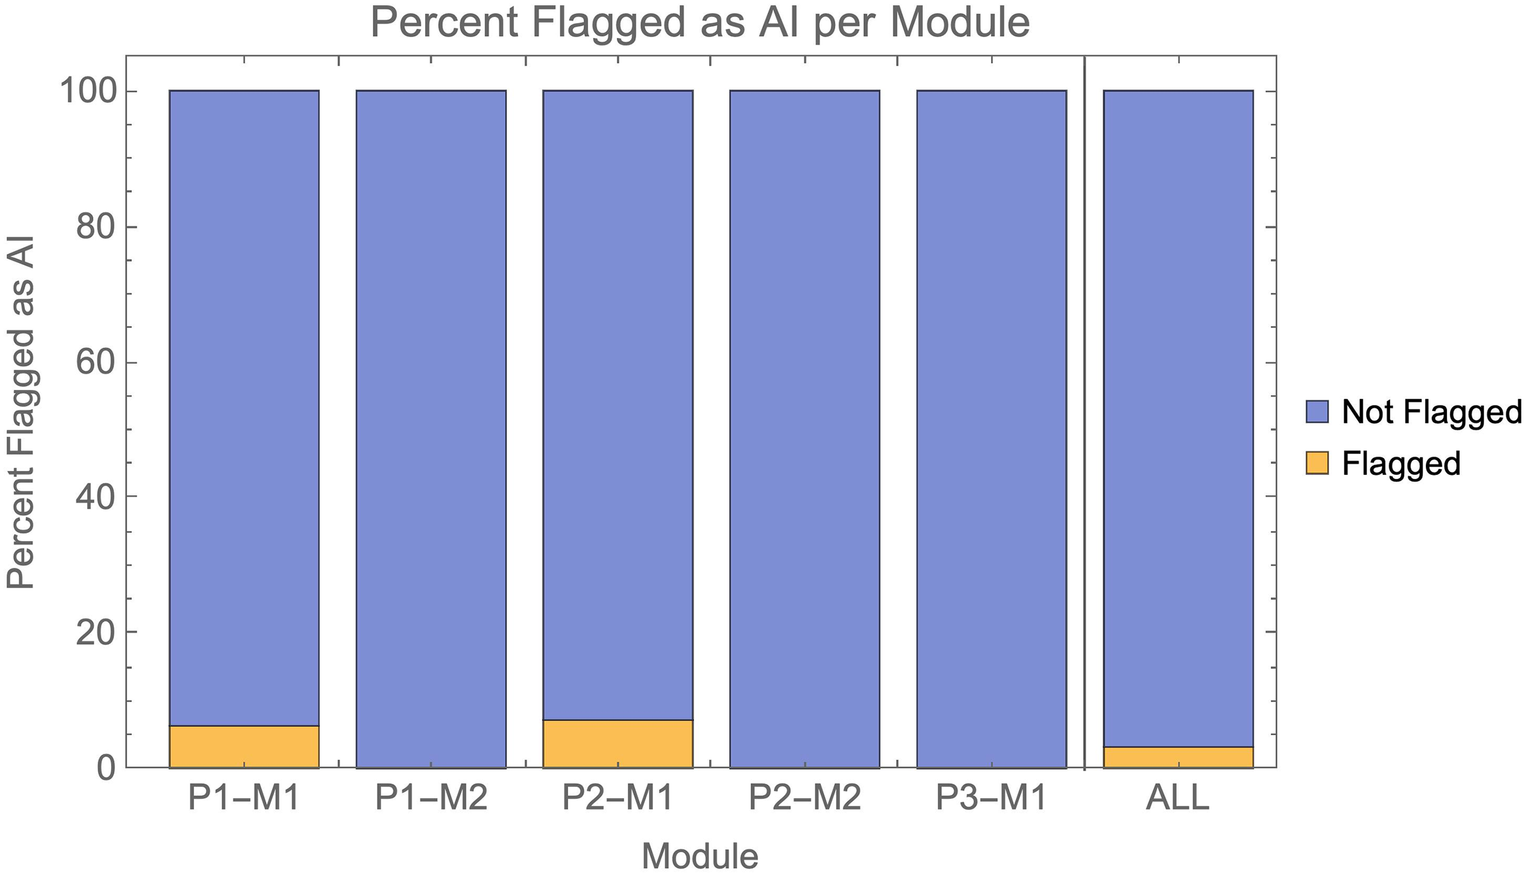
Detection of misconduct
Can humans detect AI-generated answers? - No (MCQs, short answers or essays)
Can AI detect it? Other patterns of misconduct?

Slide 28
Conclusions
AI is here to stay
Part of everyday life and clinical practice
We need to educate ourselves, our trainees & our regulators
Useful and time-saving
Beware hallucinations, data security
Currently - high-stakes exams avoid access to LLMs
In the future - examinations need to evolve to reflect clinical practice

Slide 29
AI in European Exams:
Friend or Foe ?
Chris Plummer
Notes:
23 April 2022 – 30min + questions

