Slide 1
UEMS CESMA Picking your PROVIDER
Maeve Durkan, President UEMS CESMA

Slide 2
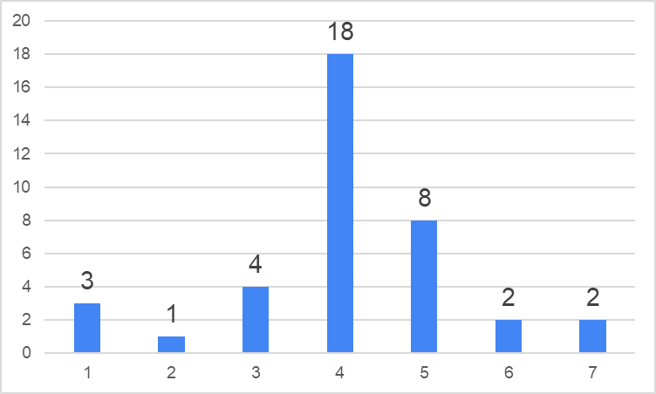
How do you foresee the future setting of European Examinations ? Prof Battista 2021
AVERAGE = 4,07 n = 38
Fully online Part hybrid fully on site

Slide 3
If your examination is organized in two parts, how do you envisage the organization of part 1 (theoretical) ?
AVERAGE = 2,35 n = 20
Fully online Part hybrid fully on site

Slide 4
What to look for in your ‘ Provider’ What can and what do they provide
Can they deliver on site
Can they deliver off site
If off site ,how can they guarantee security of candidate taking exam *
If off site – starting times
What’s the back up if exam fails – exam internet collapses

Slide 5
Challenges of setting up your MCQ exam ( Part 1 )
MCQ . Onsite / Off site
Off site : Pearson Vue location / Home PC
On site ..Easier to police * Expense of travel but link to congress
Off site : Pearson Vue model Travel only , cheaper for candidate , secure
Off site : Home PC / cheaper for candidate / security ?

Slide 6
Picking your provider
Meeting and interviewing Providers
But know what you want
Know the questions to ask
Know your costs and cost structure

Slide 7
What to look for in your ‘ Provider’ What can and what do they provide
Question writing support / teaching / workshops
Question banks AND storage and security Q bank
Psychometrics *
Cost ( integral in package or separate )

Slide 8
What to look for in your ‘ Provider’. What can and what do they provide
Psychometrics
Analyzing data
Cutting out bad questions
Failing the bad candidate *

Slide 9
What to look for in your ‘ Provider’ What can and what do they provide
Security of candidate verification
Collating the data
Bank for names that are validated
Issuing results
Issuing certificates

Slide 10
What to look for in your ‘ Provider’ And FINALLY
Know your costs
For each itemized part of this business relationship
Forget ‘ the package’
Break it down ‘ fee per item service’

