Slide 1
UEMS CESMA
Picking an Exam that Suits you
Maeve Durkan, President UEMS CESMA
Hon President ( Former President ) UEMS Board & section of Endocrinology
Vice President UEMS

Slide 2

What is the Role of Examinations
Exam of knowledge & competency / hierarchical problem solving*
Aligned with curriculum ETR
Alignment with training program infers competency
Options as European exam and as National exit exam stand alone * (small exam)

Slide 3
UEMS CESMA : Qs to your section
What kind of exam do you envisage ?
How many candidates ?
How many parts ?
How much money do you have ?
Whom are you partnering with ?

Slide 4
UEMS CESMA : Q to your Section
What kind of exam do you envisage ? How many parts ?
MCQ only
Written exam
Open Book exam
Oral exam
Clinical exam

Slide 5
Partnerships with SCIENTIFIC Societies and other groups
Intellectual property rights
Sharing of costs
Sharing of ‘profit’
Sharing of control ( Board make up )
Managing the pan - European exam and inter country differences ( benchmarks )

Slide 6
UEMS CESMA : What Exam fits you best ?
MCQ only
  Single best answer , extended matching
  Paper based, On-line *
Written exam . Open Book exam.
Oral exam
  Delivery mode, locations, examiner numbers*,
  Face to face , on-line
  Consistency of questions & minimum answers
  Hawk & Dove
Clinical exam – As above

Slide 7
Best of 5 MCQ exam ( Part 1 )
Exam of knowledge only
Not always * an examination of competency
Aligned with curriculum ETR – weighted questions / core questions / ‘rare Qs
Alignment with training program infers competency
Options ( as with all ) as European exam and as National exit exam

Slide 8
UEMS CESMA :
What do you want your exam to examine ?
Assessment of Knowledge
Assessment of competency
MCQ 1 stage vs 3 stage exam
Training aligned or not ?
Eligibility Criteria for taking examination ? Europe , abroad, training year

Slide 9
UEMS CESMA :Determining your Exam pass mark
Remember *Directly related to who is taking exam
Differing ‘ experiences/ training level’*
Angoff Scoring ( what the minimally passing candidate will score)
Modified Angoff Scoring
Hofstee Method ( minimum and maximum accepted failure rates )
Cohen method ( cut off score taking 60% achieved by 95th percentile candidate)

Slide 10
UEMS CESMA ?
When to take the Exam (optimally)
European trained* candidates
In context harmonized training assuming no differences*
Homogeneity has implications in standard setting & pass mark *
  Endocrinology experience
Within in 1 year of graduation of training?
Within 3-5 years of graduation ?
National exit / European exit exams

Slide 11
UEMS CESMA :How will you deliver your exam ?
On-line
  Providers
  Security provider ( not necessarily the same )
  Selecting provider according to your exam*
On site
  Where
  When ( minimizing cost )
  Logistics of access & cost to candidate and Board( candidates & examiners )

Slide 12
When it all goes wrong ? (Pandemic experiences )
On line delivery failure
Back up plan
Security & cheating
The candidate who challenges the results ?

Slide 13
UEMS CESMA SURVEY ASSEMBLY
Prof Gian Battista June 19, 2021
39 respondents. / 34 examinations
14 one part exam only
20 two part exam +
2 oral examination only. ( 3 No exam organized yet )

Slide 14
UEMS CESMA SURVEY ASSEMBLY June 19, 2021
If in one or two parts , where do you envisage future part 1 ?
11 /20 : One part exam FULLY ONLINE
1 / 20 : On site

Slide 15
UEMS CESMA SURVEY ASSEMBLY June 19, 2021
If in one or two parts , where do you envisage future part 2 ?
0 /20 : One part exam FULLY ONLINE
13 / 20 : On site

Slide 16
UEMS CESMA SURVEY ASSEMBLY June 19, 2021
Preferences / The future on COVID era
MCQ ..
On line delivery
Remote delivery ( security * cost )
2/3 extended exam
18/38 foresee a Hybrid model ( split on line/ on site )
On-line MCQ
On line 2- way Oral…but preference to revert face to face - remote

Slide 17
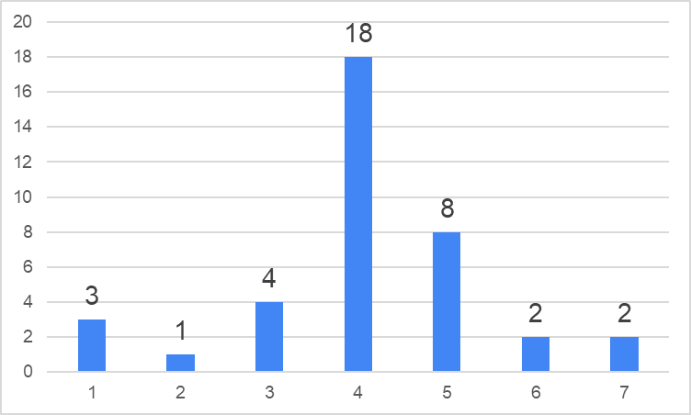
How do you foresee the future setting of European Examinations ? Prof Battista 2021
AVERAGE = 4,07 n = 38
Fully online Part hybrid fully on site

Slide 18
Is your European Examination organized into One/ two parts:
Part 1, more theoretical (e.g. MCQ) and
Part 2, more clinical (e.g. OSCE) ?
NO = 14 One part only
YES = 20 Two parts
Oral examination only = 2
No exams organized yet = 3

Slide 19
If your examination is organized in two parts, how do you envisage the organization of part 1 (theoretical) ?
AVERAGE = 2,35 n = 20
Fully online Part hybrid fully on site

Slide 20
If your examination is organized in two parts, how do you envisage the organization of part 2 (practical) ?
AVERAGE = 5,35 n = 20
Fully online Part hybrid fully on site

Slide 21
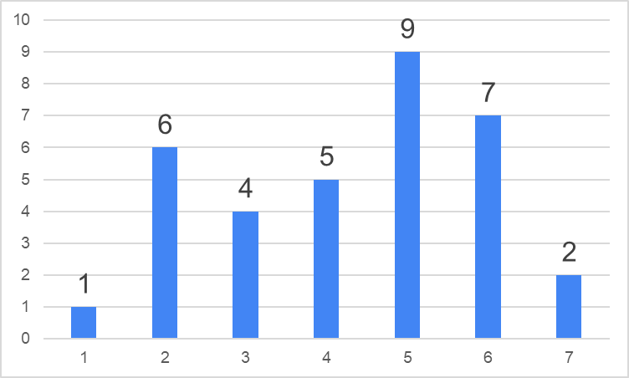
How relevant will the impact of budgetary considerations be on these choices ?
AVERAGE = 4,29 n = 34
Totally
irrelevant
Heavily
impacting

Slide 22
Next STEP
Meeting and interviewing Providers (5)
But know what you want
Know the questions to ask
Know your costs and cost structure

