Slide 1
EBEEDM Exam Standard Setting:
Welcome and Introduction
Keith Farrington, RCPI Education Department
08.11.24

Slide 2
Orientation
Plan for the two days
Questions to be standard set
Keith Farrington, Maurice Kinsella
Virginia Cidfuentes

Slide 3
Where we are
2024 Question writing
April - September 2024 Questions approved
October 2024
200 questions selected for the papers

Slide 4
Over the next two days
Identification of candidate
Minimally competent candidate
Defined last year
Rating of question difficulty
Minimally competent candidate
% of MC candidates that will score a question correct
200 questions
Review & discuss where appropriate

Slide 5
Criteria for “good” assessment
Guidelines
Medical Councils
FAIMER (Foundation of International Medical Education and Research)
AMEE (Association of Medical Education in Europe)

Slide 6
Characteristics
Reliability
Educational
Acceptable
Defensible
Feedback
Validity
Feasibility
Fairness
Equivalence

Slide 7
Assessment Cycle
CURRICULUM
BLUEPRINT DEVELOPMENT
CREATE ASSESSMENT ITEMS (QUESTION WRITING)
COMPILE THE TEST ITEMS
STANDARD SET THE EXAM
DELIVER THE TEST
REVIEW

Slide 8
Identifying Minimally Competent Candidate
Who is this exam intended for?
What level should barely passing candidates be at?
What should the candidates know
What should the be able to do?
Overall
For each area

Slide 9
Identifying Minimally Competent Candidate
Candidates
Low scoring Candidates
Borderline Candidates
High scoring Candidates
Characteristics of these candidates

Slide 10

Medical Education Spectrum
Intern
SHO
SpR
Fellow
Consultant
1-2 years of Endocrinology Training
Basic Knowledge
History/Phys Exam
Guidelines
2-3 years
Specific rotations completed
Have undergone WBA
4+ years
Completed penultimate year
Research knowledge
Deep specialty knowledge

Slide 11
Defining minimally competent candidate
Defining “who” should pass the exam helps determine a reproducible cut score
Helps SME’s on the panel to rate questions with similar expectations of candidates
Must be documented as part of defensible examination

Slide 12
Defining minimally competent candidate
A candidate has just passed the exam…
Who is this person?
What do you want the exam to be?
    High level test of knowledge/skills (pre-completion of training
    General level – certification that every endocrinologist should have

Slide 13
Defining minimally competent candidate
Higher level exam
Will probably see a lower pass rate
Questions will need to be of appropriate difficulty
More general exam
Will probably see a higher pass rate
Wider range of question difficulty

Slide 14
How will we do this
Discuss a candidate who would receive a borderline result but would pass the exam
Define what this candidate would find:
    Very Difficult
    Difficult
    Moderate
    Easy
    Very Easy

Slide 15
What do these ratings mean?

Slide 16
Are all sub areas equal difficulty?
Diabetes
Adrenal
Reproductive/Gonads
Other – (Genetics, Obesity, Lipids)
Hypothalamus & Pituitary
Thyroid
Parathyroid/Bone/Ca²⁺

Slide 17
Standard Setting Considerations
Are all topics and skills that the candidate needs to acquire of equal or different difficulty
Option 1: Define adequate competency as a fixed value e.g. 50%
Option 2: criterion reference e.g., Angoff Criterion being difficulty of the question

Slide 18
Standard Setting Considerations
Define borderline candidate
% who will score correctly
Discuss ratings
Average estimate
Cut score is sum of averages
Record each raters estimate

Slide 19
How we will proceed
Part 1
Define minimally competent candidate
General Discussion
Rate each topic difficulty
Part 2
Standard Set Questions
Rate each question individually
Discuss questions with variation

Slide 20
Part 1 - minimally competent candidate
The passing Borderline Candidate
Basic Concepts
Working Knowledge
Comprehensive
Application of basic science
Solving common problems
Recognition & management of emergencies

Slide 21
Part 2 – Standard Setting
200+ questions
Rate difficulty in increments of 5 (5-95)
Consider 100 borderline candidates
Consider all factors discussed
Stem, Options, Probability of chance
7 Raters

Slide 22
Part 2 – Standard Setting
Each rater will take the test without knowing answer
Rate difficulty in increments of 5 (5-95)
Confidential & Individual file
Assess ratings together
Discuss and re-rate variations
Agree proposed cutscore and range

Slide 23
What makes a question difficult?
Accurate question rating
Level of experience
More difficult
Variations in practice
Stem (Cognitive load)
Topic
Options
Data interpretation
Easier

Slide 24
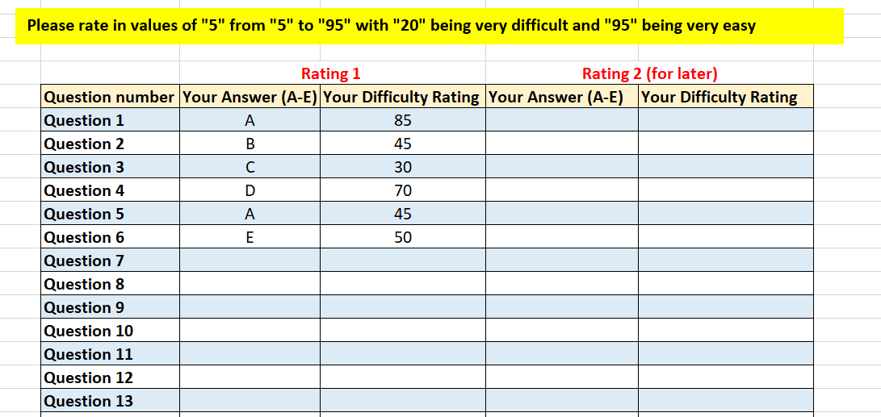
Standard Setting – What we need

Slide 25
Standard Setting: Discussion
Compare ratings for each question
Calculate Standard Error of Judgement (SEJ)
Aiming for SEJ <2
Better Agreement
(Lower SEJ)
Greater Disagreement
(Larger SEJ)

Slide 26
Standard Setting: Discussion
If larger SEJ (greater disagreement) we will need a second round of assessment (for these questions)
We need consensus but….!

