Slide 1
UEMS CESMA Survey Examination Portofio
Maeve Durkan, President UEMS CESMA
Hon President ( Former President ) UEMS Board & section of Endocrinology
Vice President UEMS

Slide 2
Respondents
27 respondents
24 Sections/ MJC etc

Slide 3
UEMS CESMA : 24 groups How many parts to your exam
6 ONE part exam
14 TWO part exam
4 THREE part exam

Slide 4
UEMS CESMA : 24 groups How many parts to your exam
6 ONE part exam - MCQ
14 TWO part exam – MCQ/ Oral ( live/on line) /OSCE
4 THREE part exam

Slide 5
UEMS CESMA : 24 groups Exam delivery
8 ON SITE only
2 ON SITE / OFF SITE
3 OFF SITE ( Pearson View / Training centre)
11 REMOTE PROCTORING

Slide 6
UEMS CESMA : 24 groups Exam Cost
1 National Exam and so no cost
2 Trainees 250 / 230
1 Europeans 550 / Non Europeans. 650
1 Training dependant 250 – 550
1 Mandatory 460 / Full fee country 920
1 TWO part exam 900 / THREE part 1200

Slide 7
UEMS CESMA : 24 groups How long is your exam running
7 < 5 years
7 > 5 and < 11 years
> 11 and < 20
6 > 20 years

Slide 8
UEMS CESMA : 24 groups Number candidates
6 < 50 candidates
> 50 and < 100
3 > 100 and < 200
3 > 200 ( 205 & 232 with second part oral 139 & 98 )
2 > 900 ( 900 & 1200 )

Slide 9
UEMS CESMA : 24 groups Training in/outside Europe
5 Programs. 2/3 In Europe
6 Programs. 80-90 % European trained
2 programs >90% European trained
6 programs European only
2 programs < 1/3 European trained

Slide 10
UEMS CESMA : Q to your Section
What kind of exam do you envisage ? How many parts ?
MCQ only
Written exam
Open Book exam
Oral exam
Clinical exam

Slide 11
Partnerships with SCIENTIFIC Societies and other groups
Intellectual property rights
Sharing of costs
Sharing of ‘profit’
Sharing of control ( Board make up )
Managing the pan - European exam and inter country differences ( benchmarks )

Slide 12
Q & A

Slide 13
UEMS CESMA : What Exam fits you best ?
MCQ only
Single best answer , extended matching
Paper based, On-line *
Written exam . Open Book exam.
Oral exam
Delivery mode, locations, examiner numbers*,
Face to face , on-line
Consistency of questions & minimum answers
Hawk & Dove
Clinical exam – As above

Slide 14
Best of 5 MCQ exam ( Part 1 )
Exam of knowledge only
Not always * an examination of competency
Aligned with curriculum ETR – weighted questions / core questions / ‘rare Qs
Alignment with training program infers competency
Options ( as with all ) as European exam and as National exit exam

Slide 15
UEMS CESMA : What do you want your exam to examine ?
Assessment of Knowledge
Assessment of competency
MCQ 1 stage vs 3 stage exam
Training aligned or not ?
Eligibility Criteria for taking examination ? Europe , abroad, training year

Slide 16
UEMS CESMA :Determining your Exam pass mark
Remember *Directly related to who is taking exam
Differing ‘ experiences/ training level’*
Angoff Scoring ( what the minimally passing candidate will score)
Modified Angoff Scoring
Hofstee Method ( minimum and maximum accepted failure rates )
Cohen method ( cut off score taking 60% achieved by 95th percentile candidate)

Slide 17
UEMS CESMA ? When to take the Exam (optimally)
European trained* candidates
In context harmonized training assuming no differences*
Homogeneity has implications in standard setting & pass mark *
Endocrinology experience
Within in 1 year of graduation of training?
Within 3-5 years of graduation ?
National exit / European exit exams

Slide 18
UEMS CESMA :How will you deliver your exam ?
On-line
Providers
Security provider ( not necessarily the same )
Selecting provider according to your exam*
On site
Where
When ( minimizing cost )
Logistics of access & cost to candidate and Board( candidates & examiners )

Slide 19
When it all goes wrong ? (Pandemic experiences )
On line delivery failure
Back up plan
Security & cheating
The candidate who challenges the results ?

Slide 20
UEMS CESMA SURVEY ASSEMBLY Prof Gian Battista June 19, 2021
39 respondents. / 34 examinations
14 one part exam only
20 two part exam +
2 oral examination only. ( 3 No exam organized yet )

Slide 21
UEMS CESMA SURVEY ASSEMBLY June 19, 2021
If in one or two parts , where do you envisage future part 1 ?
11 /20 : One part exam FULLY ONLINE
1 / 20 : On site

Slide 22
UEMS CESMA SURVEY ASSEMBLY June 19, 2021
If in one or two parts , where do you envisage future part 2 ?
0 /20 : One part exam FULLY ONLINE
13 / 20 : On site

Slide 23
UEMS CESMA SURVEY ASSEMBLY June 19, 2021 Preferences / The future on COVID era
MCQ ..
On line delivery
Remote delivery ( security * cost )
2/3 extended exam
18/38 foresee a Hybrid model ( split on line/ on site )
On-line MCQ
On line 2- way Oral…but preference to revert face to face - remote

Slide 24
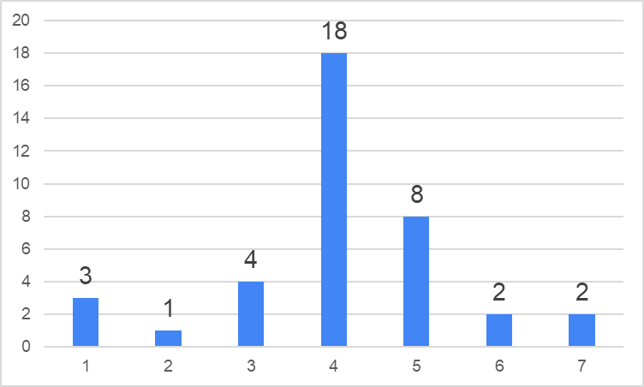
How do you foresee the future setting of European Examinations ? Prof Battista 2021
AVERAGE = 4,07 n = 38
Fully online Part hybrid fully on site

Slide 25
Is your European Examination organized into One/ two parts: Part 1, more theoretical (e.g. MCQ) and Part 2, more clinical (e.g. OSCE) ?
NO = 14 One part only
YES = 20 Two parts
Oral examination only = 2
No exams organized yet = 3

Slide 26
If your examination is organized in two parts, how do you envisage the organization of part 1 (theoretical) ?
AVERAGE = 2,35 n = 20
Fully online Part hybrid fully on site

Slide 27
If your examination is organized in two parts, how do you envisage the organization of part 2 (practical) ?
AVERAGE = 5,35 n = 20
Fully online Part hybrid fully on site

Slide 28
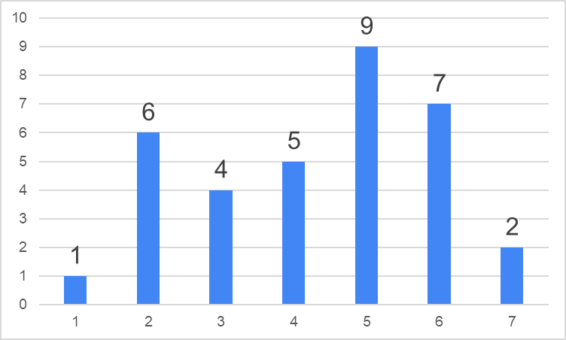
How relevant will the impact of budgetary considerations be on these choices ?
AVERAGE = 4,29 n = 34
Totally
irrelevant
Heavily
impacting

Slide 29
Next STEP
Meeting and interviewing Providers (5)
But know what you want
Know the questions to ask
Know your costs and cost structure

