Slide 1
UEMS-CESMA Appraisals Certificates
Prof. dr. Danny G.P. Mathysen (MSc, PhD) danny.mathysen@uantwerpen.be
Universiteit Antwerpen (UAntwerpen) – Universitair Ziekenhuis Antwerpen (UZA) PGME training coordinator University of Antwerp and Antwerp University Hospital
European Union of Medical Specialists – Council for European Specialty Medical Assessments UEMS-CESMA Appraisals and Liaison Officer
FOD Volksgezondheid, Veiligheid van de Voedselketen en Leefmilieu SPF Santé Publique, Sécurité de la Chaîne alimentaire et Environnement 1) Plaatsvervangend lid van de Federale Planningscommissie – Medisch Aanbod Membre suppléant de la Commission de Planification – Offre Médicale 2) Uitgenodigd expert Taskforce Kwaliteit van de stages van artsen-specialisten in opleiding Expert invité Taskforce Qualité des stages des médecins spécialistes en formation 3) Uitgenodigd expert werkgroep Kwaliteit Hoge Raad van Artsen-specialisten en van Huisartsen Expert invité groupe de travail Qualité du Conseil Supérieur des médecins spécialistes et des médecins généralistes
Image generated with DALL-E AI Image Generator

Slide 2
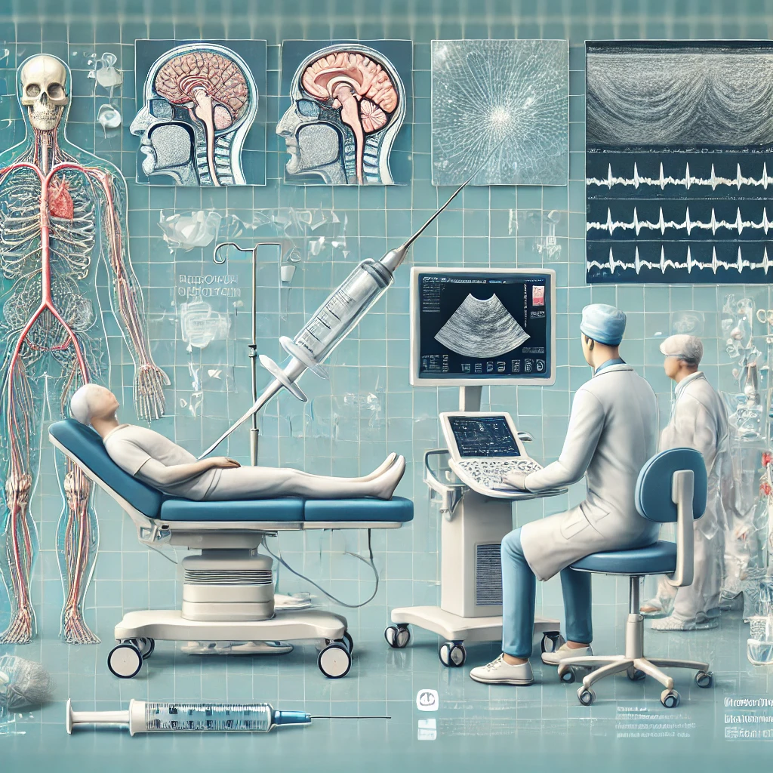
Regional Anaesthesia and Pain Management Already presented in Antwerp
Image generated with DALL-E AI Image Generator

Slide 3
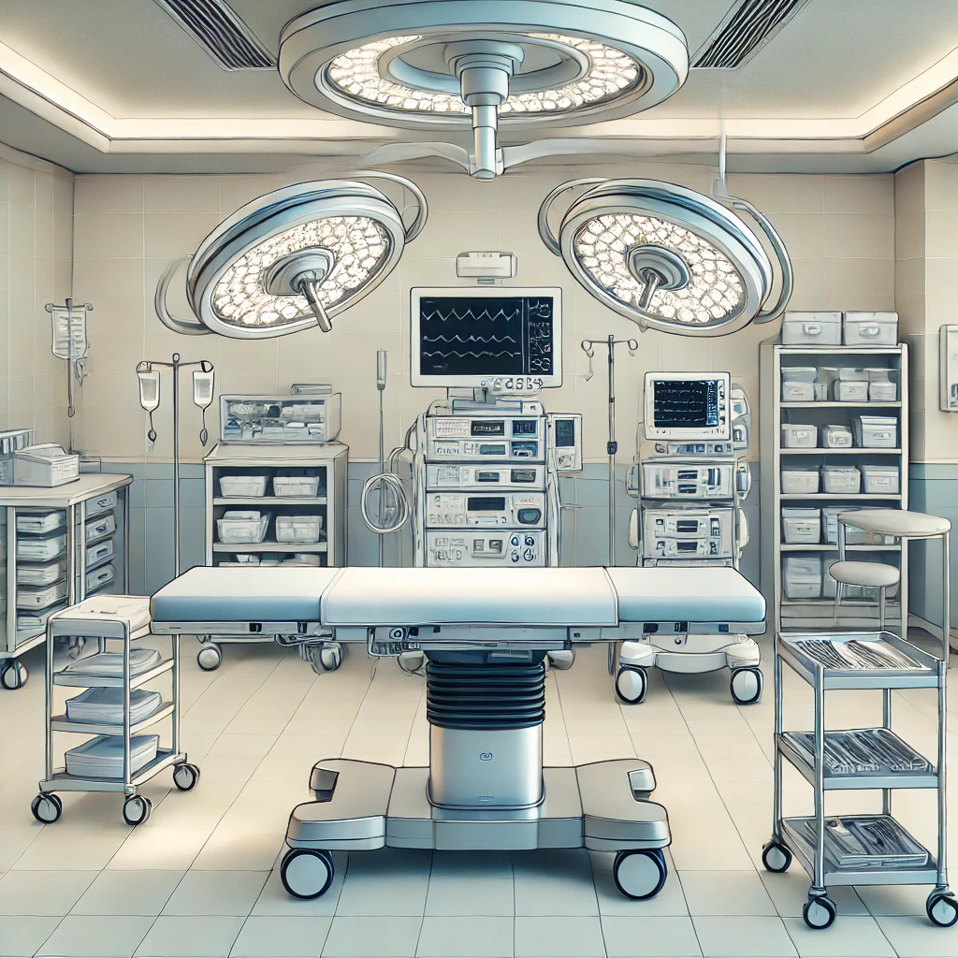
General Surgery Already presented in Antwerp
Image generated with DALL-E AI Image Generator

Slide 4
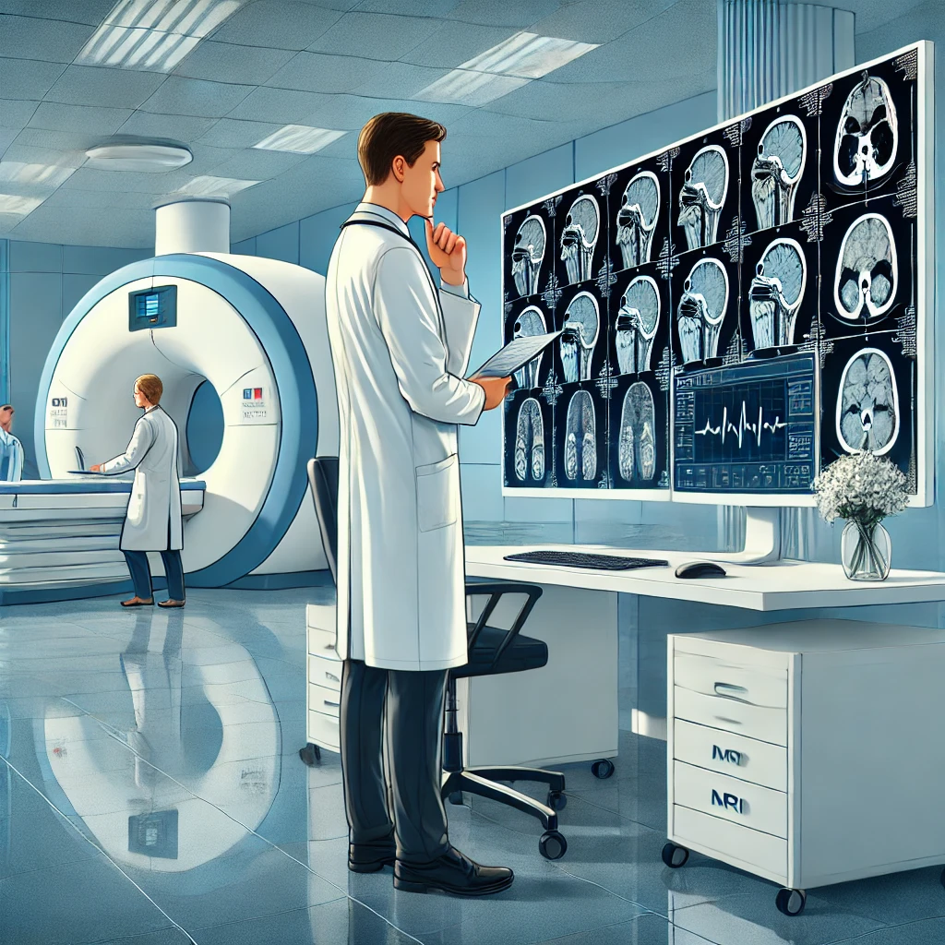
Radiology Already presented in Antwerp
Image generated with DALL-E AI Image Generator

Slide 5
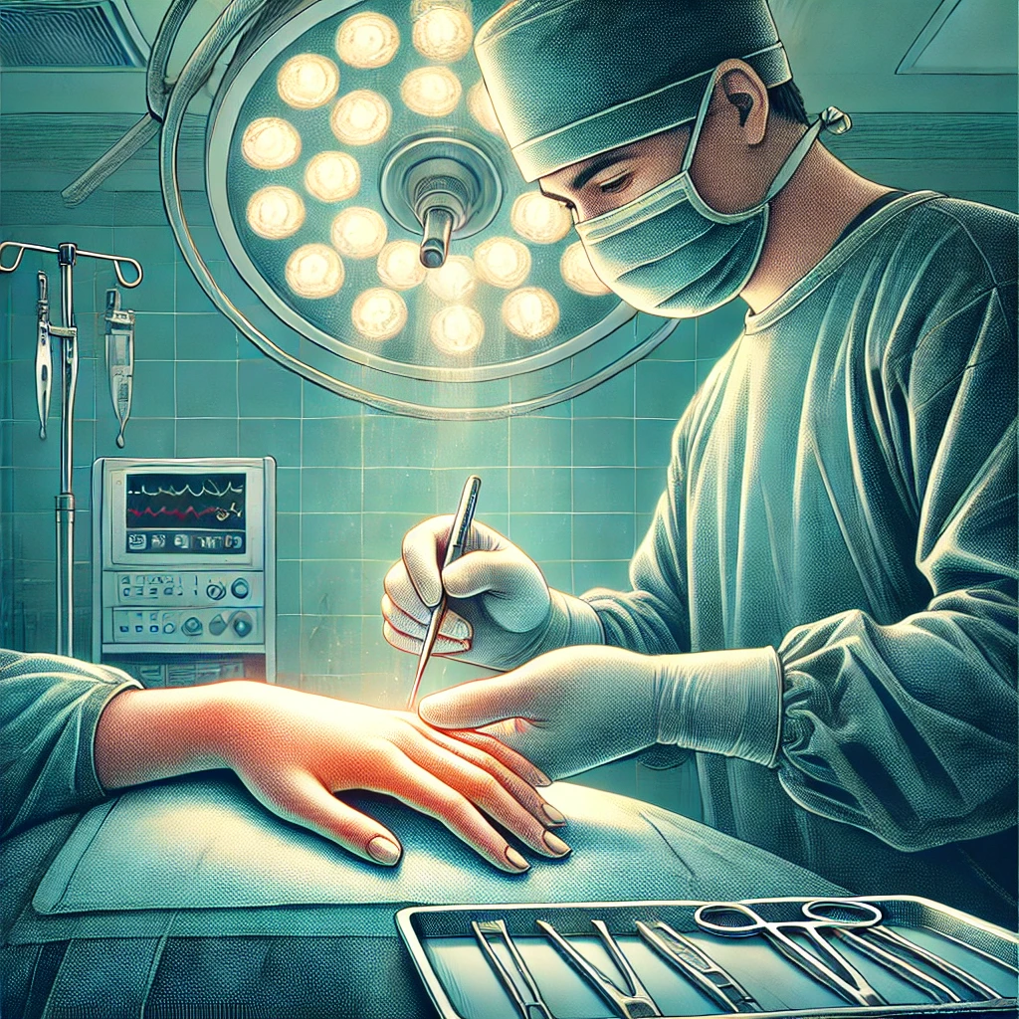
Hand surgery Re-appraisal
Image generated with DALL-E AI Image Generator

Slide 6
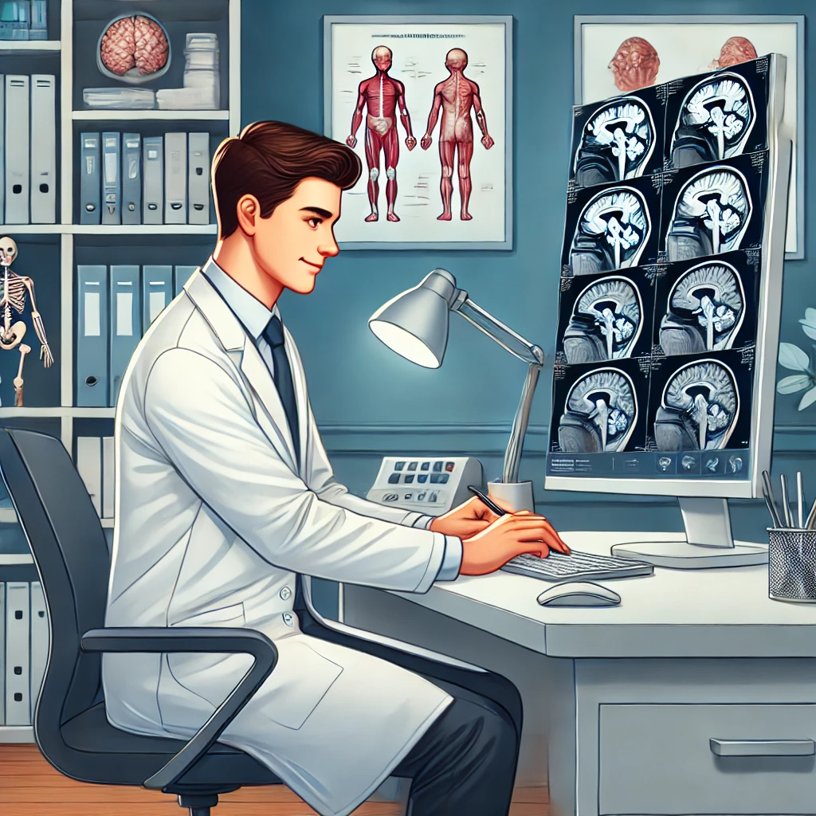
Neurology Re-appraisal
Image generated with DALL-E AI Image Generator

Slide 7
Medical Genetics and Genomics
Image generated with DALL-E AI Image Generator

Slide 8
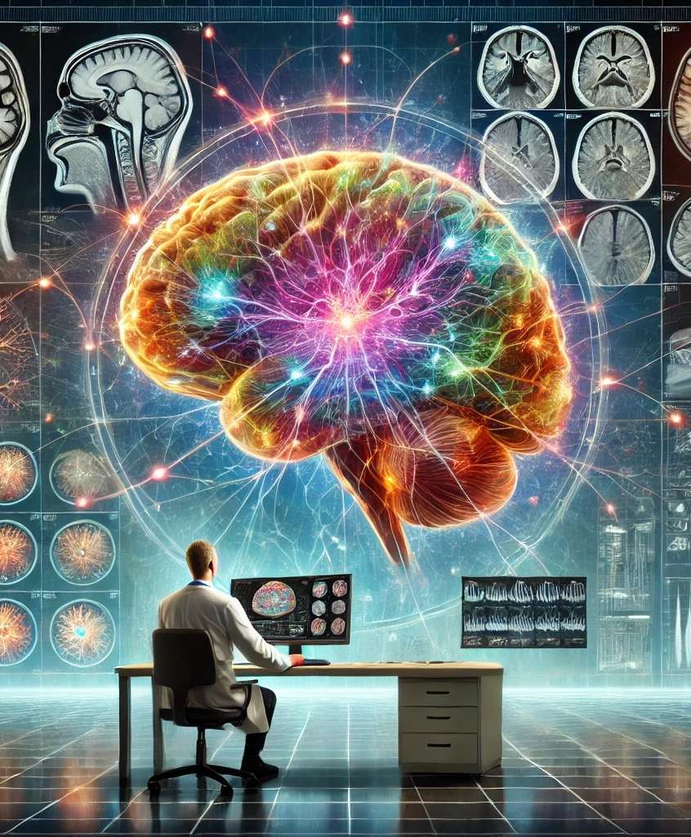
Neuroradiology
Image generated with DALL-E AI Image Generator

Slide 9
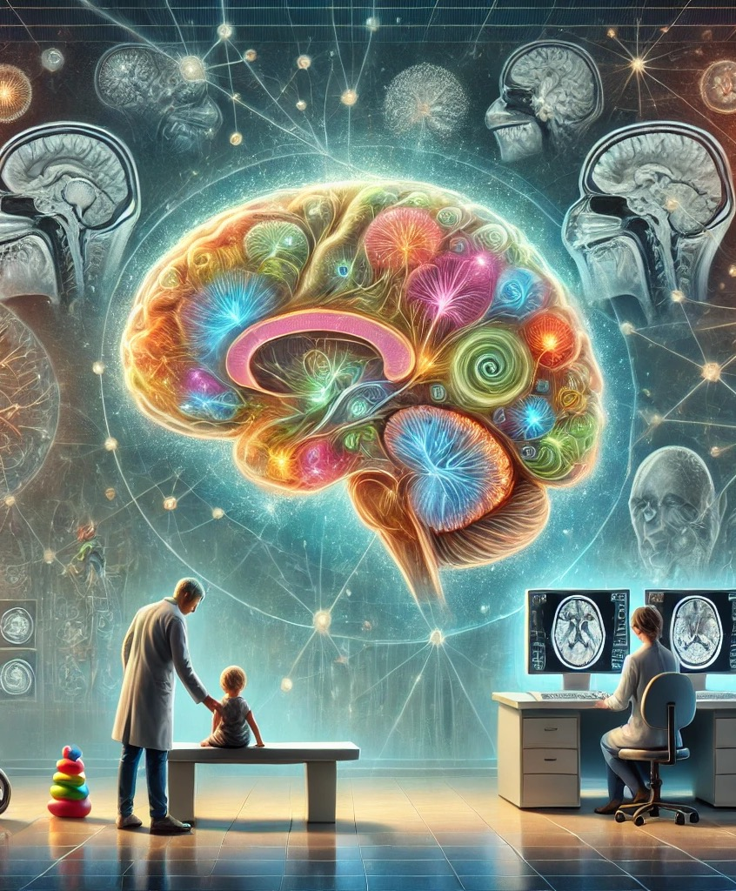
Paediatric Neuroradiology
Image generated with DALL-E AI Image Generator

Slide 10
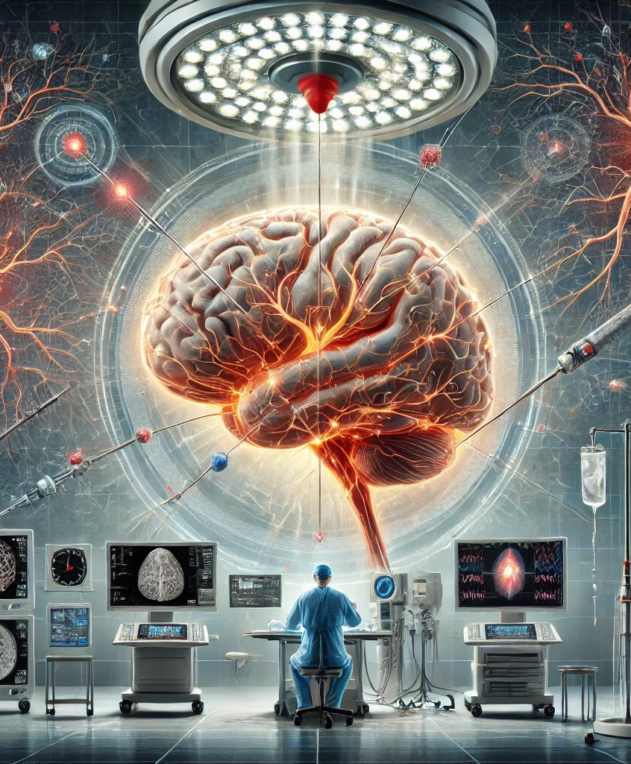
Interventional Neuroradiology
Image generated with DALL-E AI Image Generator

Slide 11
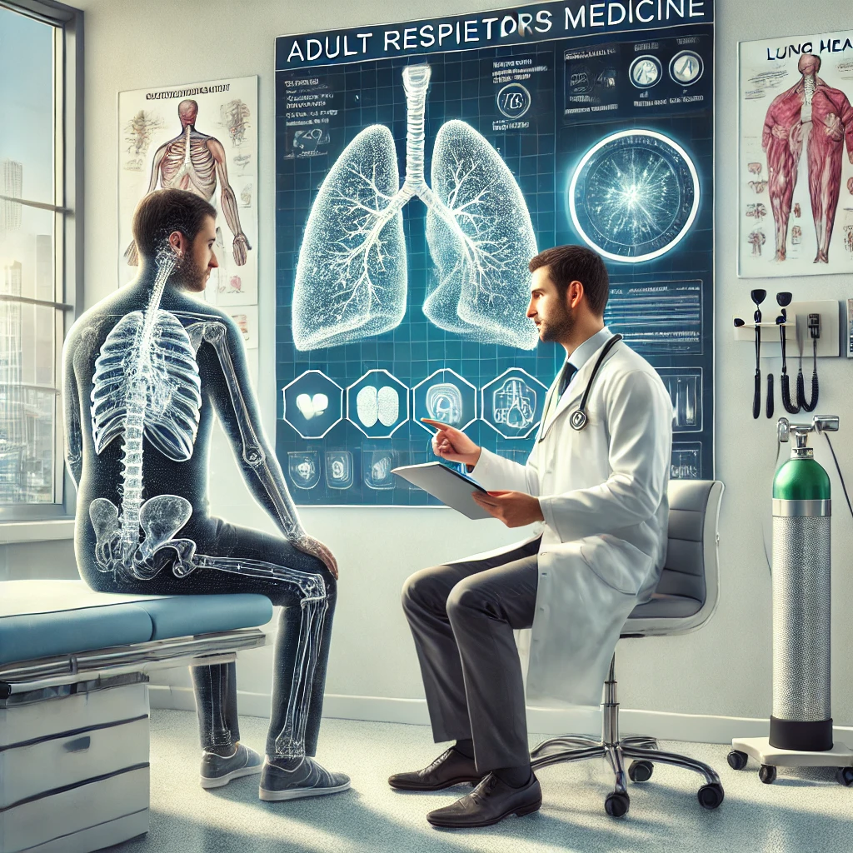
HERMES Adult Respiratory Medicine
Image generated with DALL-E AI Image Generator

Slide 12
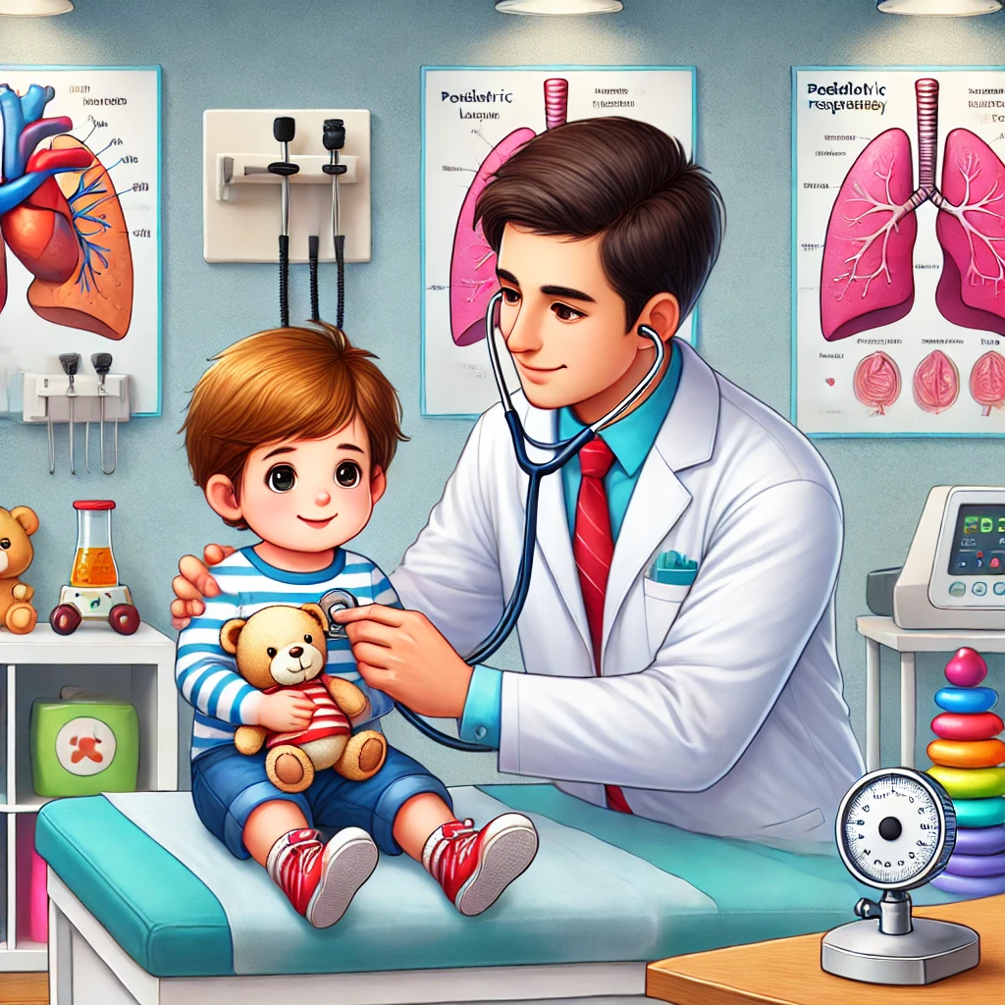
HERMES Paediatric Repiratory Medicine
Image generated with DALL-E AI Image Generator

