Slide 1




Artificial Intelligence (AI) in medical exams: friend or foe?
Prof. dr. Danny G.P. Mathysen (MSc, PhD)
danny.mathysen@uantwerpen.be
Universiteit Antwerpen (UAntwerpen) – Universitair Ziekenhuis Antwerpen (UZA)
PGME training coordinator University of Antwerp and Antwerp University Hospital
European Union of Medical Specialists – Council for European Specialty Medical Assessments
UEMS-CESMA Appraisals and Liaison Officer
FOD Volksgezondheid, Veiligheid van de Voedselketen en Leefmilieu
SPF Santé Publique, Sécurité de la Chaîne alimentaire et Environnement
1) Plaatsvervangend lid van de Federale Planningscommissie – Medisch Aanbod
Membre suppléant de la Commission de Planification – Offre Médicale
2) Uitgenodigd expert Taskforce Kwaliteit van de stages van artsen-specialisten in opleiding
Expert invité Taskforce Qualité des stages des médecins spécialistes en formation
3) Uitgenodigd expert werkgroep Kwaliteit Hoge Raad van Artsen-specialisten en van Huisartsen
Expert invité groupe de travail Qualité du Conseil Supérieur des médecins spécialistes et des médecins généralistes
Image generated with DALL-E AI Image Generator

Slide 2


Artificial Intelligence in European Medical examinations
The presenter does absolutely not claim to be an expert in artificial intelligence...
Image generated with DALL-E AI Image Generator

Slide 3
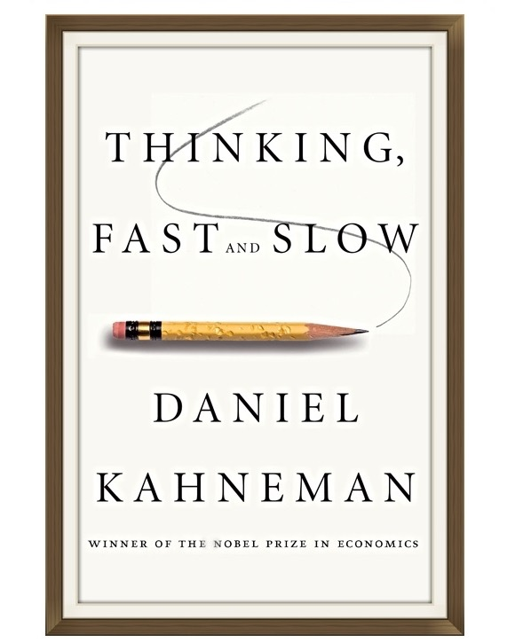
Why do we ”need” Artificial Intelligence?
Thinking, fast and slow (Daniel Kahneman)

Slide 4

Brain exercise
You have 30 seconds to take out 6 bottles of your own choice
After you have taken out the 6 bottles, make sure that in each row there is an even number of bottles left (either 0, 2, 4 or 6)
After you have taken out the 6 bottles, make sure that in each column there is an even number of bottles left (either 0, 2 or 4)

Slide 5
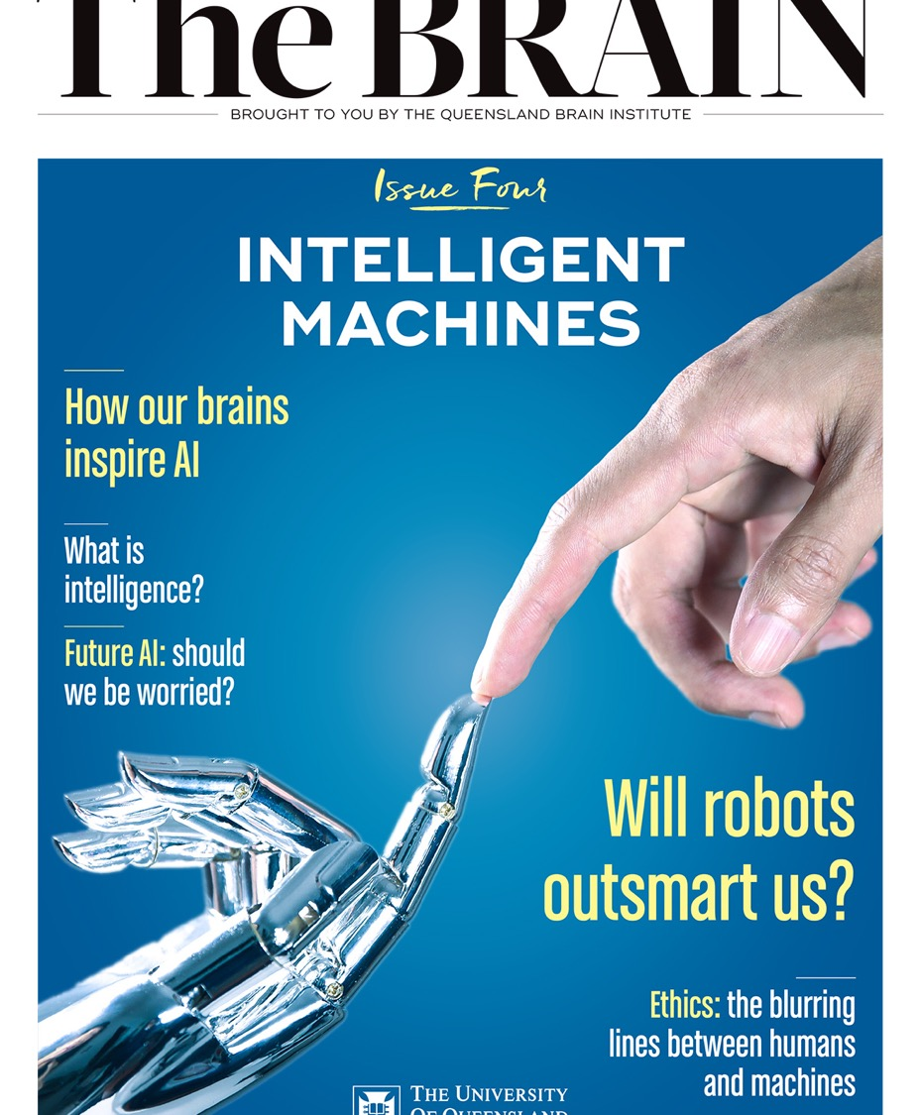
Why do we ”need” Artificial Intelligence?
Intelligent Machines (Issue of “The Brain”,
University of Queensland)

Slide 6
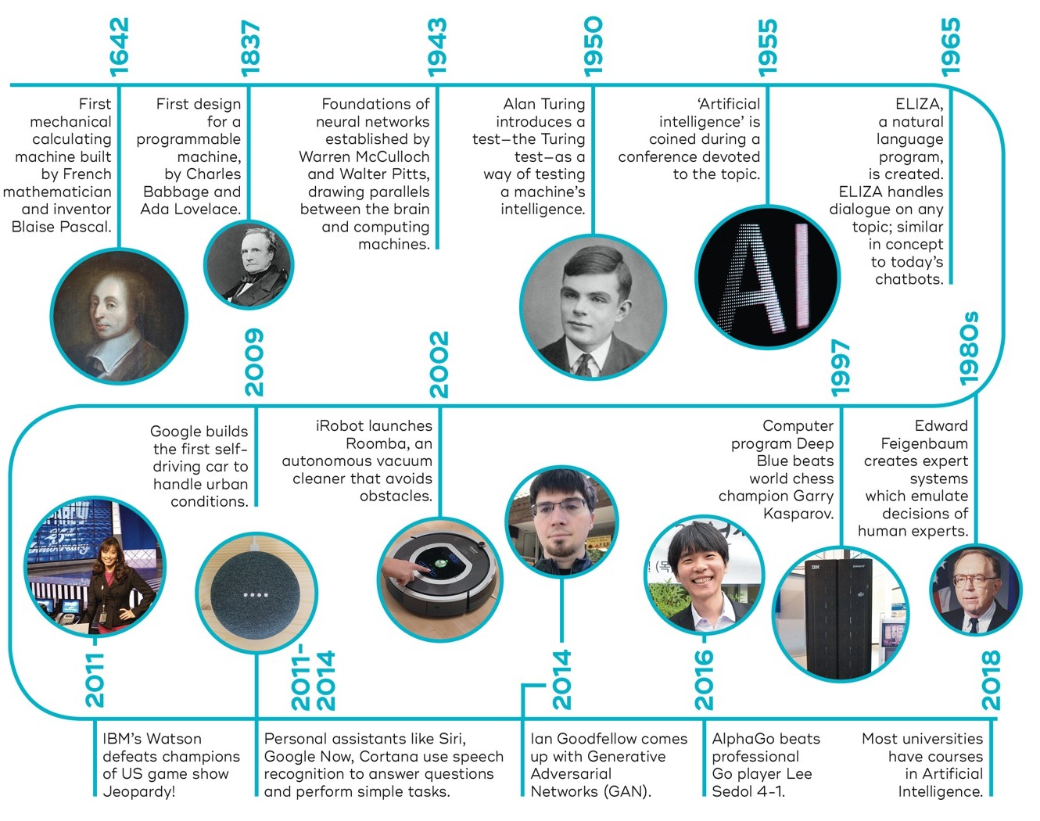
The idea of artificial intelligence is not that new…

Slide 7

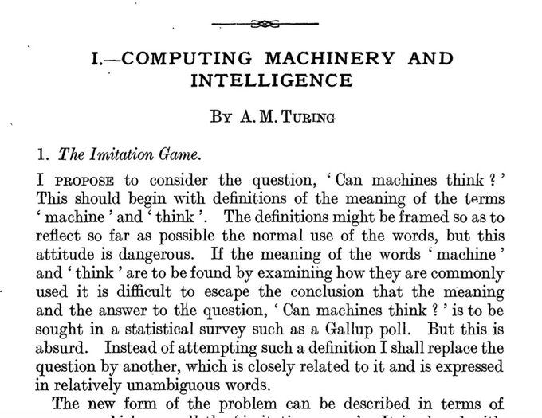

Slide 8
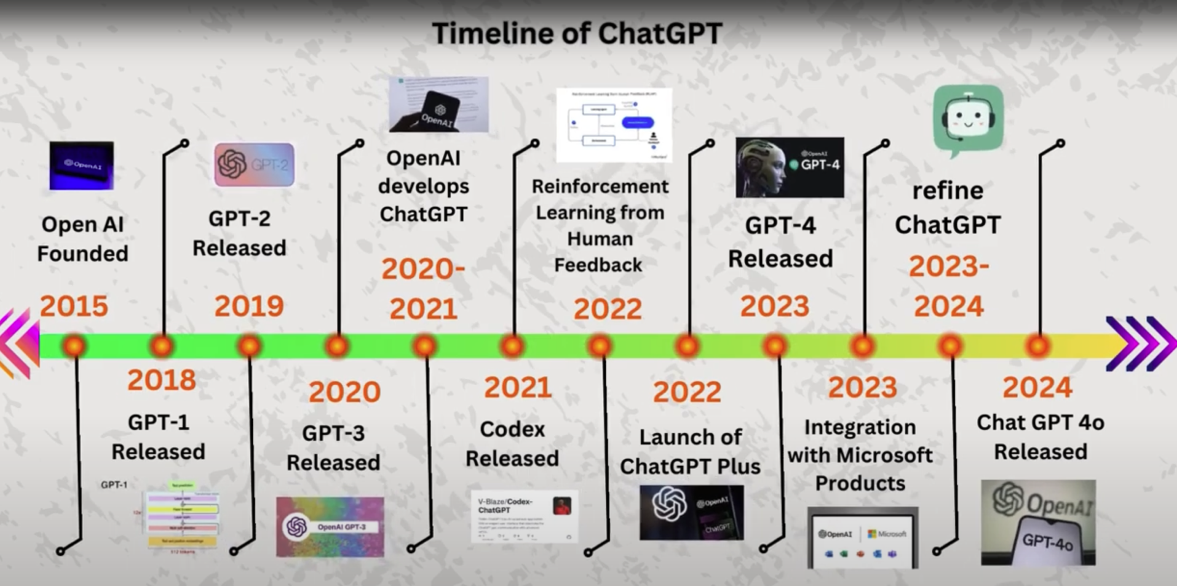
… but the revolution of artificial intelligence is brand new (GenAI)

Slide 9

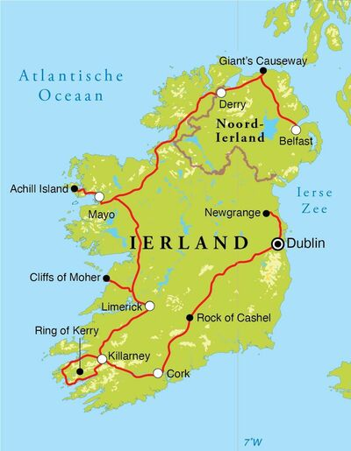

Electricity hungry data centers are responsible for
1% of global electricity usage
20% of current data center capacity is used for AI (growing trend)

Slide 10

Abuse of AI
technology can
have major
consequences...

Slide 11



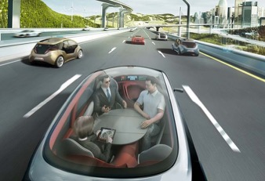
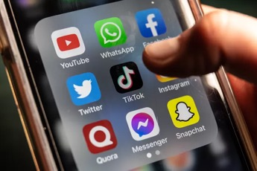




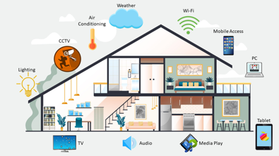
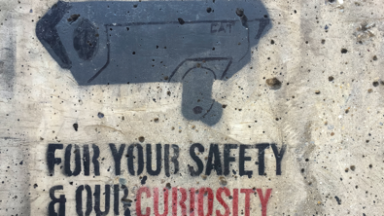
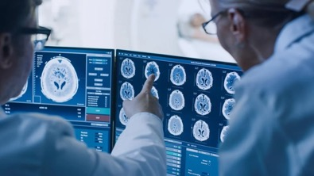
Artificial Intelligence (AI) is omnipresent in our lives
(autonomous driving) cars
recommendation algorythms
automatic translation and text suggestions
smart home
surveillance and security
medical diagnoses
Notes:
voorbeelden:
autocorrector
het lijkt of we afgeluisterd worden
bankapp

Slide 12

Impact of Artificial Intelligence on questionbanks for medical examinations
Security issues
Opportunities for question writing process
(complete questions, distractors, etc.)
Image generated with DALL-E AI Image Generator

Slide 13
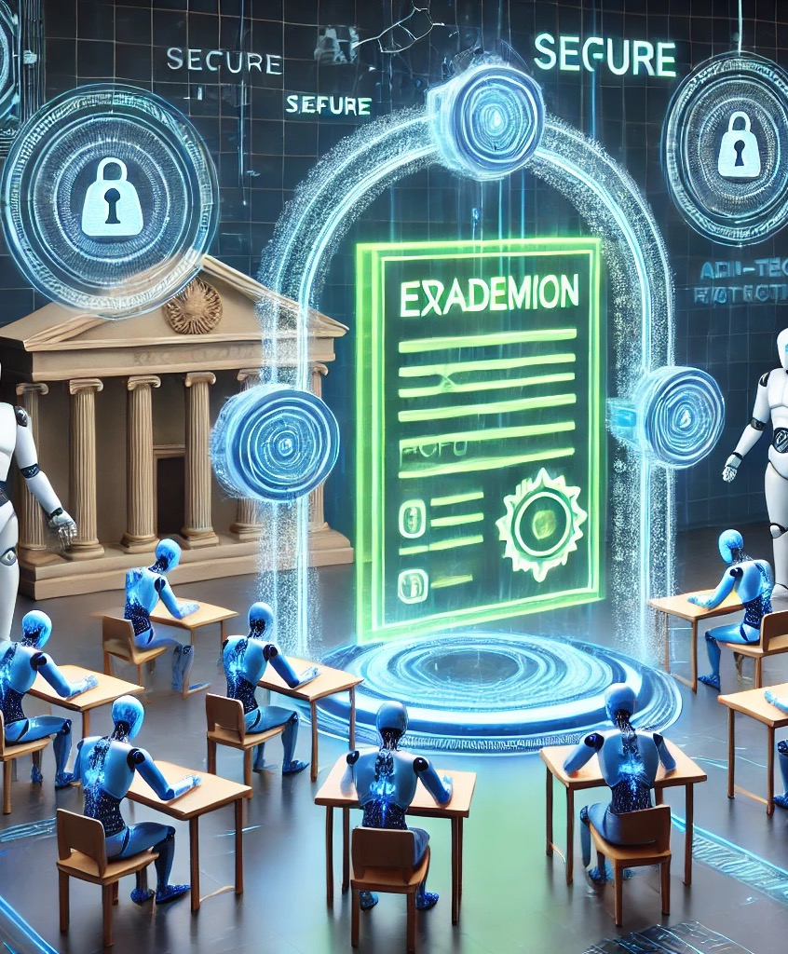
Impact of Artificial Intelligence on delivery of medical examinations
Security issues
(see also presentation of Morné Wolmarans)
Evolution towards open book exams?
(see also presentation of Chris Plummer)
Image generated with DALL-E AI Image Generator

Slide 14
Is it a good or a bad thing that AI bots are able to pass “our” medical exams?
Maybe, we have to answer this question in relation to quality benchmarking of our exams:
It would be a bad sign if AI bots were unable to pass “our” medical exams...
Access to the original manuscripts available via hyperlink in the above-mentioned screenshots

Slide 15
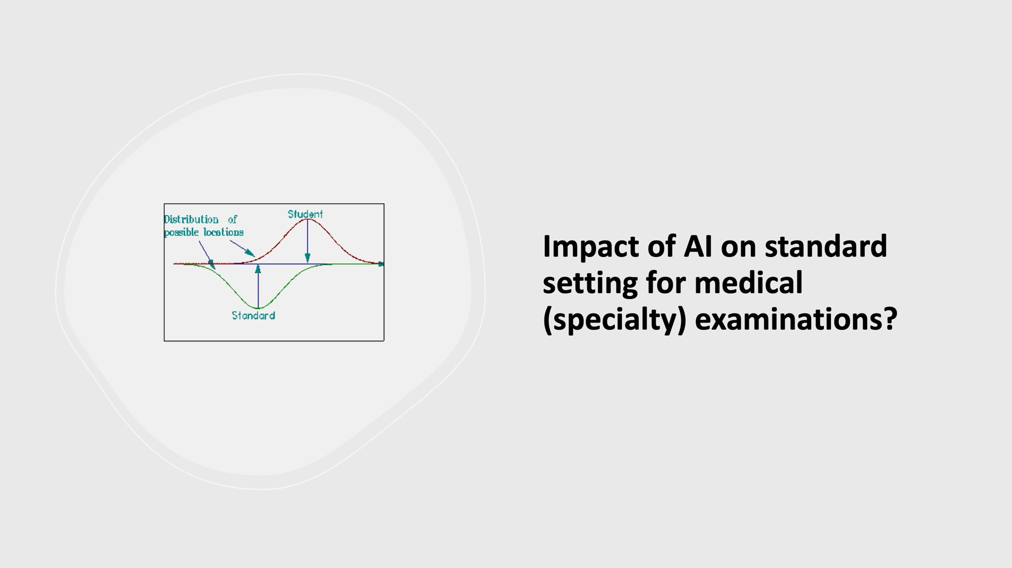
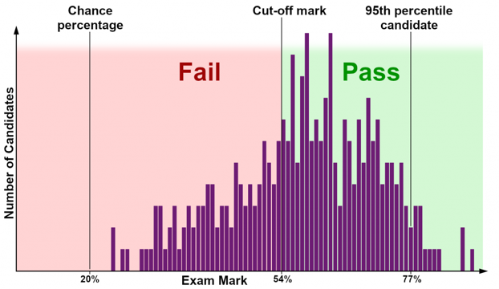

Slide 16
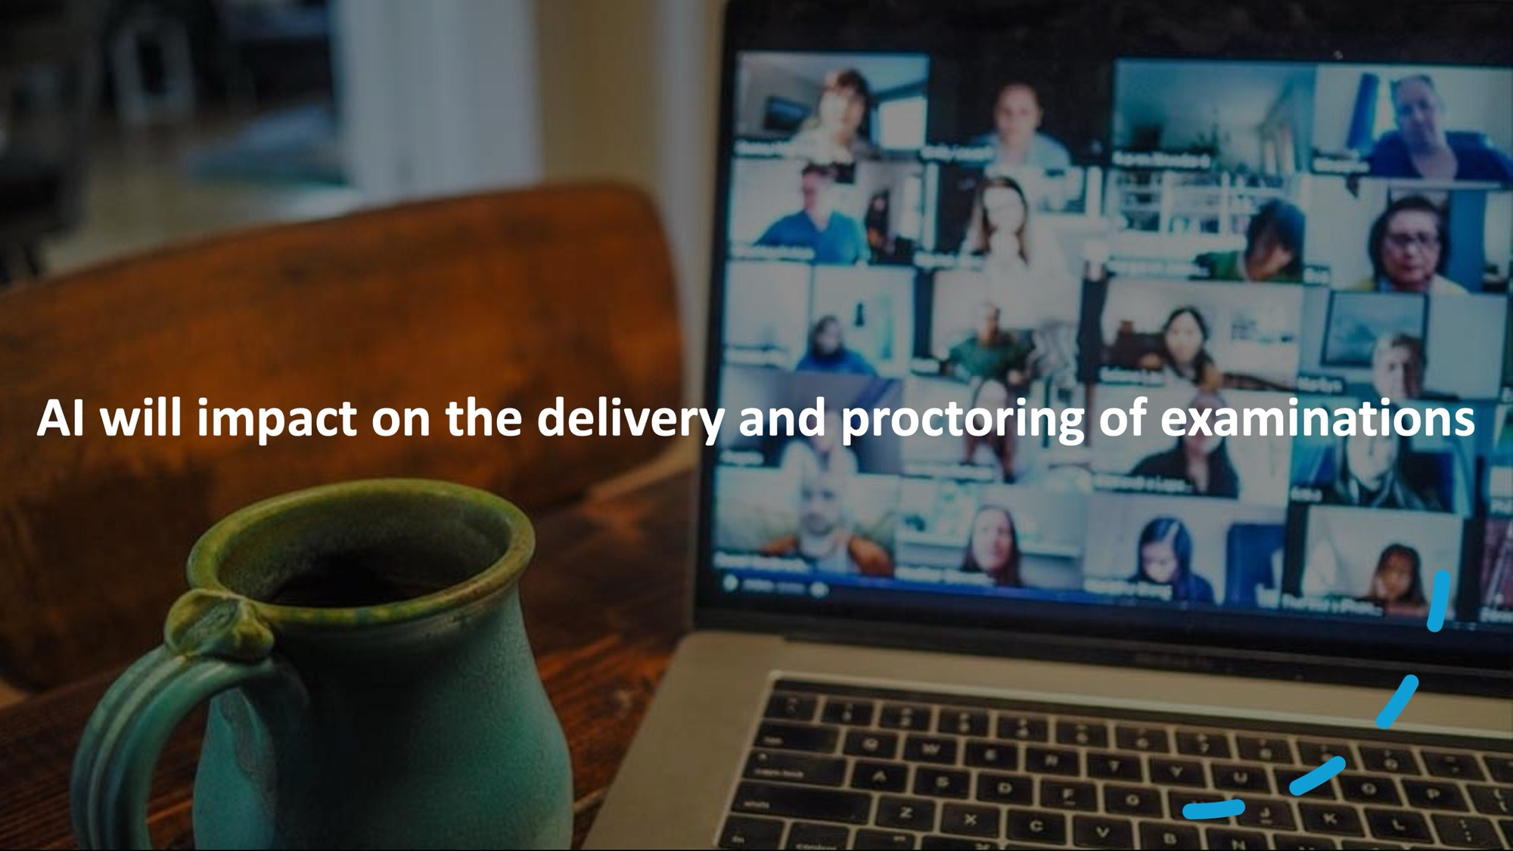

Slide 17

Students use AI to study and prepare themselves for examinations
Source of the video: Youtube (speaker: J. Wesley Boyd, psychiatrist – Harvard Medical School)

Slide 18
ChatGPT could be able to pass the USMLE examination
(February 2023)
Access to the original manuscript available via hyperlink in the above-mentioned screenshot

Slide 19
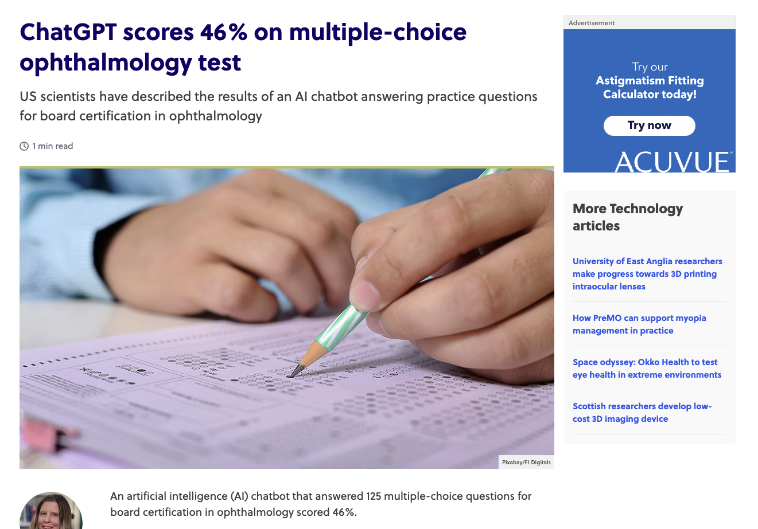
May 2023
Access to the original manuscript available via hyperlink in the above-mentioned screenshot

Slide 20
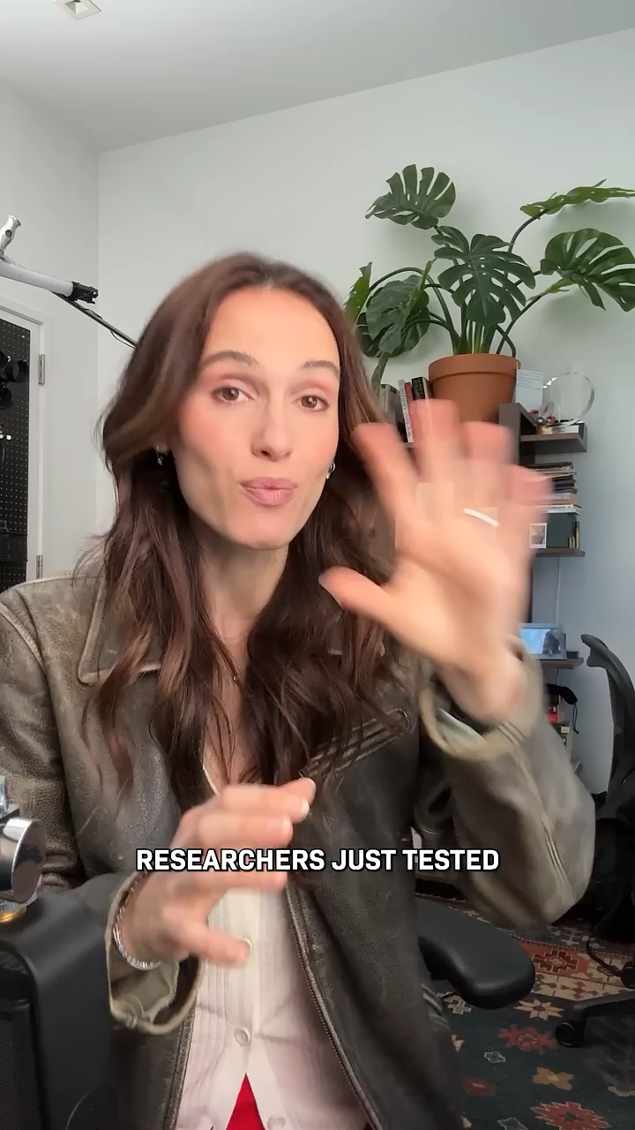
AI versus MD’s
(April 2024)
Source of the video: Youtube (speaker: Cleo Abram – Video producer at Vox)

Slide 21

Source of the video: Youtube (Fragment of CNBC edition on ChatGPT: AI outperforms doctors)
Study presented on USMLE (July 18th, 2024)

Slide 22
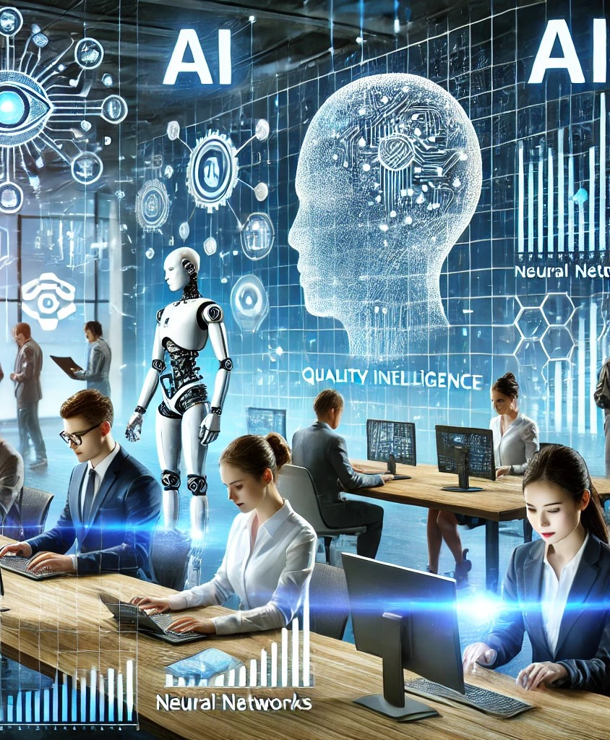
Impact of Artificial Intelligence on performing UEMS-CESMA appraisals?
We’ll have to embrace the fact that Artificial Intelligence is present in our daily lives
... as well as in our examinations
Image generated with DALL-E AI Image Generator

Slide 23

Open for discussion ...
How will Artificial Intelligence impact
UEMS-CESMA in the (near) future?
Image generated with DALL-E AI Image Generator

