Slide 1
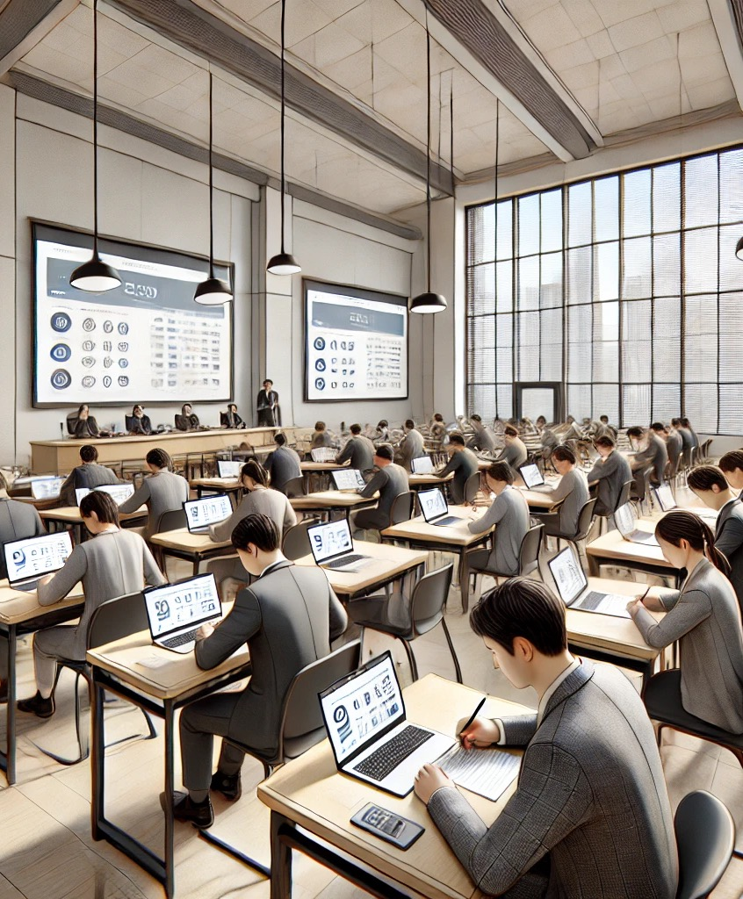



UEMS-CESMA Appraisals
Prof. dr. Danny G.P. Mathysen (MSc, PhD)
danny.mathysen@uantwerpen.be
Universiteit Antwerpen (UAntwerpen) – Universitair Ziekenhuis Antwerpen (UZA)
PGME training coordinator University of Antwerp and Antwerp University Hospital
European Union of Medical Specialists – Council for European Specialty Medical Assessments
UEMS-CESMA Appraisals and Liaison Officer
FOD Volksgezondheid, Veiligheid van de Voedselketen en Leefmilieu
SPF Santé Publique, Sécurité de la Chaîne alimentaire et Environnement
1) Plaatsvervangend lid van de Federale Planningscommissie – Medisch Aanbod
Membre suppléant de la Commission de Planification – Offre Médicale
2) Uitgenodigd expert Taskforce Kwaliteit van de stages van artsen-specialisten in opleiding
Expert invité Taskforce Qualité des stages des médecins spécialistes en formation
3) Uitgenodigd expert werkgroep Kwaliteit Hoge Raad van Artsen-specialisten en van Huisartsen
Expert invité groupe de travail Qualité du Conseil Supérieur des médecins spécialistes et des médecins généralistes
Image generated with DALL-E AI Image Generator

Slide 2
Part 1. Collaborations?
Are collaborations necessary for the UEMS-CESMA Appraisal process?

Slide 3

Presentation of appraisal certificates
UEMS-CESMA meeting
Saturday December 7th, 2024
Image generated with DALL-E AI Image Generator

Slide 4

Electronic signature process for
finalised UEMS-CESMA appraisal reports
DocuSign
Image generated with DALL-E AI Image Generator

Slide 5

Confidential information handled
during a UEMS-CESMA appraisal process
Confidentiality agreement is currently implicitly expected
Confidentiality agreement might be effectively signed in the near future
Image generated with DALL-E AI Image Generator

Slide 6

Appraisal report finalization depends on the availability of observational data
UEMS-CESMA appraisal is not only observing the preparation, delivery and managing of an examination
UEMS-CESMA is also writing an (extensive) appraisal report with feedback for the organisers of the examination
Image generated with DALL-E AI Image Generator

Slide 7

Technical issues
E-mail correspondence while being abroad is not always reliable ... (observational experience)
Image generated with DALL-E AI Image Generator

Slide 8
UEMS-CESMA Appraisal report template
Preparation by UEMS-CESMA Appraisals Liaison Officer
Discussed within UEMS-CESMA Core Appraisal Group
Put into practice for 2024 appraisal procedures
Adaptation for 2025 “safety” will be replaced with “security”
current UEMS-CESMA Appraisal Report template

Slide 9

General conclusion of UEMS-CESMA
Spring 2024 meeting in Antwerp
We can do it with volunteers from within UEMS-CESMA

Slide 10

Delay between visit and report delivery
Limited number of available appraisers
(high time investment)
Appraisal report template has been aligned in 2024 with report templates of companies that are specialized in exam certifications
(structured but very detailed guidance for appraisers)
All appraisers in 2024 have expressed the need for secretarial or other support!
(huge workload for appraisers)
Image generated with DALL-E AI Image Generator

Slide 11

UEMS-CESMA Appraisal need for support
Limited number of available appraisers
(high time investment)
Appraisal report template has been aligned in 2024 with report templates of companies that are specialized in exam certifications
(structured but very detailed guidance for appraisers)
All appraisers in 2024 have expressed the need for secretarial or other support!
(huge workload for appraisers)
Image generated with DALL-E AI Image Generator

Slide 12

UEMS-CESMA Appraisal fee
Has been increased to 3.000 euro
Increased fees come with increased expectancies...
Fee per examination, which means that multiple fees are applicable when simultaneous appraisals are conducted!
Image generated with DALL-E AI Image Generator

Slide 13

General conclusion of UEMS-CESMA
Spring 2024 meeting in Antwerp
We can do it with volunteers from within UEMS-CESMA
Reality check in 2024: it is not possible this way, we cannot postpone the decision and keep on deciding at every UEMS-CESMA meeting “to give it another try” !!!

Slide 14

UEMS-CESMA Core Appraisal Group
September 20th, 2024
October 25th, 2024 (cancelled due to circumstances)
March 19th, 2025 (guidance document & collaboration)
Image generated with DALL-E AI Image Generator

Slide 15

UEMS-CESMA Appraisal need for support
Partner that can be trusted
Partner with expertise in exams?
Partner with expertise in medicine?
Partner with expertise in exams and in medicine?
Partner within UEMS or outside of UEMS?
Image generated with DALL-E AI Image Generator

Slide 16

Open for discussion ...
Need for input on general acceptable concepts for UEMS-CESMA to liaise with professional support for the UEMS-CESMA appraisal procedures, that can be further implemented by the Core Appraisal Group in Spring 2025
Image generated with DALL-E AI Image Generator

Slide 17
Part 2. Update on document progress
Update on the UEMS-CESMA appraisal guiding documents

Slide 18

Documents needed to support UEMS-CESMA Appraisals
Guidance document for appraisers on
“How to do a UEMS-CESMA appraisal?”
(many ideas, 1st draft to be presented by UEMS-CESMA Appraisals Liaison Officer to the Core Appraisal Group for open discussion:
March 19th, 2025)
Guidance document for appraisers on “Standards for European Specialist Medical Examinations”
(finalization expected in Spring 2025)
Image generated with DALL-E AI Image Generator

Slide 30
Part 3. Appraisals update
Update on finalized, outstanding and expected UEMS-CESMA Appraisals
Rules and regulations (responsibilities) – Confidentiality – Challenges for appraisals

Slide 31

General conclusion of UEMS-CESMA
Spring 2024 meeting in Antwerp
We can do it with volunteers from within UEMS-CESMA
Reality check in 2024: it is not possible this way, we cannot postpone the decision and keep on deciding at every UEMS-CESMA meeting “to give it another try” !!!

Slide 32
Delay between visit and report delivery
Limited number of available appraisers
(high time investment)
Appraisal report template has been aligned in 2024 with report templates of companies that are specialized in exam certifications
(structured but very detailed guidance for appraisers)
All appraisers in 2024 have expressed the need for secretarial or other support!
(huge workload for appraisers)
Image generated with DALL-E AI Image Generator

Slide 33

Finalised UEMS-CESMA appraisals (‘23-’24)
Pain Medicine + Regional Anaesthesia
Physical and Rehabilitation Medicine
General Surgery
Neuroradiology + Paediatric Neuroradio-logy + Interventional Neuroradiology
Obstetrics and Gynaecology
Dermato-Venereology
Medical Genetics
Image generated with DALL-E AI Image Generator

Slide 34

Ongoing UEMS-CESMA appraisals (‘23-’24)
Intensive Care Medicine
HERMES
Oro-maxillo-facial surgery
Paediatrics
Head & Neck Neuroradiology + Spine Neuroradiology
Image generated with DALL-E AI Image Generator

Slide 35
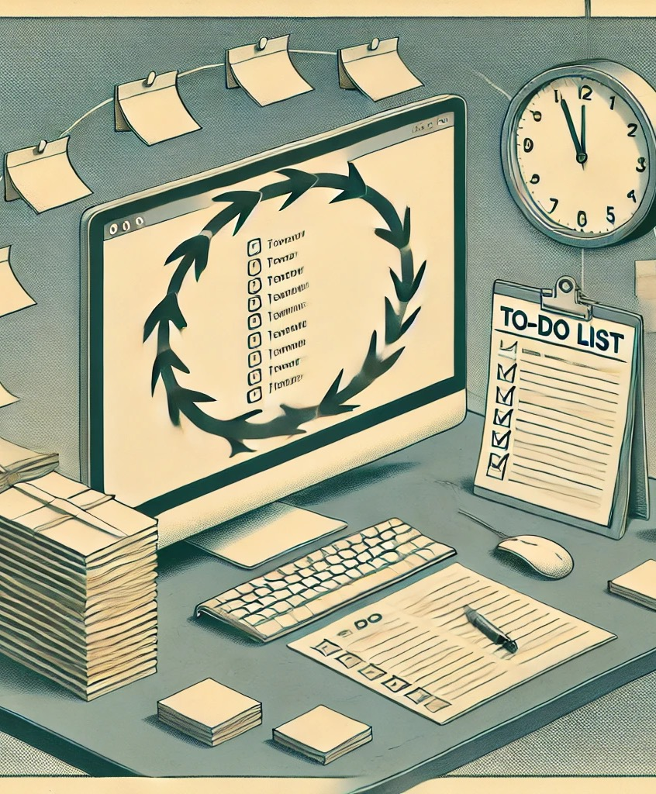

UEMS-CESMA appraisals to be repeated
Hand surgery (re-appraisal)
Cardiology (1st time appraisal)
Neurology (re-appraisal)
Image generated with DALL-E AI Image Generator

Slide 36

Application for UEMS-CESMA appraisals
At least 3 months prior to the exam activities
Image generated with DALL-E AI Image Generator

Slide 37

UEMS-CESMA appraisals 2025 (already known)
Cardiology examinations (different dates)
Maeve Durkan + ...
Venue: Online examinations
Occupational Medicine (October 20th, 2025)
To be scheduled
Venue: Domus Medica Europaea, Brussels
Clinical embryology (mid-October, 2025)
To be scheduled
Venue: Online examination
Otorhinolaryngology (November 8th, 2025)
To be scheduled
Venue: University of Music and Performing Arts, Vienna
Image generated with DALL-E AI Image Generator

Slide 38
Part 4. Scope for appraisals
Scope of examinations for UEMS-CESMA Appraisal: UEMS or UEMS-aligned
What does alignment mean?

Slide 39
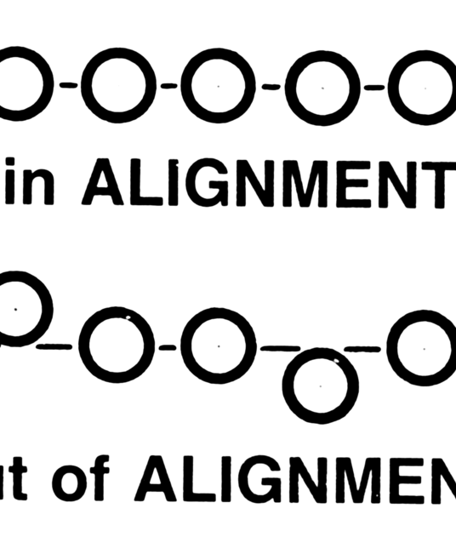
Scope for UEMS-CESMA appraisals
UEMS examinations
UEMS aligned examinations:
what does alignment mean?
Image generated with DALL-E AI Image Generator

