Slide 1
RECOGNITION OF GENERAL PRACTICE/FAMILY MEDICINE AS A SPECIALTY IN EUROPE – THE UEMS PORTFOLIO FOR THE ADVANCEMENT OF MEDICAL SPECIALIST PRACTICE IN EUROPE
UEMS-UEMO Joint Session
Brussels, 18 October 2024

Slide 2
Conflict of Interests Declaration
Head of the General Surgery Department in Hospital da Luz Oeiras in Oeiras, Portugal.
UEMS Secretary General since 2020
Head of the European Accreditation Council for Continuing Medical Education (EACCME®)

Slide 3
Late 1950’s…Early 1960’s
Birth of European Medical Organizations
Aiming to translate the ideas and ideals of European collaboration and integration into the medical profession

Slide 4
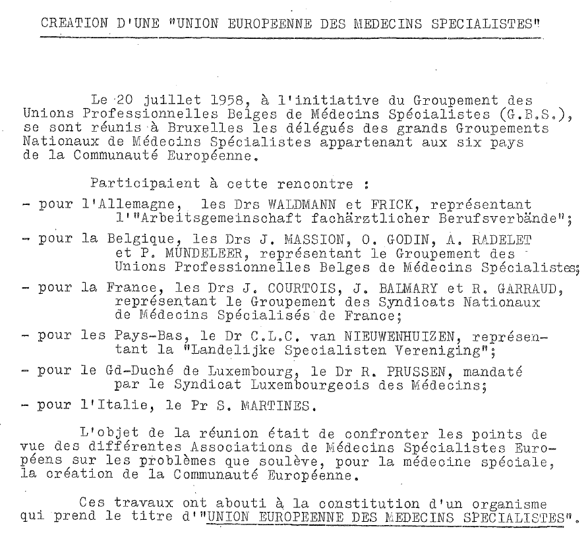
So, on 20 July 1958…

Slide 5
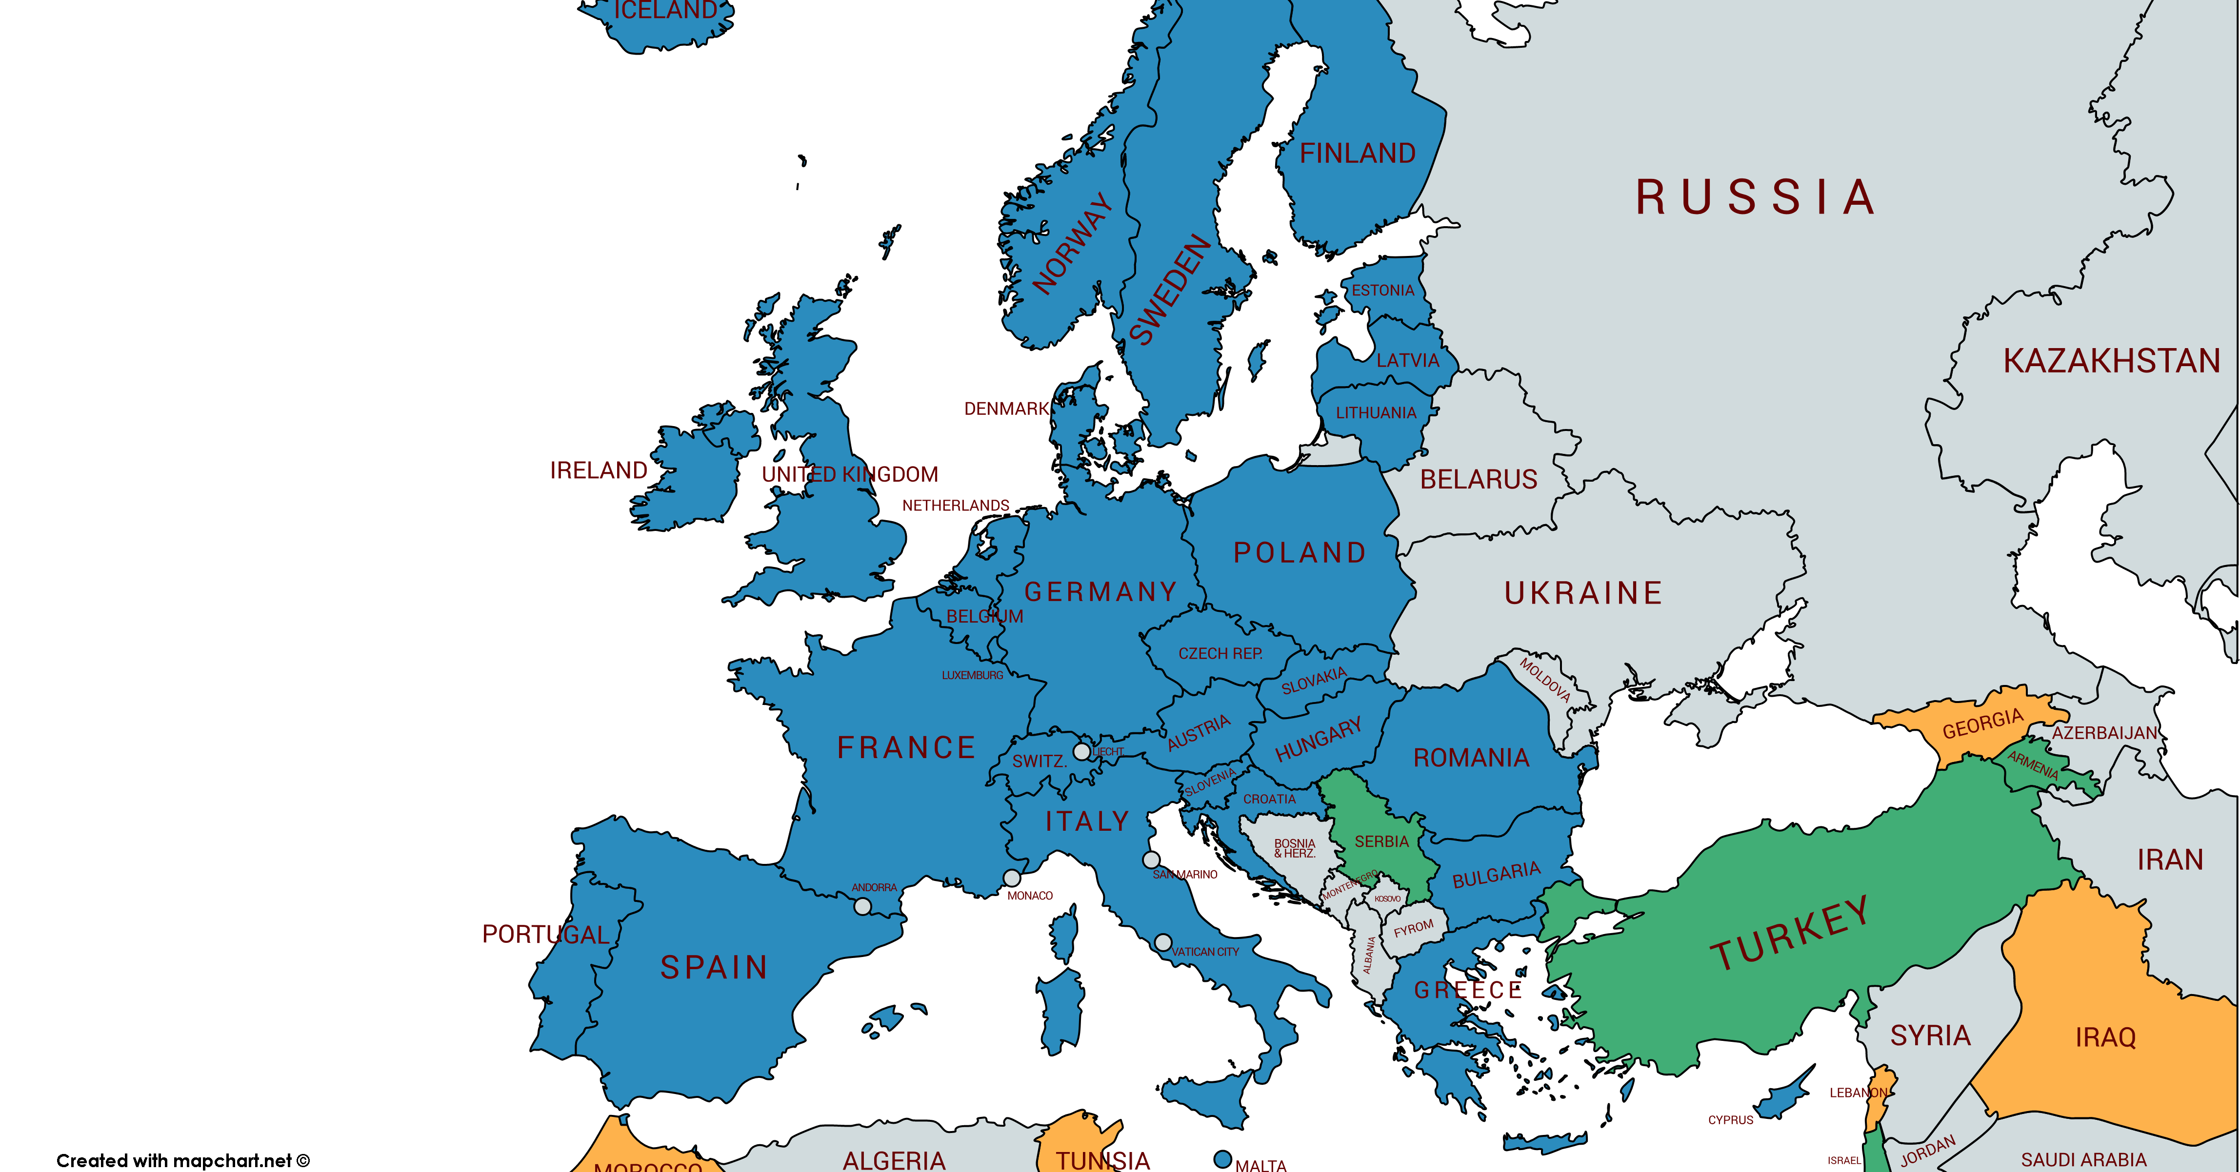
UEMS
66 years young
41 Countries
National Medical Associations of:
> 80 Specialists bodies
1,600,000 Medical Professionals

Slide 6
OBJECTIVES
Promote free movement
through the harmonisation of the highest level of specialist training and medical care
VISION
Set standards in the fields of:
Postgraduate Specialist Medical Training
Continuing Med. Education and Prof. Development
Quality Assurance in specialist medical practice

Slide 7
GP/FM Across Europe
469.000 doctors*
94.000 in France*
85.000 in Germany*
Recognized as a specialty in 20 European Countries
> 65% of countries have > 3 years of training**
Eurostat 2023 data
** UEMO 2016 survey

Slide 8
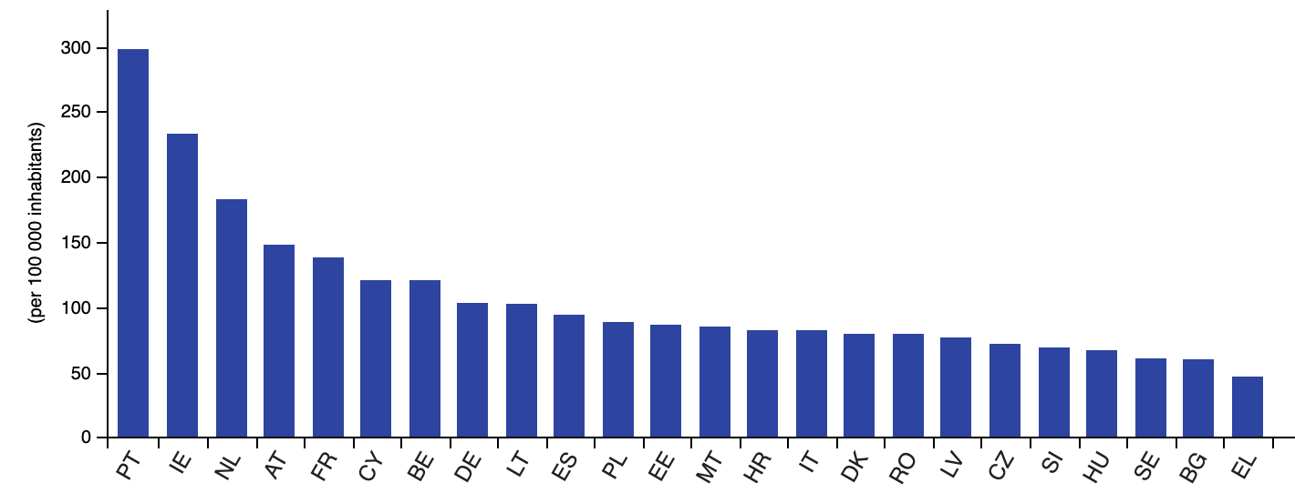
GP/FM per 100.000 inhabitants

Slide 9
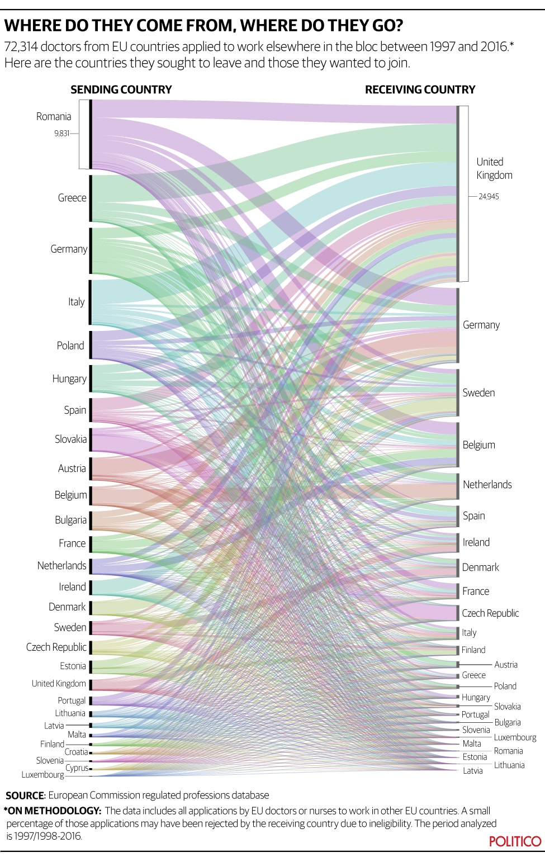
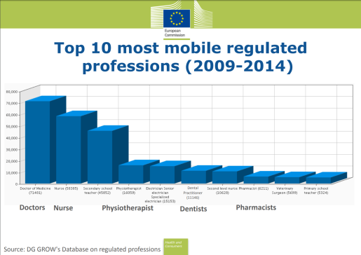
New World – New Realities
Free movement of health care professionals
Free movement of patients
Health care systems across Europe are inter-dependent
In many countries, assessments of education, training, competence and professional development either they do no exist, or they are not well developed

Slide 10
EU Healthcare Directive 2011/24/EU
The rights of the patients
The freedom to receive health services throughout the European Union must be accompanied by guarantees of quality and security. In order to make an informed choice, patients must be able to access all the information they require on the conditions under which they will receive healthcare in another EU Member State and the conditions under which they will be reimbursed once they return home.
Quality of Training, Quality of Care, Quality of Outcomes

Slide 11
The Aging Population

Slide 12
Vulnerable Population

Slide 13
Patient Empowerment

Slide 14
Translating the principles into real life oportunities
How do we do it?

Slide 15
EUROPEAN TRAINING REQUIREMENTS ASSESSMENTS EUROPEAN ACREDITATION COUNCIL ON CONTINUING MEDICAL EDUCATION (EACCME)

Slide 16
European Training Requirements and Assessments
UEMS Sections, Boards, Divisions and MJC’s develop European standards in medical training that aim to reflect modern medical practice and current scientific findings.
Definition of PGT training contents is National Authorities competence!
ETR’s aim is to complement these and ensure that high quality training is provided across Europe.

Slide 17
European Training Requirements and Assessments
Involves:
Relevant UEMS Section
The National Scientific Societies represented in the Section
The relevant European Scientific Societies
As broad consultation as possible at a national and European level (Universities, Colleges, Professional Organizations...)

Slide 18
European Training Requirements and Assessments
Wide and in-depth discussion regarding:
Training requirements (clinical, academic, professional)
Standards of clinical care
Accreditation of trainers
Appraisal and accreditation of training centers

Slide 19
European Training Requirements and Assessments
Content and format of the assessment:
Existing experience across Europe and beyond
Consultation with already established European Boards
Innovative ideas
Preparatory courses
Affordable/ No fixed failure rate

Slide 20
European Training Requirements and Assessments
Consensus of all parties involved:
Not the lowest common denominator
Highest commonly agreed standards

Slide 21
UEMS - Council of European Specialists Medical Assessments (CESMA)
UEMS Organization
40 European Specialties
Assessment Boards
Share experience and expertise
Appraisal programme
Produce guidelines
Pave the way for the future

Slide 22
CESMA Quality Control of UEMS Exams
Committee of Appraisers:
Other UEMS Boards
European or National Societies,
Professional Boards, Colleges
Academia

Slide 23
EACCME
Founded in 2000
2009 → implemented criteria for the accreditation of e-learning materials.
2016 → EACCME® 2.0
2022 → EACCME® 3.0 including new forms of acreditation (microlearning, hybrid events, reading of scientific articles, etc)

Slide 24
EACCME
The purpose of the EACCME® is to provide accreditation of international CME in Europe and to facilitate the recognition of credits between the various countries in Europe.

Slide 25
EACCME Review
Double Scientific Review
National Accreditation Authority (NAA) of the country in Europe within which the LEE will be held
The relevant specialty-based organisation, whether UEMS Specialist Section and Board/Multidisciplinary Joint Committee (MJC), or European Specialty Accreditation Board (ESAB)

Slide 26
EACCME Review
Strict rules on conflict of interests
Strict rules for industry support
Comprehensive scientif evaluation of events
Accreditation by the EACCME® means that the CME/CPD activity provided is of high scientific value, is free of commercial bias and promotes active adult learning.

Slide 27
EACCME Mutual Recognition Agreements
Austria
Armenia
Belgium
Bulgaria
Croatia
Cyprus
Finland
Georgia
Greece*
Hungary
Ireland
Regione Lombardia
Luxembourg
Malta
Netherlands
Norway
Poland
Portugal
Romania
Slovakia
Slovenia
Spain*
Sweden
Tunisia
Turkey
United Kingdom
Unites States of America
Canada
CONFEMEL*
* also for accreditation of national events

Slide 28
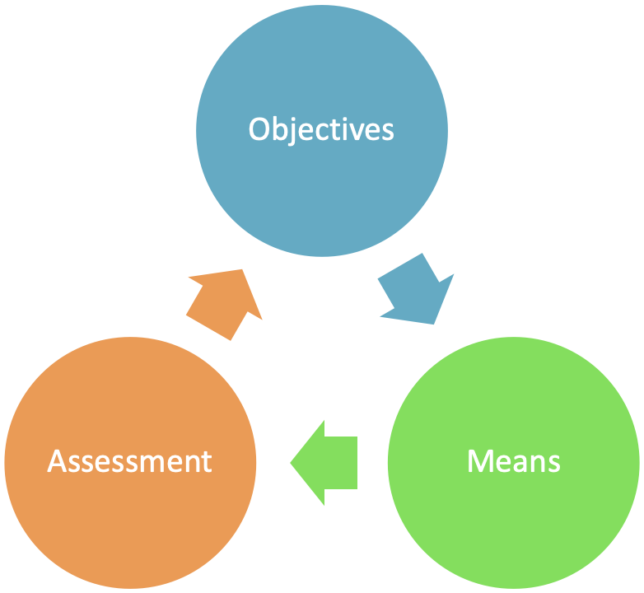
Projects for real people in real life
EACCME
ETR’s

Slide 29
Projects for real people in real life
“If you can dream it, you can achieve it”*
* WARNING: It takes a lot of work!!!

Slide 30
RECOGNITION OF GENERAL PRACTICE/FAMILY MEDICINE AS A SPECIALTY IN EUROPE – THE UEMS PORTFOLIO FOR THE ADVANCEMENT OF MEDICAL SPECIALIST PRACTICE IN EUROPE
THANK YOU!

