Slide 1
Recognition of Family Medicine/General Medicine as a European Medical Specialty
Update Report
UEMO-UEMS Joint session, Bruxelles, 18th– 19th October 2024

Slide 2
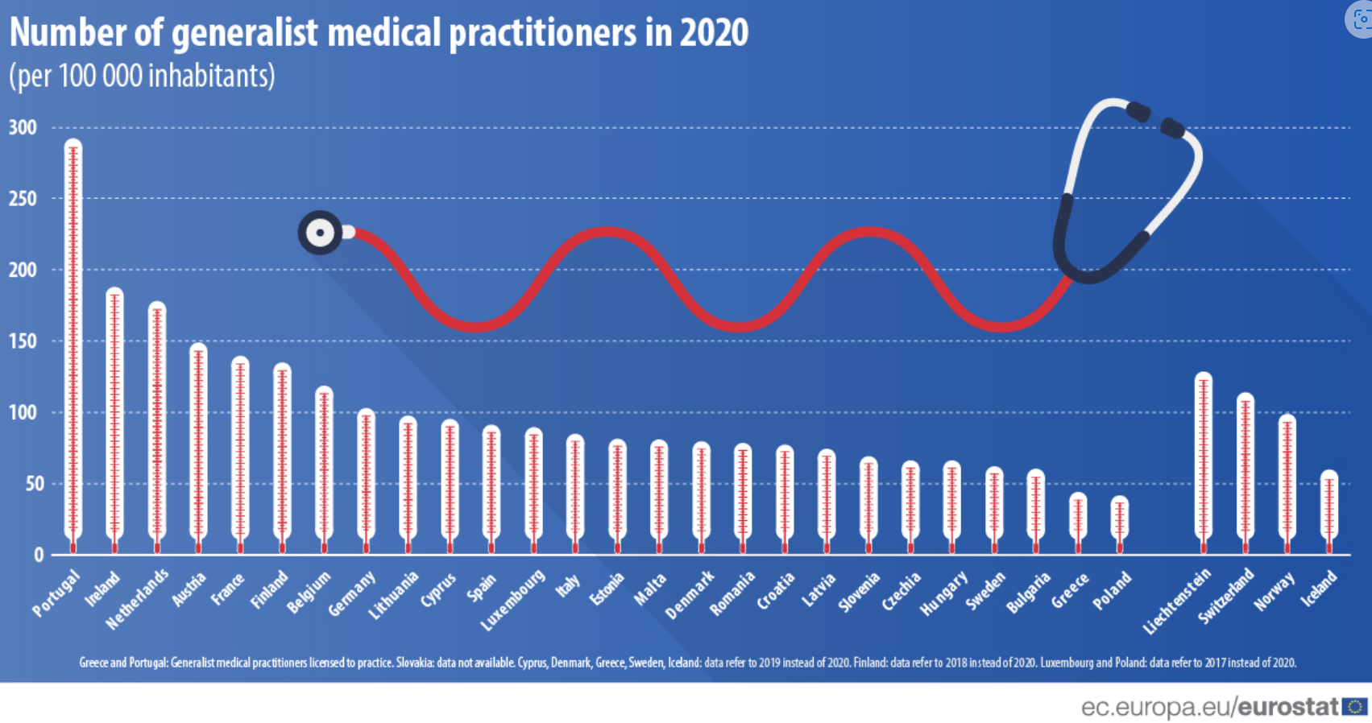
Notes:
Who are we talking about: In 2020, there will be approximately 454,000 GPs across the EU. The highest number of GPs was recorded in France (94,000), followed by Germany (85,000), while Portugal and Ireland reported the highest number of GPs per 100,000 inhabitants (292.3 and 187.7 per 100,000 inhabitants, respectively).

Slide 3
“Even when you are bored stiff saying the same thing again and again, say it again. Even when you think everybody will be fed up hearing it, say it again. Because the politicians may not yet have heard you.”
Notes:
We have not given up and will never give up fighting for equality among all medical specialists in Europe.

Slide 4
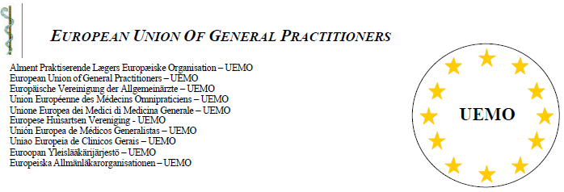
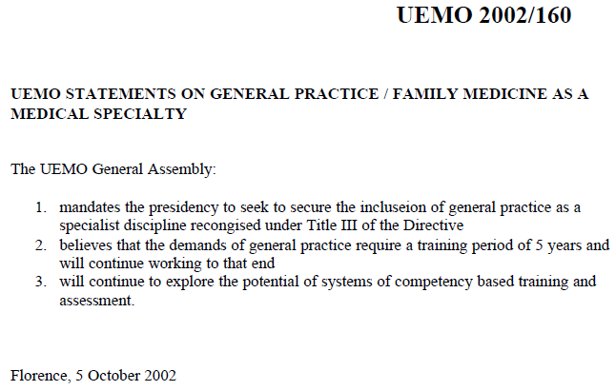
Notes:
Twenty-two years ago, the UEMO declaration mandated the Presidency to try to ensure the inclusion of family medicine as a specialist discipline in the title of the directive at that time. Furthermore, the UEMO advocated a 5-year training period and competence-based assessment.

Slide 5
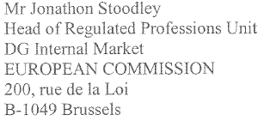
”The professional activities of general practitioners are covered by a specific system which differs from that for basic practitioners and specialized medical practitioners. The Member States cannot therefore recognize any medical specialty which has a field of professional activity similar to that of general practitioners”.
(Recital 13, COM(2002)119 final, 7.3.2002, UEMO 2002/037)
Notes:
We are aware of the total lack of knowledge about the role of family medicine on the part of politicians. This confusion has persisted for more than 22 years also at the level of the European Commission and its Directorates, but we are finally seeing some realities being accepted, as we will soon see.

Slide 6
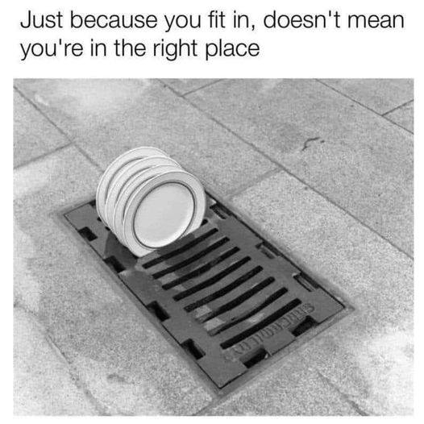
”Generalist medical practitioners are physicians including family and primary care doctors, who do not limit their practice to certain disease categories or methods of treatment and may assume responsibility for the provision of continuing and comprehensive medical care to individuals, families and communities. Occupations included in this category require completion of a university-level degree in basic medical education plus postgraduate clinical training or equivalent for competent performance. Medical interns who have completed their university education in basic medical education and are undertaking postgraduate clinical training are included here. Although in some countries ''general practice'' and ''family medicine'' may be considered as medical specializations, these occupations should always be classified here. In Commonwealth of Independent States, district paediatric doctors and district therapeutants are included in this category”.
WHO: Study on Primary Health Care Impact, Performance and Capacity in South Eastern European Countries; Glossary of terms for PHC
Notes:
This was not far from the WHO position at the time: Although in some countries ''general practice'' and ''family medicine'' may be considered as medical specializations, these occupations should always be classified as generalist medical practitioners.

Slide 7
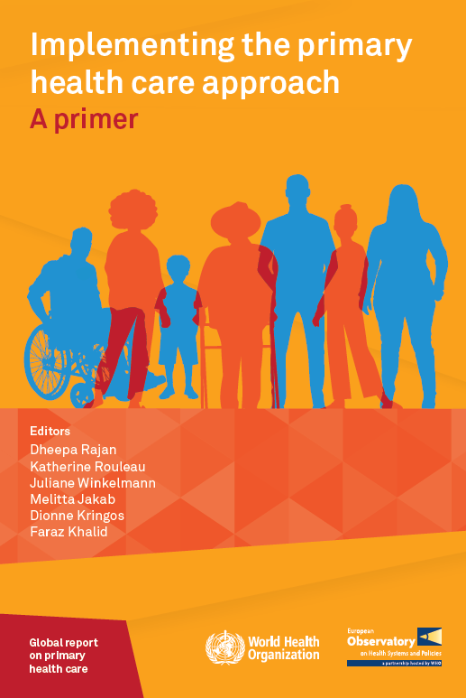
”In a limited number of countries, general/family practice is not yet recognized as a specialty, and the term “general practitioner” refers to individuals who enter clinical practice directly after basic medical training, often immediately after graduating from medical school, without any further postgraduate training or without postgraduate training informed by the principles of family medicine. However, the global trend is to require specialty training in family medicine before a doctor starts practicing”.
”General practice (also called family medicine) is a globally recognized medical specialty rooted in a generalist and person-centred approach. It involves well-defined competencies achieved through postgraduate/medical residency training”.
”To strengthen primary care, the development and recognition of general practice/family medicine as a specialty equivalent to other medical specialities is very important.”
Notes:
As I was saying, we are currently witnessing a change of optics on the part of some institutions that we thought were definitively anchored in past:
- In a limited number of countries, general/family practice is not yet recognized as a specialty... the global trend is to require specialty training in family medicine before a doctor starts practicing
- General practice (also called family medicine) is a globally recognized medical specialty
- To strengthen primary care, the development and recognition of general practice/family medicine as a specialty equivalent to other medical specialties is very important

Slide 8
The differentiation between ‘General medical practice activities’ and ‘Specialist medical practice activities’ is no longer an accurate or useful distinction since 19 out of 27 Member States recognise the specialty of general practice/family medicine. This number is expected to further increase in the coming years.
Furthermore, the International Standard Industrial Classification of All Economic Activities (ISIC), Revision 4, classifies medical practice activities as follows: “8620 Medical and dental practice activities. This class includes: - medical consultation and treatment in the field of general and specialized medicine by general practitioners and medical specialists and surgeons […]”, without any further subcategories.
Notes:
We can only be grateful to the European organizations, which have supported these principles of recognition as a specialty, both through professional arguments (such as UEMS) and legal arguments (such as CPME), for example by calling for the elimination of segregation in the classification of professions, considering that family physicians are equal to physicians of other specialties.

Slide 9
Article 21 (...)
6. Each Member State shall make access to, and pursuit of, the professional activities of doctors, nurses responsible for general care, dental practitioners, veterinary surgeons, midwives and pharmacists subject to possession of evidence of formal qualifications referred to in points 5.1.1, 5.1.2, 5.1.4, 5.2.2, 5.3.2, 5.3.3, 5.4.2, 5.5.2 and 5.6.2 of Annex V respectively, attesting that the professional concerned, over the duration of his training, has acquired, as appropriate, the knowledge, skills and competences referred to in Articles 24(3), 31(6), 31(7), 34(3), 38(3), 40(3) and 44(3).
basic medical training
Article 25 Specialist medical training
1. Admission to specialist medical training shall be contingent upon completion and validation of a basic medical training programme as referred to in Article 24(2) in the course of which the trainee has acquired the relevant knowledge of basic medicine.
Notes:
Without trying to burden you with the technicalities of the legislation, an example of a possible source of confusion is Article 21 of Directive 36 which allows the decision whether or not to grant the right to practise after graduation, depending on the specific conditions of each country. From Annex V it can be seen whether or not this right exists in each EU country (i.e. in fact only after completion of specialized/specialized training or not). According to Art. 25 - access to specialization can be done without the need to obtain the right to practice (that is to say they are not linked).

Slide 10
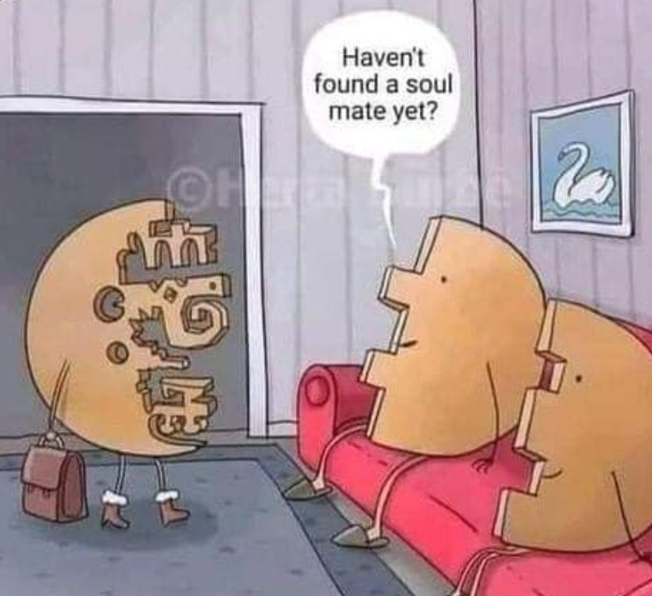
Haven't they recognized you yet, to fit in?
Notes:
This approach of allowing free practice only after specialisation or special training and not only after basic training is important for clarifying over time the segregation between family doctors and other specialties, as a clear demarcation from doctors with basic training who have access in some countries to practice as GPs will have to be made at some point, precisely to eliminate confusion between "GPs" and "family medicine specialists". The clear position of the 8 European countries which have included this condition in national legislation, is a supporting element, being apparently paradoxically defined as a "majority" minority (in the sense that other countries although they not specified so, maybe apply it, as such the rest of the countries that allow free practice are probably in a minority).

Slide 11
Training period in FM/GM (23 respondents)
Three years (8 countries)
Four years (8 countries)
Five years (4 countries)
Other period (3 countries)
IS
FIN
NOR
S
6/7 years
EE
LT
DK
LV
S
NL
IE
FIN
B
UK
AT
NL
PL
UK
CZ
LT
D
NOR
B
LU
CZ
42 months
SK
MT
D
SK
HU
AT
HU
CH
I
F
CH
RO
P
SI
SI
ES
HR
I
HR
F
BG
IE
RO
AL
TR
TR
P
ES
EL
Recognition of the specialty - UEMO Internal Task Force
MT
Notes:
The minimum period of training must be chosen wisely and we agreed that this should be three years. We already have at least one basis for starting in the matter of optimal length of training: according to UEMO 2016 Survey, more than 65% of the countries have more than three years of training in FM/GP.

Slide 12
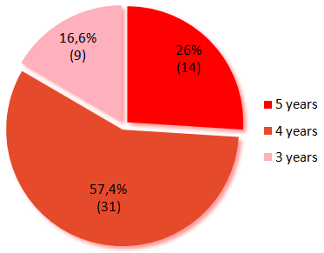
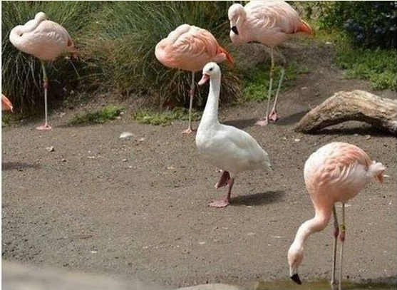
Anaesthetics
Ophthalmology
Otorhinolaryngology
General Haematology
Endocrinology
Physiotherapy
Dermato-venereology
Allergology
Stomatology
Notes:
I underline that the three-year period is a minimum period, and there are other specialties with three years: Anaesthetics, Ophthalmology, Otorhinolaryngology, General Haematology, Endocrinology, Physiotherapy, Dermato-venereology, Allergology, Stomatology. After all, they are not a bad company and we are not even the black swan. In addition, the UEMS has the objective that all the specialties in the annex should have a minimum of 5 years of preparation for the foreseeable future, so we are directly interested in being in the right place at the right time. From 54 specialties recognized in Annex 5.1.3, 14 (26%) have 5 years, 31 (57,4%) 4 years and 9 (16,6%) have 3 years of training.

Slide 13
The situation of the GM/FM according to Professional title Dir 2005/36
IS
FIN
S
Specialty
Qualification
NOR
EE
LT
”Patience is not the ability to wait, but the ability to keep a good attitude while waiting”
LV
DK
IE
UK
NL
PL
D
B
LU
CZ
SK
F
AT
HU
CH
RO
SI
HR
BG
I
ES
AL
P
EL
TR
CY
MT
Notes:
The latest developments regarding the recognition of the speciality at Member State level are encouraging, currently 20 out of 27 Member States have this internal recognition, the last one being Austria this year. I recall you that in 2015, when the UEMO task force on recognition was created, only 12 Member States had declared national recognition of the specialty.

Slide 14
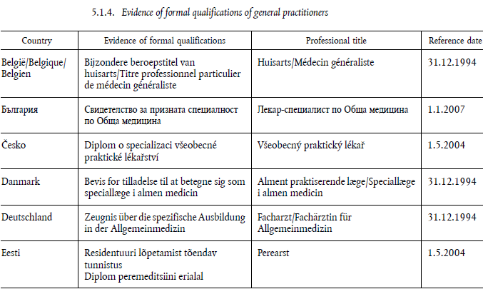
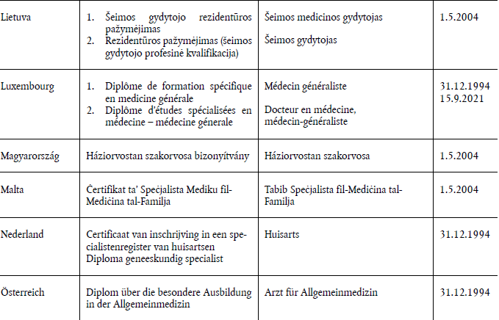
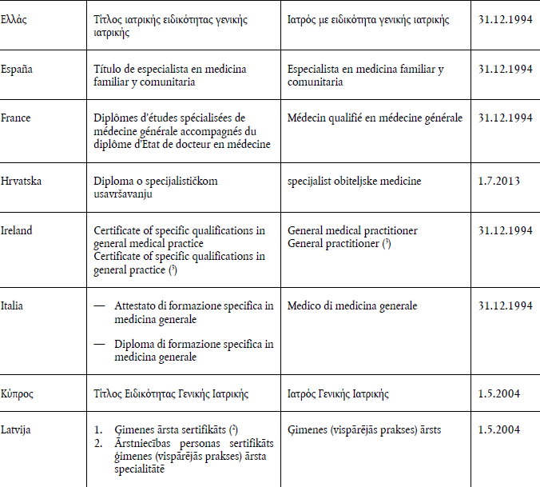
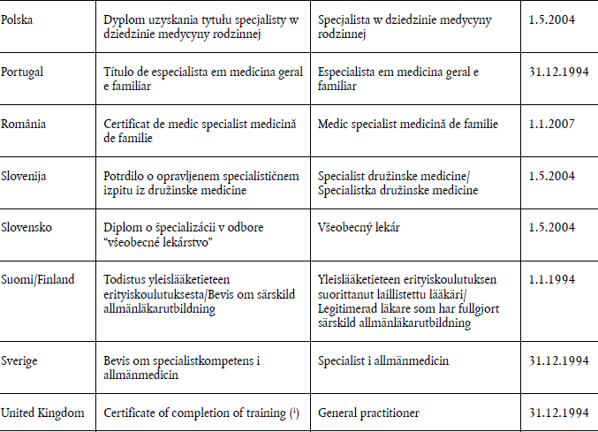
Notes:
The specialty name should be chosen with equal care: the title of Specialist in General Medicine is used most frequently, by 10 countries, followed by the Specialist in Family Medicine by 5 countries, then Family and Community Medicine Specialist by 1, General and Family Medicine Specialist - 1, Specialization General Practice Medicine - 1, and finally, Certificate of registration in a specialist register of general practitioners – 1. In None of the Member States we don’t have the designation of specialist in general practice.

Slide 15
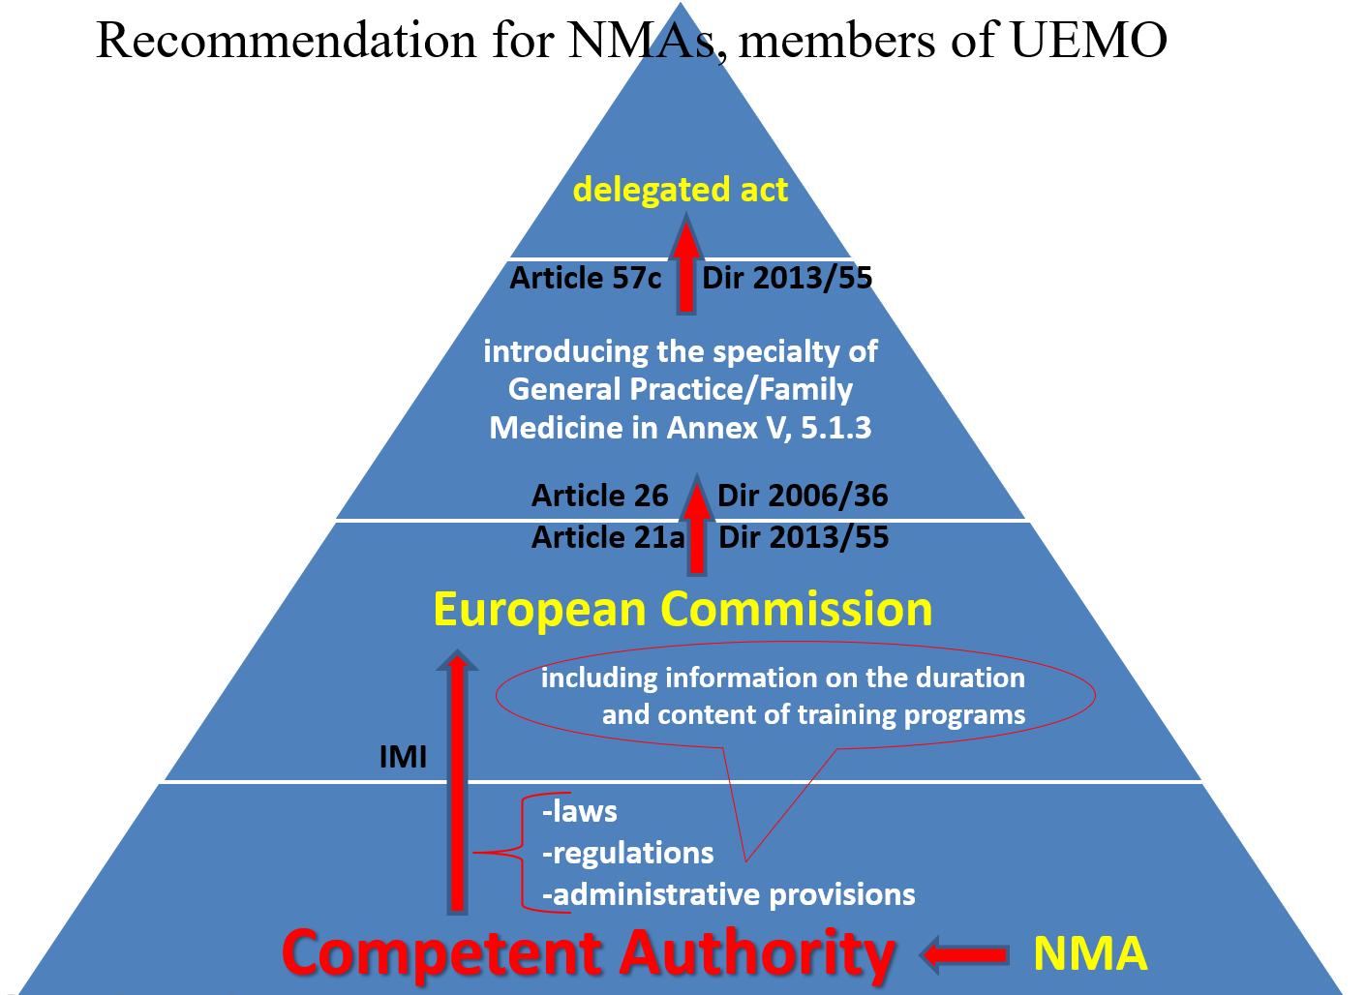
Family Medicine looks like a specialty, behaves like a specialty, has all the attributes of a specialty, and should be recognised as such at European level
Notes:
How should we proceed? The UEMO strategy, called by us “the dual path”, provides not the transformation of “specific training in general medical practice” into a specialty, but the introduction of a new specialty called Family Medicine or/and General Medicine. Consequently, UEMO does not aim at eliminating Articles 28-30 in any way, but addresses the delegated act provided for in Directive 55 and maintains the qualification of the "specific training in general medical practice", applicable to a decreasing number of healthcare professionals in the primary care. The introduction of the Family Medicine/General Medicine specialty in Annex 5.1.3, with the retention of Annex 5.1.4 unchanged, corresponds to the real situation in at least 20 EU member states, where the clinical specialty of Family Medicine exists.

Slide 16
(16) the following article is inserted:
‘Article 21a
Notification procedure
1. Each Member State shall notify the Commission of the laws, regulations and administrative provisions which it adopts with regard to the issuing of evidence of formal qualifications in the professions covered by this Chapter.
In the case of evidence of formal qualifications referred to in Section 8, notification in accordance with the first subparagraph shall also be addressed to the other Member States.
2. The notification referred to in paragraph 1 shall include information about the duration and content of the training programmes.
3. The notification referred to in paragraph 1 shall be transmitted via IMI.
4. In order to take due account of legislative and administrative developments in the Member States, and on condition that the laws, regulations and administrative provisions notified pursuant to paragraph 1 of this Article are in conformity with the conditions set out in this Chapter, the Commission shall be empowered to adopt delegated acts in accordance with Article 57c in order to amend points 5.1.1 to 5.1.4, 5.2.2, 5.3.2, 5.3.3, 5.4.2, 5.5.2, 5.6.2 and 5.7.1 of Annex V, concerning the updating of the titles adopted by the Member States for evidence of formal qualifications and, where appropriate, the body which issues the evidence of formal qualifications, the certificate which accompanies it and the corresponding professional title.
5. Where the legislative, regulatory and administrative provisions notified pursuant to paragraph 1 are not in conformity with the conditions set out in this Chapter, the Commission shall adopt an implementing act in order to reject the requested amendment of points 5.1.1 to 5.1.4, 5.2.2, 5.3.2, 5.3.3, 5.4.2, 5.5.2, 5.6.2 or 5.7.1 of Annex V.’;
Notes:
The notification procedure provides that each Member State shall notify via IMI the Commission of the laws, regulations and administrative provisions which it adopts with regard to the issuing of evidence of formal qualifications in the professions. The Commission is empowered to adopt delegated acts in order to amend points 5.1.1 to 5.1.4, concerning the updating of the titles adopted by the Member States for evidence of formal qualifications.

Slide 17
Notes:
Introduction of a new specialty in Annex 5.1.3. is clearly not considered to be an addition or amendment of an essential element of the Directive, being specified as such in the preamble to point (31) of The Directive 2013/55. The latest proof of this is the European Commission's seventh delegated act of 5 March 2024 which amends Directive 36, in fact Annex V, introducing sports medicine as a recognised European speciality.

Slide 18
”If you as a professional body ensure that there is support from your counterparts in the other Member States, plus the agreement of the Romanian Ministry of Health and, by implication, the competent public authorities in the other Member States, we can start this procedure."
Notes:
An example of how this path is perfectly feasible is the request for the introduction of the new specialty in Annex V from the Romanian College of Physicians, as the competent authority for the recognition of qualifications in Romania (together with the Ministry of Health), to the National Coordinator for Directive 36/2005/EC, which in Romania belongs to the Ministry of Education, receiving the following official response, whereby, if we, as a professional body, ensure that there is support from our counterparts in the other Member States, plus the agreement of the Romanian Ministry of Health and, implicitly, of the competent public authorities in the other Member States, this procedure can be started.

Slide 19
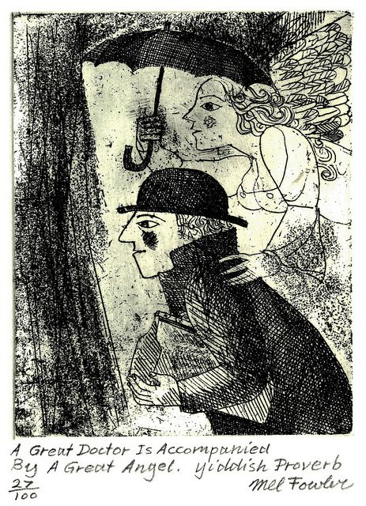
Notes:
It is necessary the 11 national medical organizations from the Member States to initiate this step in order to achieve this desire already for decades, the recognition of the specialty of Family Medicine / General Medicine, with the same rights and obligations as other European specialties.

