Slide 1
OECD data collection on categories of doctors (Generalists And Specialists)
New OECD Survey on Patient Experiences and Outcomes
Gaetan Lafortune, OECD Health Division
Joint Session UEMO-UEMS, 18 October 2024

Slide 2
OECD approach to data collection on health workforce
OECD does not invent the data!
“OECD data” cannot be better – or worse – than national data
OECD collects data from countries through Joint Questionnaire with Eurostat and WHO:
National data correspondents encouraged to provide corresponding data based on best national data sources
OECD publishes data and underlying national sources
Based on proposed definitions and categorisation that can be used by European and non-European countries

Slide 3
The Joint Questionnaire collects data based on 3 activity status
Practising physicians
Providing services directly to patients
Professionally active physicians
Practising
Working in health system as managers, researchers, etc. (excluding direct contact with patients)
Physicians licensed to practice
All health professionals who are licensed to practice, including non-practising (e.g. unemployed, retired, working abroad)
3

Slide 4
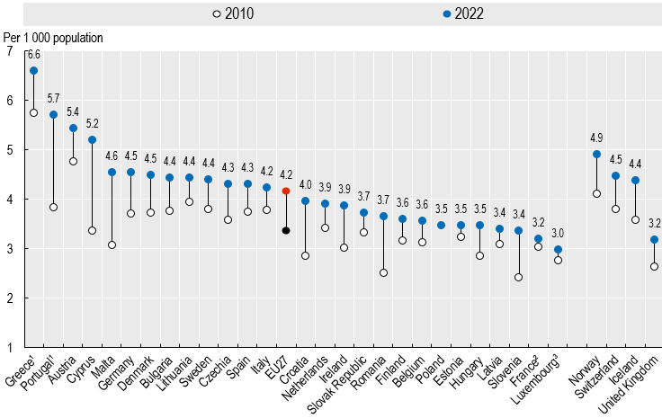
Results from 2024 data collection (all doctors)
Notes: 1. Data refer to all doctors licensed to practice, resulting in large over-estimation of practising doctors. 2. Data for France do not include medical interns and residents. 3. Data for Luxembourg relate to 2017.
Source: Health at a Glance: Europe 2024 (based on OECD/Eurostat/WHO Joint Questionnaire)
4

Slide 5
Why might there be differences between “your” national data and OECD data?
Differences in data sources
Differences in “concept” and data coverage
Practising doctors vs all doctors licensed to practice
Inclusion/exclusion of physicians-in-training
Differences between headcounts vs FTEs
Gap between headcounts and FTEs may increase if working time of doctors is decreasing
Differences in the “denominator”
Population data to calculate density per population can vary
Different sources almost always provide different numbers

Slide 6
Data collection on categories of doctors
Categories of doctors | Definitions/Categorisations
1) Generalist medical practitioners (2211)
General practitioners | GPs/family doctors responsible for continuous care Interns or residents specialising in general practice
Other generalists (non-specialists) | Non-specialist doctors working in hospital or elsewhere Interns who have not started their specialisation yet
2) Specialist medical practitioners (2212) | Interns or residents training in different specialties Medical group of specialists: Internal medicine, Cardiology, Endocrinology, Gastroenterology, Pulmonology, Respiratory medicine, Oncology, Gynaecologic oncology, Immunology, Rheumatology, Neurology, Oto-rhino-laryngology, Radiology, Infectious diseases, Microbiology-bacteriology, Haematology, Dermatology, Pathology, Occupational medicine, Community medicine Surgical group of specialists: General surgery, Neurological surgery, Plastic surgery, Orthopaedics, Ophthalmology, Urology, Nephrology, Anaesthesiology, Intensive care, Accident and emergency medicine
General paediatricians
Obstetricians & gynaecologists
Psychiatrists
Medical group of specialists
Surgical group of specialists
Other specialists (n.e.c)
3) Medical doctors not further defined | Doctors who cannot be classified in other categories Interns and residents not classified in other categories
6

Slide 7
How to avoid double counting doctors with more than one specialisation?
Two criteria proposed to countries for allocation:
predominant (main) area of practice
last specialty for which doctors have received registration
7

Slide 8
Results of 2024 data collection
on different categories of doctors
Note: 1. In Portugal, there is some double counting of counting, and only about 30% of doctors employed by the NHS work as GPs in primary care (the other 70% work in hospitals). 2. The data for Luxembourg refer to 2017.
Source: OECD/Eurostat/WHO Joint Questionnaire
8

Slide 9
Focussing on trends in density of GPs
Note: 1. Data for Portugal and Greece relate to all doctors licensed to practice, resulting in large over-estimation.
2. Data for Finland, Switzerland and UK refer to generalist medical practitioners. 3. The data for Luxembourg refer to 2017.
Source: OECD Health Statistics 2024

Slide 10
Trends in density of general paediatricians
Note: 1. Data refer to all doctors licensed to practice, resulting in a large over-estimation of the number of practising doctors. 2. The latest data refer to 2017 only.
Source: OECD Health Statistics 2024.

Slide 11
Patient-Reported Indicator Surveys (PaRIS)

Slide 12
PaRIS survey in a nutshell
The PaRIS survey is a new international survey of outcomes and experiences of patients living with chronic conditions who are managed in primary care
Launched at the last OECD Health Ministerial meeting (2017)
Fills a major gap in knowledge by adding the patients’ perspective in a systematic and rigorous way

Slide 13
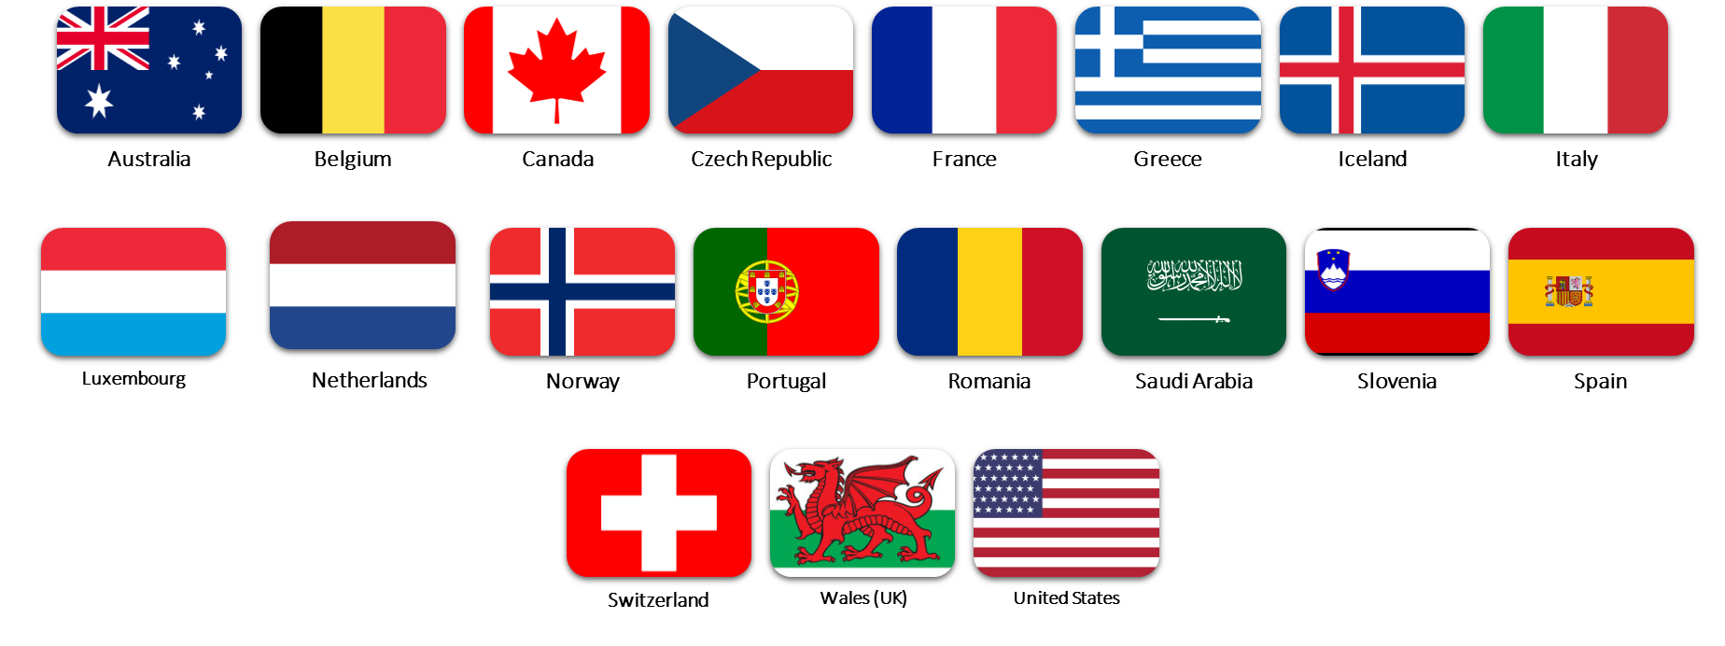
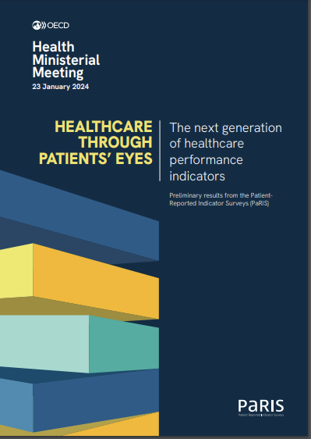
PaRIS sheds light on how primary care models deliver from people’s perspectives
19 countries (including 15 European)
>114000 Patients linked to
>1800 primary care settings
The survey is unique in its scale and level of co-creation with stakeholders and has therefore the potential to become an international standard

Slide 14
How does PaRIS work?
Linking two sources of data in the main survey:
data provided by patients about health conditions, health literacy, health behaviours, physical and mental health outcomes and experiences of health care
data by healthcare providers about clinic characteristics, payment systems and care models (focus on chronic conditions)
PaRIS collects data from patients
PaRIS collects data from healthcare providers
Together this information helps us understand how well health systems are performing
Provides information for international learning
Provides national and sub-national performance data
Provides information to healthcare providers for quality improvement
Survey completed by primary care physicians, nurses, other allied health professionals or practice managers (persons most familiar with how the practice operates)

Slide 15
Some questions that PaRIS can address
Do the outcomes and experiences of people with chronic conditions differ by different socioeconomic characteristics?
Do people with chronic conditions report better experiences in certain primary care practice types? (e.g., multiprofessional practices)

Slide 16
Release of PaRIS report
(20 February 2025)
Outline:
How countries compare
Inequalities (by gender and socioeconomic status)
Living with multiple chronic conditions
People-centred care
Trust
For more information: https://www.oecd.org/health/paris/
paris_survey@oecd.org
Patient-Reported Indicator Surveys (PaRIS)

