Slide 1

Joint session of UEMS and UEMO
Brussels 19 October 2024
Peter JP Holden MB ChB FIMCRCSEd FRCGP DRCOG
Vice President, UEMO

Slide 2
It is time to re-establish and re-state physician primacy
within the healthcare team
Peter JP Holden MB ChB FIMCRCSEd FRCGP DRCOG
Vice President, UEMO
Notes:
Morning / Afternoon
Please note the greeting is morning not GOOD morning as that would be an opinion and chargeable!
Thank you for inviting me to address you.. For the third time

Slide 3

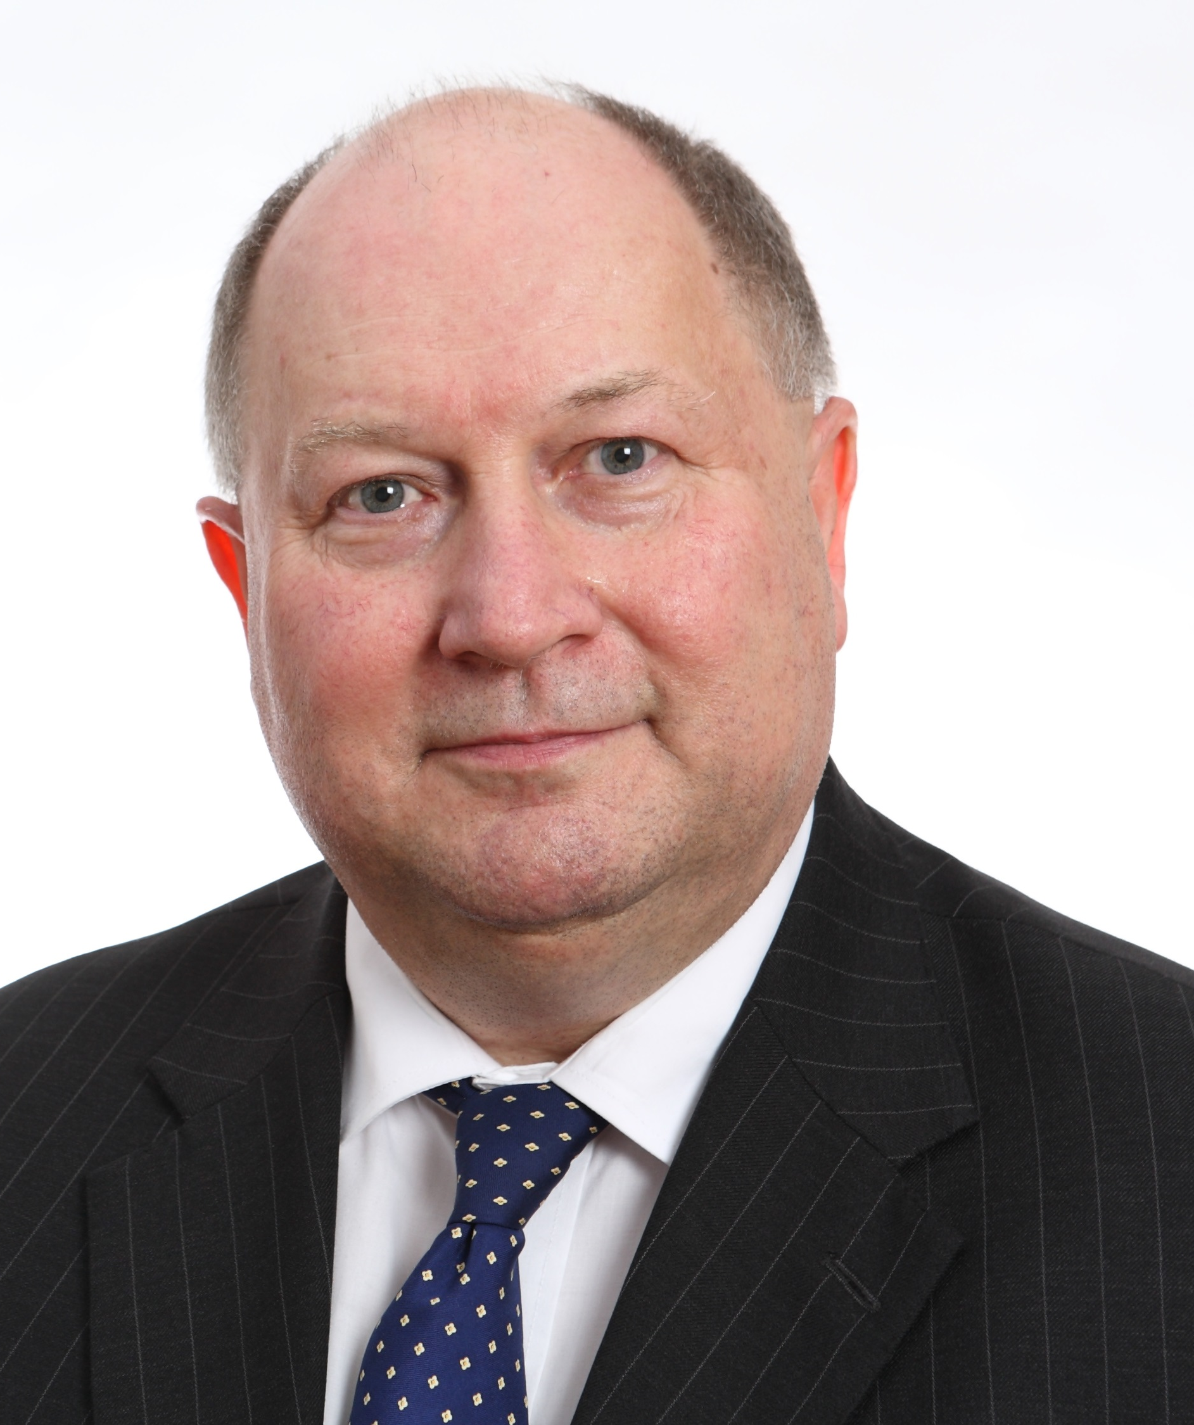
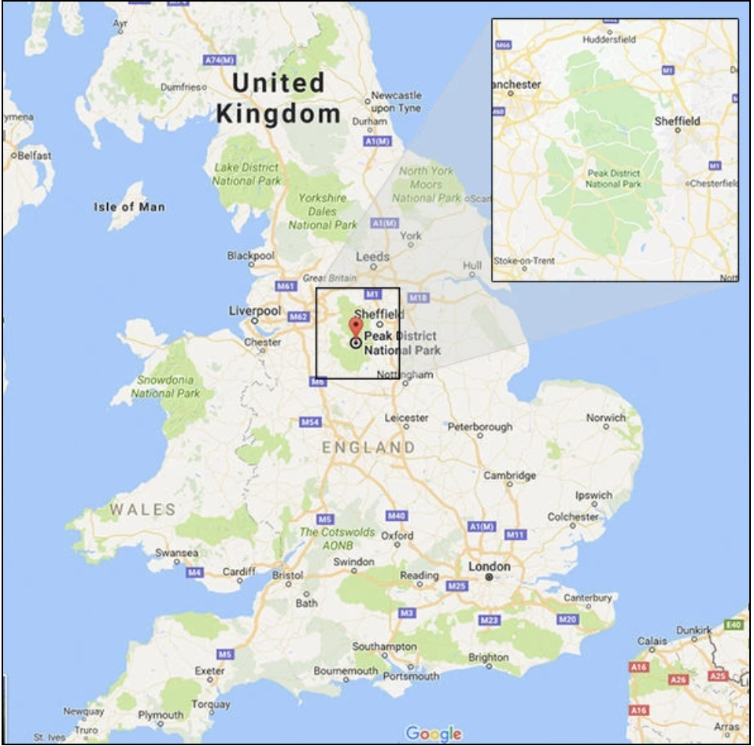
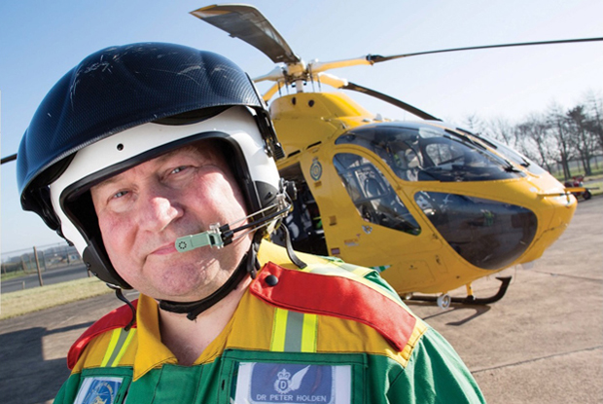


Dr Peter Holden - a portfolio GP
Vice- President UEMO, Head of UK delegation
Council Member, British Medical Association
Family Doctor – The Matlock & Ashover Practice 1985-2023, Eyam Surgery 2023 → date
Out of Hours GP, DHU CIC 1996→ date
Consultant in PreHospital Emergency Medicine & Strategic Medical Advisor, East Midlands Ambulance Service NHS Trust
Treasurer, The Faculty of PreHospital Care, The Royal College of Surgeons of Edinburgh
Notes:
I am a PORTFOLIO GP but still with skin in the game from my old practice
I am unusual in that whilst primarily a generalist I am a specialist. Trained family physicians are recognised as specialists but unusually for a UK GP I have an accredited second specialty
In presenting this talk 2 things are vital to contextualise it
Firstly that you read the briefing document sent last eeek
Secondly remember the conributions of the representative from DG GROW European Commission and from the OECD in Paris.

Slide 4
UEMO
UEMO
Proposition
Healthcare provision pressures are tempting governments and healthcare organisations to adopt solutions which reduce physician
Autonomy
Respect
Economic status
Academic status
Team leadership status
Notes:
Perusal of any of the serious newspapers reveals that this proposition is a real existential threat to the WHOLE profession internationally
WHY?
MEDICNE IS An INTERNATIONAL PROFESSION , AN INTERNATIONAL COMMODITY AND AN INTERNATIONAL SERVICE
Whether we like it or not

Slide 5
Healthcare supply, demand and, cost
Governments are feeling the heat from their electorates if healthcare cannot be procured at an acceptable price, speed or, patient convenience.
Nations which have a state-based health service, or a state-backed health insurance system are seeking to solve these problems by encouraging healthcare systems to be more efficient through political and financial initiatives.
Governments are politically sensitive to the tax burden/healthcare cost dynamic and constantly seek efficiencies in care delivery
Efficiency measures are limited because healthcare delivery is customised to each individual patient and delivered by human beings who also have their own needs, failings and limitations.
Governments and patients want bespoke treatment at off the peg prices and is frequently incompatible with efficiencies. Patients are not widgets
Ultimately clinical capacity can only be increased by increasing the number of personnel able to deliver healthcare.
Notes:
EFFICIENCY

Slide 6
Healthcare is a commodity
For governments healthcare is votes and tax costs
For insurers healthcare is profit
For healthcare corporations, healthcare provision is big business
For the patient healthcare has become a “right”, and a service to which they feel entitled
Unlike any other product in a marketplace the customer/patient does not always
  Know what they need versus what they want
  whether what they need or want is safe or appropriate for them at that time or at anytime
Healthcare provision is labour intensive and labour costs are the largest single cost factor
Big healthcare corporations from the USA are circling to get a slice of the action and THEY KNOW HOW TO CUT COSTS
What starts in the US usually transitions to Europe often trailed and stage-posted via the British Isles
Suppression of the primacy of physicians is no exception to this rule
Notes:
Whether we like it or not!

Slide 7
The increasing clinical capacity gap
Notes:
So Why is this?

Slide 8
Physician supply
Doctors take 10-15+ years to train to European standards
Training is arduous challenging and costly
Doctors are not cheap and nor should their personal expectations be low
No longer prepared to or able to work crazy hours – and why should they?
On call = AT WORK
The gender shift
Work-life balance
Modern medicine requires constant physician inputs not occasional injects
Long hours no longer possible on patient safely and physician health grounds
There are NO SHORTCUTS

Slide 9
Healthcare demand and capacity
Demand for medical services worldwide is rising rapidly driven by numerous pressures including
patient demand arising from knowledge accessed from the Internet
ageing populations
professional and scientific ability to cope with (and imperfectly treat) multi-morbidity
increasing technological capability within the medical sciences
increasing personal and national wealth
rising (and sometimes unrealistic) expectations of patients, their families and politicians in terms of scope and speed of treatment
Shortage of physicians is no longer a third world problem but a first world one too.
Improving Physician supply is a government priority all over the world

Slide 10
So, what is happening?
The governmental temptation is to shorten medical training and/or Physician substitution
Improve physician supply by
  Reducing the length of undergraduate entry training
  Alternative routes to a primary registrable physician qualification such as apprenticeship rather than a traditional university based education
  Physicians supervising non physicians to do physician tasks
Task re-assignation to other healthcare professionals
Introduction of Physician Associates/Assistants
LIKELY RESULTS
DUMBING DOWN of our learned self-governing profession
Where this happens physicians will become qualification prisoners in their own country
Loss of free movement of labour
(Why else do EU member nations NOT apply for specialist recognition?
– to prevent easy movement of labour and keep YOU captive!)

Slide 11
Substitution with MAPS working at the “Top of their License to practise”
Governments are pushing the boundaries with non physicians encouraging Medical Associate Practitioners
THEY ARE TECHNICIANS of limited safe scope of practice and NEED SUPERVISION
They CANNOT safely see undifferentiated patient presentations
Top of their license = perilously close to their limits of knowledge skill and attitudes on a regular and routine basis
Dunning-Kruger Effect – Confidence >>>> Competence
Recruiting persons into 2 year MAP courses after (any) university degree many therefore lack
  Basic Maturity
  Clinical judgement skills
  Clinical acumen
  And don’t know what they don’t know
NB MAPs are NOT the same as for example Advanced Practitioners which are drawn from the ranks of experienced registered health care professionals and undertake extra education and training for specific clinical service delivery roles
Notes:
DO NOT CONFUSE MAPs with conventional Advanced practitioners
For example the Dutch MAP is NOT like the English MAP but MUCH more lie a UK ANP and has a similar training and background

Slide 12
UEMO
Physician substitution - the UK experience
At least one government (England) is attempting wholesale physician SUBSTITUTION ( 10,000 posts)
Other nations outside the UK are watching with great interest
BEWARE governments everywhere are dumbing down the profession whether generalist or specialist
The results for patient safety and the scale of substitution have led to
  Patient deaths, and Patient confusion
  the production of urgent guidance to the profession Patient DANGER and Physician Medico-Legal Hazard
  Credible legal action against the government and the professional regulator
  Major backtracking by several Royal Colleges including RCGP and RCoA
  The downfall of the President of the Royal College of Physicians of London
SEE YOUR BRIEFING DOCUMENT especially appendix 1
DON’T BELIEVE THAT YOUR NATION IS IMMUNE
Medicine is an international business
Notes:
Health care is devolved in the UK we have 4 health services but ONE profession

Slide 13
Turning us from professionals to technicians 1
(Medical) Professionals
Possess a powerful knowledge and skill base permitting us to
  Challenge situations, ask appropriate questions, seek answers, and test our own practice
  Make bespoke decisions for individual patients based on our knowledge and skill base
  Base our work on a full understanding of how the human body operates
  Respond with interventions bourn out of a deep understanding resulting from a comprehensive and lengthy undergraduate medical education
  Continuously update their skills and understanding through initiating and evaluating new research
  And we reflect on the impact of our practise and adapt as new knowledge and procedures emerge

Slide 14
Turning us from professionals to technicians - 2
Technicians
Following training (rather than education)
Work from assumptions that tell them what to do
Follow a script
Identify problems or a situation and then
  Either search for someone who knows what to do or how to proceed.
  Or follow protocols with accuracy and precision, SOPs or procedures requiring specific steps which rarely vary
Rarely make complex decisions requiring a broad base of knowledge and experience.
Work is practical and proficient without requiring fundamental comprehension and ability to synthesis from basic knowledge
do as instructed and supervised
Notes:
And when one country decides to dumb down don’t be surprised if other countries consider derecognition

Slide 15

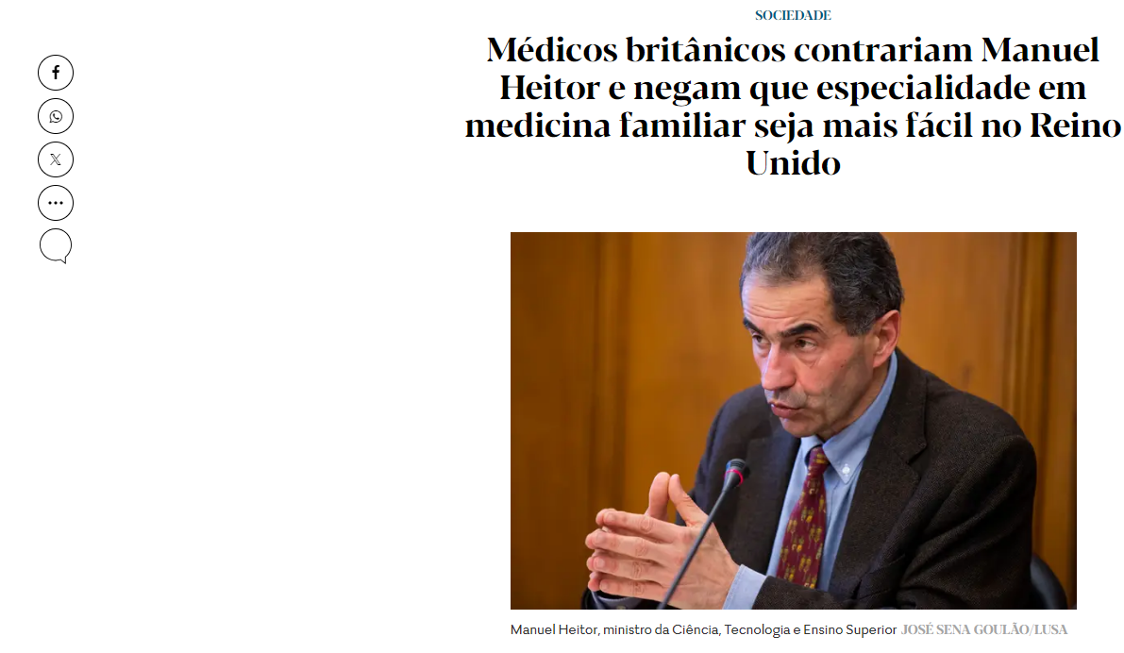
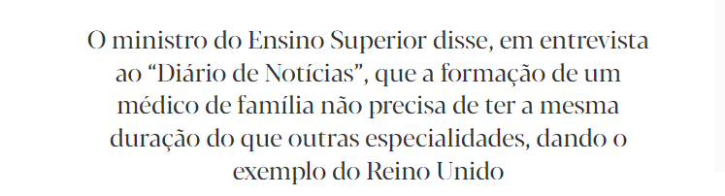

Slide 16
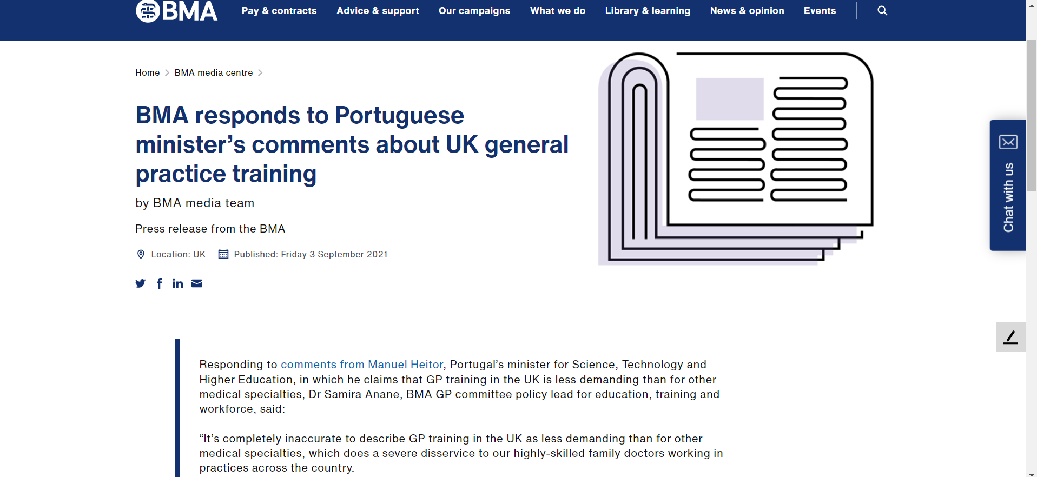
Source: https://www.bma.org.uk/bma-media-centre/bma-responds-to-portuguese-minister-s-comments-about-uk-general-practice-training

Slide 17
Professional or technician, where next?
No time for being squeamish for fear we might offend others
MUST (politely but forcibly and repeatedly) say it how it is
This is about US.
This is about OUR survival
This is about US as a profession
Other valuable team colleague interests come SECOND to OUR OWN as physicians
We are threatened with an existential crisis as a liberal self governing senior profession
We risk downgrading to medically qualified technicians employed as civil servants with allegiance to the government of the day

Slide 18
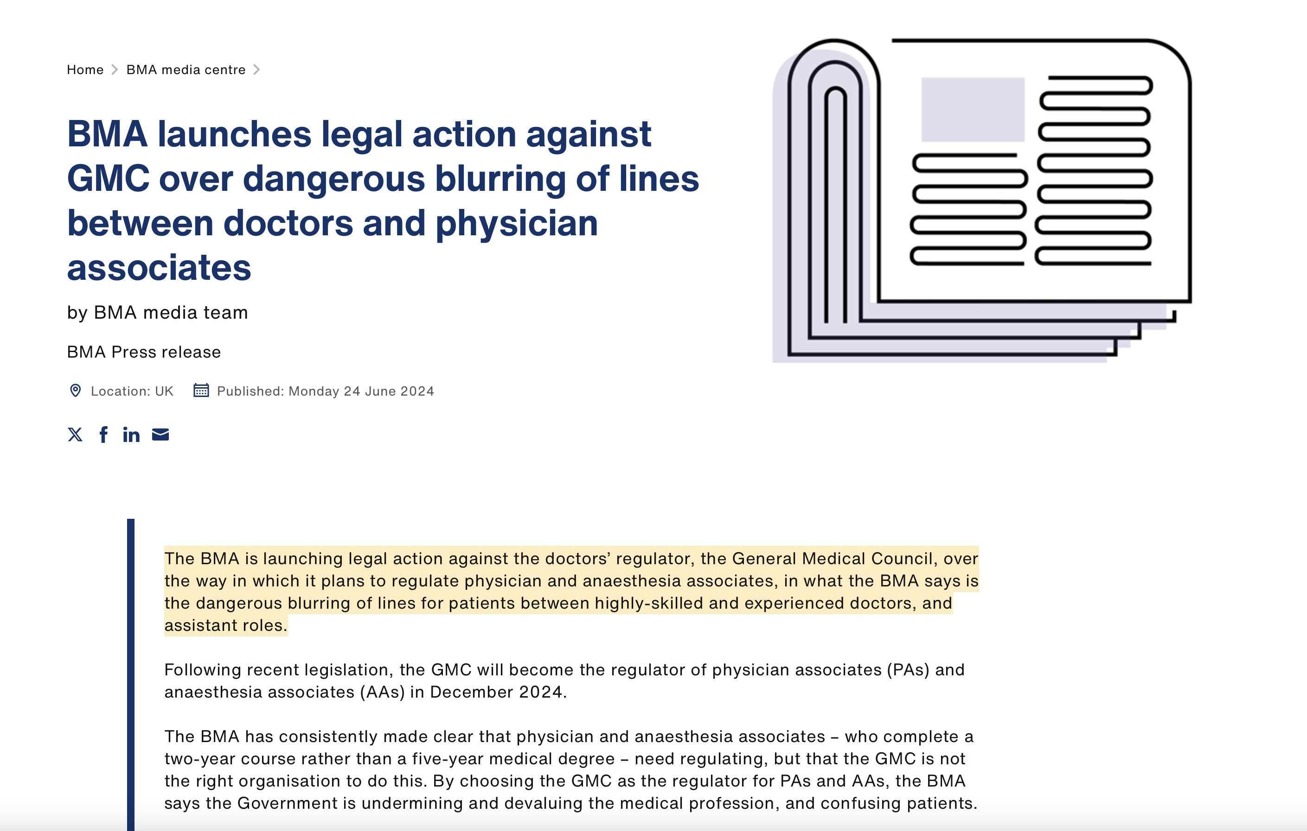
Taking a stand
Notes:
In June we The BMA issued proceedings against the medical regulator the GMC

Slide 19
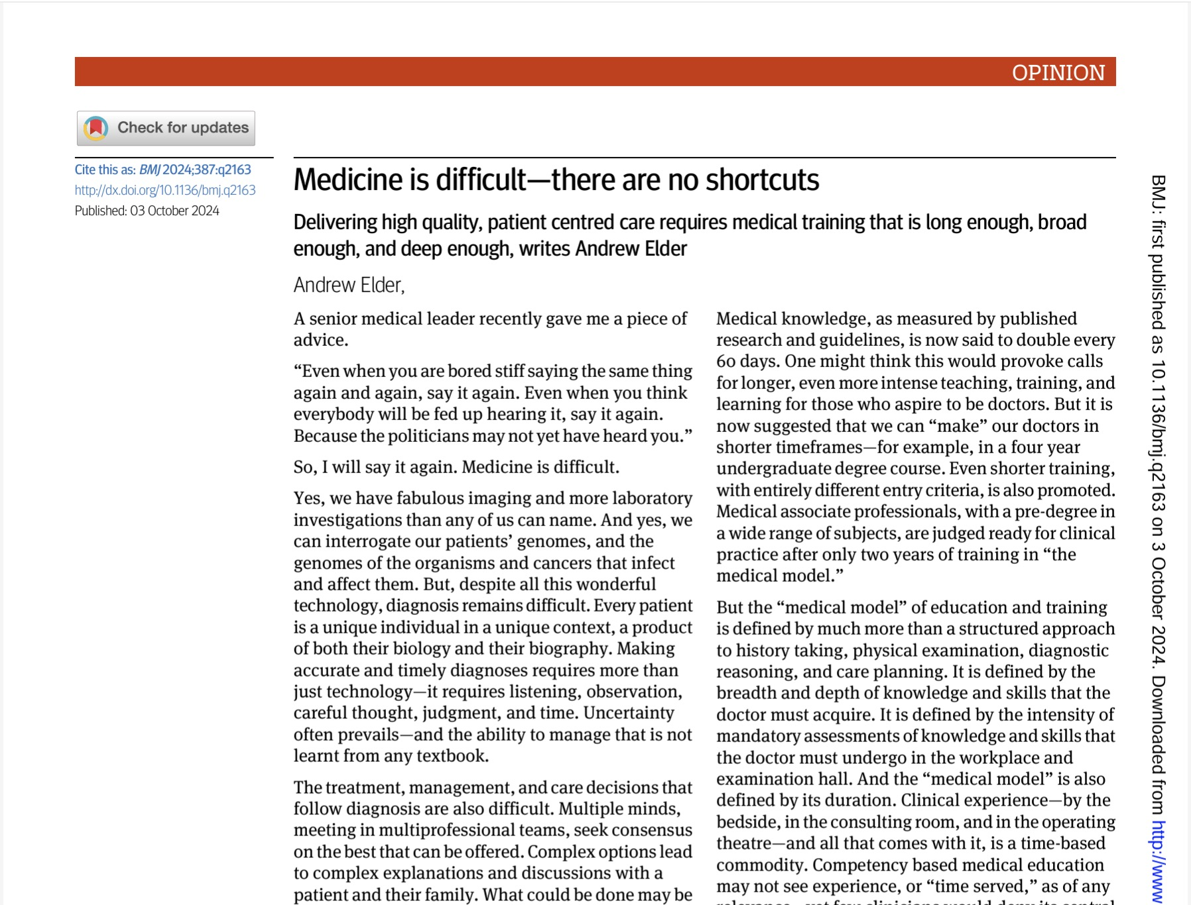
BMJ 04 October 2024 - Medicine is difficult – There are no shortcuts
Notes:
Every health policy manager and journalist should read this
The link is in the briefing paper

Slide 20
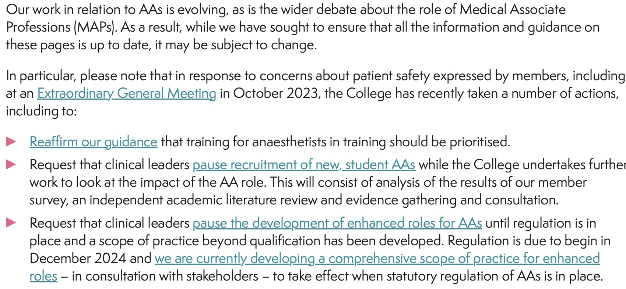
Royal College of Anaesthetists
Notes:
Royal Colleges are changing direction
Bloodbath at RCPL President had to resign
RCGP changed directio

Slide 21
18 October 2024 United Kingdom
The BMA General Practitioners Committee voted unanimously that
This meeting believes that the role of physician associates in general practice is fundamentally unsafe and:
there should be no new appointments of physician associates in general practice
the role of physician associates in general practice should be phased out
the role of a physician associate is inadequately trained to manage undifferentiated patients, and there should be an immediate moratorium on such sessions.
Passed in all parts
Notes:
Your “duty clinician” sessions are cancelled with immediate effect and we will have to review your job description

Slide 22

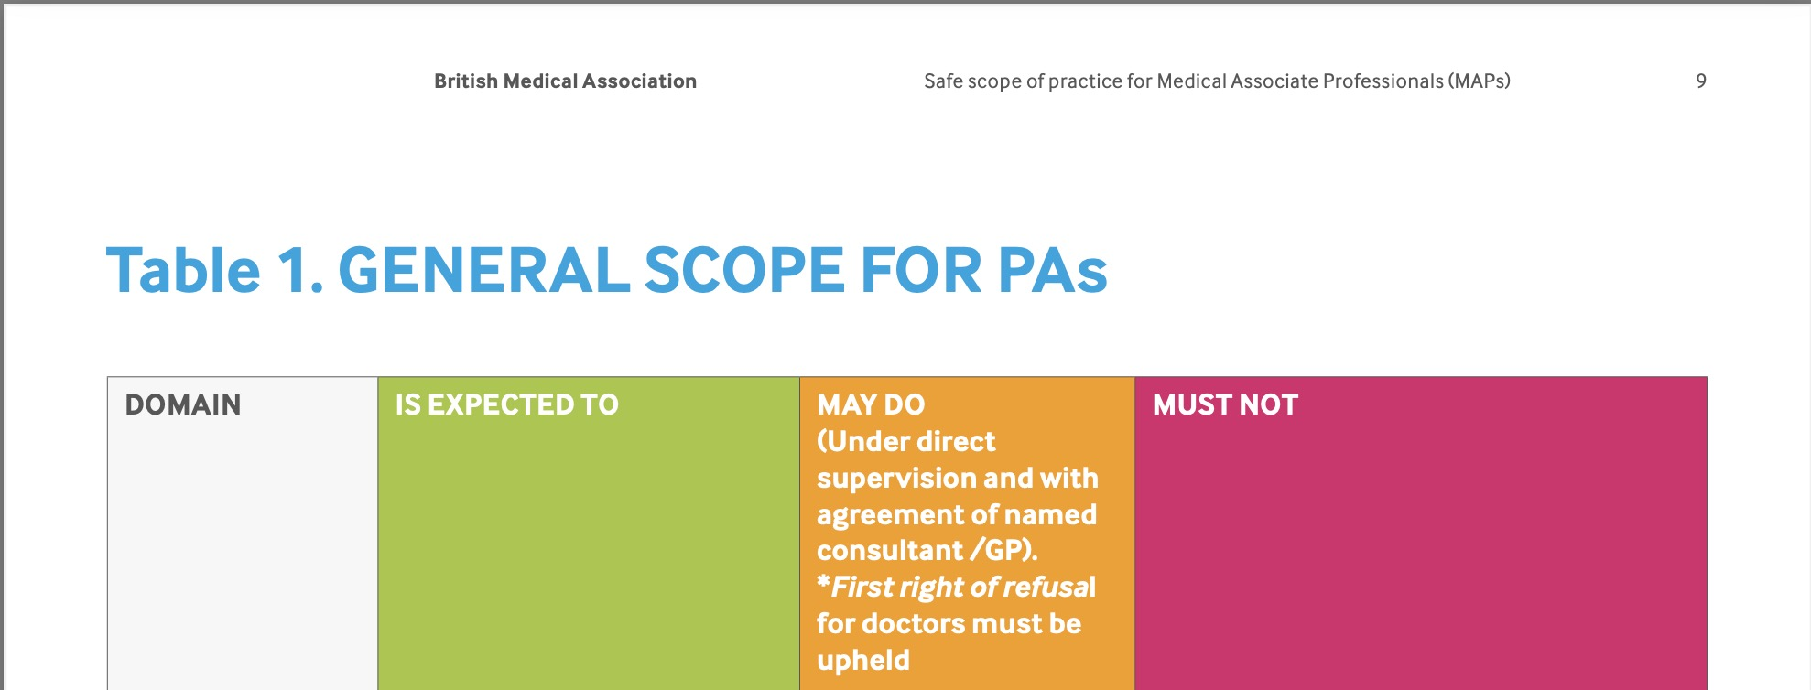
Emergency Guidance to the profession
Notes:
In your briefing paper is an internationalized version of this publication
The examples will surprise you that we have even had to issue such guidance such is the insidious and inappropriate expansion of scope of practice

Slide 23
Medicine is international – YOUR Country will be NEXT!
Governments and big business will use market forces/physician underemployment to dictate
  How and when physicians work
  When physicians work
  Where we work and the content of our work
  That we supervise Medical Associate Professionals(Physician Associates, Physician Assistants, Anaesthetic Associate)
WE LOSE CONTROL of
  Our professionalism and autonomy
  Our educational standards, our economic status and our societal standing
Patients LOSE
  the high quality professional PHYSICIAN LED service they are used to
  The safe service arising BECAUSE physicians are operating well inside their very extensive boundaries of knowledge skills attitudes
Notes:
Once we lose our primacy we will NEVER regain it

Slide 24
Thank you
In your own long term professional interests, please consider supporting the Joint draft statement from UEMO and UEMS concerning MAPs and the shortening of the undergraduate entry medical degree courses

Slide 25
Peter Holden contact details
peter.holden28@btinternet.com
+44 7802 305335

Slide 26
QUESTIONS
Questions?
Questions?
Questions?
Questions?
Questions?

