Slide 1
The need for high standards of health care education and training
Professor Nada Cikes
Chair, European Training Requirements Review Committee
European Union of Medical Specialists (UEMS)
UEMS-UEMO meeting, Brussels 2024

Slide 2
The World Health Organization – long history of the global standardisation of medical education
WHO Guidelines for Quality Assurance of Basic Medical Education /training in …..region(s)
Global strategy on human resources for health: workforce 2030. WHO 2016
Activities in support of implementation
….provide technical cooperation on health workforce education, optimizing the scope of practice of different cadres…..
….facilitate the sharing of best practices on health workforce planning and projections, health system needs, education policies….
Global milestones (by 2020)
…..the realisation of accreditation mechanisms for health training institutions in all countries ….
etc……

Slide 3
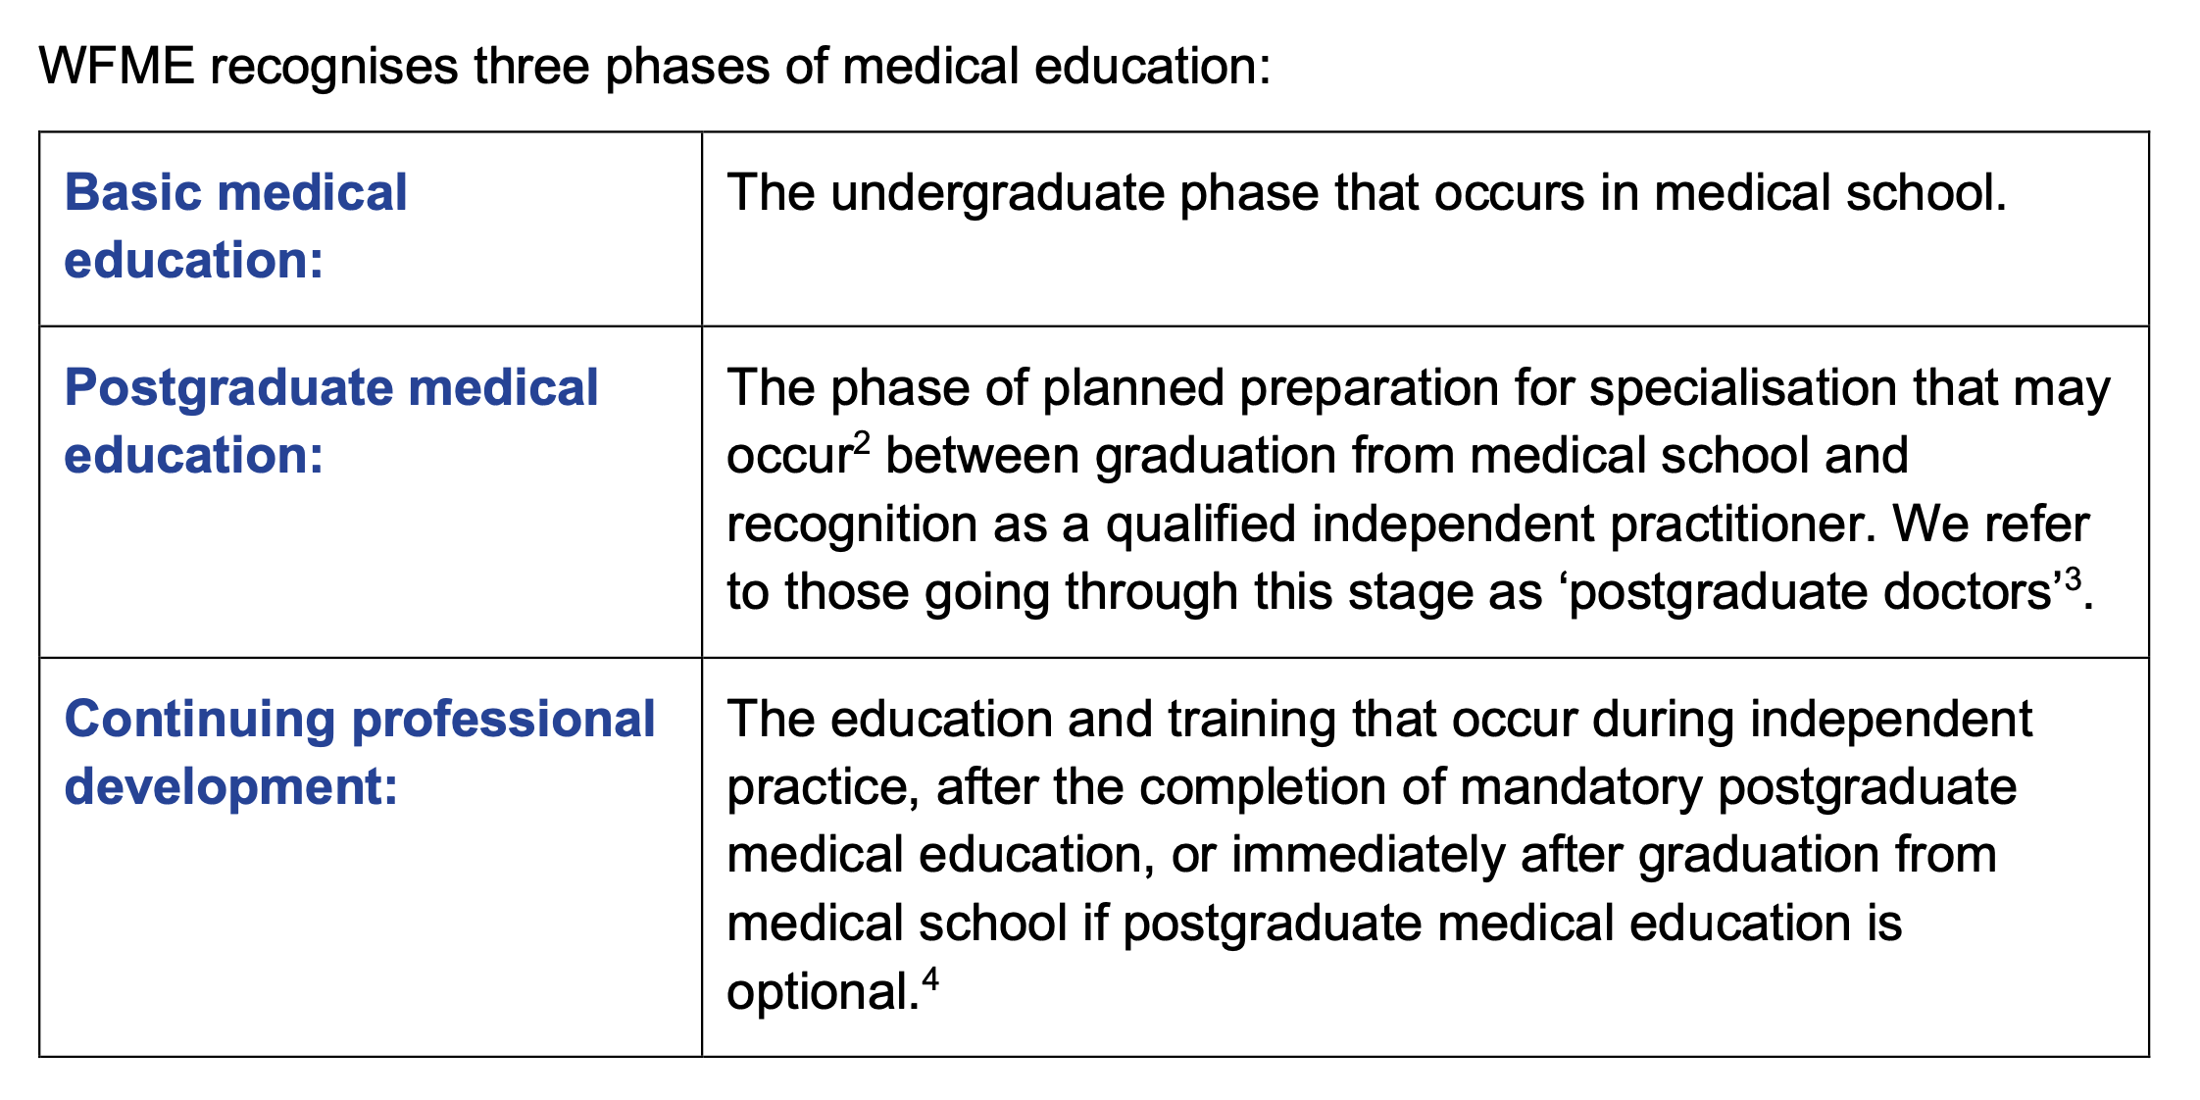
WORLD FEDERATION FOR MEDICAL EDUCATION Standards in Medical Education, Revision 2023

Slide 4
Directive 2005/36/EC of the European Parliament and of the Council of 7 September 2005 on the recognition of professional qualifications (Text with EEA relevance)
The guarantee conferred by this Directive on persons having acquired their professional qualifications in a Member State to have access to the same profession and pursue it in another Member State with the same rights as nationals
Freedom of movement and the mutual recognition of the evidence of formal qualifications of doctors, nurses ……..should be based on the fundamental principle of automatic recognition of the evidence of formal qualifications on the basis of coordinated minimum conditions for training.

Slide 5
Directive 2005/36/EC Definitions
regulated profession’: a professional activity or group of professional activities, access to which, the pursuit of which, or one of the modes of pursuit of which is subject, directly or indirectly, by virtue of legislative, regulatory or administrative provisions to the possession of specific professional qualifications; in particular, the use of a professional title limited by legislative, regulatory or administrative provisions to holders of a given professional qualification shall constitute a mode of pursuit
professional qualifications’: qualifications attested by evidence of formal qualifications, an attestation of competence referred to in Article 11, point (a) (i) and/or professional experience;
‘regulated education and training’: any training which is specifically geared to the pursuit of a given profession which comprises a course or courses complemented, where appropriate, by professional training, or probationary or professional practice.

Slide 6
Directive 2005/36/EC
Basic medical training
1. Admission to basic medical training shall be contingent upon possession of a diploma or certificate providing access, for the studies in question, to universities.
2. Basic medical training shall comprise a total of at least six years of study or 5 500 hours of theoretical and practical training provided by, or under the supervision of, a university.
For persons who began their studies before 1 January 1972, the course of training referred to in the first subparagraph may comprise six months of full-time practical training at university level under the supervision of the competent authorities.
3. Basic medical training shall provide an assurance that the person in question has acquired the following knowledge and skills:
 | adequate knowledge of the sciences on which medicine is based and a good understanding of the scientific methods including the principles of measuring biological functions, the evaluation of scientifically established facts and the analysis of data; sufficient understanding of the structure, functions and behaviour of healthy and sick persons, as well as relations between the state of health and physical and social surroundings of the human being; adequate knowledge of clinical disciplines and practices, providing him with a coherent picture of mental and physical diseases, of medicine from the points of view of prophylaxis, diagnosis and therapy and of human reproduction; suitable clinical experience in hospitals under appropriate supervision.

Slide 7
Directive 2005/36/EC Specialist medical training

Slide 8
Directive 2005/36/EC
ANNEX V
Recognition on the basis of coordination of the minimum training conditions
V.1. DOCTOR OF MEDICINE
5.1.1. Evidence of formal qualifications in basic medical training
Country | Evidence of formal qualifications | Body awarding the qualifications | Certificate accompanying the qualifications | Reference date
5.1.2. Evidence of formal qualifications of specialised doctors
Country | Evidence of formal qualifications | Body awarding the qualifications | Certificate accompanying the qualifications | Reference date

Slide 9
Directive 2011/24/EU of the European Parliament and of the Council of 9 March 2011 on the application of patients’ rights in cross-border healthcare
The Member State of affiliation may need to receive confirmation that the cross-border healthcare will be, or has been, delivered by a legally practising health professional.
It is therefore appropriate to ensure that information on the right to practise contained in
the national or local registers of health professionals, if established in the Member State
of treatment, are, upon request, made available to the authorities of the Member State of affiliation.

Slide 10
CHARTER on TRAINING of MEDICAL SPECIALISTS in the EUROPEAN COMMUNITY Charter adopted by the Management Council of the UEMS, October 1993
OBJECTIVES
The Charter describes the requirements for adequate training, which prepares
specialists for practice of their specialty at an appropriate level in any Member State
of the EC. The definition of the content of this training is necessary to further the
harmonization of training into medical specialties in the EC. This charter divides the
requirements regarding content of training into a general part, defined by the
European Union of Medical Specialists (UEMS), and a specific part for each
recognized specialty, defined by the UEMS Specialized Sections.
Training requirements for each specialty separately described in Chapter 6

Slide 11
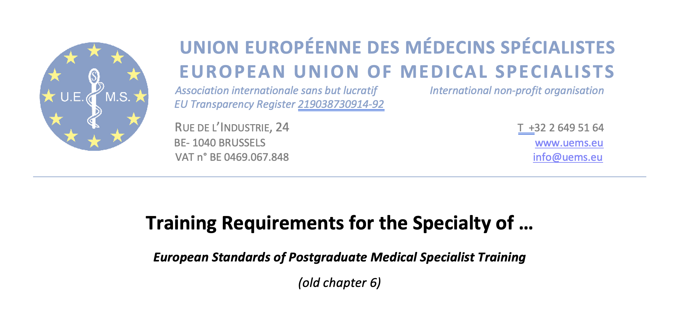

Slide 12
I. TRAINING REQUIREMENTS FOR TRAINEES
1. Content of training and learning outcome
Competencies required of the trainee
Definition of competency: knowledge, skills and professionalism
a. Theoretical knowledge
Should include the main domains covered by the specialty with a short description of domains that trainee should master in the specialty
b. Practical and clinical skills
Key skills to possess in this specialty
Number of procedures required
c. Competences
Description of levels of competencies
The European Specialist Curriculum must cover not only knowledge and skills, but also domains of professionalism, as detailed by the UEMS Section.

Slide 13
2. Organisation of training
a. Schedule of training
Minimum duration of training
Include required timing
b. Curriculum of training
c. Assessment and evaluation
Definition of assessment, description of formative and summative assessments,
Assessment: Process by which information is obtained relative to some known objective or goal (a broad term that includes testing)
Evaluation: Inherent in the idea of evaluation is "value." Process designed to provide information that will help us make a judgment about a given situation
d. Governance

Slide 14
II. TRAINING REQUIREMENTS FOR TRAINERS
1. Process for recognition as trainer
a. Requested qualification and experience
b. Core competencies for trainers
Special Qualifications of the trainers when required (if not covered by EU Directive on Professional Qualifications)
2. Quality management for trainers

Slide 15
III. TRAINING REQUIREMENTS FOR TRAINING INSTITUTIONS
1. Process for recognition as training centre
a. Requirement on staff and clinical activities
Minimal number of patients cared for as inpatients and as out patients
Range of clinical specialties
Composition and availability of faculty, training programme defined, guidelines applies Trainee / trainer ratio
Minimal scientific activity
b. Requirement on equipment, accommodation
Medical-technical equipment, library, opportunities for R&D
2. Quality Management within Training institutions
Accreditation
Clinical Governance
Manpower planning
Regular report
External auditing
Transparency of training programmes
Structure for coordination of training
Framework of approval – how are they approved

Slide 16
European Training Requirements for GP/FM specialist training (EURACT and WONCA, 2018)
Chapter 1. Requirements for trainees
What do trainees have to learn/achieve (competence driven?)
How should trainees achieve this?
How are the competences assessed?
How long should training last?
Where should training be organised?
How should selection of trainees occur?
Chapter 2. Requirements for trainers
Chapter 3. Requirements for training institutions
Michels NRM et al. EDUCATION FOR PRIMARY CARE
2018, VOL. 29, NO. 6, 322–326

Slide 17
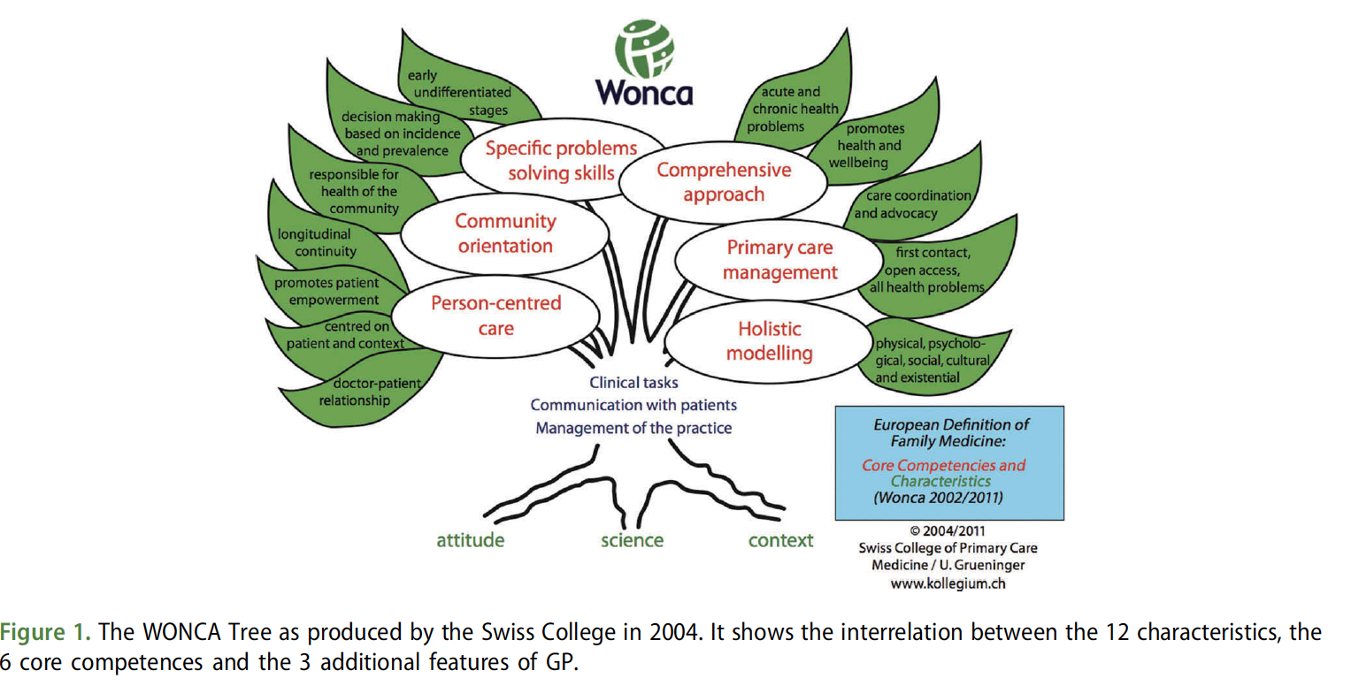
Michels NRM et al. EDUCATION FOR PRIMARY CARE
2018, VOL. 29, NO. 6, 322–326

