Slide 1
Exploring Educational Needs on Frailty Outside Geriatrics:
An Initiative of the UEMS Geriatrics Section
Prof. Román Romero Ortuño
UEMS Geriatrics Section
Friday 18th October 2024
Meeting of the UEMS Advisory Board

Slide 2
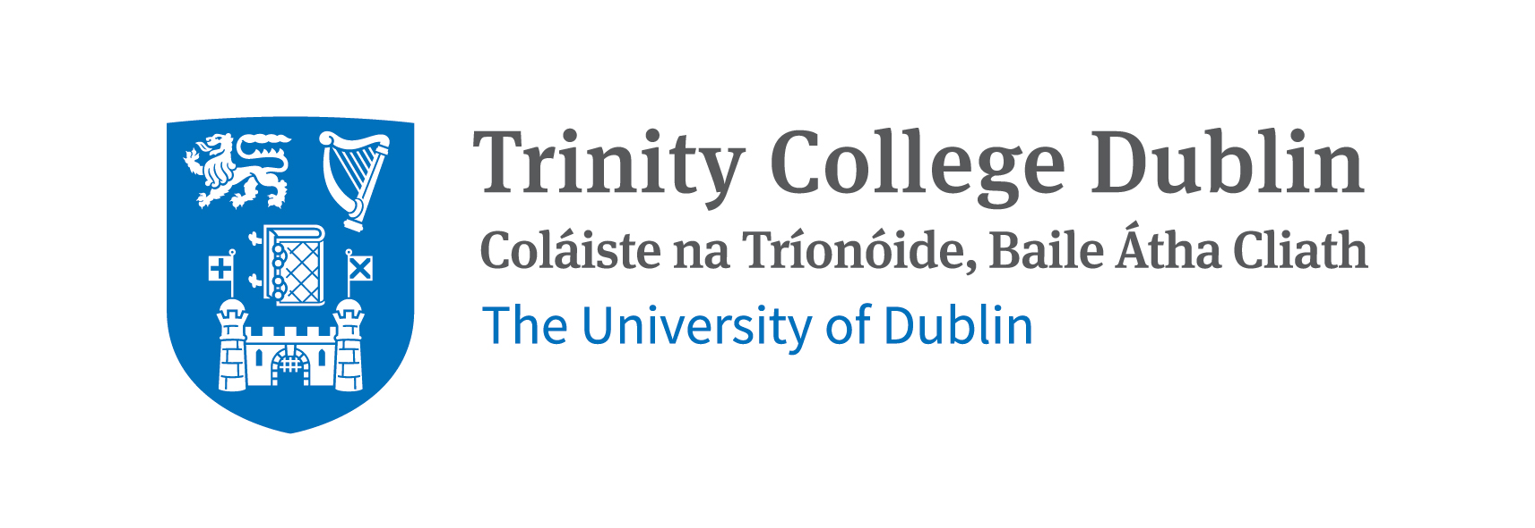
About me
Geriatrician in St James’s Hospital, Dublin
Professor in Medical Gerontology at Trinity College Dublin
Board Member (Ireland), UEMS Geriatrics Section (2022 - )
Director for Education and Training, EuGMS (2024 - 2027)

Slide 3
2010
100+
95 - 99
90 - 94
85 - 89
80 - 84
75 - 79
70 - 74
65 - 69
60 - 64
55 - 59
50 - 54
45 - 49
40 - 44
35 - 39
30 - 34
25 - 29
20 - 24
15 - 19
10 - 14
5 - 9
0 - 4
20
16
12
8
4
0
0
4
8
12
16
20
Source: United Nations

Slide 4
2050
100+
95 - 99
90 - 94
85 - 89
80 - 84
75 - 79
70 - 74
65 - 69
60 - 64
55 - 59
50 - 54
45 - 49
40 - 44
35 - 39
30 - 34
25 - 29
20 - 24
15 - 19
10 - 14
5 - 9
0 - 4
20
16
12
8
4
0
0
4
8
12
16
20
Source: United Nations

Slide 5
Frailty is a state of increased vulnerability to poor resolution of homeostasis following a stress, which increases the risk of adverse outcomes in an older person
Clegg A et al. Frailty in elderly people. The Lancet 2013; 381:752-62
Not every older person is frail
Frailty prevalence in general population: 7% – 24%
Higher prevalence in healthcare and residential settings
O'Caoimh et al. Prevalence of frailty in 62 countries across the world: a systematic review and meta-analysis of population-level studies. Age and Ageing 2021; 50:96-104

Slide 6
Stress (unplanned or planned)
ROBUST
Functional abilities
Independent
FRAIL
Dependent
Time
Clegg A et al. Frailty in elderly people. The Lancet 2013; 381:752-62

Slide 7
Frailty
Not a diagnosis, often not a patient’s identity
Frequently presents alongside other geriatric syndromes
Dynamic in nature, potentially preventable & remediable
Early identification and management improve outcomes
Dent E, Martin FC, Bergman H, Woo J, Romero-Ortuno R, Walston JD. Management of frailty: opportunities, challenges, and future directions. The Lancet 2019; 394:1376-1386

Slide 8
FRailty Outside Geriatrics (FROG)
Frailty affects most specialties, not just geriatrics
Non-geriatricians may have different interpretations of frailty
Many non-geriatricians lack formal education on frailty
Romero-Ortuno R, Stuck AE, Masud T. The giants of education in geriatric medicine and gerontology. Age and Ageing 2022; 51(2)

Slide 9
Purpose of the Initiative
Assess educational needs on frailty among non-geriatric specialists.
Conduct a structured survey, coordinated by UEMS, on frailty perceptions, tools, and training needs across relevant UEMS bodies.
Collaboratively explore the development of a basic frailty curriculum for non-geriatricians, potentially leading to an academic publication and/or appendix to ETRs.
Further details are available in the supporting document.

Slide 10
Acknowledgements
Prof. Vassilios Papalois, President of UEMS
Dr João Grenho, Secretary General of UEMS
Prof. Nada Čikeš, Chair of the UEMS ETR Review Committee
Prof. Jūratė Macijauskienė, President of the UEMS Geriatrics Section
All members of the UEMS Geriatrics Section Board

Slide 11
Thank you for your attention
Email: romeroor@tcd.ie

