Slide 1
Mapping and Matching Of Medical Specialties (MaMoMS)
Presented by: Prof. Dr. Armand Girbes
Head Dutch Delegation UEMS & EACCME

Slide 2
Background
Free movement of medical professionals within the EU is a key goal.
Current national differences in medical specialty recognition hinder this. Example: Medical oncology is a separate specialty in some countries, part of internal medicine in others.

Slide 3
MaMoMS Initiative
MaMoMS: Mapping and Matching of Medical Specialties. A roadmap to align medical specialties across UEMS countries and remove barriers for free movement.

Slide 4
Roadmap
1. Inventory of medical specialties and subspecialties.
2. Identify differences between specialties across countries.
3. Create a web-based database accessible to all.

Slide 5
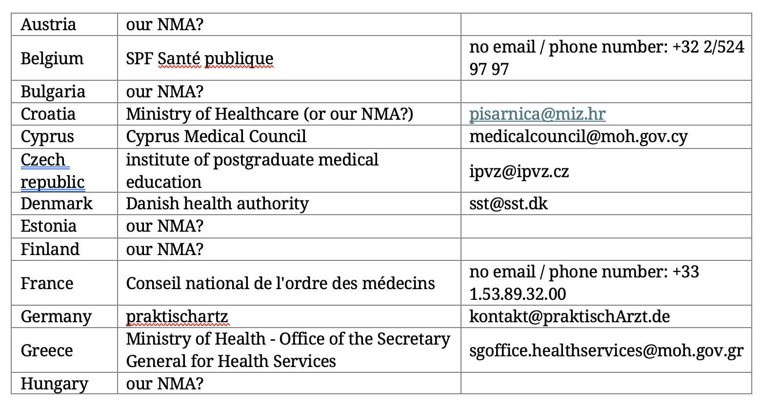
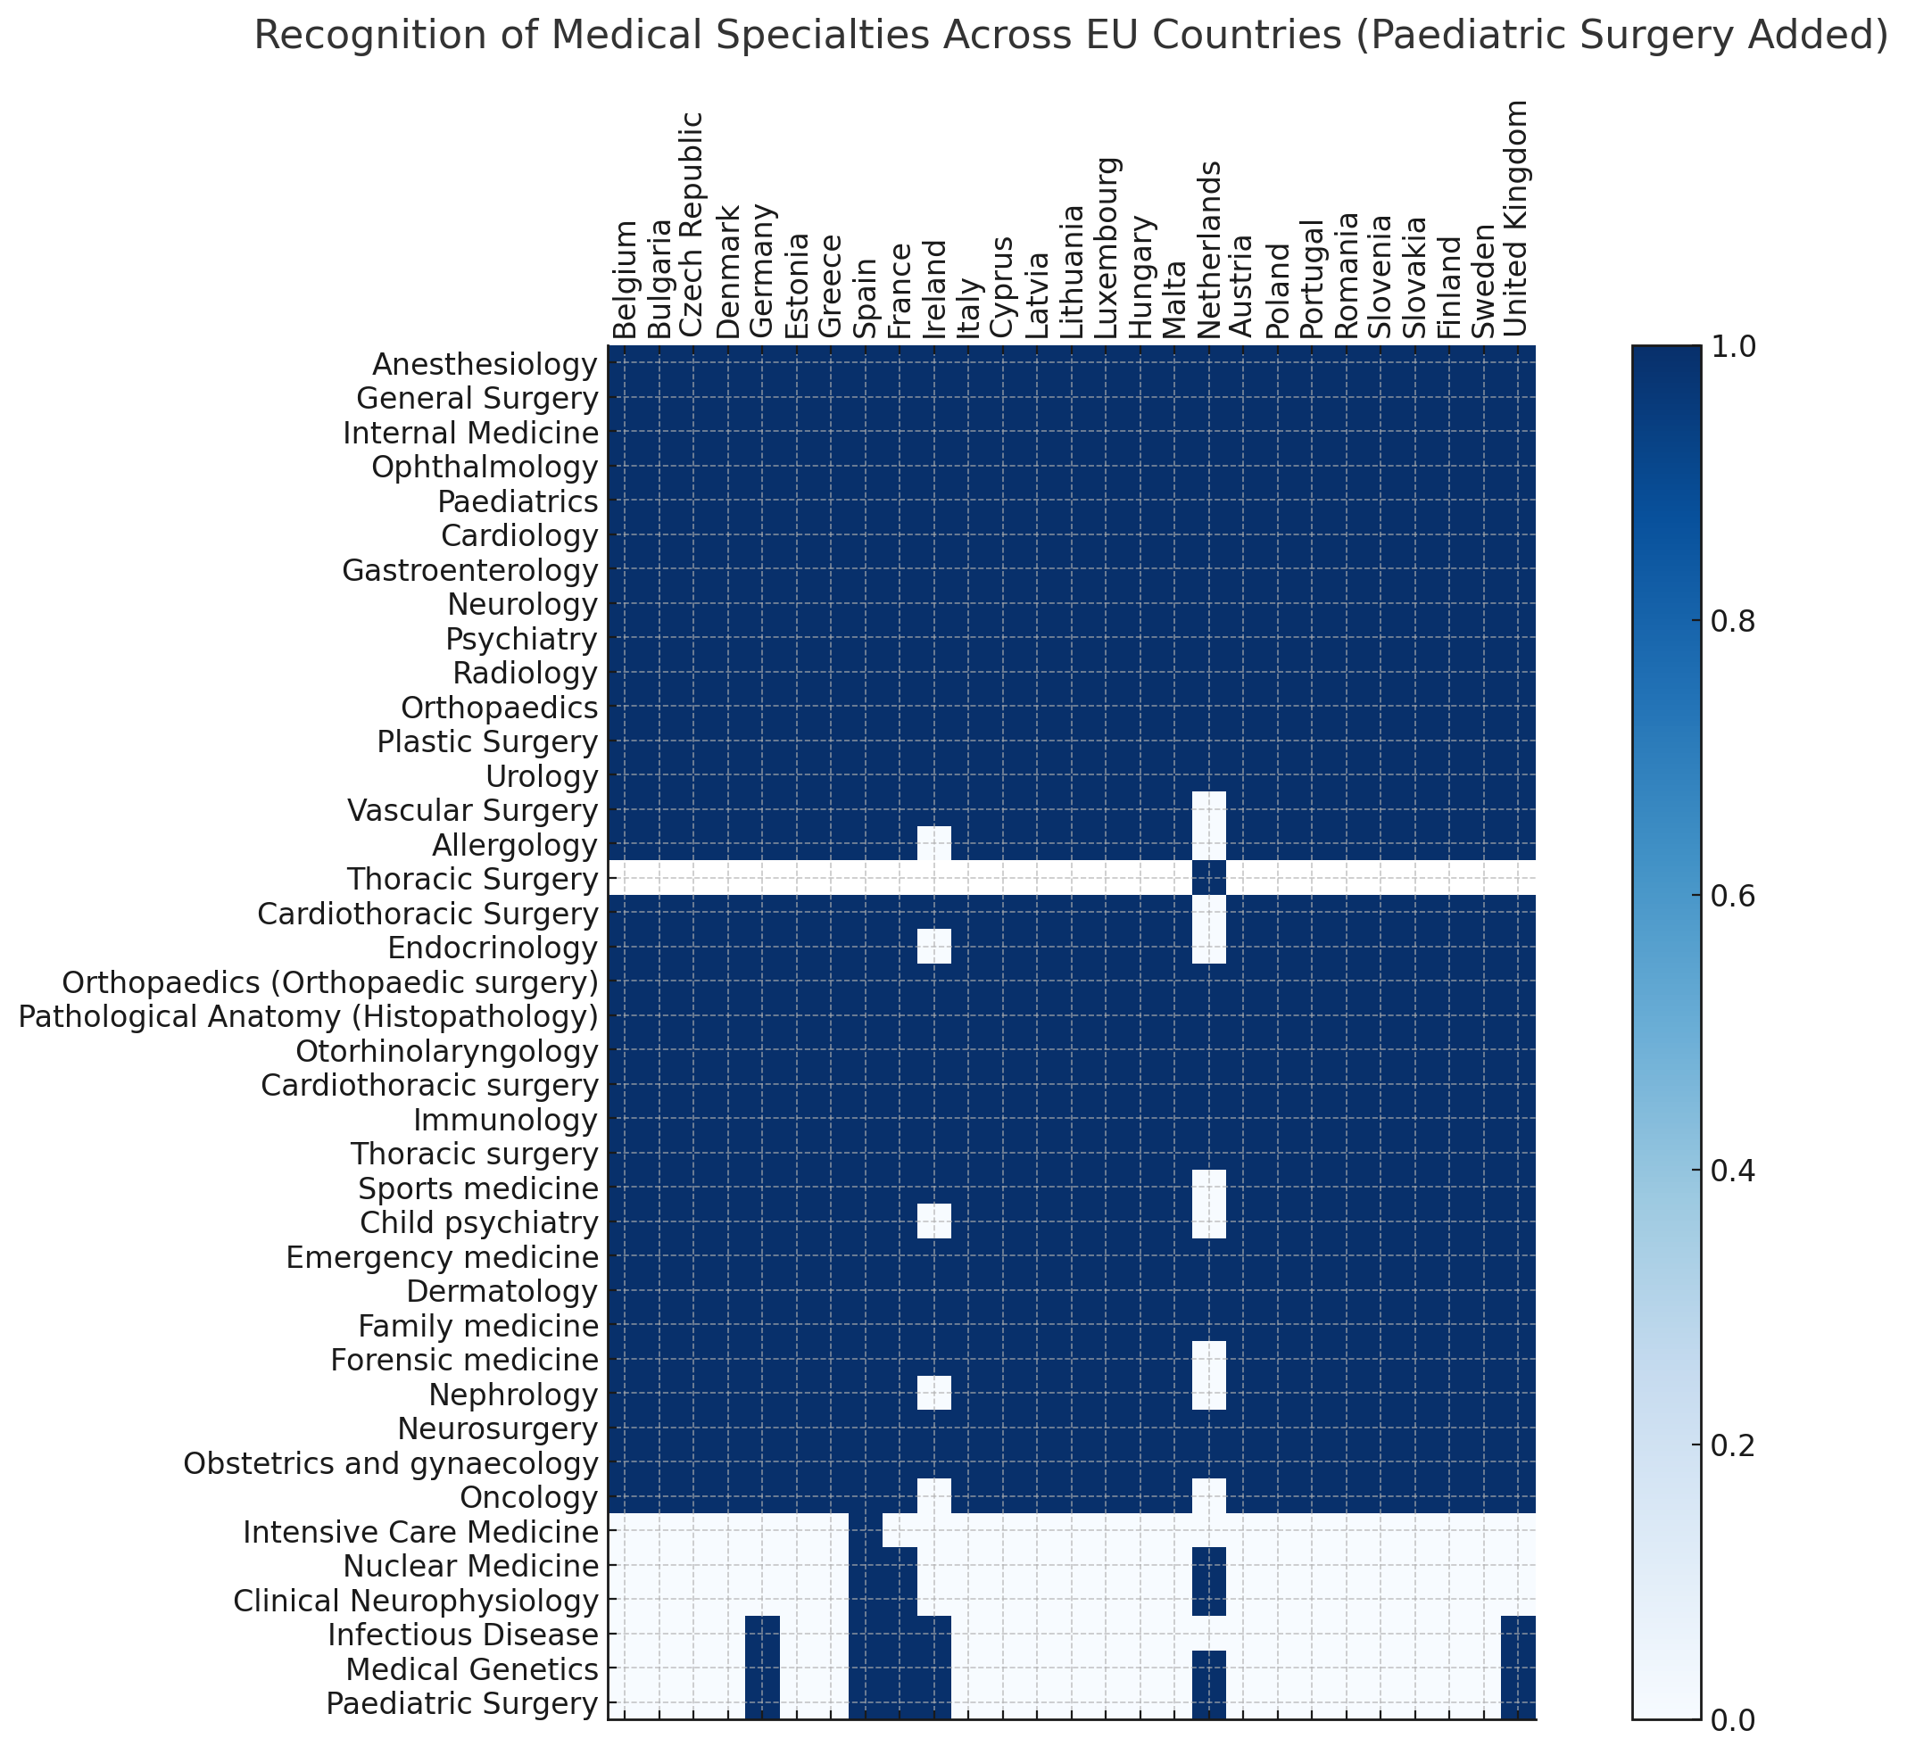
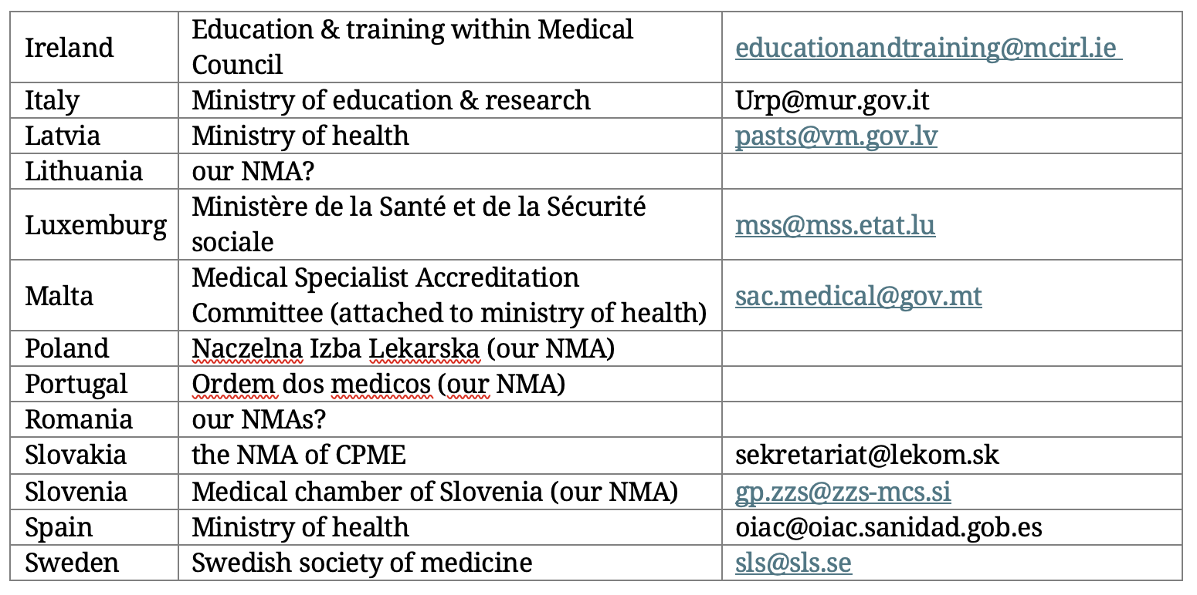
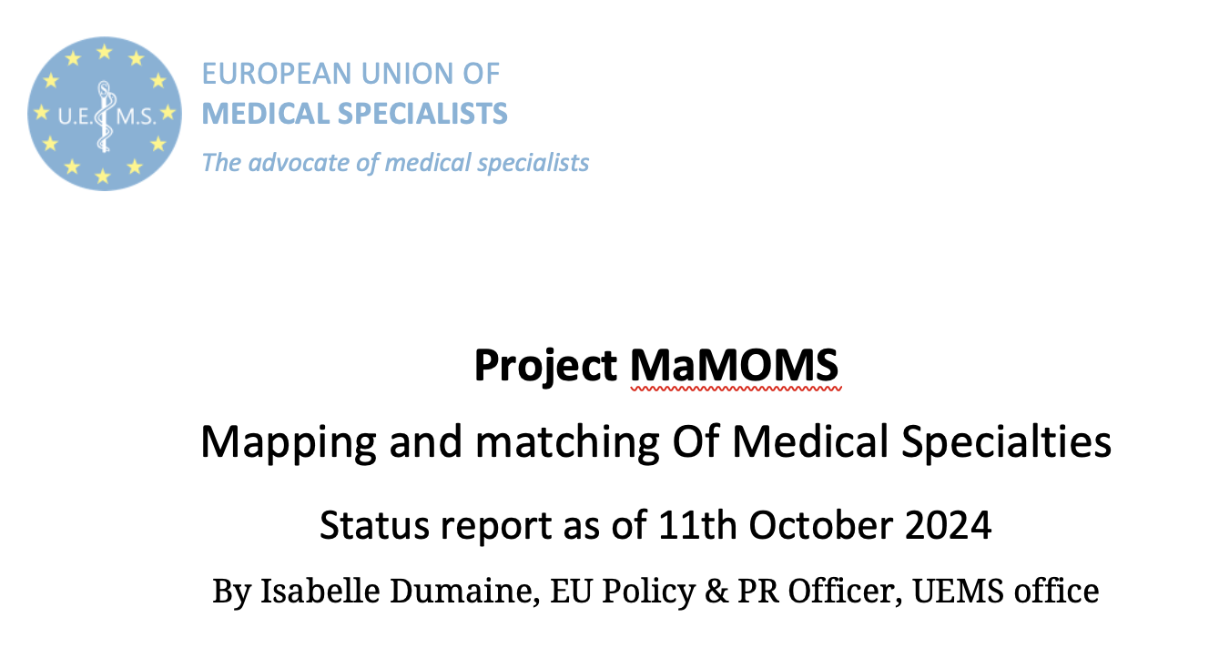

Slide 6
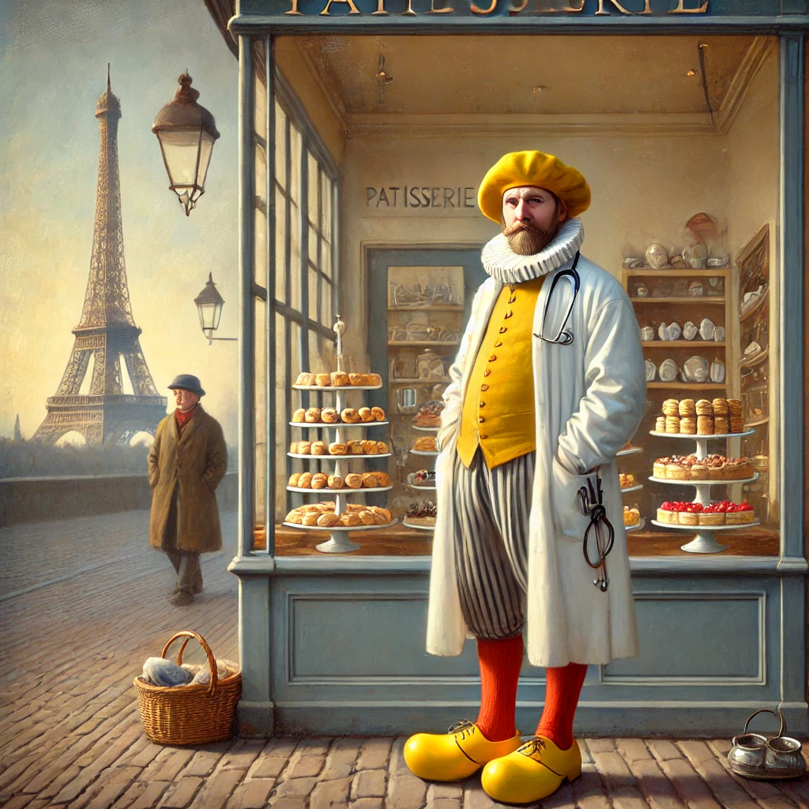
Desired Endpoint
A web-based database where specialists can view medical specialty differences across countries. Example: A Dutch specialist can easily find registration requirements in other UEMS countries like France.

Slide 7
Means and Schedule
Support from UEMS office.
Organize video meetings.
Data collection and website by January 2026.

Slide 8
Budget
Minimal expenses for website development and meetings. Supported by the Brussels office.

Slide 9
Next Steps
Inventory of specialties and subspecialties.
Verification meetings and creation of the database.

Slide 10
Contact Information
Prof. Dr. Armand Girbes
Head of Dutch Delegation UEMS & EACCME
Contact: a.girbes@demedischspecialist.nl Tel. +31.6.52.06.36.59
MaMoMS

