Slide 1
UEMS 2027 Meeting Bid
Prof. Dr. Armand Girbes

Slide 2
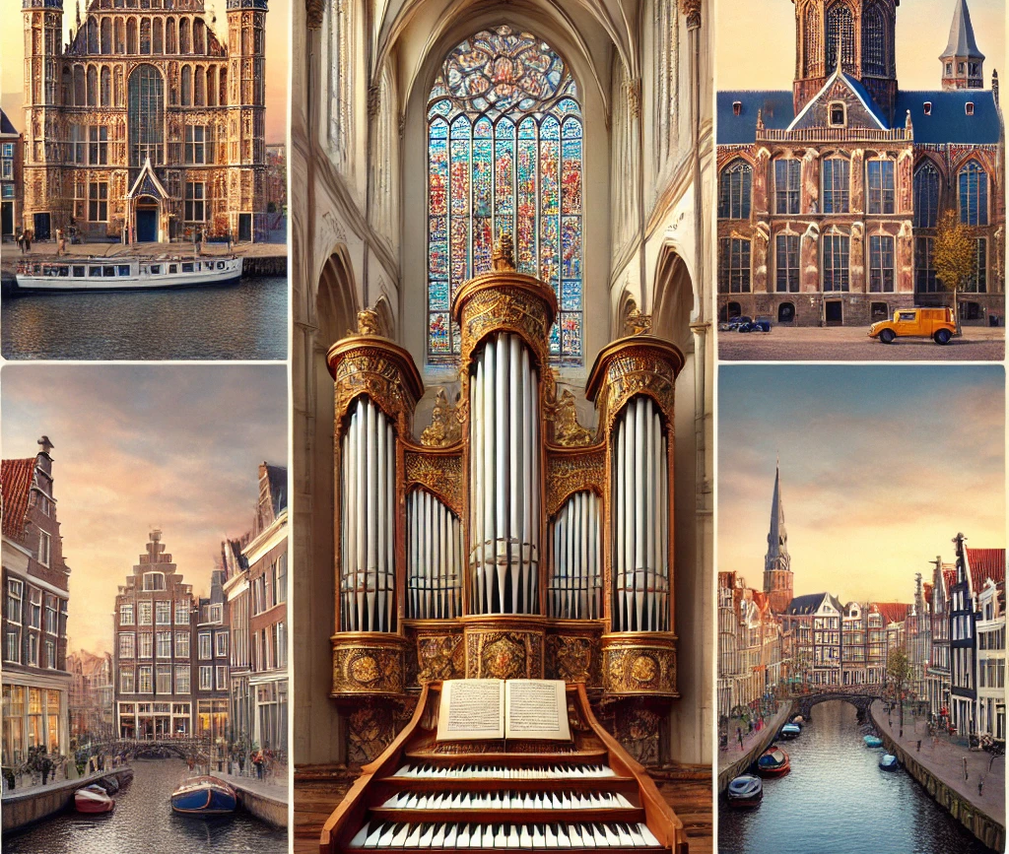
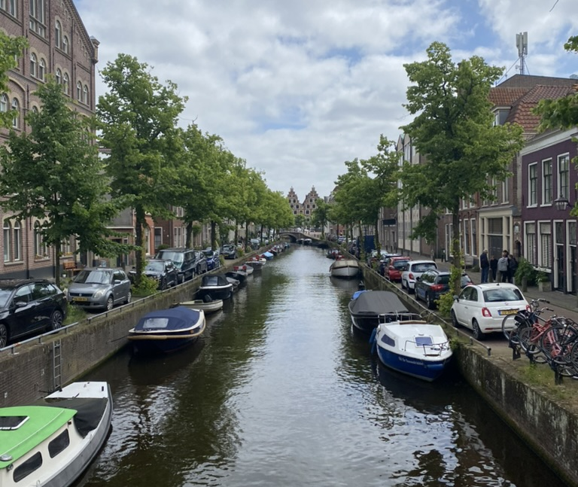
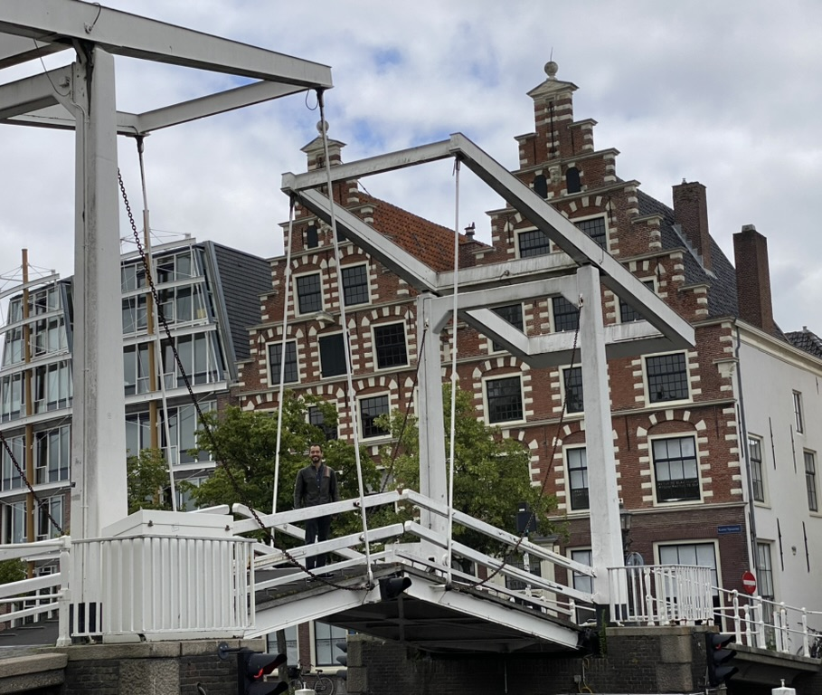
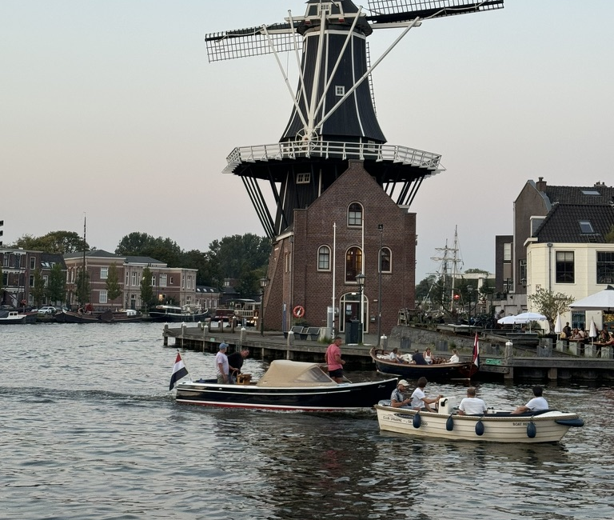
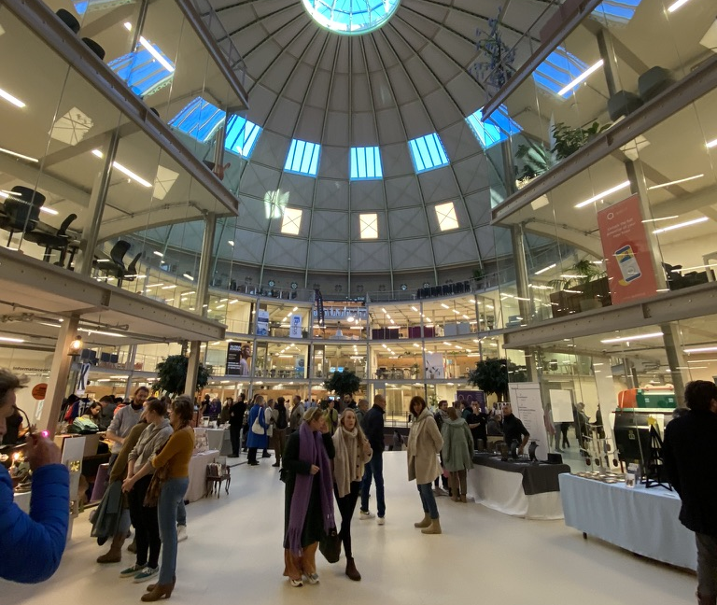
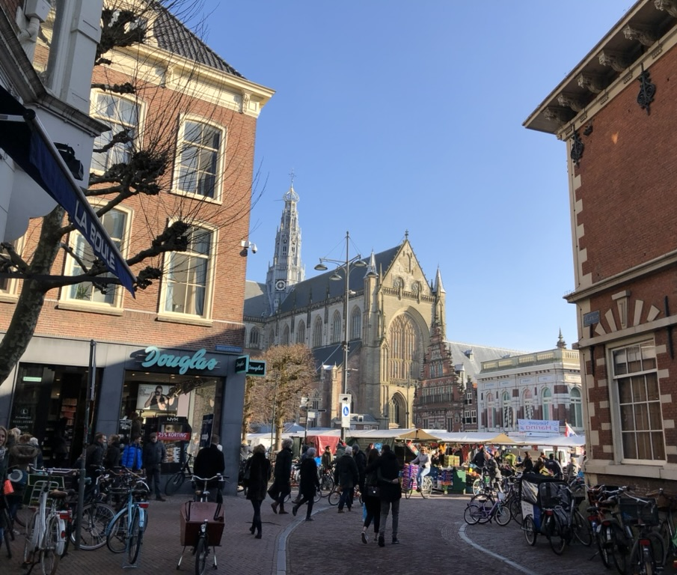

Slide 3
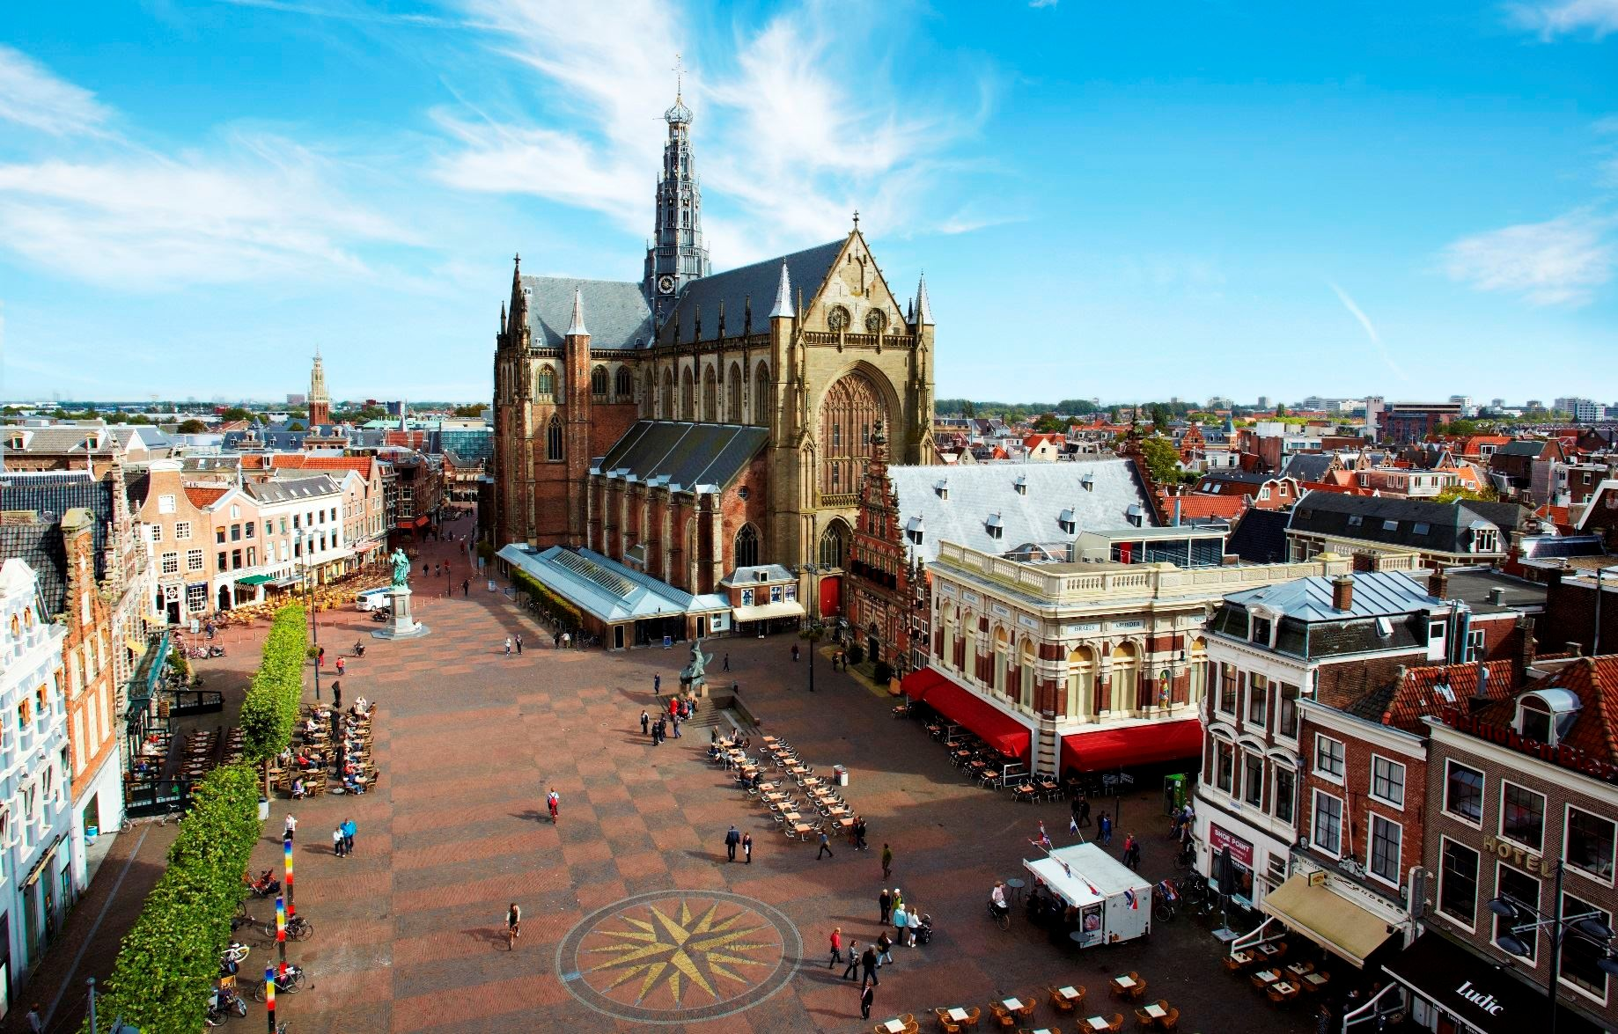

Slide 4
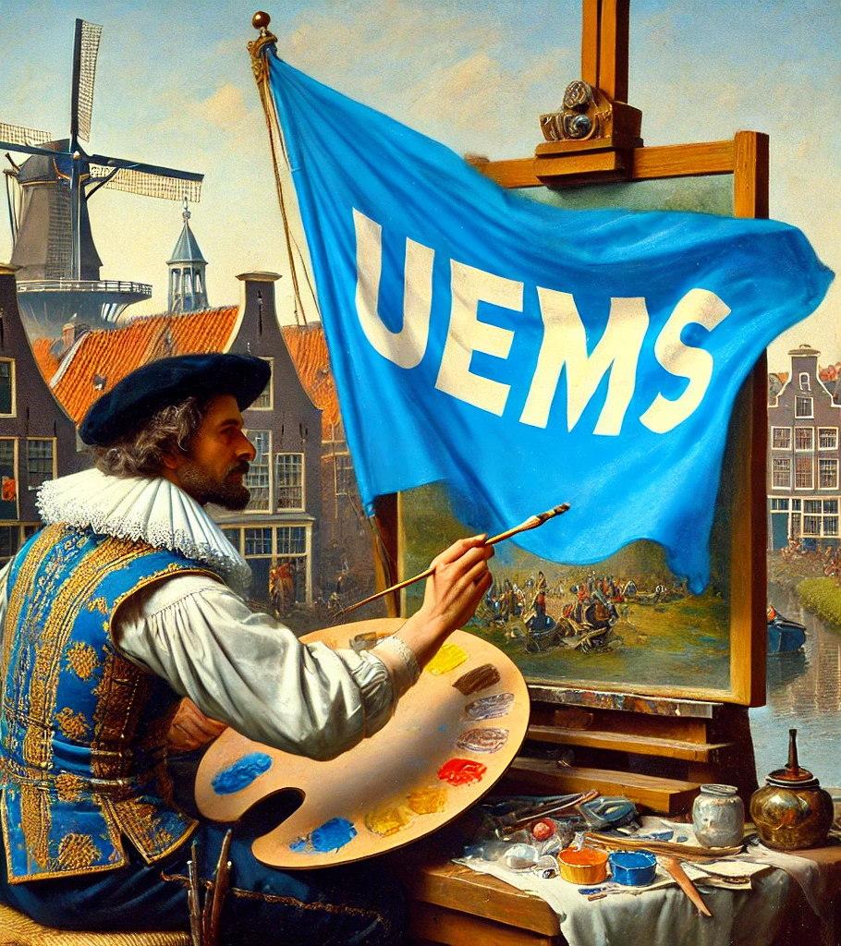
Early indications

Slide 5
UEMS 2027 Meeting Bid
Haarlem, The Netherlands
Prof. Dr. Armand Girbes

Slide 6
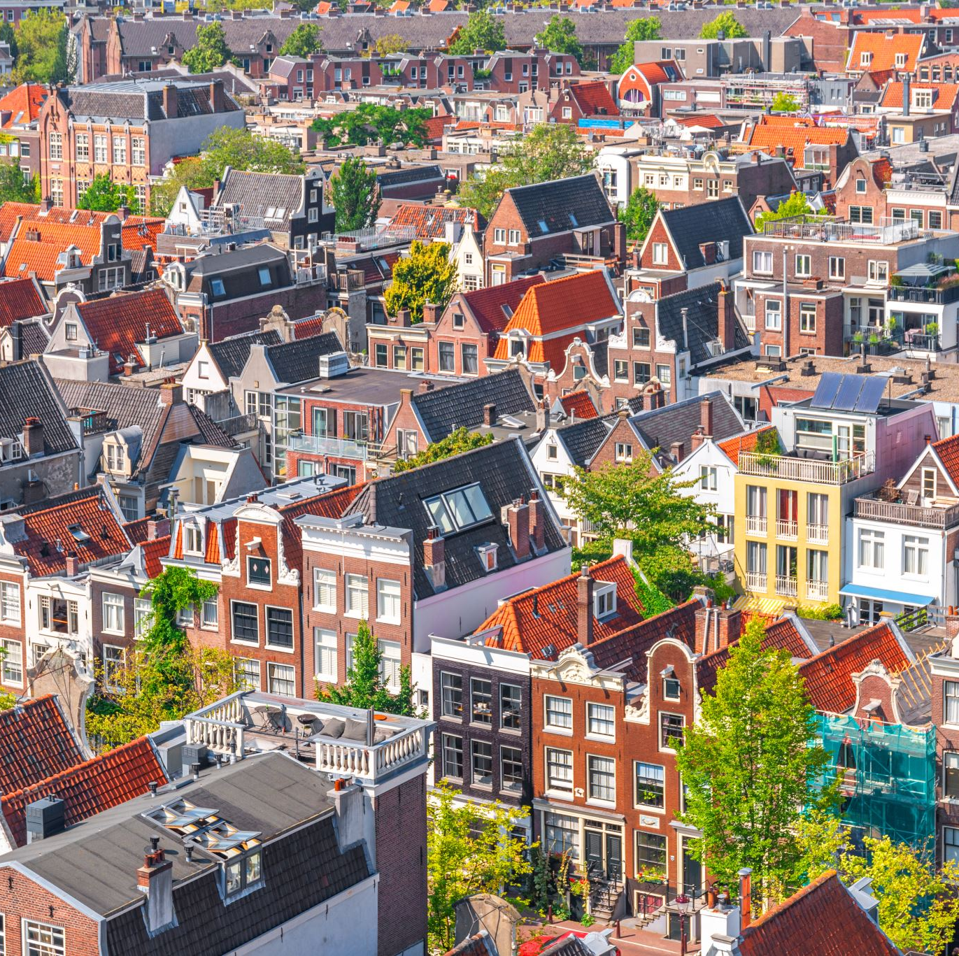
Why Haarlem for UEMS 2027?
Historic and charming city near Amsterdam (& older than Amsterdam)
Excellent location for an international event
High-quality venues and hotels
Great restaurants
Renowned Dutch hospitality

Slide 7
Location and Connectivity
Haarlem is just 15 minutes from Amsterdam Schiphol Airport
Direct and frequent railway connections to Amsterdam and other major cities
Easy access to major highways for international visitors

Slide 8
Key Venues for UEMS 2027
Ideal for conferences and meetings
E.g. Philharmonie Haarlem
Luxurious accommodations – possibilities
Amrâth Grand Hotel Frans Hals
Carlton Square Hotel
Landgoed Duin & Kruidberg
Teylers Museum and Frans Hals Museum: an option for unique social events

Slide 9
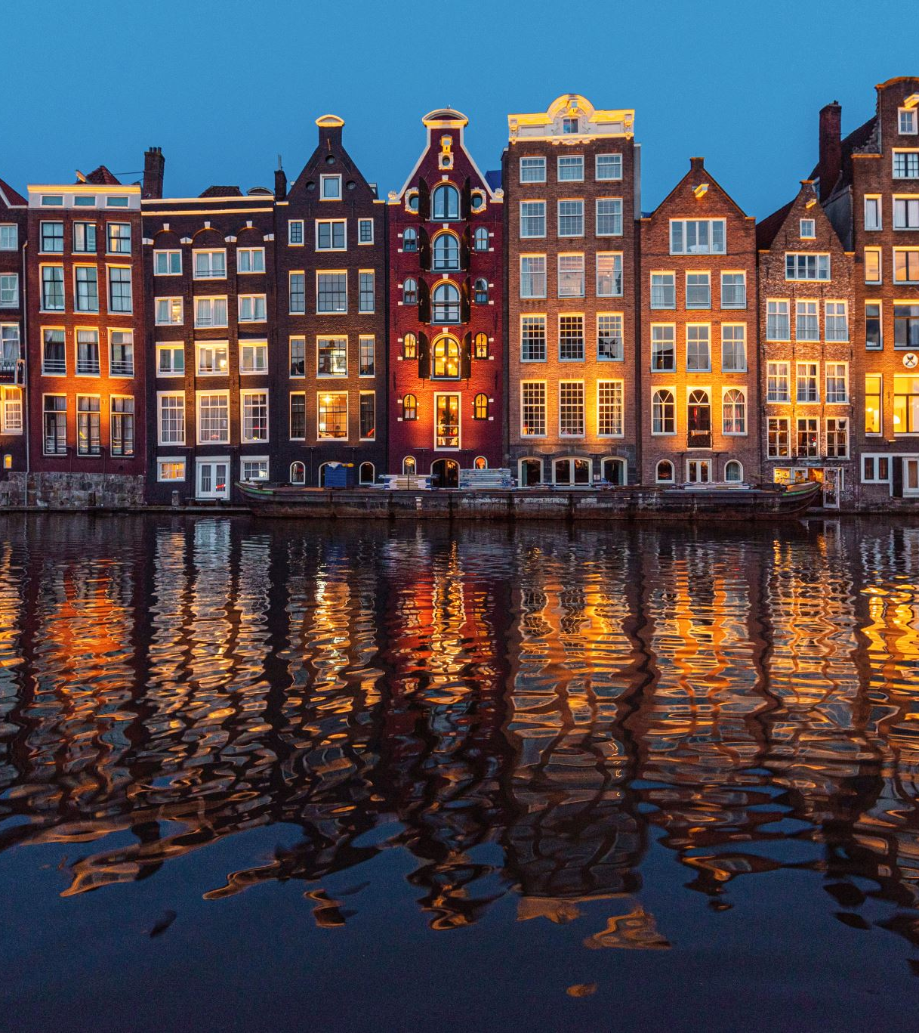
Experience Dutch Culture
Explore Haarlem's historic city centre, museums, and canals
Proximity to Amsterdam for additional cultural experiences
Vibrant restaurant scene with international and local cuisine

Slide 10
Join Us in Haarlem in 2027!
A unique opportunity to host UEMS in a beautiful Dutch city
Well-connected and equipped for international delegates
Let's make UEMS 2027 a memorable event in Haarlem!

Slide 11
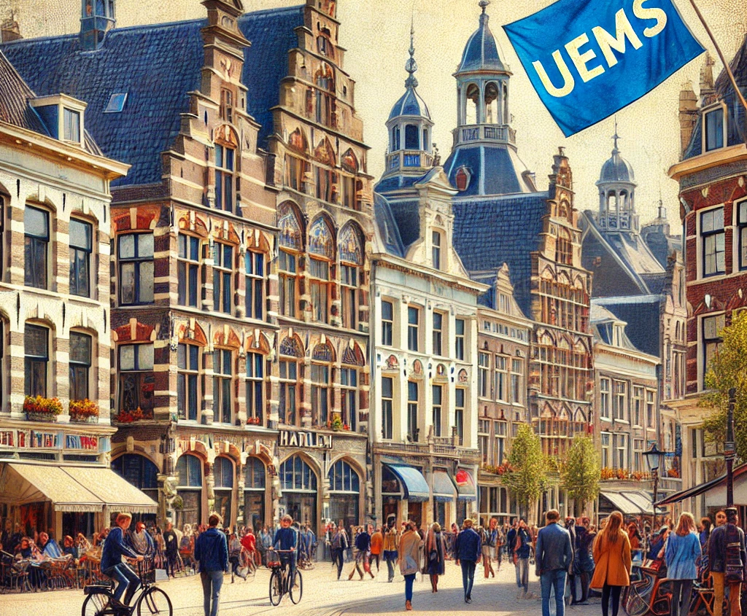
UEMS 2027

