Slide 1
UEMS CME-CPD Working Group October 18, 2024 Brussels
Report of the meeting by the Chair
Hannu Halila
UEMS Past President
UEMS Honorary Member
Gynecology, Helsinki, Finland

Slide 2
UEMS CME-CPD Working Group
Meeting well attended by around 40 colleagues
Main topic of the meeting was the Draft for the new UEMS CPD Policy, very lively discussion
The earlier CPD Policy is from 2001, the Basel Declaration
Has stood time suprisingly well
Need to be shorter, modernised, new terminology, UEMS Policy clearer etc.

Slide 3
Task Force
After the UEMS Council in April 2024 a Task Force was formed to draft the new UEMS CPD Policy
Hannu Halila Finland
Monika Brodmann-Mäder Switzerland
Emelie Hultberg Sweden
Marc Soethout The Netherlands
Foued Bouzaouache Tunisia
Aivars Vetra Latvia
Jozef Glasa Slovakia
Milena Staneva Bulgaria
Fridbjorn Sigurdsson Iceland

Slide 4
Structure of the Draft Document
General
CPD and professionalism
Rights and responsibilities
CPD and medical education
Accreditation – Quality of CPD
.

Slide 5
Political statements for future discussion
Obligation for doctors to record their CPD activities and to provide evidence of that, if necessary
CPD: starting after licensing as a doctor / after becoming specialist
Responsilities of employers (time, possibilities to attend, funding)
UEMS does not support recertification systems based on participation in CME/CPD ; this is the present UEMS Policy and changing that would be a major decision
….

Slide 6
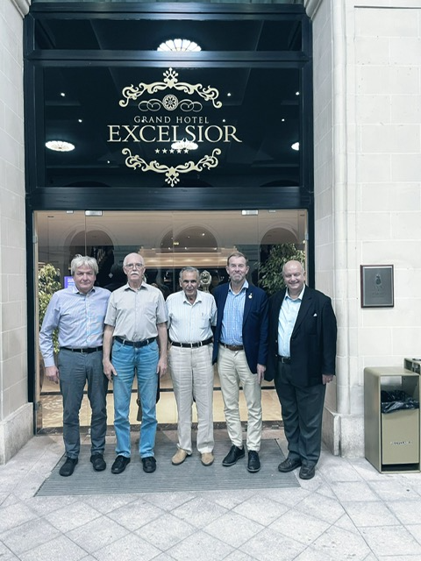
The way forward
The Task Force will continue to rewrite the Draft based on the very good and lively discussion at the WG Meeting
The document will be divided into background part and the actual UEMS Policy
The Draft will be dealt by the UEMS Enlarged Executive Committee, especially the political statements
The CPD Policy Document will be on the agenda for the UEMS Council meeting, April 2025, for discussion and possibly for adoption

Slide 7
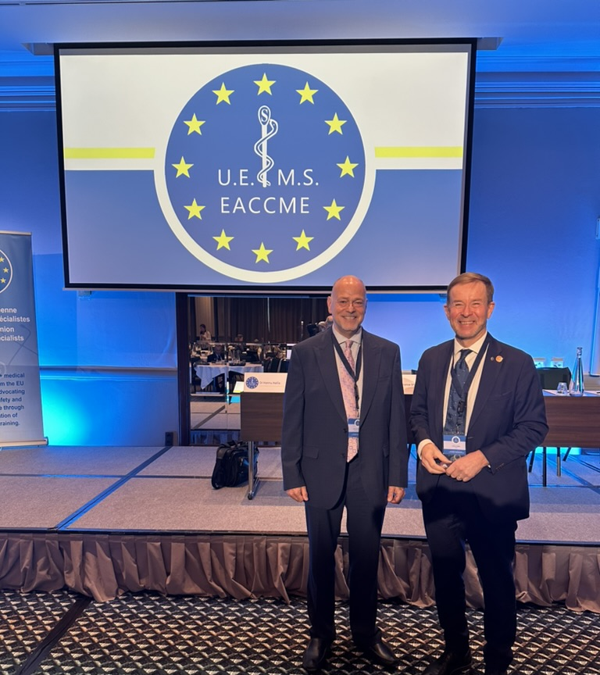
An Overview of CME/CPD Systems in Europe
AMEE 2024, Basel
Lawrence Sherman, President, Meducate Global, LLC
In collaboration with Dr. Hannu Halila, Finland
Past President of UEMS, European Union of Medical Specialist

Slide 8
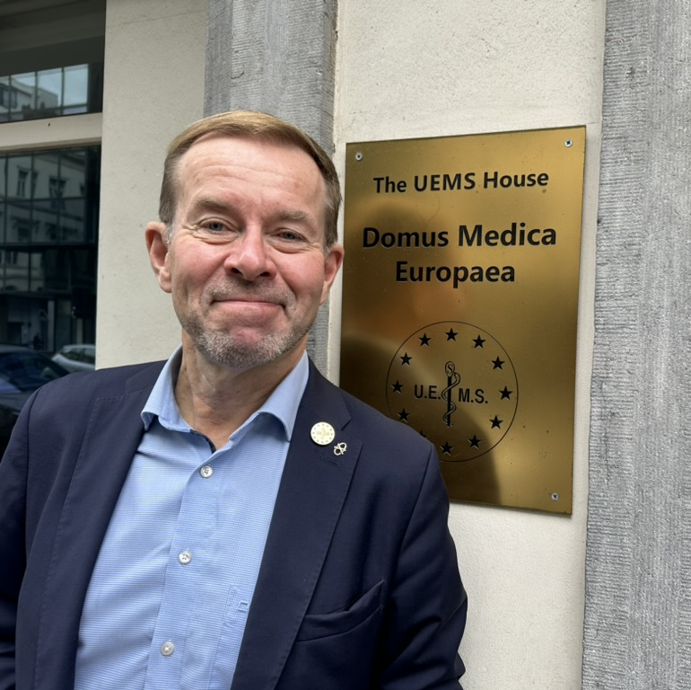
Thank you ! Kiitos !

