Slide 1

Advancing Adolescent medicine and transition care in Europe: A path forward
Adolescent Medicine and Health Multidisciplinary Joint Committee (MJC)
Assoc. Prof. Lina Zabuliene, MJC President (Lithuania)
Prof. Flora Bacopoulou, MJC member (Greece)
Dr. Anna Gutniak, MJC Vice-president (Sweeden)
Dr. Bernadra Vogrin, MJC Vice-president (Slovenia)
UEMS-UEMO
Joint Council Meeting,
Oct 18-19, 2024

Slide 2


Window of opportunity: 10-24 years of age
“Investments in adolescent health bring a triple dividend of benefits for adolescents now, for their future adult lives, and for the next generation. Their health and well-being are engines of change in the drive to create healthier, more sustainable societies.”
World Health Organization (2017)
Cyprus, 2017
World Health Organization (2017) Global Accelerated Action for the Health of Adolescents (AA-HA!): guidance to support country implementation. World Health Organization, Geneva, p 151

Slide 3
Children and young adults' care
Pediatrician, Pediatric specialist
Family physician/ General practitioner
Adolescent medicine specialists
School physician, School nurse, Youth physician
Public health specialist
Family physician/ General practitioner
Adult Specialists
Hospital, Outpatient clinic, School, college, university
Child
Adolescent and young adult
(10-24 years)
Family
ECPCP, EAP, EUSUHM , IAAH, UEMO, EFIM, Specialists organizations
ECPCP - european confederation of primary care paediatricians;; IAAH – The international association for Adolescent health; EAP The European Academy of Paediatrics ; EUSUHM the European Union for School and University Health and Medicine; UEMO European Union of General Practitioners; EFIM European Federation of Internal Medicine

Slide 4
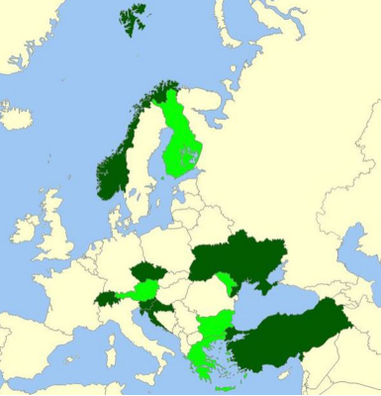
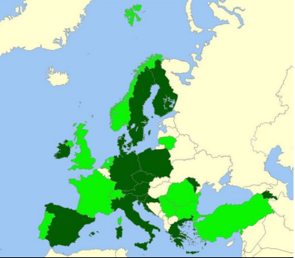
Training in adolescent health and medicine
for medical students
for residents
N = 36 countries
stand-alone teaching was available and mandatory
7 countries
15 countries
Countries providing stand-alone mandatory training sessions (dark green) or
optional stand-alone sessions (light green) to medical students, irrespective of the content
Michaud PA, et al. An exploratory survey on the state of training in adolescent medicine and health in 36 European countries. Eur J Pediatr. 2019;178(10):1559-1565.

Slide 5
Number of countries providing formal training in different areas within the training curriculum
N = 36 countries
Michaud PA, et al. An exploratory survey on the state of training in adolescent medicine and health in 36 European countries. Eur J Pediatr. 2019;178(10):1559-1565.

Slide 6
The MJC: composition and objectives
MJC Composition:
An initiative of the European Academy of Paediatrics (EAP)
Established in 2018
32 dedicated members
Objective Achieved:
Developed a concise set of Training objectives for UEMS specialists pertaining to the care of adolescents and young adults that can be integrated across all UEMS residency programs (approved by the UEMS Council in 2022).
Four main training goals:
How to conduct effective consultation
How to assess lifestyle and behaviour
How to perform a respectful physical examinations
How to provide comprehensive care to AYAs with chronic conditions (including transitional care)

Slide 7

The MJC: objectives
Objective Achieved:
  Sports Medicine ETR included topic of Physical activity in special groups: children and adolescents
  Psychiatry ETR included training objectives as Appendix 2
  Emergency medicine ETR included training objectives as Appendix 3
  Professional Development Module PDM in Pain Medicine for Anaesthesiologists (adolescents mentioned 8 times)
Further objectives:
Aim to improve healthcare outcomes for adolescents through enhanced education and training.
Continue development of a comprehensive Adolescent and Young Adults medicine curriculum/syllabus/professional development module/ minimal requirements/ continuing profession developement/ additional competence (currently in progress).
Provide user-friendly educational resources, leveraging existing tools such as EuTEACH* materials.
Tbilisi, Georgia, 2022
* European Training in Effective Adolescent Care and Health

Slide 8
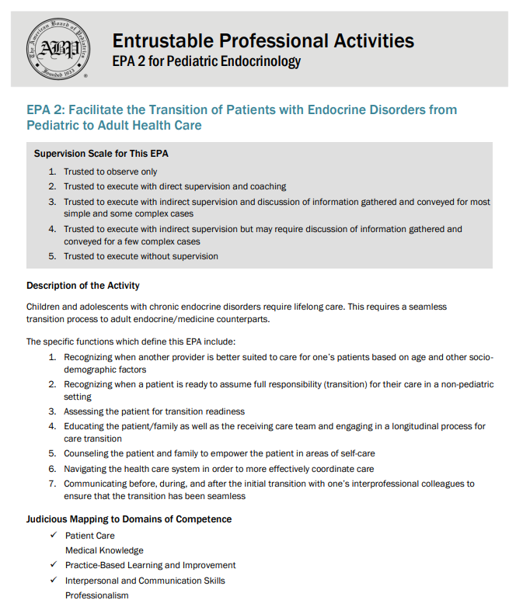

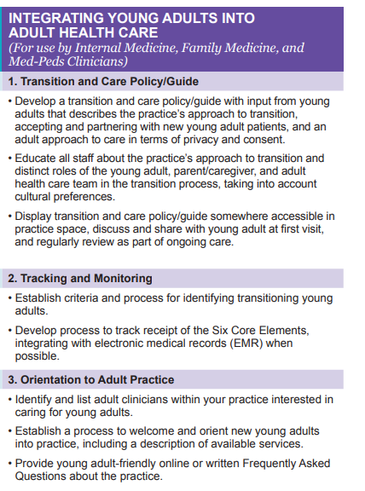
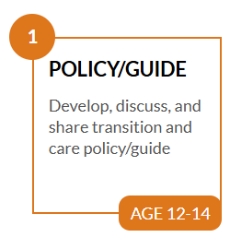
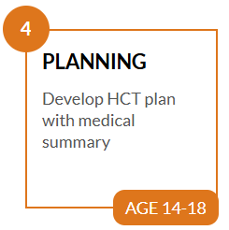
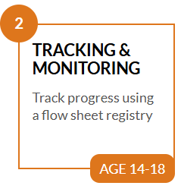
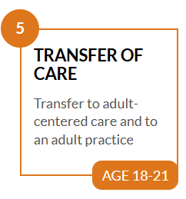
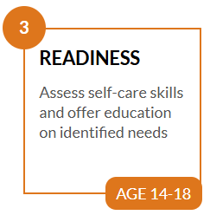
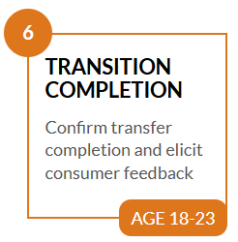
Six Core Elements™ Approach and Timeline for Youth Transitioning from Pediatric to Adult Health Care
Entrustable Professional Activities for Subspecialties | The American Board of Pediatrics (abp.org)
Six Core Elements - Side-by-Side Comparison (gottransition.org)

Slide 9
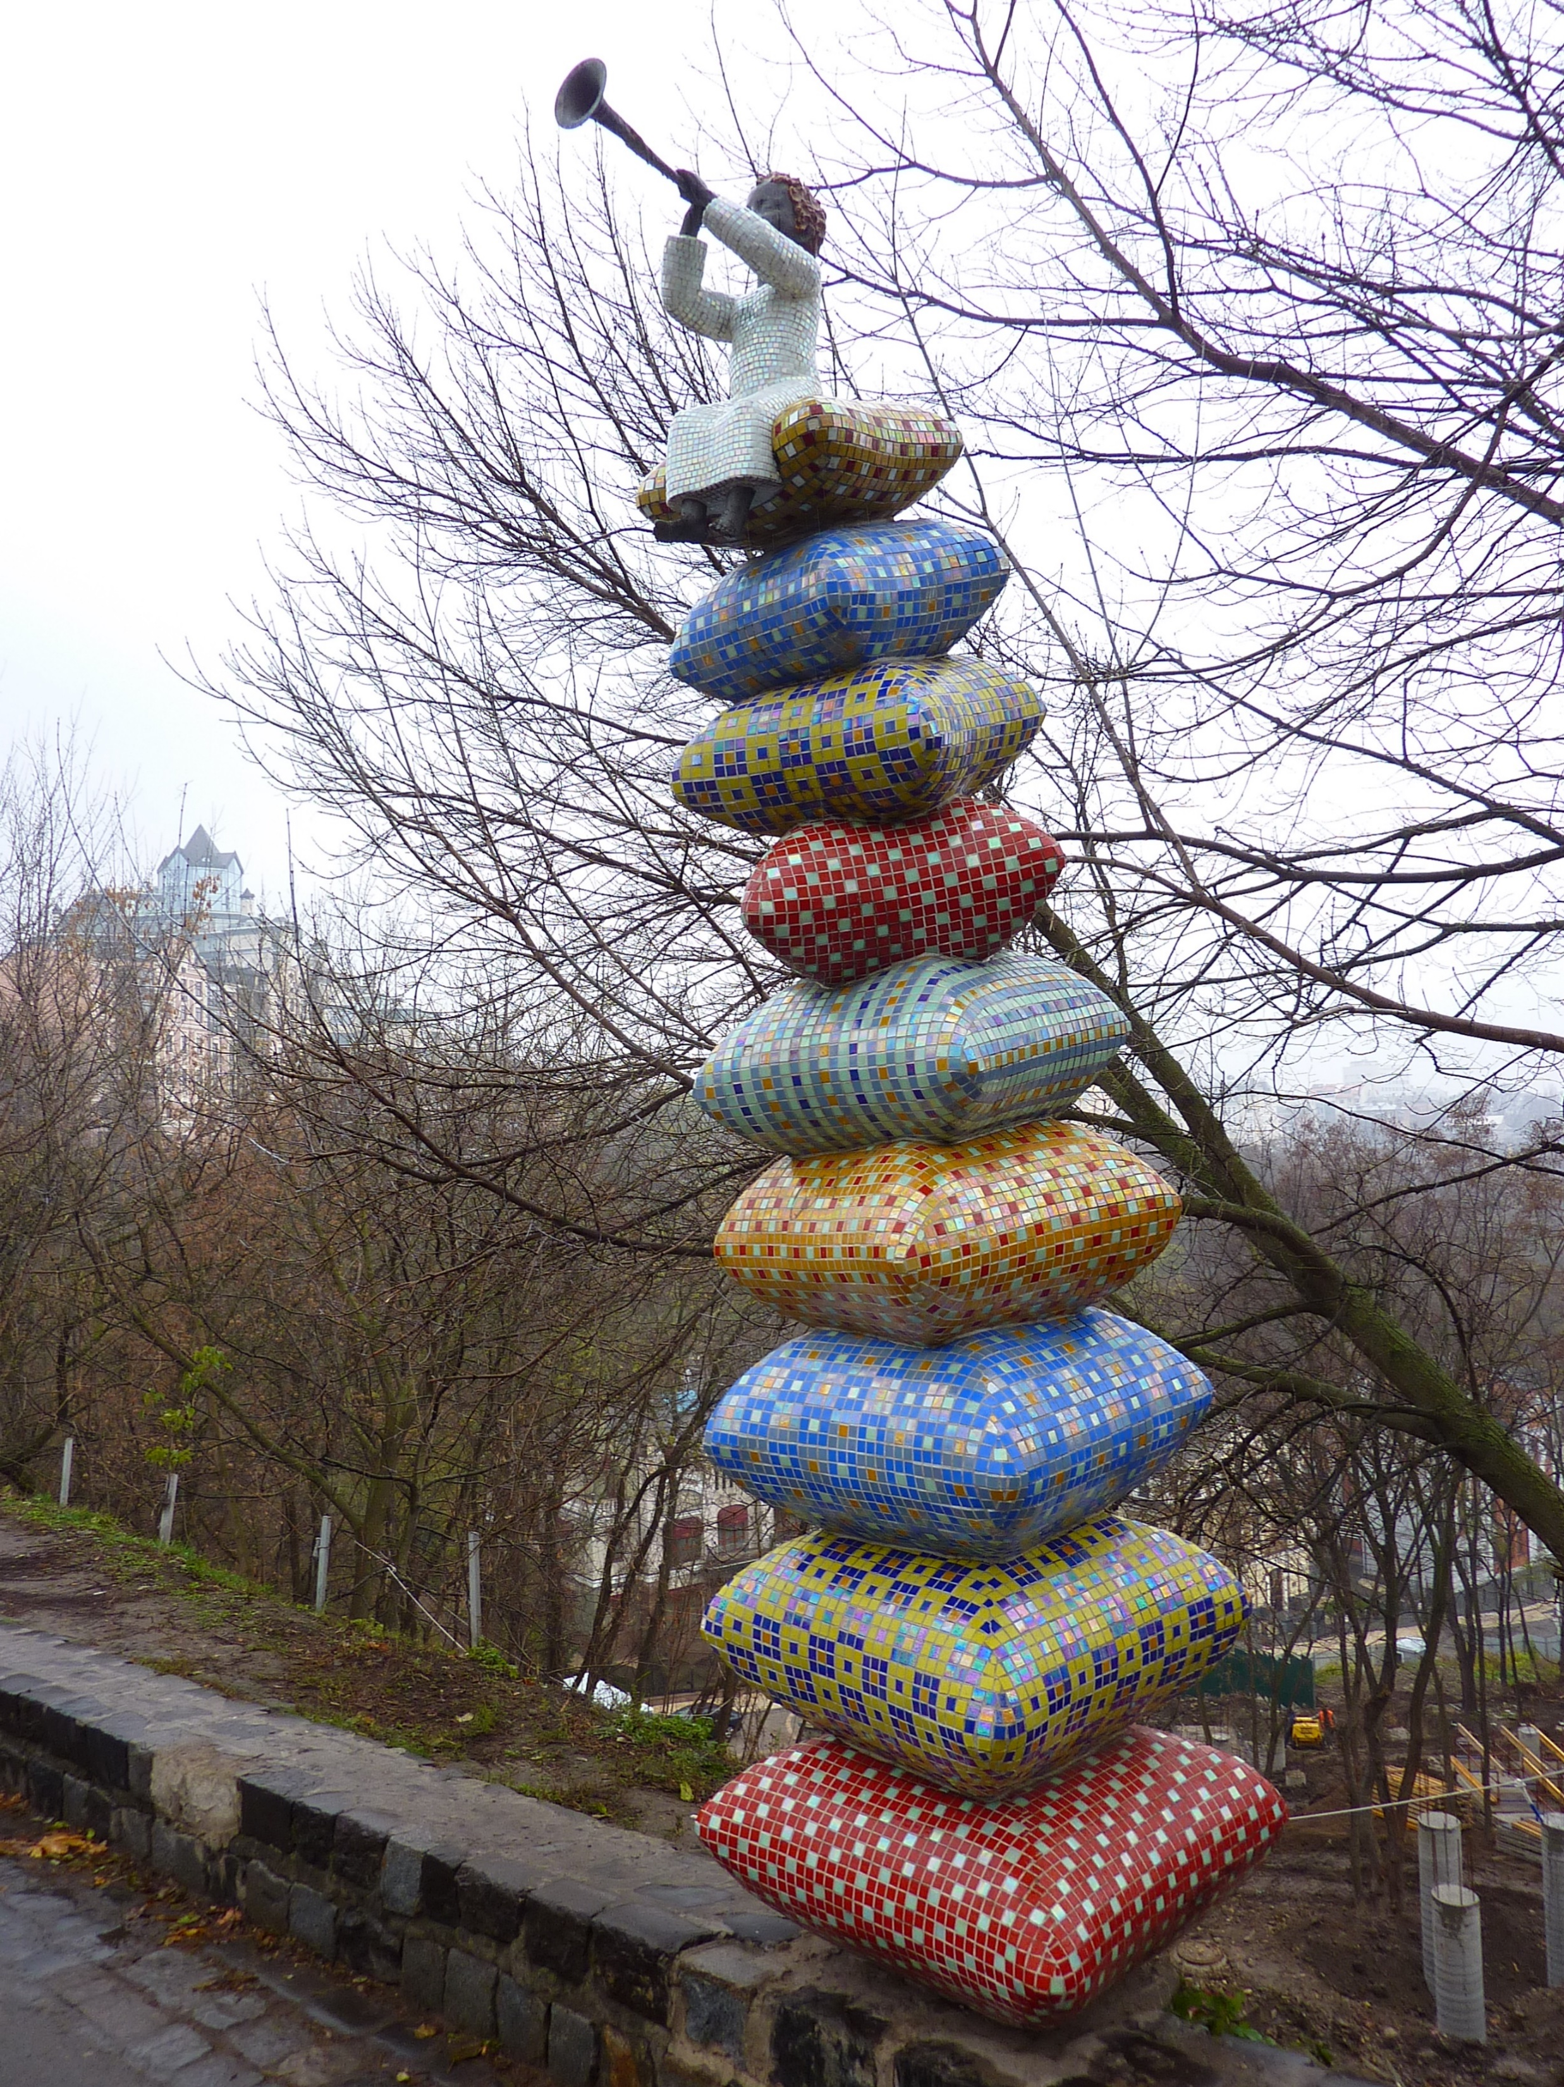
Key stakeholders of the curriculum/content
Adolescent medicine and health MJC Members Agreement on the content
European Academy of Paediatrics (EAP) – Agreement to collaborate and introduce module on transition care.
European Union of Schools and Universities in Health and Medicine (EUSUHM) – Agreement to collaborate and integrate part of the module for school physicians.
International Association for Adolescent Health (IAAH)European Train Agreement to collaborate with Educational committee
ing in Effective Adolescent Care and Health Team (EuTEACH) – Agreement to collaborate and introduce a module on transition care and explore the development of EPAs.
European Union of General Practitioners (UEMO) in progress
European Federation of Internal Medicine (EFIM) in progress
UEMS Specialty Sections, MJCs, Thematic groups in progress
Other Key Stakeholders
Kyiv, Ukraine, 2017

Slide 10
To summarize
The content outlining the required competencies for adolescent and young adult care has been developed.
Paediatricians, trainers, school specialists, and adolescent physicians, family physicians, internists, specialists, European Junior Doctors have been contacted.
An idea of module with minimal requirements (including EPAs) for transition care, including school physicians, has been finalized.
We are currently identifying trainers and training centers ready to facilitate the program, with potential centers in Switzerland, Portugal, Greece, The Netherlands, Slovenia, Sweden, and Finland.
Additionally, we are working towards reaching an agreement with EFIM, UEMO, EJD and relevant specialist sections on the next steps and delegation of active representatives

Slide 11

“To be a young adult today is to experience both excitement and uncertainty, wide-open possibility and confusion, new freedoms and new fears”
J.J Arnett, phycologist
lina.zabuliene@mf.vu.lt
Kernavė, Lithuania, 2010

