Slide 1

Fatigue project
Prof. Oleg Sabelnikovs
President of EBA
UEMS AUTUMN COUNCIL MEETING
2024

Slide 2

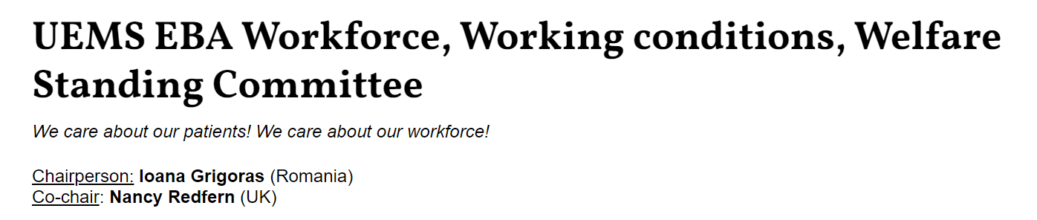
Introduction
A fatigue-related medical error is a mistake in clinical judgment or performance caused by physical or mental fatigue. It can lead to misdiagnosis, incorrect treatment, or medication errors, often due to long working hours, inadequate rest, or disrupted sleep among healthcare professionals.
On the 19th of October 2019 the European Board of Anaesthesiology approved the FATIGUE PROJECT of the EBA Workforce, Working Conditions, Welfare Standing Committee.

Slide 3
Aims of the project:
To collect and publish data about the work-related fatigue of European anaesthesiologists
To raise awareness of fatigue-related consequences on patient safety, and on anaesthesiologists wellbeing
To promote a change of culture and regulations at all levels – anaesthesiologist, departments, hospital managers, regulatory bodies
To promote implementation of a Fatigue Risk Management System within European countries
To enhance actions of other specialties
To promote a change of regulations in healthcare at the European level

Slide 4
Surveys (run from September 2021 to March 2022) distributed by National Societies via EBA and NASC and by Trainee network.
Specialists in Anaesthesiology – 1577 responders
Trainees in Anaesthesiology - 1252 responders

Slide 5
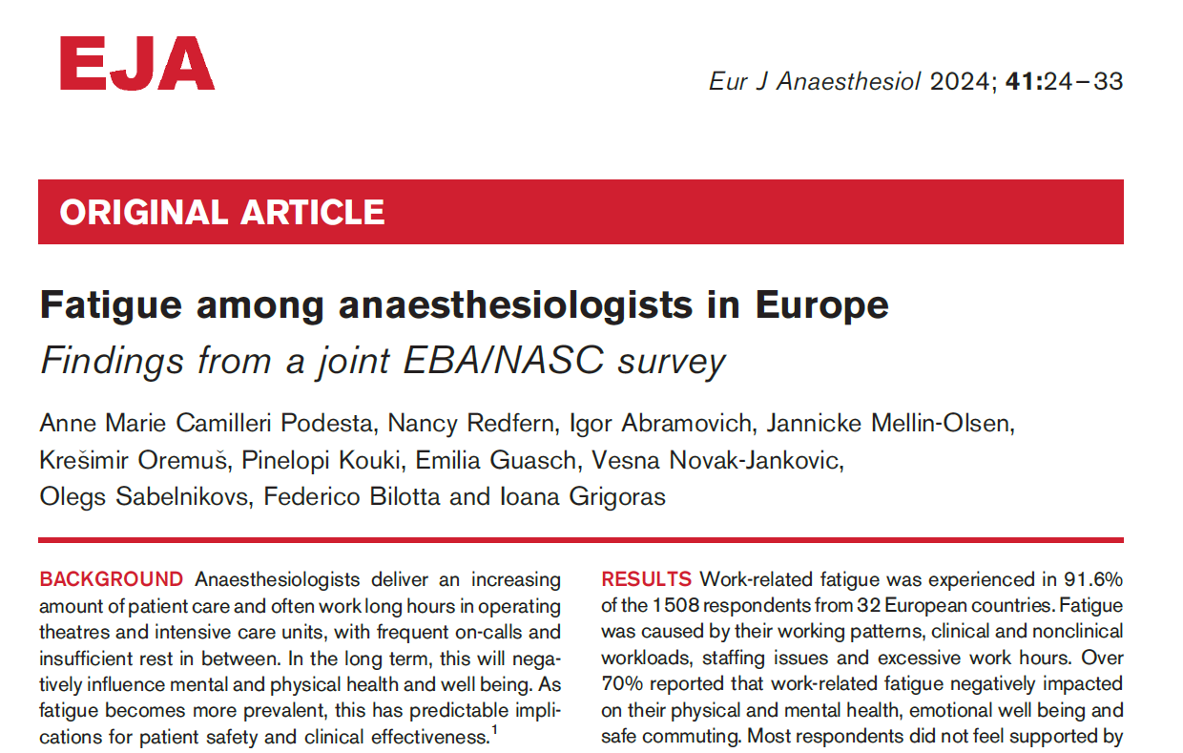


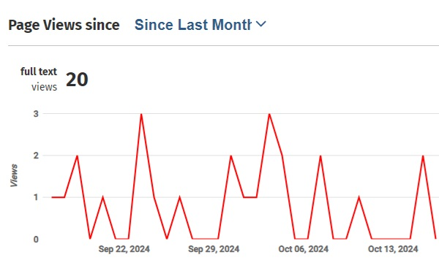
FATIGUE PROJECT
    Publications
Eur J Anaesthesiol 2024; 41:24–33

Slide 6
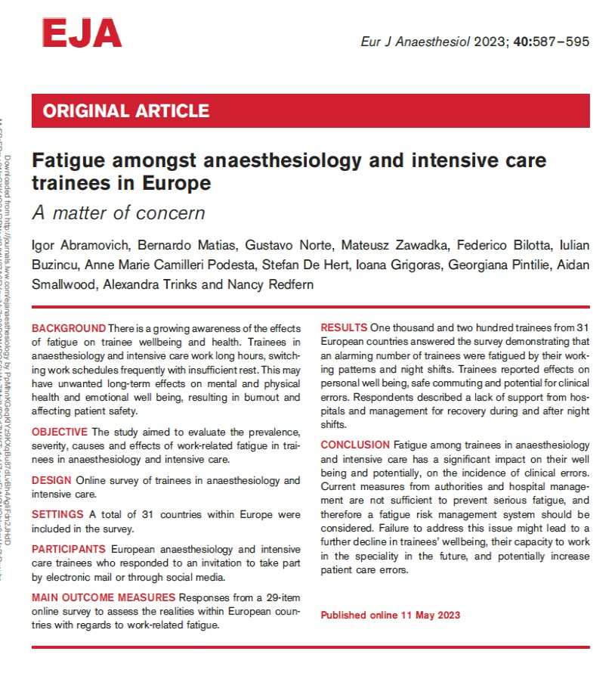

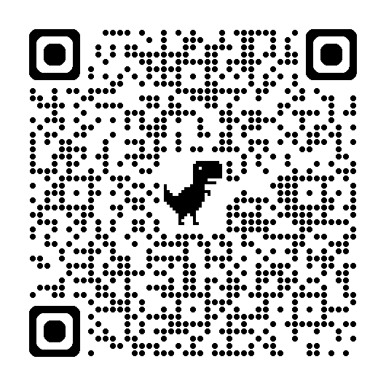
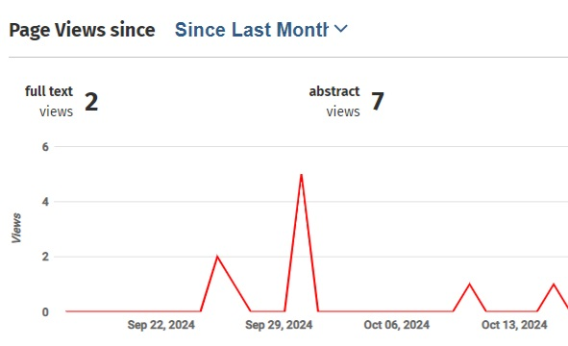
FATIGUE PROJECT
    Publications

Slide 7
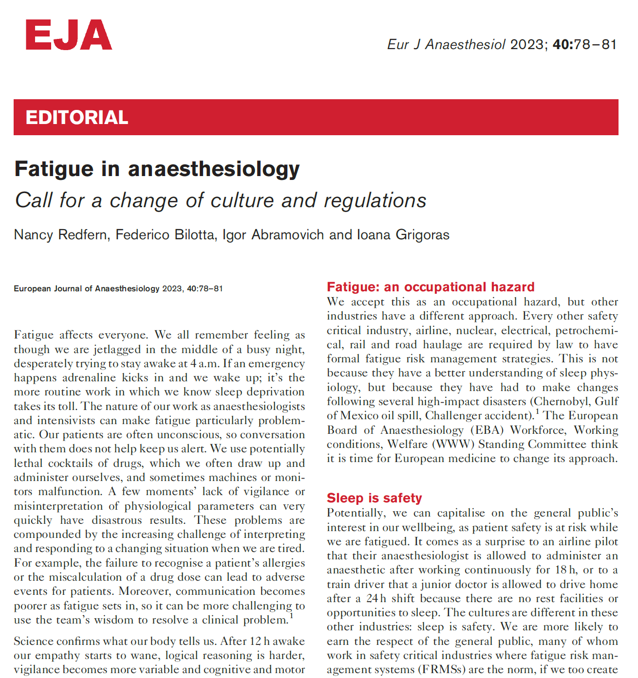


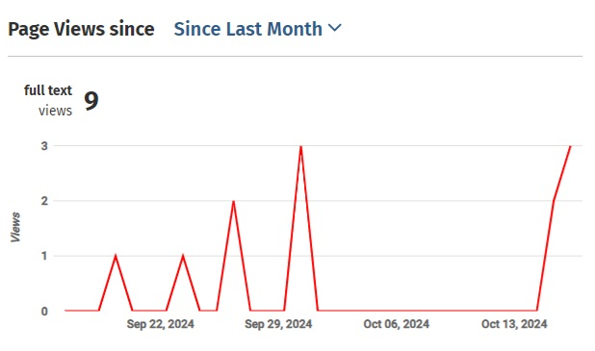
FATIGUE PROJECT
    Publications

Slide 8
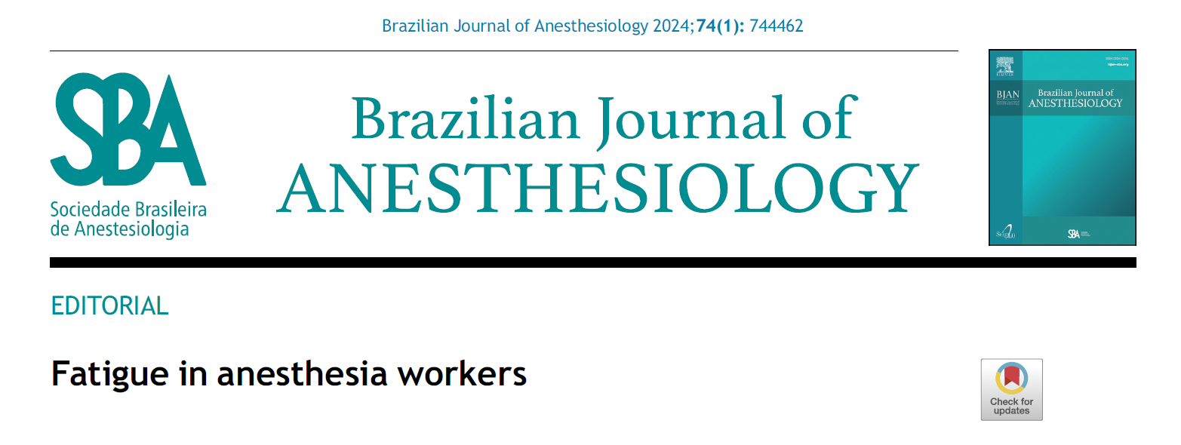
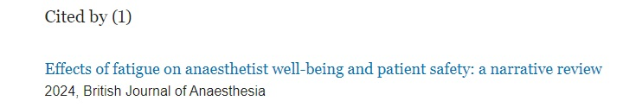
FATIGUE PROJECT
    Other publications

Slide 9
Educational or scientific events:
2021
European events
  The online European & international trainee meeting - ESAIC Trainee Network
Romania
  The Congress of the Romanian Society of Anesthesia and Intensive Care
  The National conference „Quality management in Healthcare”
  EMSA (European Medical Students Association) conference
  SSMI (Society of Medical Students in Iasi) conference
  The National Conference on Palliative Care
Portugal
  Webinar of the Portuguese Society of Anaesthesiology
Jordan
  The 11th Jordanian-Romanian Medical Conference

Slide 10
Educational or scientific events:
2022
European events
  International Forum on Perioperative Safety and Quality (ISQ)
  Euroanesthesia 2022 Milan, Italy
  European Patient Safety Foundation meeting Stockholm, Sweden
  NASC online meeting
Portugal
  The National Congress of the Portuguese Society of Anesthesiology
  Webinar of the Portuguese Society of Anaesthesiology
Netherland
  The Congress of the Dutch Society of Anaesthesiology

Slide 11
Educational or scientific events:
2023
European events
  Euroanesthesia 2023 Glasgow, UK
  2023 Patient Safety Conference, European Patient Safety Foundation, Viena, Austria
  ESAIC webinar Fatigue a safety concern
United Kingdom
  Healthcare fatigue forum – Manchester
  Healthcare service Investigation Branch meeting – London
  Parliamentary reception London

Slide 12
Educational or scientific events:
2024
International events
The 5th Mena Anesthesia and Pain Congress Dubai, Saudi Arabia
Romania
The 50th Congress of the Romanian Society of Anesthesia and Intensive Care

Slide 13

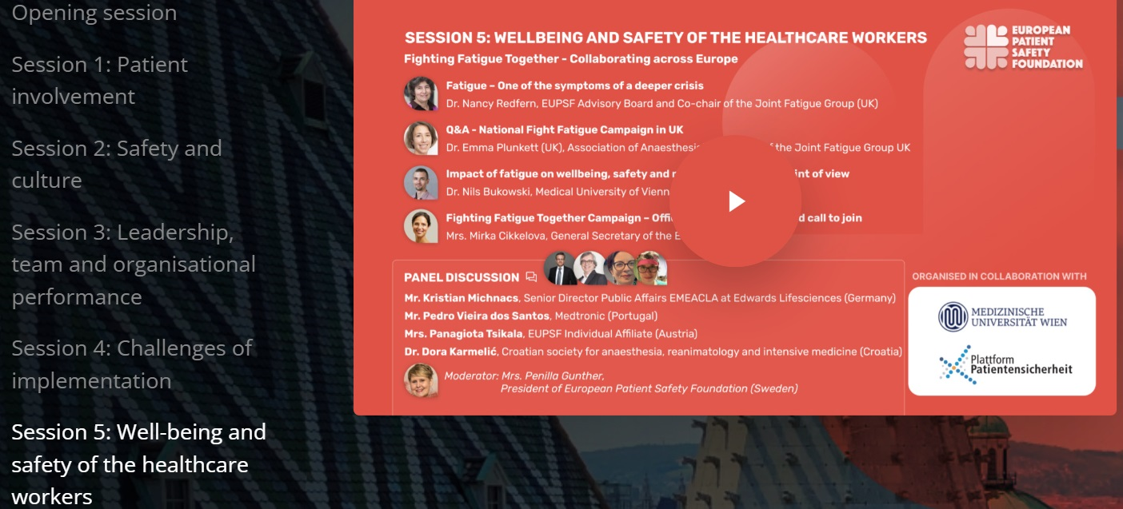
FATIGUE PROJECT

Slide 14
Collaboration with other organizations:
ESAIC Trainee Committee
ESAIC NASC Committee
European Junior Doctors
ESAIC Guideline Committee
European Patient Safety Foundation

Slide 15
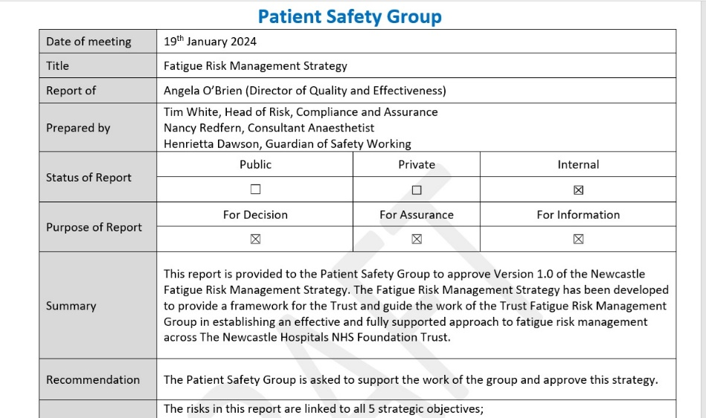
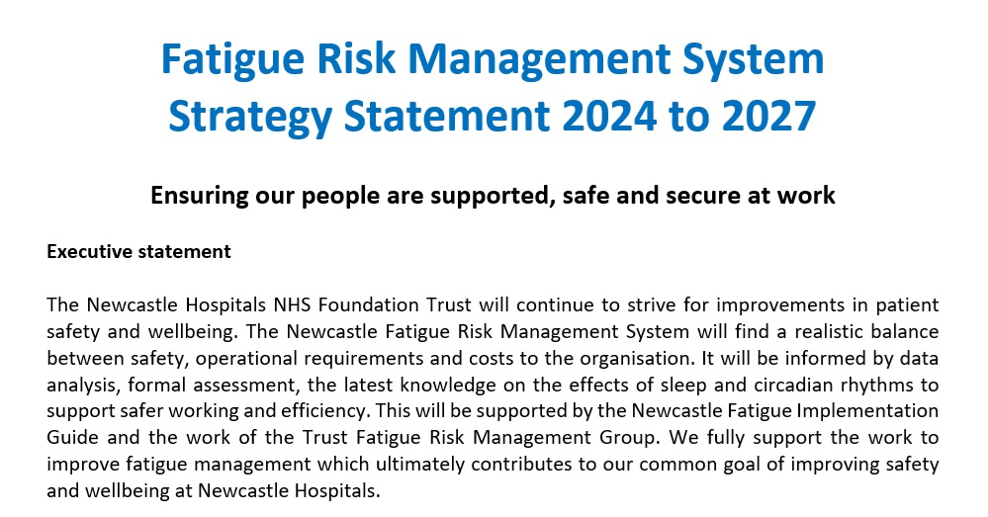
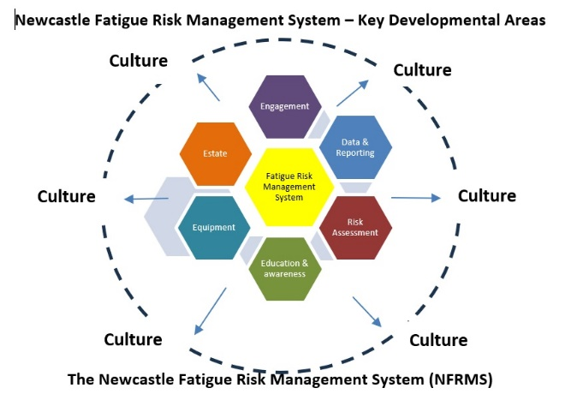
FATIGUE PROJECT
FRMS – New Castle upon Tyne, UK

Slide 16
Summary
The introduction of fatigue risk management systems will improve working conditions and enhance patient safety.
We would greatly appreciate broader collaboration within the UEMS to enhance the quality of care and promote best practices across Europe

Slide 17

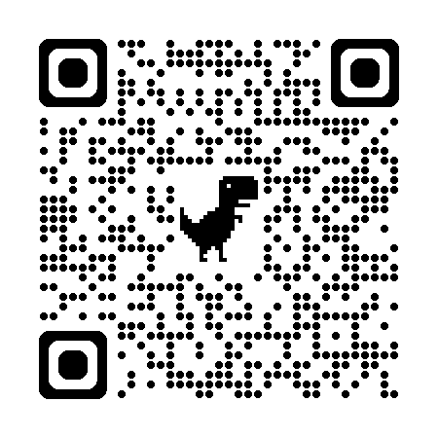
Thanks!
https://www.eba-uems.eu/

