Slide 1
UEMS and UFPMO
WE ARE GR ATEFUL FOR YOUR COOPER ATION AND SUPPOR T
Vice-President of the UFPMO
Prof. Mykola Prodanchuk

Slide 2
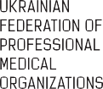
WE SUPPORT THE GOALS AND OBJECTIVES OF UEMS
2
The UEMS objective is to improve patient care throughout Europe by developing and supporting excellence in specialist medical practice.
UEMS activities and projects are concrete means to serve medical specialists in EU to aim at this objective. As example, we are deeply involved in serving and supporting the Continuing medical education (CME) and Continuing professional development (CPD) of medical doctors. CME serves to maintain, develop or increase the knowledge, skills and professional performance and relationships that a physician uses to provide services for patients, the public, or the profession.

Slide 3
JOINT POSITION OF UEMS AND UFPMO
3
We are JOINTLY concerned with the medical profession, the self-governance of healthcare professionals, and jointly implementing self-regulation of the economic activities of healthcare providers.
We are JOINTLY interested in continuously developing physician competencies to ensure the long-term sustainability of the public health system.
JOINT POSITION:
Specialised professional medical associations play a key role in setting professional standards that impact educational qualifications. They are also responsible for approving standard and personalized continuing professional development (CPD) pathways.

Slide 4
JOINT ACTIVITY
4
UEMS and UFPMO experts discussed the existing practices of professional self-government in Europe and their potential implementation in Ukraine.
Representatives of the UFPMO participate in such UEMS events as:
UEMS Advisory Board 20-21 October 2023
Chamber of Medical Specialists of Ukraine 19 September 2023
Currently, representatives of the UFPMO are participating in the
UEMS-UFPMO joint autumn meeting, which is taking place in Brussels.
After the joint meeting of the UFPMO Board with the UEMS legal expert, a summary of the draft Law on Medical Self-Government was created. This
summary aimed to integrate the Ukrainian medical self-government systems into the European UEMS system. Relevant proposals resulting from the meeting were sent to the Ministry of Health. These proposals were taken into account during the adoption of the draft law in the first reading.

Slide 5
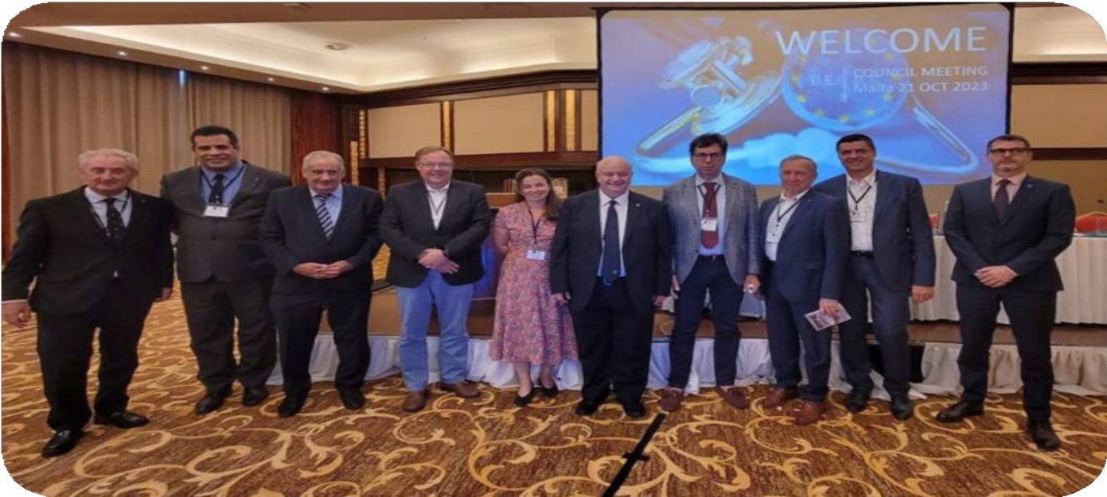
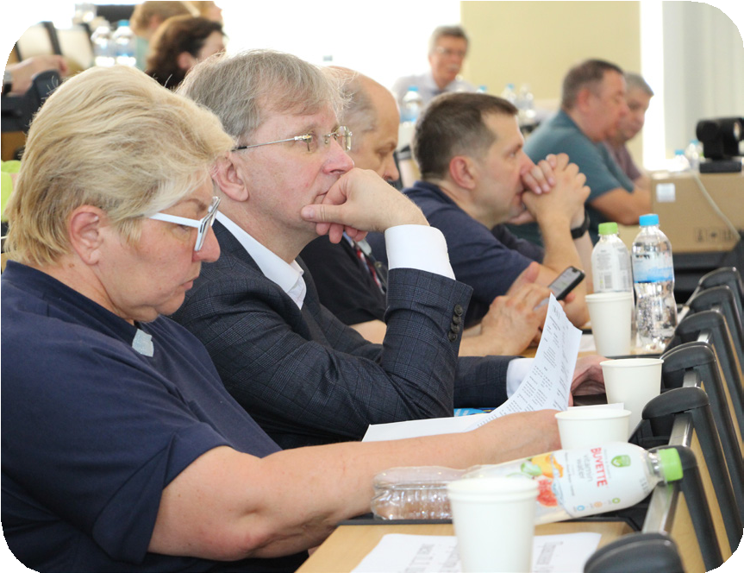
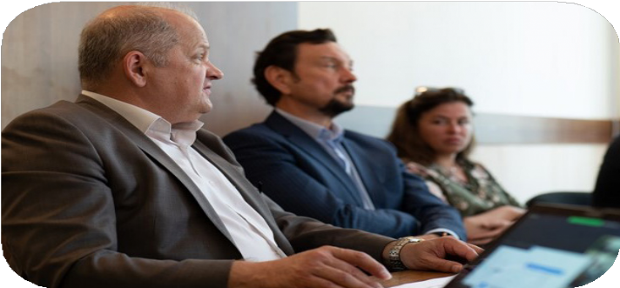
5
UEMS and UFPMO experts discussed the existing practices of professional self- government in Europe and their potential implementation in Ukraine.

Slide 6
INVOLVEMENT OF UEMS SPECIALISTS IN THE ACTIVITIES OF THE UFPMO
6
UEMS speakers and representatives take part in such events of the UFPMO as:
Work of the Chamber of Medical Spe- cialists of the UEMS
All-Ukrainian Forum ‘Per- sonnel Decide Everything’
(2 Forums, more than 1000 doctors)
Conferences dedicated to the implemen- tation of Euro- pean Training Requirements (ETR) for healthcare professionals in Ukraine
Sharing the results of the work of the Sectoral Council for the Devel- opment of Professional Standards in Healthcare

Slide 7
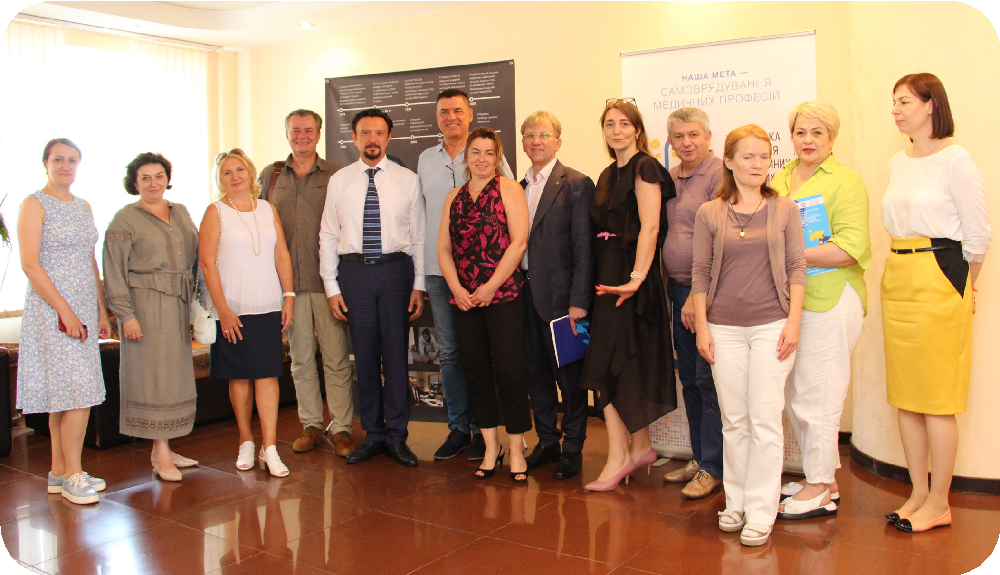
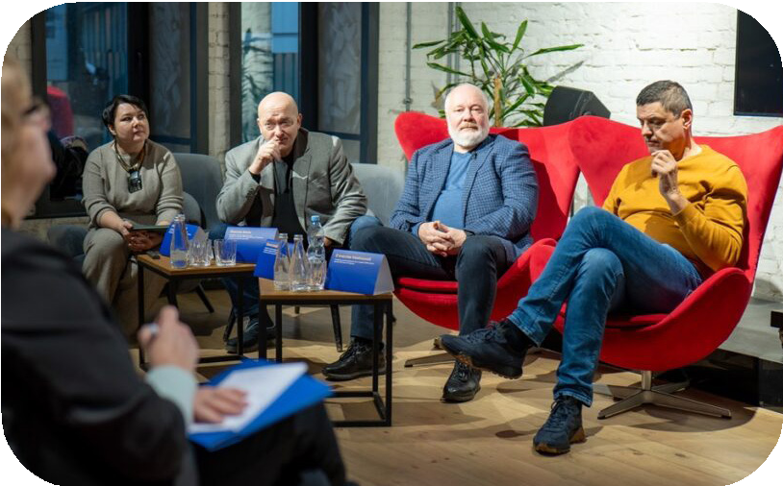
7
The creation of a modern system of Continuous Professional Development (CPD) of doctors and its integration in accordance with
European requirements is an important component of building a healthcare system in Ukraine

Slide 8
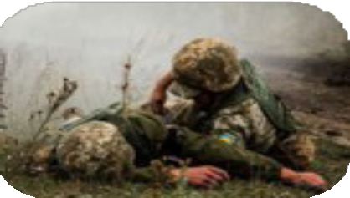
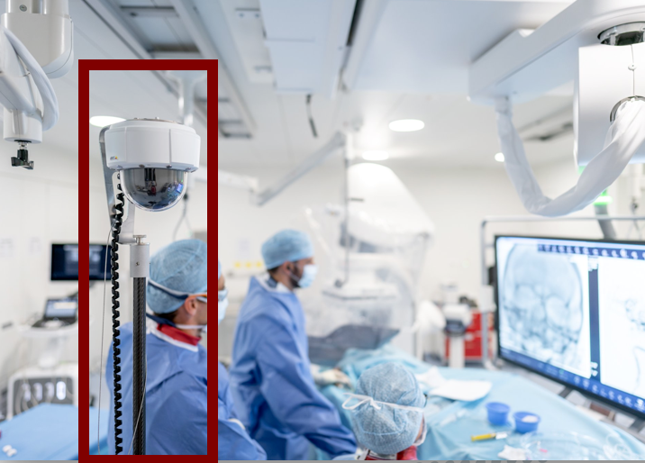
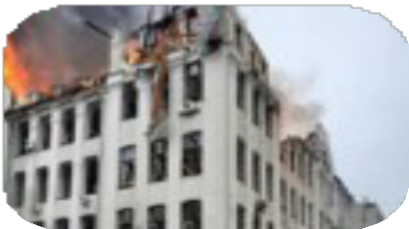
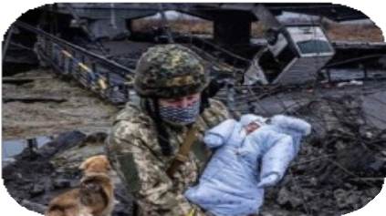
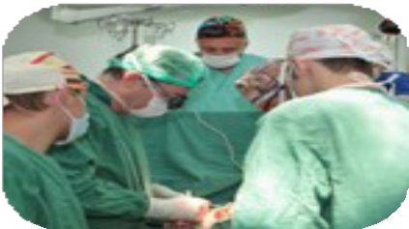
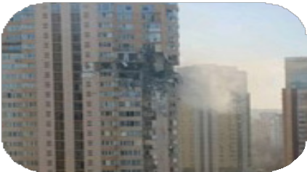
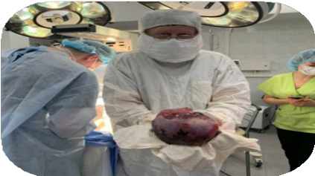
WE DO NOT ONLY CARE ABOUT SELF-GOVERNMENT WE ALSO JOINTLY DEFEND UKRAINE
8
DURING THE WAR, OUR MEDICAL SCIENTISTS AND DOCTORS SAVED THE LIVES OF SERVICEMEN AND CIVILIANS, OPERATING ON AND TREATING THE WOUNDED AND SICK

Slide 9
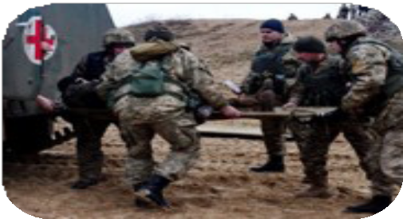
UKRAINE’S MILITARY MEDICAL DOCTRINE
9
The Military Medical Doctrine
defines the rules and principles for organising the activities of all military and civilian medical institutions in Ukraine during martial law, a state of emergency, and in times of peace. It aims to combine the efforts of military and civilian healthcare to create a single medical space.
During the 2014 — February 2024:
Up to
82%
of wounded
and sick sol- diers returned to service
80%
of the wound-
ed received proper care during the
«golden hour»
The mortality rate during the evacu- ation phase decreased to
1,35%

Slide 10
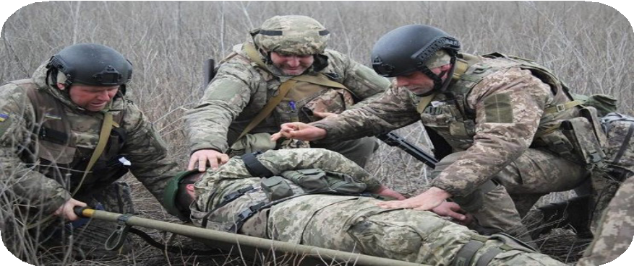
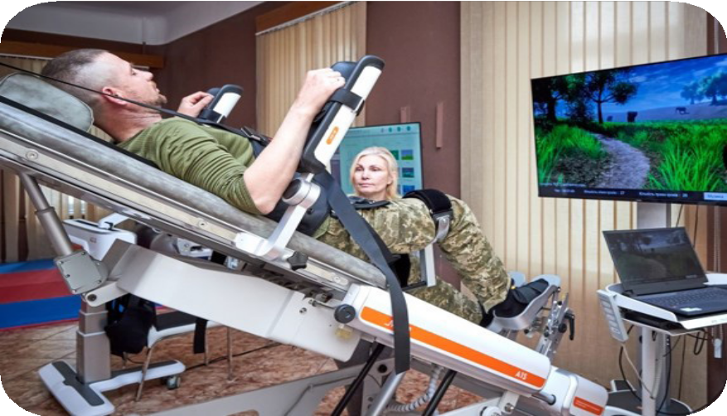
10
The establishment of a modern rehabilitation system for servicemen in Ukraine is crucial for providing medical care during armed conflict. This is a key principle of Ukraine’s military doctrine

Slide 11
UKRAINE’S MILITARY MEDICINE
9
I will describe one case that illustrates today's medicine and our army. Dmytro Dolgikh - a marine and a combat scout, was blown up by a mine during the Kharkiv offensive operation and lost his right leg. He was treated, rehabilitated and a prosthesis was installed. He insisted on returning to the front again in combat intelligence. During reconnaissance, he was wounded again in combat and again lost his right leg, or rather, a prosthesis. Our surgeons and traumatologists treated him and installed a new prosthesis. He returned to the front again. And again, he was blown up by a mine, was seriously injured and again lost his prosthesis. Our doctors treated him and installed a third prosthesis. Dmytro returned to his Marine brigade.

Slide 12
UKRAINE’S MILITARY MEDICINE
9
But, in addition to the combat mission, he decided to psychologically support his brothers, those who were injured and lost their limbs. And he did it originally - he set a Guinness national record by standing on one leg for 8 minutes and 9 seconds and holding kilogram dumbbells in his outstretched arms. This meant that even after a serious injury, one could be optimistic, be in line and support others.
This is the result of our doctors' professionalism and our soldiers' courage.

Slide 13
During the war, 100 military medics were killed. 60 medics are being held captive by the russians in violation of international conventions, laws and rules of war, as the medics are not combatants.
12

Slide 14
«YOU ARE ON THE SAME FRONTLINE AS OUR MILITARY»
12
President of Ukraine Volodymyr Zelenskyy

Slide 15
Thank you for your attention and support!
12

Slide 16
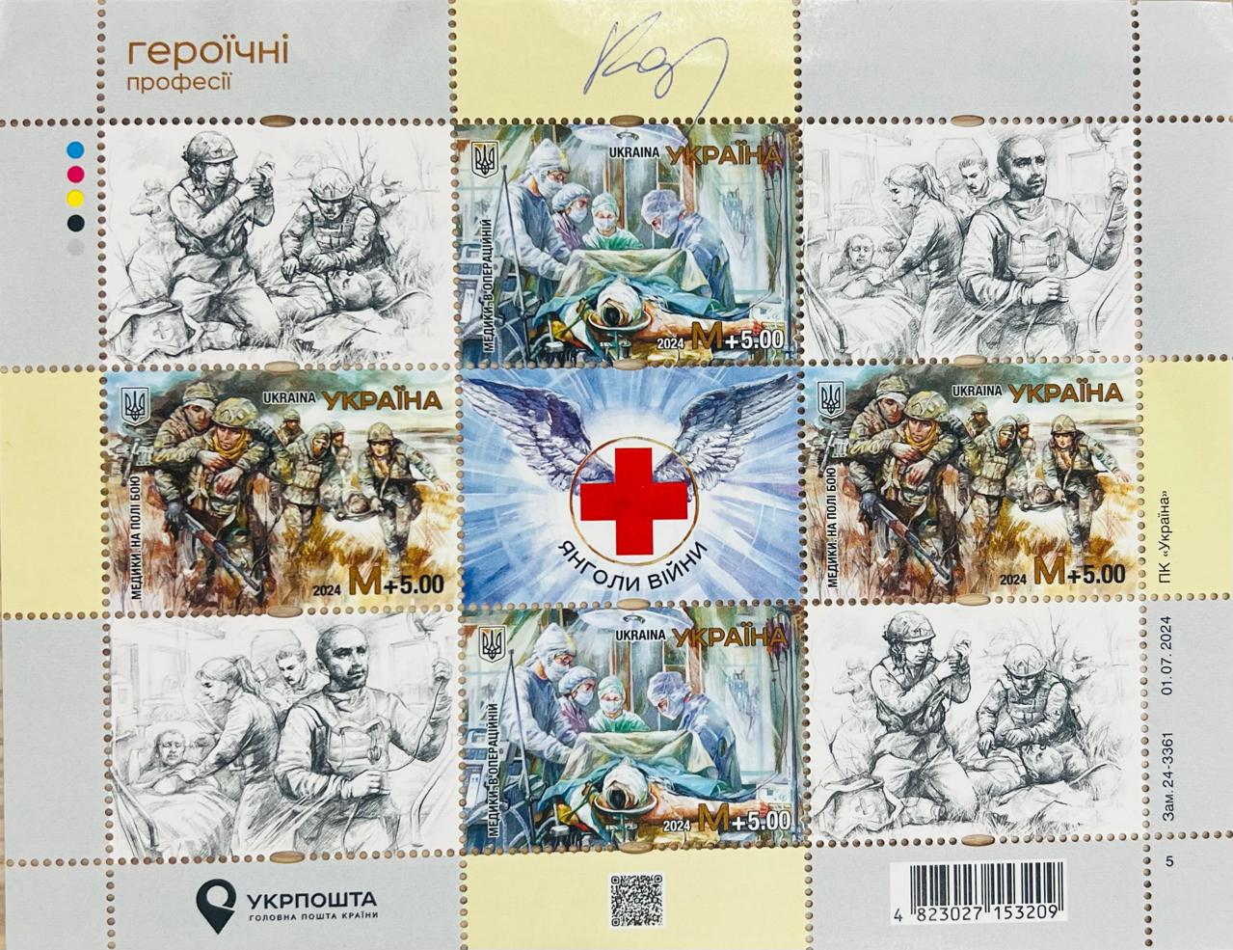
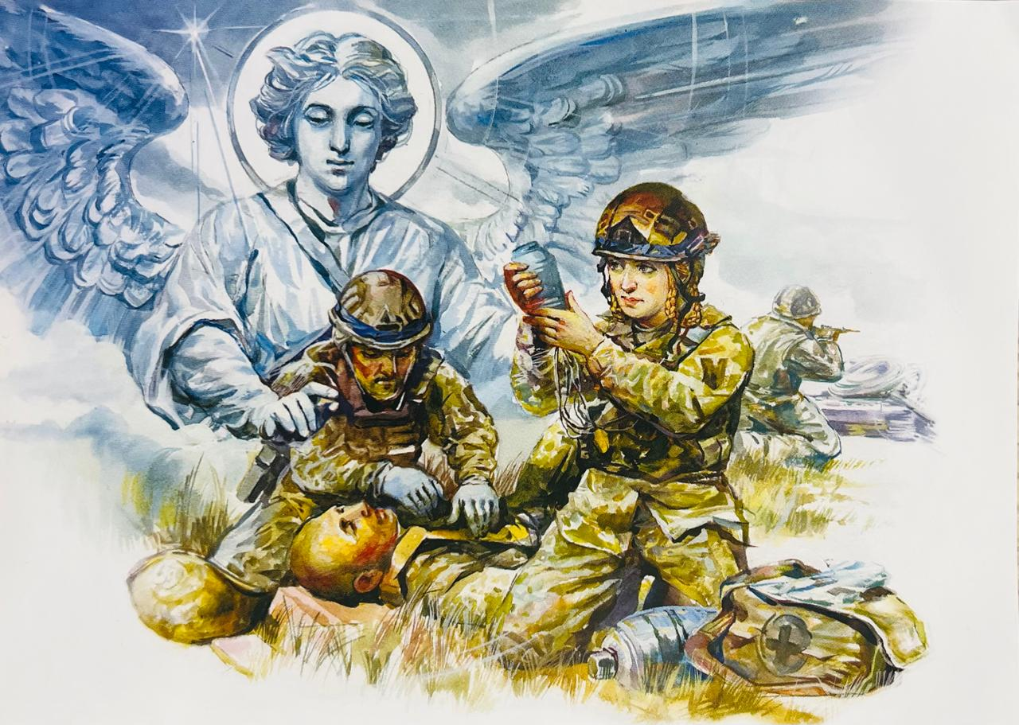
A block of postage stamps and a postcard "Angels of War", which is dedicated to military medics - members of our UFPMO and with the signature of the commander of the Medical Forces of the Armed Forces of Ukraine
A small gift for UEMS from UFPMO
12

