Slide 1
FEMS REPORT
João de Deus

Slide 2
FEMS NEW BOARD
PRESIDENT – Alessandra Spedicato
1ST VICE-PRESIDENT – Renata Čulinović-Čaić 2ND VICE-PRESIDENT- Alex Ramos
SECRETARY GENERAL - Noel Carrilho
DEPUTY SECRETARY GENERAL - Damjan Polh
TRESOURER - Patricio Trujillo

Slide 3
FEMS WHITE BOOK
João de Deus FEMS President

Slide 4
Chapter I Working Time + Annex I (Part Time Work)
Chapter II Psycho-Social Working Conditions
Chapter III Demography / Gender Imbalance Chapter IV Medical Careers Chapter V Healthcare – Finances + Annex II (Privatization of Hospitals) Chapter VI Salaries and other income
Chapter VII Doctors' Job Satisfaction
João de Deus FEMS President

Slide 5
Chapter I Working Time + Annex I (Part Time Work) Alessandra Spedicato ANAAO ASSOMED – ITALY

Slide 6
Key Takeaways
The preamble to the EWTD states that
“the improvement of workers’ safety and health at work is an objective that cannot depend on considerations of a purely economic nature”.
The directive contemplates:
A maximum average weekly working time that does not exceed 48 hours, including overtime.
Paid annual leave of at least 4 weeks.
A break if the daily working time exceeds 6 hours.
A minimum rest period of 11 consecutive hours in any 24-hour period.
A minimum uninterrupted rest period of 24 hours plus the 11 hours of daily rest mentioned above.
A maximum period of night work not exceeding 8 hours on average per 24-hour period.

Slide 7
Chapter II Psycho-Social Working Conditions José Santos CEOM PRESIDENT, PORTUGAL Jean Paul Zerbib FEMS TREASURER, FRANCE

Slide 8
Key Takeaways
The prevalence of burnout:
8% among doctors
50% of doctors had already got symptoms of burnout syndrome.

Slide 9
Chapter III Demography / Gender Imbalance Renata Čulinović-Čaić HLS, CROATIA Josip Večenaj HLS, CROATIA

Slide 10
Key Takeaways
Feminization of medicine is an undeniable fact .
Women are underrepresented in leadership and higher decision- making positions.
Gender inequality is still present among doctors.

Slide 11
Chapter IV Medical Careers Hermínia Teixeira, SIM Joana Sá, Noel Carrilho, FNAM Filipa Lança, Paulo Simões, José Santos, OM FEMS PORTUGUESE DELEGATES

Slide 12
Key Takeaways
There appears to exist a structured Medical Career throughout Europe, although there are some dissimilarities regarding its organization, definition and progression
Focus is needed to standardize medical careers and facilitate medical mobility

Slide 13
Chapter V Healthcare – Finances + Annex II (Privatization of Hospitals) Christiaan Keijzer FEMS 1ST VICE-PRESIDENT, NETHERLANDS

Slide 14
Key Takeaways
HEALTH EXPENDITURE IN RELATION TO GDP
Expenditure on average 9,2% of GDP (2022)
Highest spending country in Europe is Germany with 12.7%.
HEALTH EXPENDITURE PER CAPITA
Highest spending countries in Europe are Switzerland and Germany

Slide 15
Chapter VI Salaries and other income João de Deus FEMS PRESIDENT, PORTUGAL Eduardo Magalhães ECONOMIST, PORTUGAL

Slide 16
The remuneration of doctors plays a crucial role in the appeal of the medical profession, influencing career decisions and migration patterns among physicians
This analysis focuses on comparing the salaries of doctors across various European countries, providing a comprehensive look at the public sector compensation for doctors with different levels of experience

Slide 17
European Doctors Salaries Questionnaire
4 Categories:
Doctors in training
Specialists – 0-10 years
Specialists – 10-25 years
Specialists – more than 25 years
Average salaries:
-Gross
-Net
-Corrected by PPP

Slide 18
21 Answers from
Albania
Austria
Belgium
Bulgaria
Croatia
Cyprus
Czech Republic
France
Finland
Germany
Greece
• Italy
• Lithuania
• Netherlands
• Poland
• Portugal
• Romania
• Slovakia
• Slovenia
• Spain
• Sweden

Slide 19
Doctors in training

Slide 20
Specialists – 0 -10 years

Slide 21
Specialists – 10 - 25 years

Slide 22
Specialists – over 25 years

Slide 23
Key takeaways
Germany offers the highest gross salary for doctors in training, with strong net and PPP-adjusted salaries, indicating favourable living and working conditions.
The Netherlands offers the highest gross salary for young specialists, with competitive net and PPP-adjusted salaries.
Western European countries, particularly the Netherlands, Austria, and Germany, continue to offer the highest salaries for doctors with 10 to 25 years of experience. Belgium also offers a high gross salary, though significant deductions result in lower net salaries.
Western European countries like the Netherlands, Austria, Germany, and Belgium offer the highest gross and net salaries for senior doctors.
France stands out with the highest net and PPP-adjusted salaries, making it highly attractive despite not having the highest gross salary.
Countries like Bulgaria and Croatia, despite having lower nominal salaries, offer competitive PPP-adjusted salaries due to favourable cost-of-living adjustments.

Slide 24
Paying public healthcare systems for doctors in Europe (PPP adjusted salaries)

Slide 25
Key takeaways
Cost of living and tax systems significantly influence the effective salary, making PPP-adjusted salary a crucial metric for understanding the real value of income.
But…
Romenia 2000 euros (net) = Germany 4000 euros (net)
Congress – travel, hotel, registration – 1000 euros
50% of income 25% of income

Slide 26
Policy Implications
1. Stratification of Salaries Across Experience Levels
2. Regional Disparities in Compensation
3. Retention Challenges in Eastern Europe

Slide 27
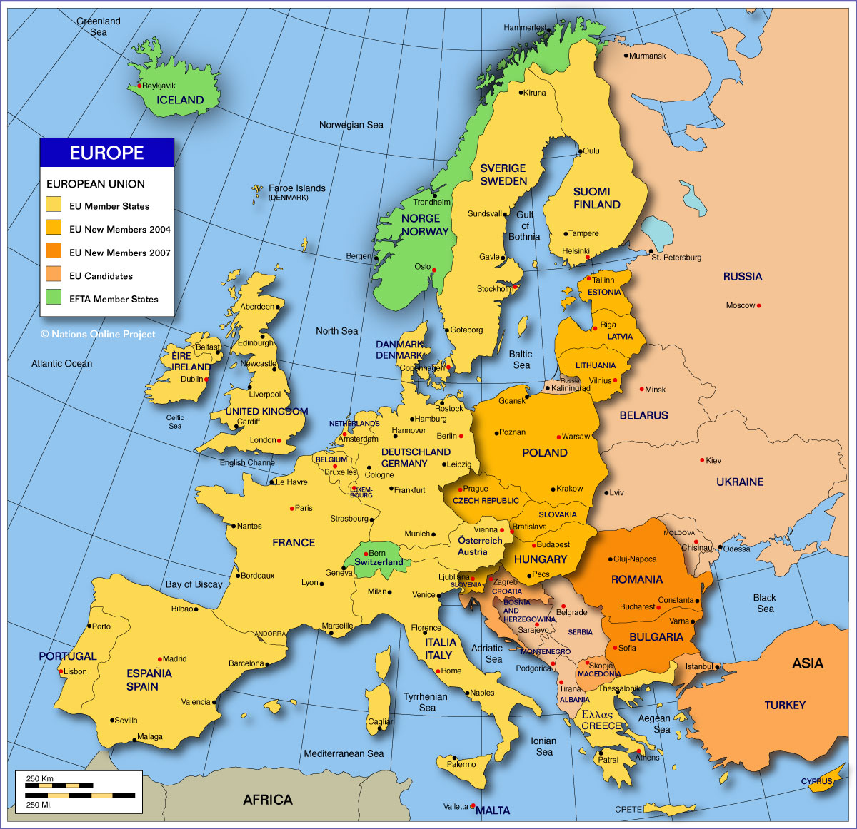

Slide 28
Chapter VII Doctors' Job Satisfaction Alessandra Spedicato ANAAO ASSOMED – ITALY

Slide 29
Key Takeaways
Financial satisfaction.
Professional satisfaction (i.e. recognition within the hospital of individual professionalism, how much the individual is allowed to develop and recognition of the social role of the profession).
Satisfaction with well-being in the workplace (i.e. work/life balance).
Satisfaction with access to career opportunities (i.e. job mobility, and therefore how easy it is to change jobs, to resign and switch from being a salaried doctor to private practice, or to change hospitals).

Slide 30
Download
https://www.fems.net/images/Fems_documents/Documents/2024/FEMS__Digital_1.pdf
News of FEMS Website:
www.fems.net

Slide 31
Thank you
João de Deus

