Slide 1

2005...Munich,
Germany...

Slide 2
“Don't be afraid to take a big step when one is indicated. You can't cross a chasm in two small steps.”
― David Lloyd George
“It's not doing what is right that's hard for a President. It's knowing what is right.”
― Lyndon Johnson

Slide 3

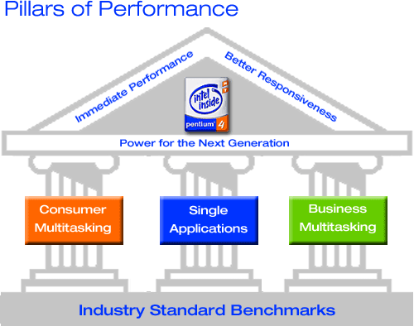
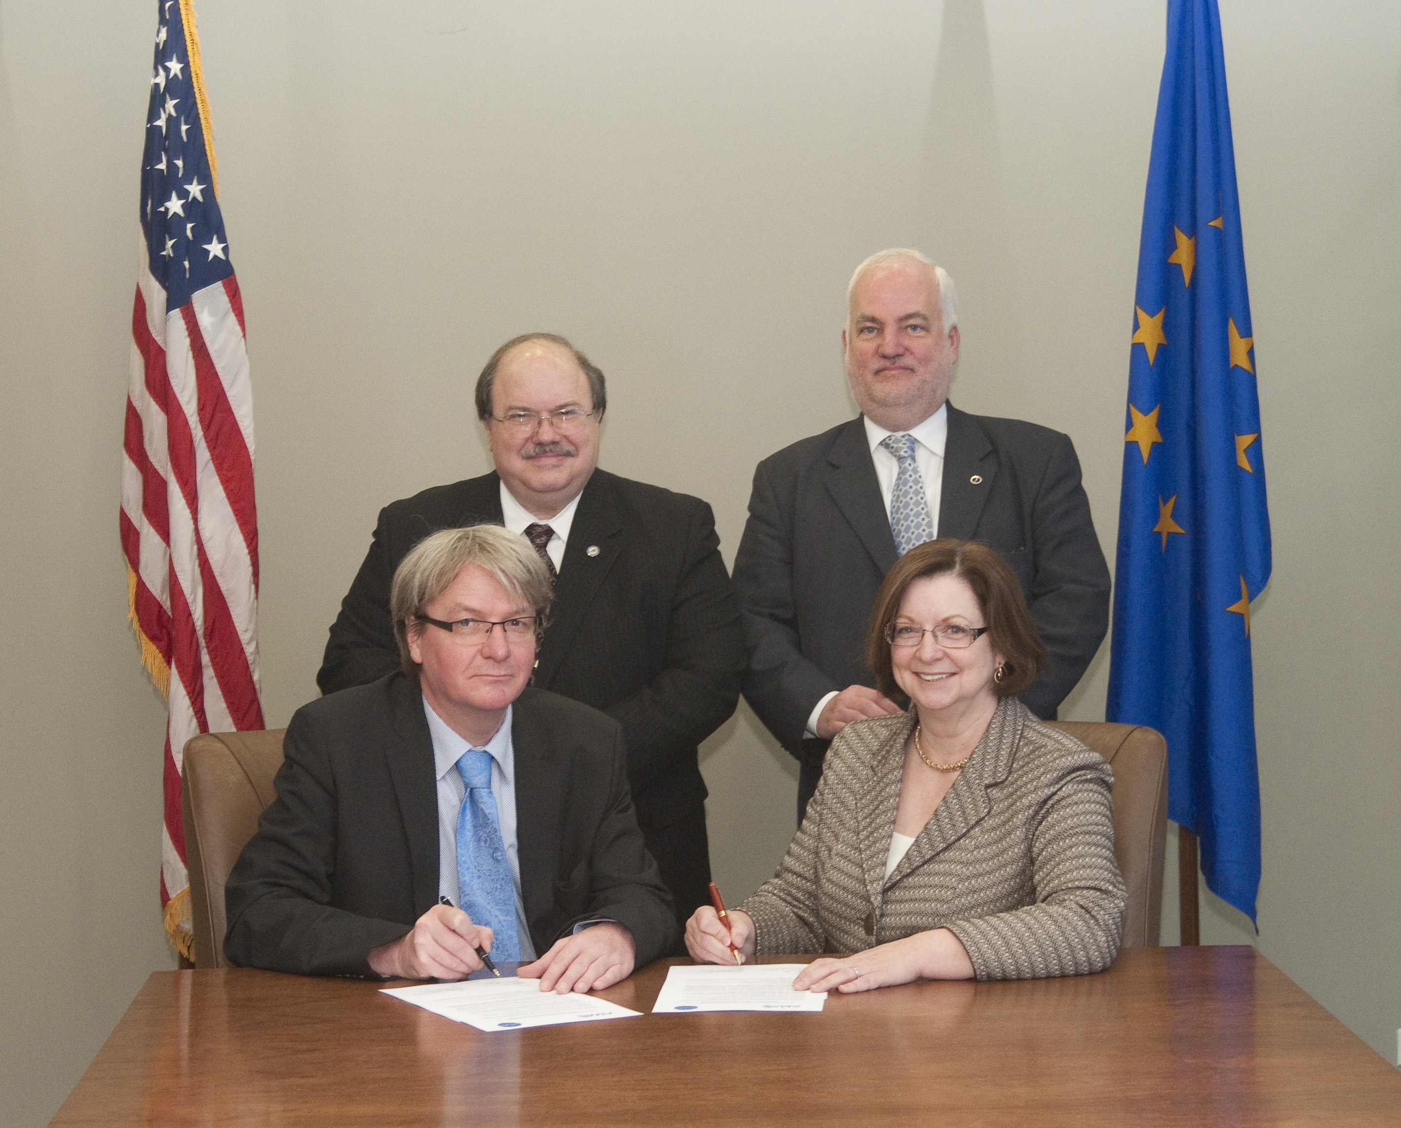

VISION
(UEMS STRATEGY 2008)
European Assessment & Certification
of medical competence (ECAMSQ™ / CESMA)
coordination
support
executive
Applicant
@
@
@
Knowledge Assessment
Practical Skills Assessment
Assessment of Professionalism
PGT
CME/CPD
QA
Formative process
MCQs on accredited:
-textbook chapters
-guidelines
-articles
-CME products
e-Logbook
e-Portfolio
DOPS (direct observation of practical skills)
CPD activities
360° Appraisal
constituent bodies, membership
Certification
(ECAMSQ® / CESMA)
Ref.: UEMS Strategy, 2008

Slide 4
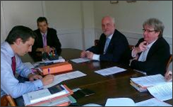
Legal ownership
Wednesday, June 29, 2011
The UEMS President, Dr. Zlatko Fras and
the Secretary-General, Dr. Bernard Maillet
....officially signed on behalf of the UEMS Council (& its Board)
the contract that finally made the house located at
24 Rue de l’ Industrie in Brussels the property of the UEMS...

Slide 5
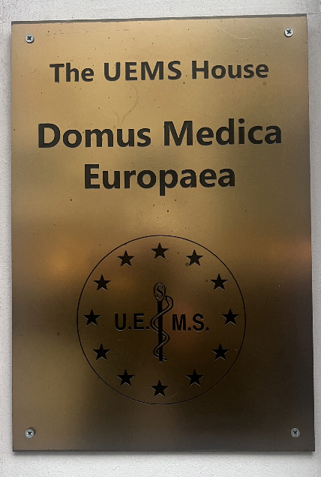
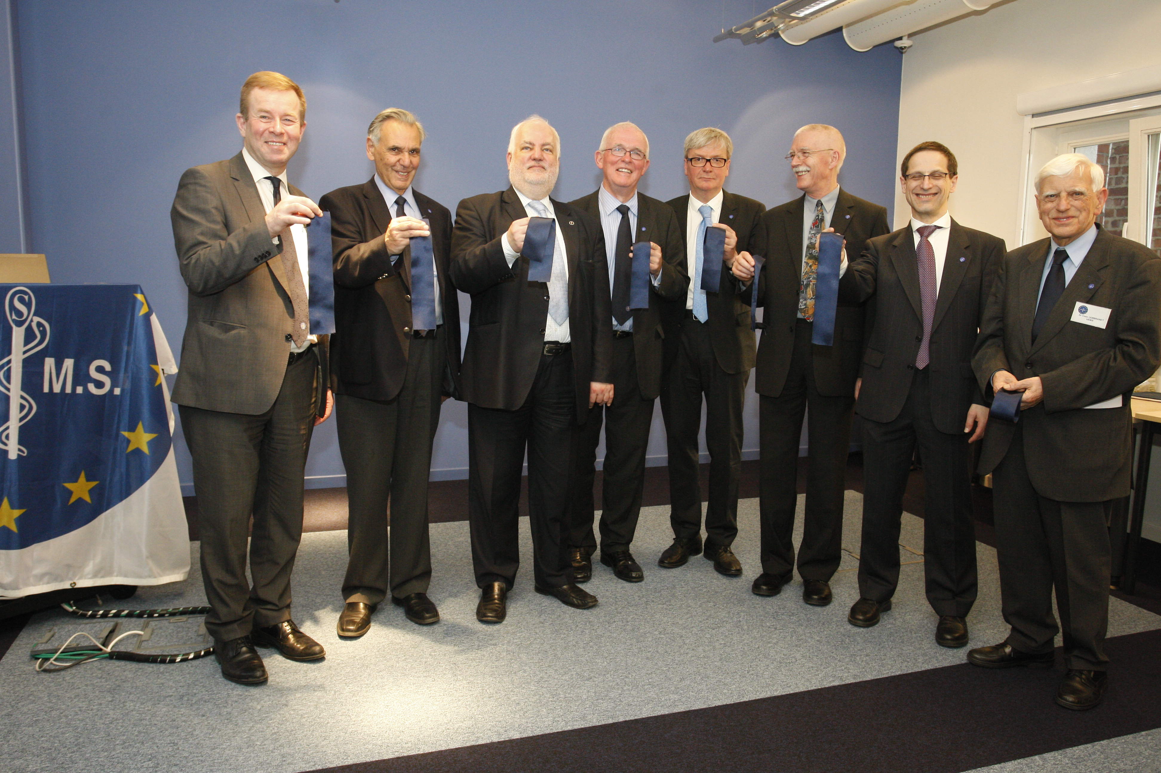

Slide 6
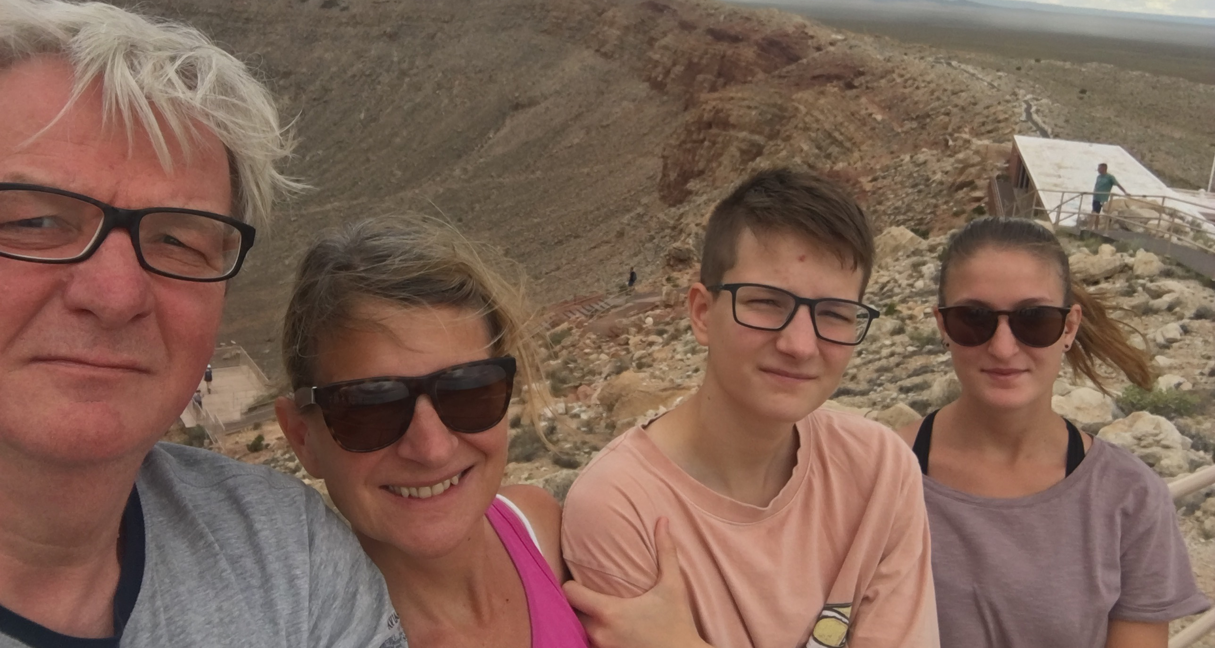
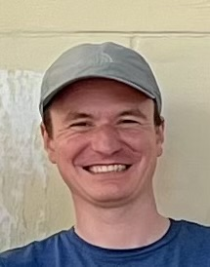
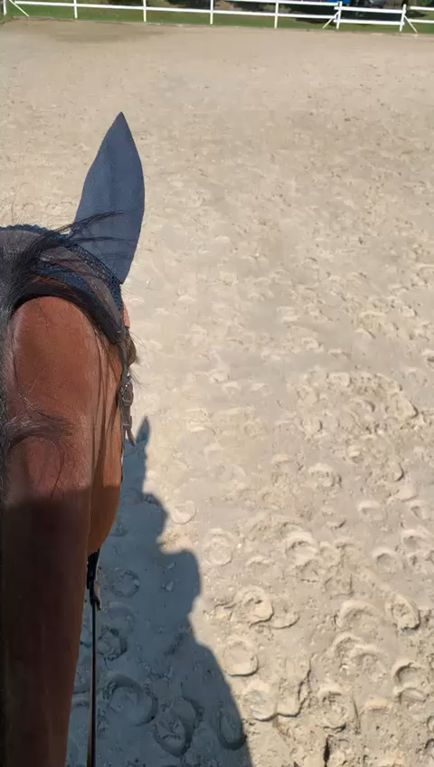
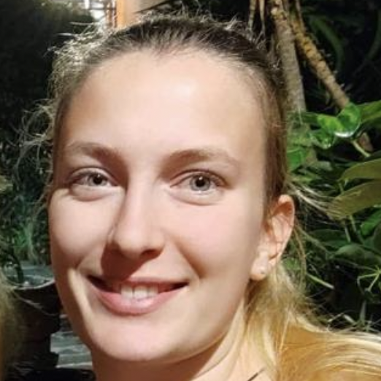
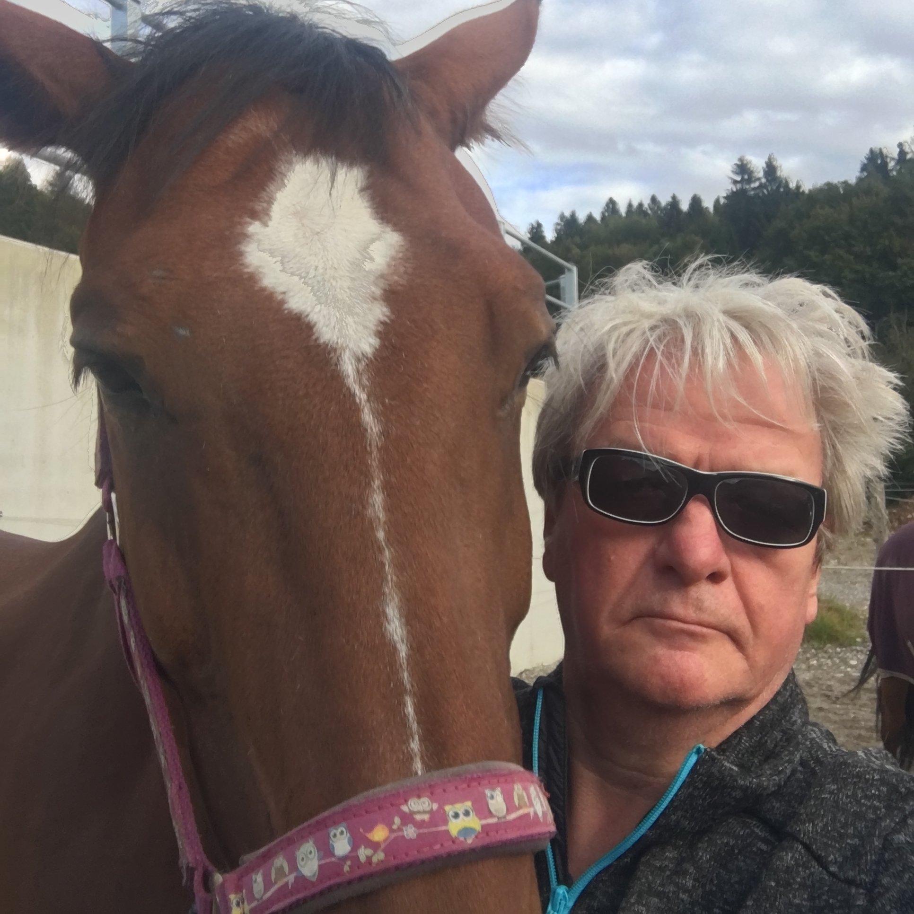
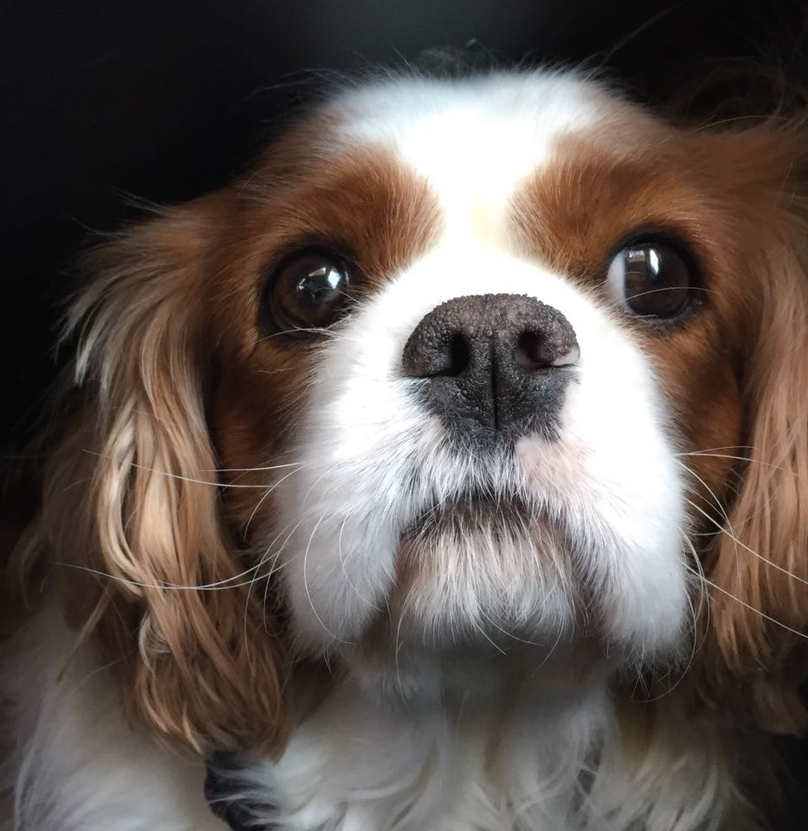

Slide 7
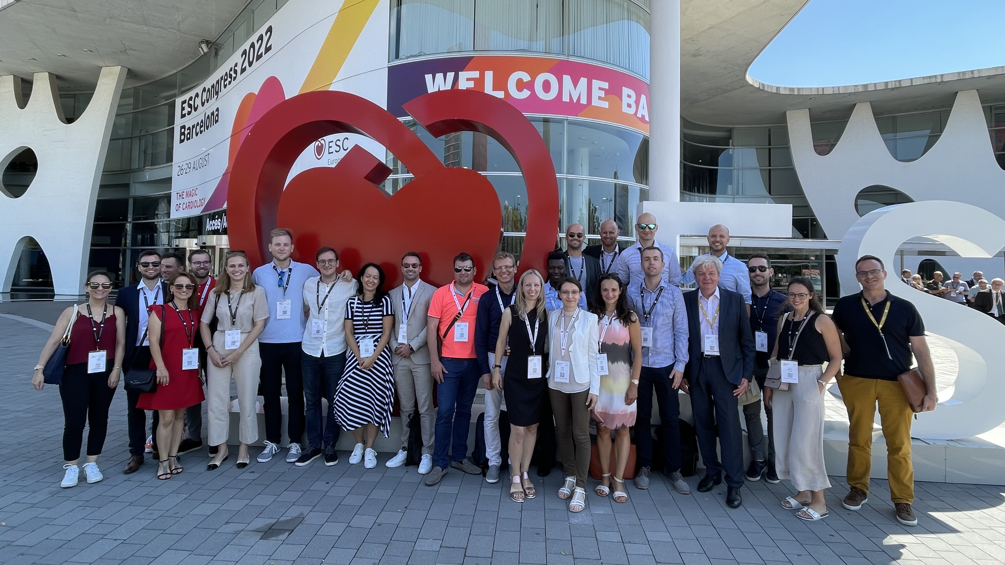
Empowerment...

Slide 8

...suggested reading:
"Everyone wants to do better.
Trust them.
Leaders are everywhere.
Find them.
People achieve good things,
big and small, every day.
Celebrate them.
Some people wish things were different.
Listen to them.
Everybody matters.
Show them."

