Slide 1

UEMS-UEMO Joint Council Meeting
18-19 October 2024, Brussels
UEMS AWARDS 2024
18 – 19 October 2024 • UEMS Awards

Slide 2

Laureates
We sincerely thank the UEMS National Medical Associations and UEMS Bodies for their invaluable recommendations and unwavering support in recognising the outstanding laureates of the UEMS Awards 2024.
Your collaboration continues to enhance the prestige of these awards and celebrates excellence on the European scene of specialist care.
UEMS Awards – 2024 Edition

Slide 3

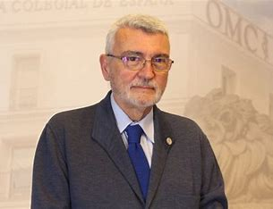
Dr Arcadi GUAL
UEMS Gold Badge of Honour
Director of SEAFORMEC (Sistema Español de Acreditación de la Formación Médica Continuada), which is the Spanish Accreditation System for Continuing Medical Education and playing a vital role in certifying the ongoing professional development of healthcare professionals, a key partner in the UEMS Accreditation Program.
Under the chairmanship of Dr Arcadi Gual, SEAFORMEC has been instrumental in the introduction, dissemination, and implementation of the European CME Credits (EMECs) system, both in Spain and throughout the Latin American region represented by CONFEMEL (Confederación Médica Latinoamericana y del Caribe).
Through this partnership, the UEMS EACCME and SEAFORMEC have helped standardize medical education, ensuring that professionals across these regions have access to high-quality, accredited learning opportunities. This effort has enhanced the global recognition of EMECs and fostered a greater integration of European and Latin American medical education standards.
UEMS Awards –2024 Edition

Slide 4
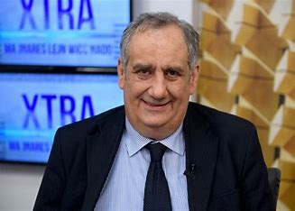
Dr Martin BALZAN
UEMS Gold Decoration of Honour
Key positions held within the UEMS: Past President of the UEMS Section of Pneumology, current Head of Delegation of the Medical Association of Malta to the UEMS.
Contributions:
Dr Balzan played a pivotal role in reversing the brain drain of Maltese doctors, who historically left the country in large numbers. He was instrumental in establishing legislation for recognizing medical specialists and creating a specialist accreditation committee, which helped retain skilled professionals and strengthened Malta's healthcare system.
Dr. Balzan’s contributions span beyond the national level, as he has been instrumental in advancing pulmonology in Europe. He negotiated UEMS approval of the pulmonology curriculum, establishing a European standard for specialist training. He also brokered two key agreements between UEMS and the European Respiratory Society, regulating CME accreditation and formalizing a European exam process, which significantly improved the quality and consistency of pulmonology training across the continent.
UEMS Awards –2024 Edition

Slide 5
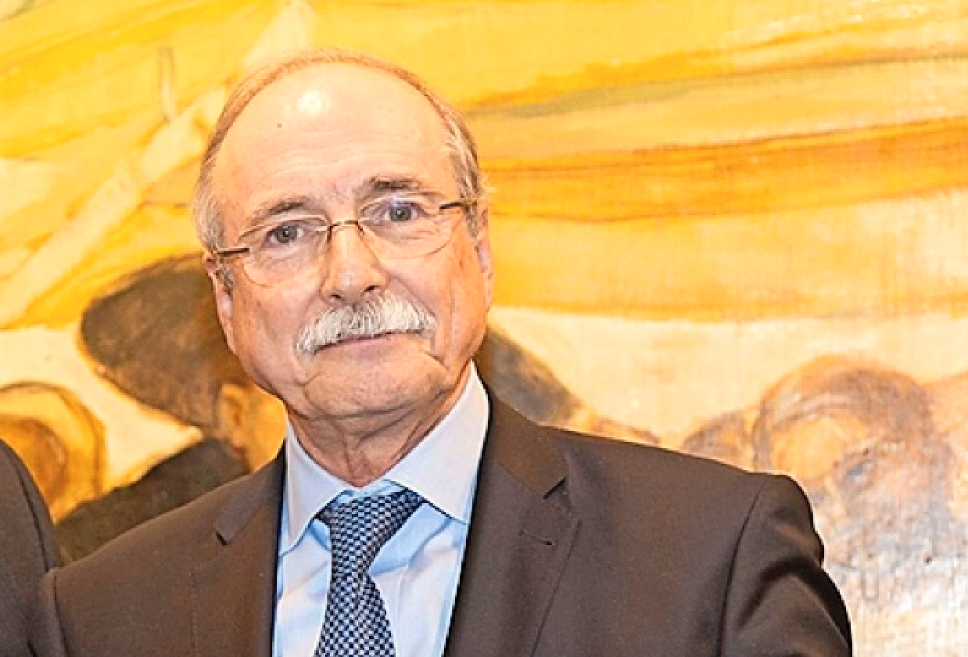
Prof. Daniel CASANOVA
UEMS Gold Decoration of Honour
Key positions held within the UEMS: Past President of the UEMS Transplantation Division; current President of the largest UEMS Section, Surgery.
Contributions:
Professor of Surgery, in Santander, Daniel Casanova’s has had an extensive and impactful career, contributing significantly to the advancement of surgical science and education in Europe and beyond. Under his leadership, the Surgery Section's Divisions have achieved an unprecedented success rate in the European Examinations.
His pioneering work on the SEVE project, alongside his involvement in the European Examinations in Surgery, has been pivotal in shaping the future of surgical education and setting rigorous standards across Europe. The SEVE project (Surgical Expertise Validity Experience), a collaborative initiative between the AEC and the UEMS Surgery Section, is dedicated to creating a comprehensive model and online platform designed to evaluate and track surgical complications across Europe. This innovative tool aims to improve patient outcomes by enhancing the evaluation of surgical expertise continent-wide.
With numerous peer-reviewed publications, his research has influenced a wide range of surgical disciplines, from innovative techniques to improved patient outcomes.
UEMS Awards –2024 Edition

Slide 6
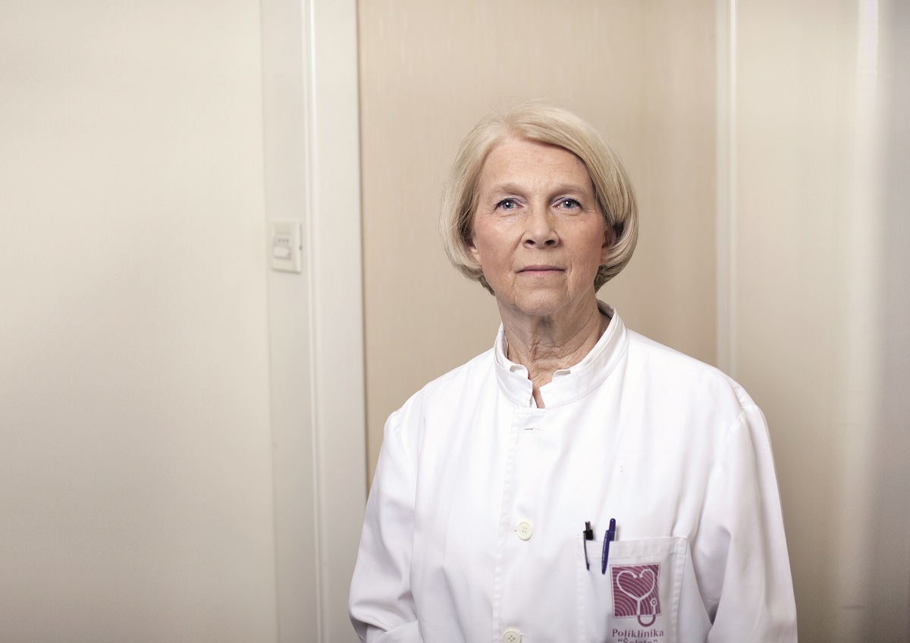
Prof. Nada Čikeš
UEMS Gold Decoration of Honour
Key positions held within the UEMS: Past President of the UEMS Rheumatology Section and European Board; UEMS Past Vice-President; UEMS representative in EULAR; Chair of the UEMS ETR Review Committee.
Contributions:
Prof. Emerita Čikeš, a distinguished Consultant in Clinical Immunology and Rheumatology in Croatia, has devoted her career to the advancement of medical education, particularly in aligning it with European standards. Her unwavering commitment to the harmonization of medical training across Europe has earned her recognition as a leader in her field.
Within the UEMS, Prof. Čikeš has played a pivotal role in the establishment of one of the organization’s flagship initiatives: the European Training Requirements (ETR). Her contributions have been instrumental in shaping the framework for this project, including the creation of the ETR Timeline, the ETR Guideline, and the ETR Preamble, which serve as foundational elements for harmonized postgraduate medical education across Europe.
Her work remains a driving force in shaping the future of medical training in Europe, enhancing both the quality and integration of healthcare systems throughout the continent. She also laid the foundation for the inaugural ETR Conference within UEMS, a significant milestone in advancing postgraduate medical education.
UEMS Awards –2024 Edition

Slide 7
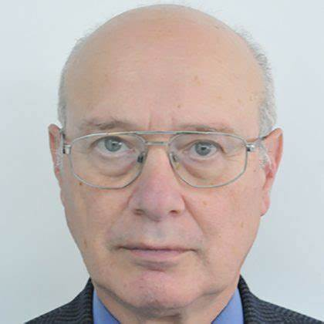
Mr Arthur FELICE
UEMS Gold Decoration of Honour
Key positions held within the UEMS: President of the European Board of Surgery; former Chairperson of the General Surgery Examination Board; President of the UEMS Division of General Surgery; Member of the UEMS ETR Review Committee; CESMA EBSQ Examinations Appraisal Officer since 2015.
Contributions:
Mr Arthur G. Felice (Malta) has been a dedicated contributor to the UEMS, particularly in the field of surgery. Since 2010, he has served as an Examiner for the UEMS EBSQ General Surgery Examination, and from 2014 to 2018, he chaired the Examination Board. In addition, he is a member of both the Bureau of the UEMS Surgery Section and Board, and the UEMS Division of General Surgery Bureau.
Dr Felice has also served as UEMS-CESMA Appraisal Officer for five distinct EBSQ Specialty Exit Examinations, playing a vital role in maintaining high standards for surgical training across Europe.
He is the lead author of the European Training Requirements (ETR) for General Surgery, co-authored with Dr Veronique Laloé.
Beyond his academic and professional achievements, Dr Felice has been actively engaged in various commissioned projects, addressing critical areas such as postgraduate training, managing waiting lists, forecasting medical student intake, conducting academic audits, implementing the Bologna Process, complying with the European Working Time Directive, and facilitating Memorandums of Understanding (MOUs) for bilateral agreements between countries and universities. His work has been instrumental in shaping the future of surgical education and healthcare policy across Europe.
UEMS Awards –2024 Edition

Slide 8
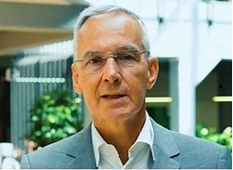
Prof. Rijk GANS
UEMS Gold Badge of Honour
Key positions held within the UEMS: Board member of the EEC (2017-2021); President EB Internal Medicine (2017- present); current Chair of the UMES Section of Internal Medicine; active member of the CESMA, active member of the ETR Review Committee.
Contributions:
Professor of Internal Medicine in The Netherlands, Rijk Gans played a vital role in medical education and healthcare, both nationally and internationally.
Has been a driving force behind competence-based medical education (CBME) in The Netherlands and has had a major influence on PGT in all medical specialties.
Prof. Gans has made significant contributions to the advancement and revision of the European Training Requirements for the specialty of Internal Medicine. He has also been instrumental in the development of European Examinations for Internal Medicine and the recognition of training institutions. His efforts have greatly facilitated the mobility and mutual recognition of specialists across the European Union, thereby strengthening the integration of Internal Medicine professionals within the EU.
UEMS Awards –2024 Edition

Slide 9
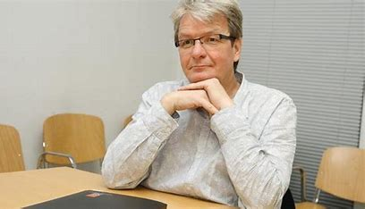
Prof. Zlatko FRAS
UEMS Honorary Membership
Key positions held within the UEMS: Zlatko Fras (Slovenia) has been UEMS President 2006-2011 and Chairman of the Postgraduate Training Working Group 2001-2006. He was also UEMS Liaison Officer 2012-2019. He continues as Past President in the UEMS Enlarged Executive Committee.
Contributions:
During his presidency, the newly established UEMS accreditation programme, EACCME, experienced steady growth and development. Zlatko Fras has played a pivotal role in shaping the Postgraduate Training (PGT) structures within UEMS, ensuring that these frameworks meet the evolving needs of medical professionals. His efforts have been crucial in assessing and enhancing the quality of postgraduate training, which has had a lasting impact on the education of specialists across Europe.
Moreover, Prof. Fras’s extensive professional network has significantly strengthened UEMS's connections with other European Medical Organizations (EMOs), fostering collaboration and knowledge exchange among various stakeholders in the medical field. His ability to build relationships has not only benefited UEMS but has also contributed to a more integrated approach to medical training and professional development in Europe.
UEMS Awards –2024 Edition

Slide 10
Our warm congratulations to all the laureates.
Thank you for your votes.

