Slide 1


ERN-RND and the
European Training Requirement for Rare Neurological Diseases
Holm Gressner & Béla Melegh
ERN RND/MJC RUD/EBRUD
UEMS Council Meeting 2024.10.18.-19., Brussels

Slide 2
1. The ETR for "Rare and Undiagnosed Diseases", which consist of the next files:
Training Requirements for the Specialty of Rare and Undiagnosed Diseases (15 pages, number: UEMS 2020/12)
Description of “Rare and Undiagnosed Diseases” as a Medical Competency in EU: Aims and objectives for competency training (6 pages, number : UEMS 2020/12)
Syllabus for residents and trainees in Rare and Undiagnosed Diseases (13 pages, number: UEMS 2020/12)
2. The European training requirements for the specialty of "Rare Adult Solid Cancers", which consist of the next files:
Training Requirements for the Specialty of Rare Adult Solid Cancers (17 pages, number: UEMS 2020/11)
Description of “Rare adult solid cancers” as a Medical Competency in EU: Aims and objectives for competency training (10 pages, number: UEMS 2020/11)
Syllabus for residents and trainees in Rare Adult Solid Cancers 513 pages, number: UEMS 2020/11)
3. European training requirement for "Neuroendocrine Neoplasia Medicine", which is a collaborative effort of the MJC RUD and the European Neuroendocrine Tumor Society (ENETS). (18 pages, number: UEMS 2020/09)

Slide 3
European Reference Networks
    Since 2017
    28 EU countries + Norway
    > 350 European hospitals
    > 1.600 clinical units
    Focus on equity and improvement of care

Slide 4
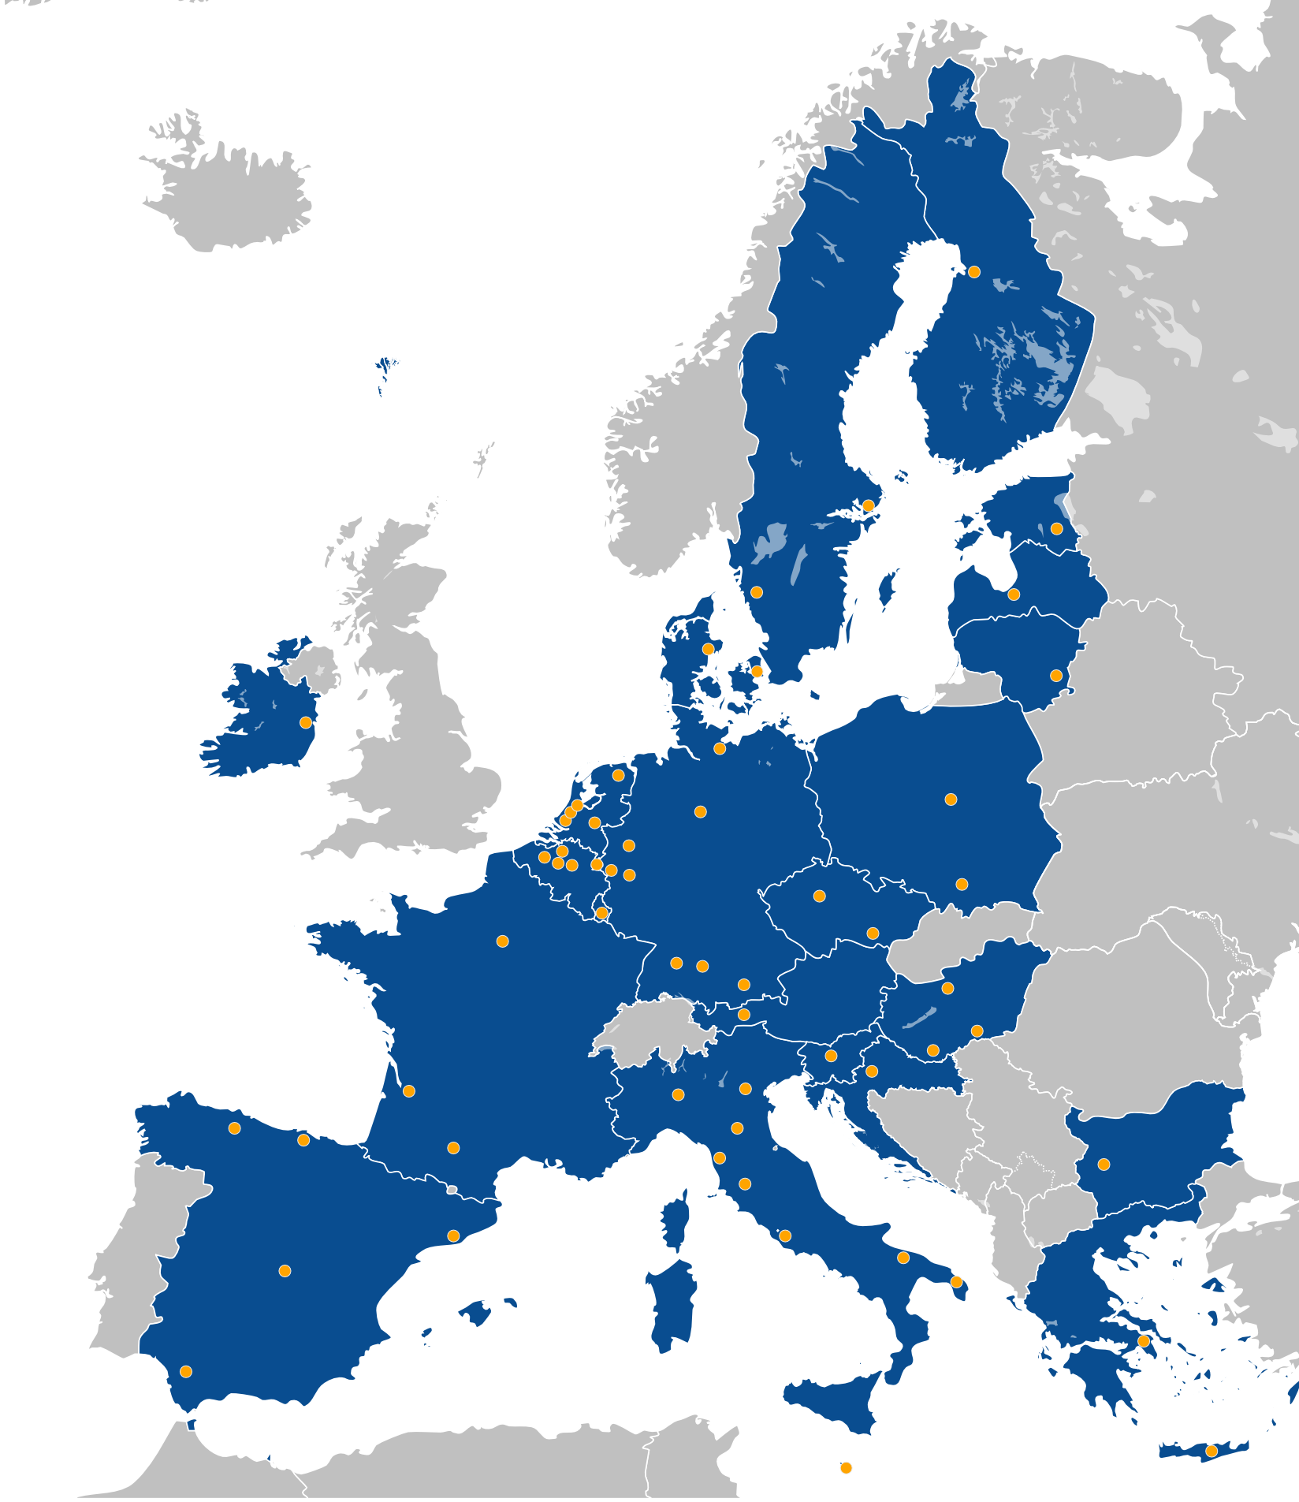
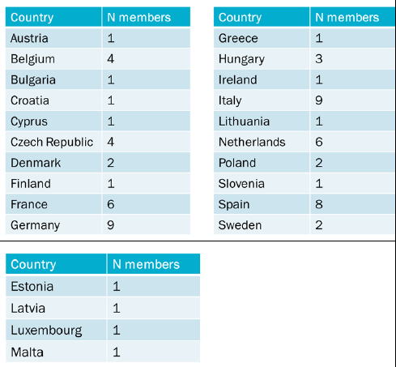
ERN-RND –
European Reference Network for rare neurological diseases
    68 expert centres in 24 EU countries (medium large ERN)
    > 35.000 patients per year (adults and paediatric)

Slide 5
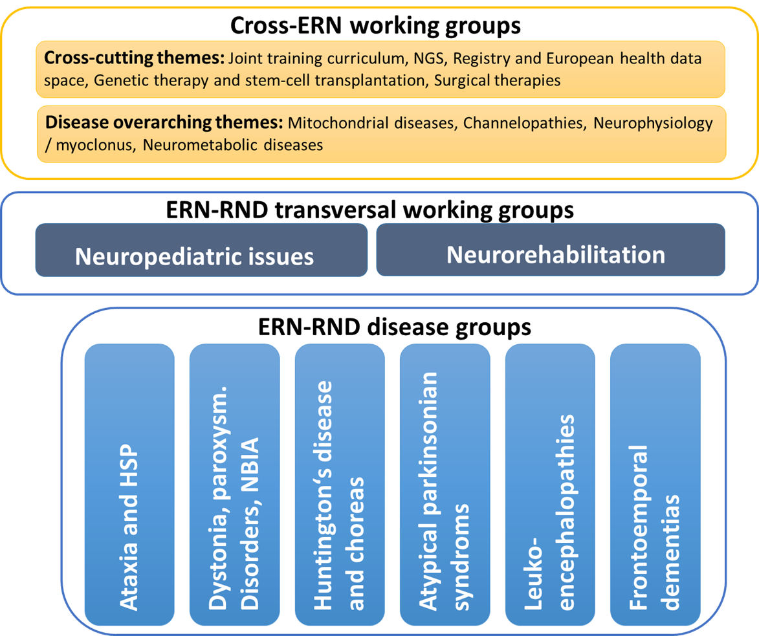
Governance
ERN-RND Board
ERN-RND ePAG
ERN-RND Management Team
ERN-RND Advisory Board
ERN-RND Coordination Office
Disease Expert Groups and Working Groups
Cross-ERN working groups

Slide 6
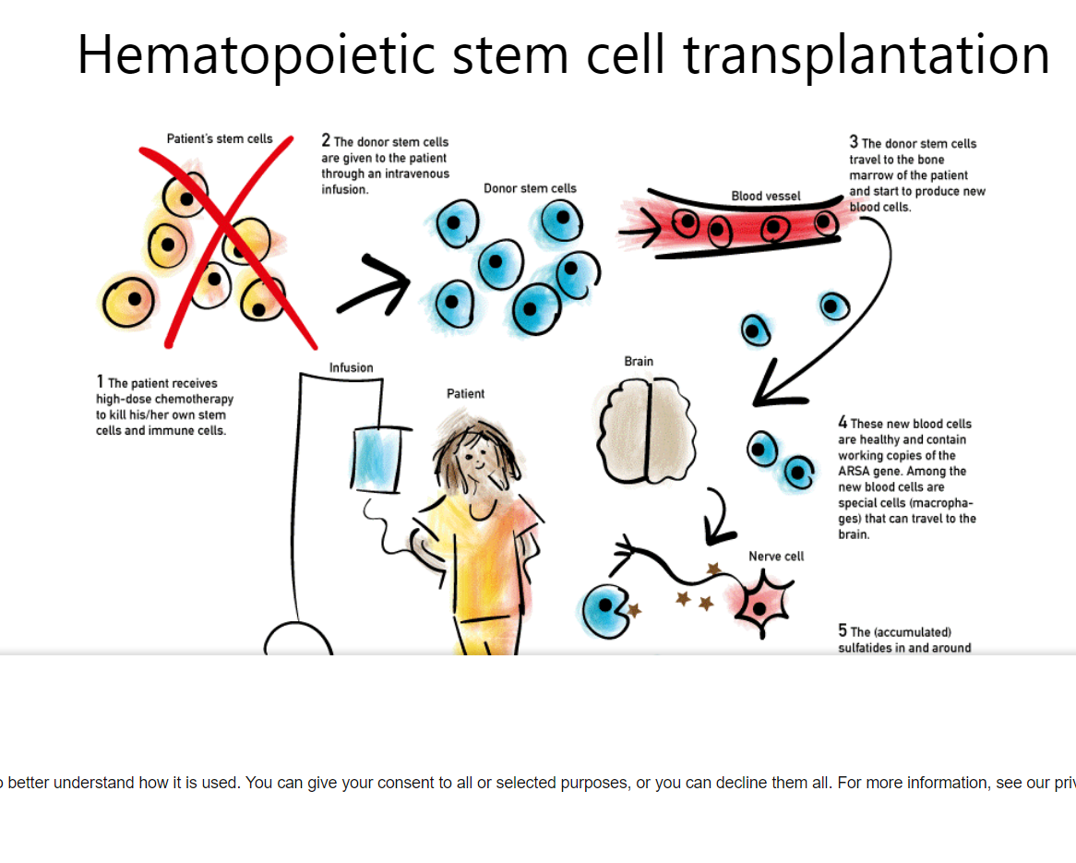
ERN-RND –
European Reference Network for rare neurological diseases
    Focus on highly specialised healthcare services
    Next Generation Sequencing
    Neuroimaging
    Botulinum toxin treatment
    Deep brain stimulation
    Stem Cell transplantation
    Neurorehabilitation
    Genetic therapies
    Etc.
        Features
        Top-class medicine
        Expertise and experts are scarce
        Strategies for expertise building and sharing are needed
        Economy of scale effects to be achieved on EU level

Slide 7
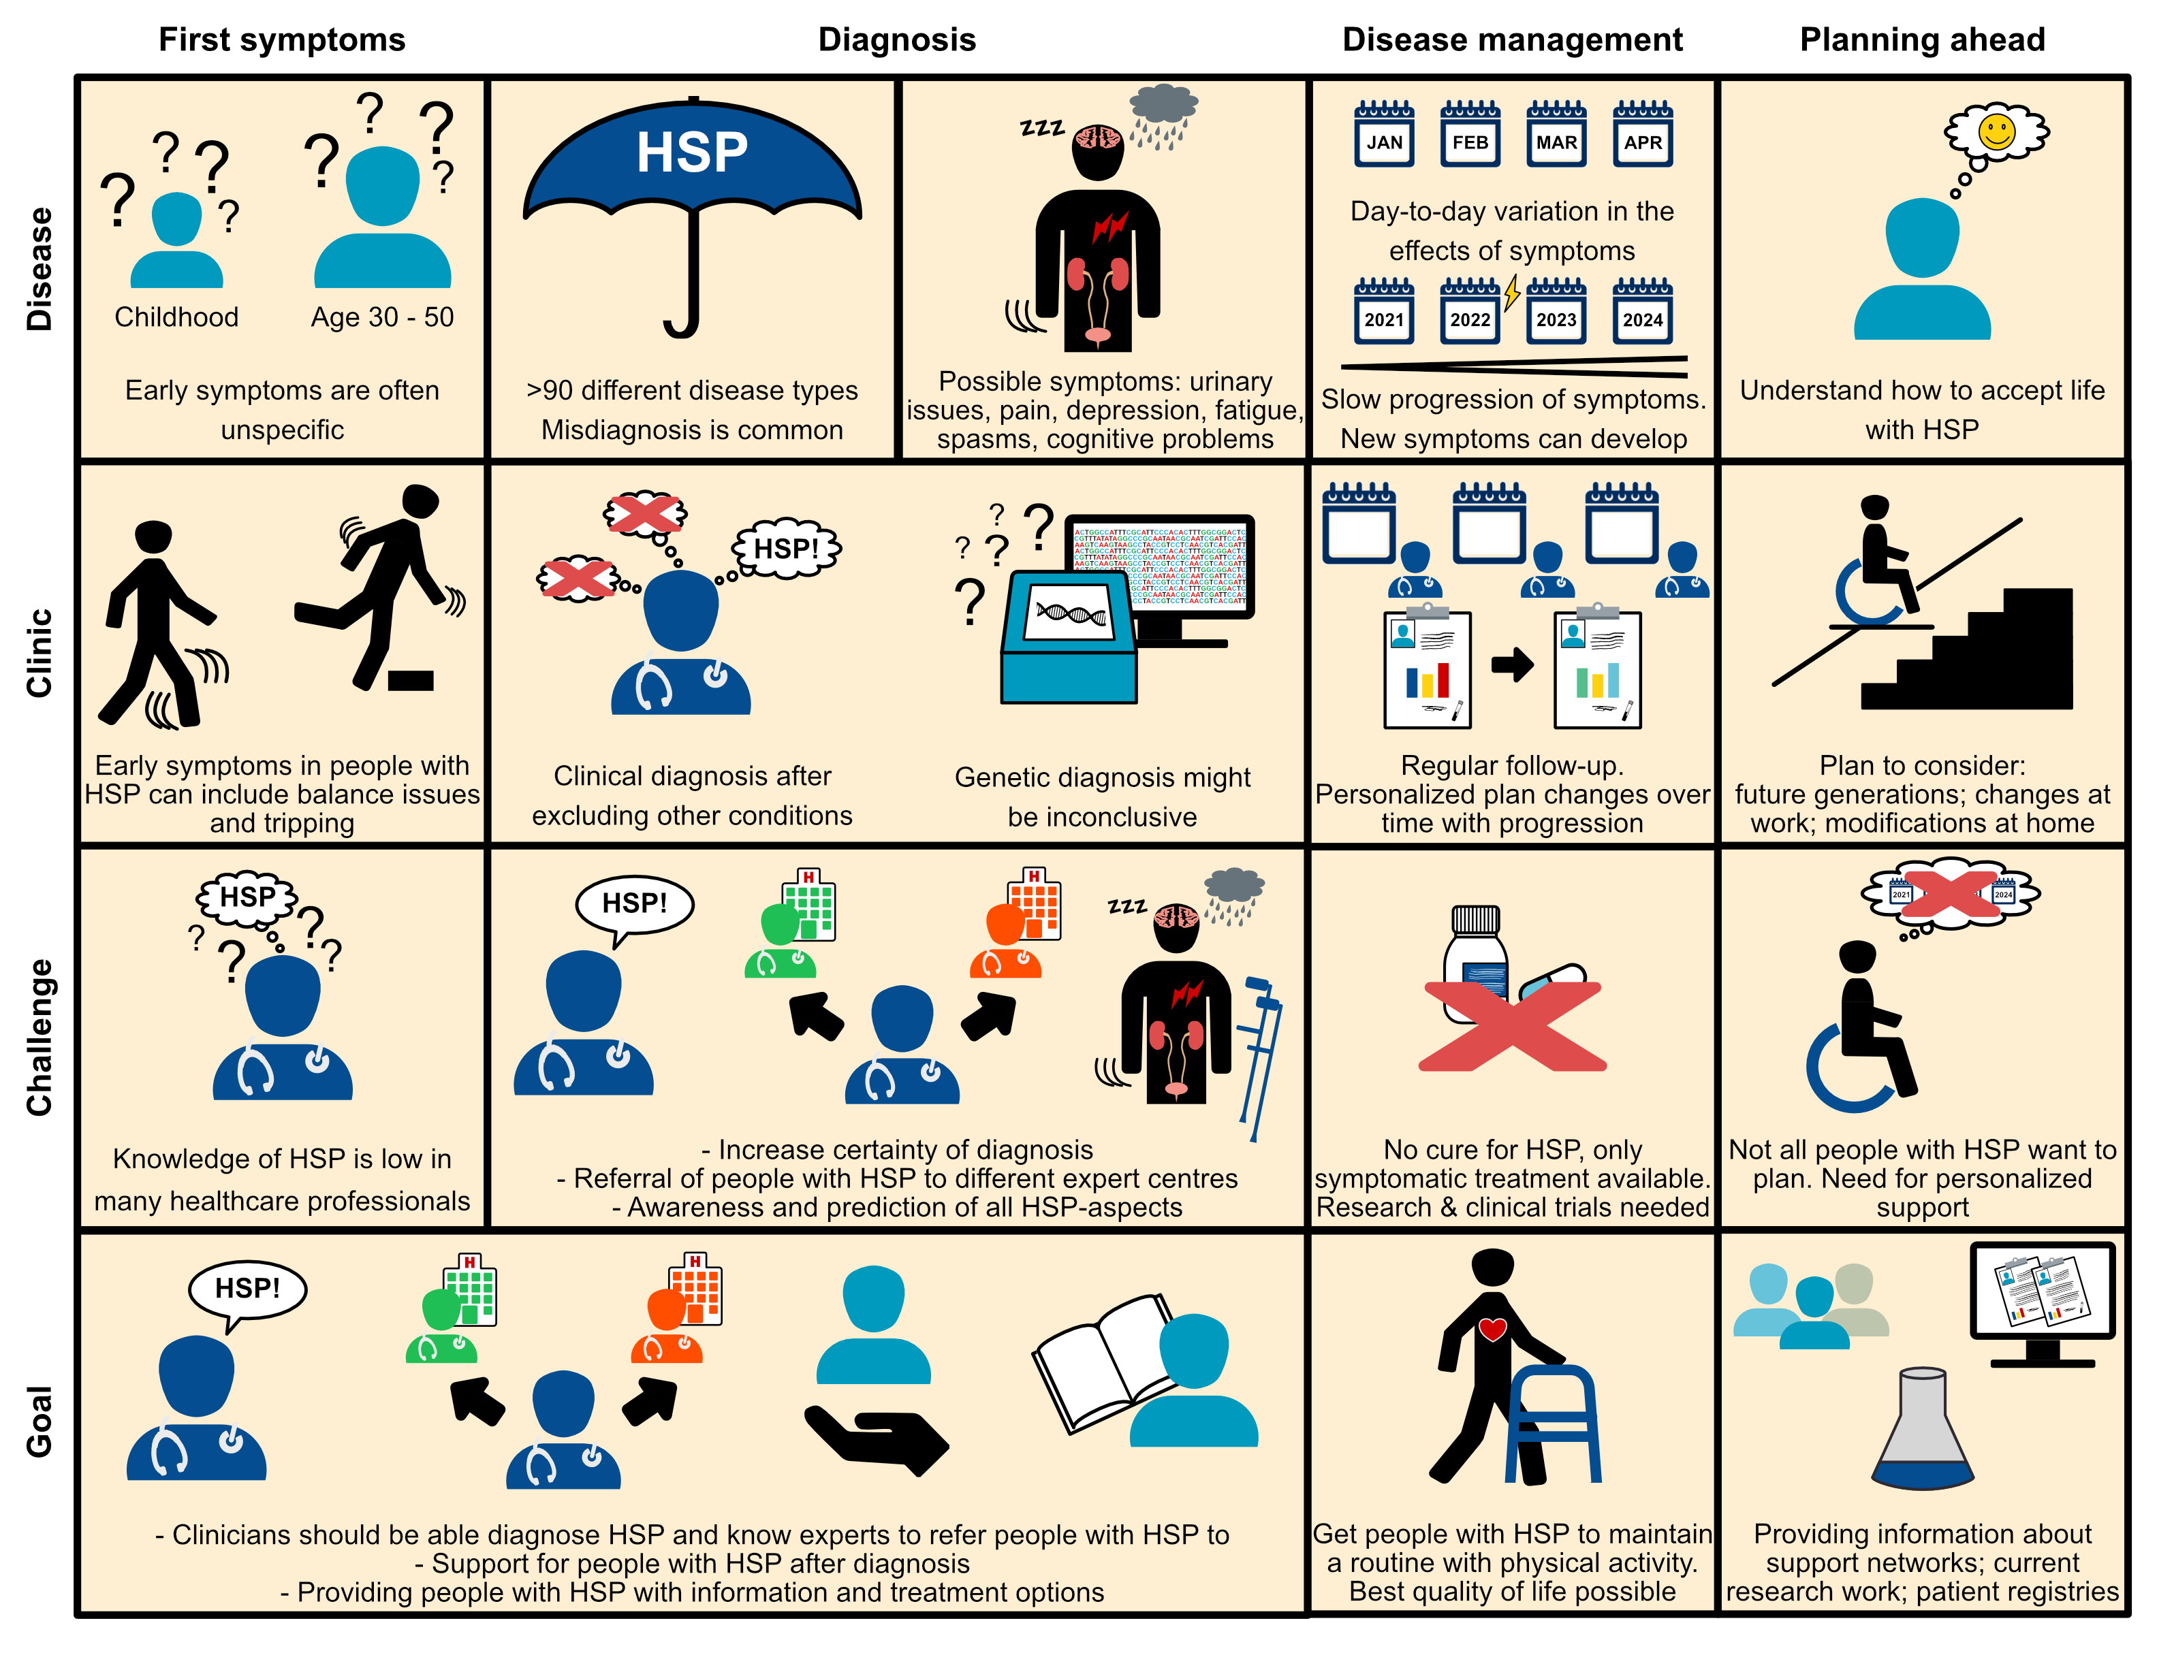
Core activities of ERN-RND
  Crossborder e-healthcare
  Training and education of health professionals
  Patient information
  ERN-RND registry
  Guidelines and Clinical Decision Support Tools
Example: Patient Journey for Hereditary Spastic Paraplegia

Slide 8


ERN-RND Activities – example DBS in Dystonia
Standard pathway for harmonizing & optimizing DBS management decisions in Dystonia patients.
Cross-border healthcare
Online multidisciplinary Board for DBS in Dystonia
Harmonizing care
Consensus on best practice and minimum requirements (standard operating procedure)
Online Learning
Expert webinars and post-graduate curriculum
F2F Exchange
Symposium in Würzburg, Germany
2025
Hands-on training
Exchanges to DBS expert centers
Notes:
HOLM nochmal prüfen - Begriffe

Slide 9
Core Activity – Training and Education

Slide 10




Training and Education: Postgraduate Curriculum
Development of a postgraduate curriculum
in rare neurological diseases
 | reviewed | input patient represen-tatives | consensus process | final document approved
BoK Ataxia and HSP
BoK Chorea and HD
BoK Dystonia, NBIA, paroxysmal disorders
BoK Leukodystrophies
BoK FTD
BoK Atypical Parkinsonism
Competencies/ Learning Objectives → BODY OF KNOWLEDGE (BoK)
TRAINING CONTENTS
Webinars & Spring/Winter School: convey knowledge
Educational cases (eLearning): apply knowledge
Stays at expert centres: consolidate practical knowledge
Status
Start
End
Define competencies
Define learning objectives to attain the competencies
Map existing educational materials covering those learning objectives
Use suitable formats for knowledge transmission (webinars, educational cases, readings, stays at expertise centers)
Create the materials with the defined formats
Competency-based, modular educational curriculum for RND

Slide 11
Training and Education: Postgraduate Curriculum
TRAINING CONTENTS
Webinars & Spring/Winter School : convey knowledge
  -> number of expert webinars: > 100
  -> Annual Spring/Winter School : 2024 – „Challenges in treating RND“; 2023 -„DBS in Dystonia”; 2022 – “Neuroimaging in RND”; 2021 – “Neurorehabilitation in RND” ; etc.
Educational cases (eLearning): apply knowledge
  -> under progress: case content definition according BoK; developmentof the first eLearning case using the eLearning Software Casus (Instruct gGmbH)
Stays at expert centres:
consolidate practical knowledge
  -> Short Exchange Program started in
  September 2021;
  number of scheduled for 2014/2025
  short time exchanges: 3
 | project | home institution | host institution | duration
1 | Hereditary Ataxias | AOU di Pisana (University Hospital of Pisa), Italy | Vall d’Hebron University Hospital, Barcelona, Spain | 2 weeks (10 working days)
2 | SCA29 and Gillespie Syndromie; collaboration on clinical characterization of ITPR1-related ataxic patients and cerebellar organoids | Bambino Gesù Children’s Hospital, Rome, Italy | University Hospital of Oulu, Finland | 1 week (5 working days)
3 | Clinical examination and MRI volumentry in SCA patients | Motol University Hospital Prague, Czech Republic | University Hospital Bonn, Germany | 2 weeks (10 working days)

Slide 12
European Training Requirement for Rare Neurological Diseases

Slide 13
UEMS - European Training Requirement for RND
On 15 September a draft European Training Requirement (ETR) for RND was submitted to UEMS
This ETR is very much based on the Body of Knowledge (BoK) as developed in ERN-RND
This document has been reviewed and amended according to UEMS procedures and concepts
ETR is a living document → will be supplemented according to availability of updated/new BoK

Slide 14
UEMS European Training Requirement for RND – Content
TRAINING REQUIREMENTS FOR TRAINEES
TRAINING REQUIREMENTS FOR TRAINERS
TRAINING REQUIREMENTS FOR TRAINING INSTITUTIONS (for on-site training stay at RND expertise centre)
Annex 1: ERN-RND Syllabus
Annex 2: ERN-RND Syllabus for ataxias and Hereditary Spastic Paraplegia (HSP)
Annex 3 : Specific criteria of ERN-RND as applied for the accreditation of the network and its members

Slide 15
UEMS European Training Requirement for RND – Target Group
Trainees in RND
Trainees in RND are medical doctors who have completed their general professional training and are
  either in an accredited training programme to become a recognised specialist in Neurology, Child Neurology or RND related Specialities such as Medical Genetics
  or have a Board Certification on one of these specialities already.

Slide 16
UEMS European Training Requirement for RND – Required Competencies
Elements of knowledge base
Clinical/Medical knowledge and specialist-level skills including
  Disease etiology
  Disease presentation, onset, progression and natural history aspects
  Disease diagnostic methodologies and technologies
Standards of care as developed, endorsed or affirmed-in-value by ERN-RND
Patient counselling and communication skills in subjects such as genetics and social aspects
Laboratory skills
Maintaining Good Medical Practice
Clinical research skills
Competencies required to gain by the trainee
sufficient knowledge and experience to recognize, diagnose and manage a complex rare disease.
multidisciplinary knowledge required for management of patients and families including social, palliative and psychological aspects
able to undertake research in the particular rare neurological disease
good communication and counselling skills.
coordinating patient routes and follow-up.

Slide 17
UEMS European Training Requirement for RND – Syllaus
Knowledge base and the competencies to be gained by the trainee are directly derived from the RND syllabus that has been developed using the concept and methodology of Blümcke et al. 2019 (PMID: 30892268).
In the respective competency-based educational syllabus, learning domains constitute the framework of the syllabus and contain elements of all teaching levels.
The RND syllabus put forward by ERN-RND covers accordingly five domains:
  General/Theory
  Diagnostics/Genetics
  Specific disease management aspects
  Treatment/Therapy
  Communicating with and counselling patients

Slide 18
UEMS European Training Requirement for RND – key operational points
Curriculum of training
The course of the training program of a RND module will consist of an introduction, readings, an online learning path and a 3-6 month stay at an expert centre for the respective disease group.
  Readings will represent the current state of knowledge and will cover the competencies as defined in the curriculum.
  The online learning path consists of two parts, (i) educational webinars and (ii) virtual patient cases.
  Through stays at expert centres the trainees will consolidate and practically apply the respective disease knowledge as defined by competencies and learning objectives. The expert centre which the trainee will visit needs to be an ERN-RND member centre and/or a European nationally recognized expert centre for the respective disease group.

Slide 19
List of comprehensive Entrustable Professional Activities (EPAs)
Diagnose a new patient with a rare neurological disease
Evaluate and manage a new patient with a rare neurological disease (RND) and coordinate care between healthcare providers across multiple care settings
Manage the care of patients with RND across multiple care settings
Lead a family meeting to inform about genetic causation of the disease in an understandable, comprehensible and sensitive way, helping patients to understand the consequences and to make informed decisions and choices about their care
Recognize and diagnose non-neurological disease aspects (i.e., ophthalmological, psychiatric etc.) and refer appropriately to other specialty care
Access medical information and knowledge in particular ERN-RND endorsed/affirmed/created to provide evidence-based care
Know and use ERN-RND Patient Journeys to facilitate the understanding and discussion of patients, their families, and members of the multidisciplinary team
Counsel patients and families about psychological, social and life style issues related to the respective disease and the respectively available support options

Slide 20
UEMS European Training Requirement for RND – key operational points
Documentation of training
Each trainee should keep an official trainee logbook/portfolio. In this logbook the trainee demonstrates that he/she has educated by RND webinars and educational cases as well as been sufficiently exposed to and dealt with a sufficient number of RND cases in one of the six RND disease group areas, as selected by the trainee.
The content of a logbook/portfolio has to include:
  information on training activities and dates in particular webinars and educational cases
  competence-based list of performed diagnosis and care management activities including across multiple care settings, non-neurological disease aspects and transition of care for young patients transferring from pediatric to adult services
  competence based list of performed counselling of patients and families with regard to genetic causation of the disease
  competence based list of performed counselling of patients and families about psychological, social and life style issues
  list of publications
  list of research/clinical presentations at a local, regional, national or international meeting

Slide 21
UEMS European Training Requirement for RND – key operational points
Assessment and evaluation
Assessment will include Formative Assessments and Summative Assessments, specifically, a competence-based logbook and an Oral Exit Examination after the end of the stay at the expertise centre
Specific Assessments will be linked to the two parts of each training module that is e-learning path and stay at an expertise centre.
The assessment of the trainees will cover
  E-learning path:
    Educational webinars: 5 knowledge tests, 1 per domain in MCQ format - 80% percentage of questions must be answered correctly
    Educational Cases - 80% percentage of MCQ questions must be answered correctly
  Oral Exit Examination after the end of the stay at the expertise centre + review of logbook.

