Slide 1


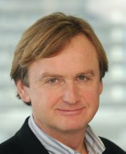
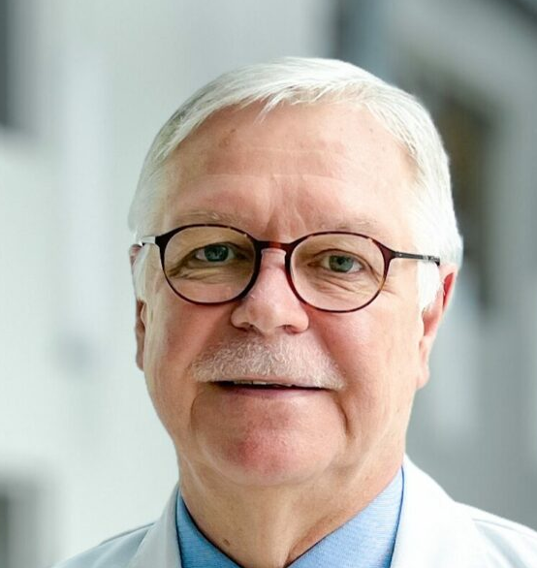
Revision Training Requirements in Orthopaedics and Traumatology
Li Felländer-Tsai, MD, Dr Med Sc, full professor
orthopaedic surgery at Karolinska Institute.
Univ.-Prof. Dr. Stefan Nehrer orthopaedic surgeon university hospital in Krems, Dean of Faculty Health and Medicine.
Aare Martson Professor MD PhD
University of Tartu · Department of Traumatology and Orthopedics
Notes:
These are the topics of my presentation

Slide 2
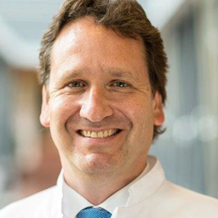
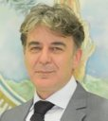
Revision Training Requirements in Orthopaedics and Traumatology
Prof. Dreinhöfer orthopedics and trauma surgery Charité Universitätsmedizin Berlin.
Stamatios A. Papadakis, MD, MSc, PhD
Orthopaedic Surgeon Head of the B' Dept of Orthopaedics KAT General Hospital of Attica
Presented by Dr Nanni Allington
Notes:
These are the topics of my presentation

Slide 3
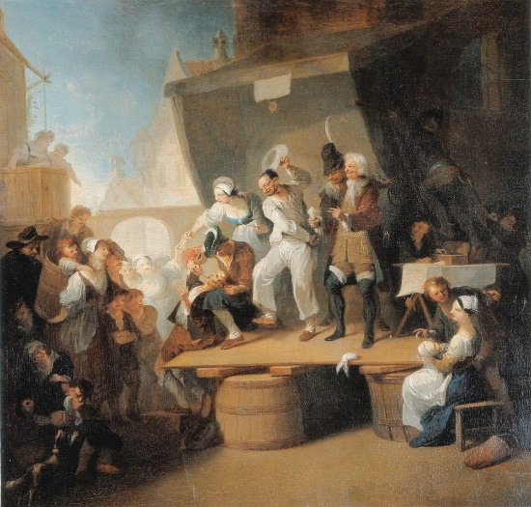

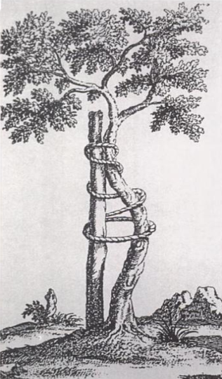
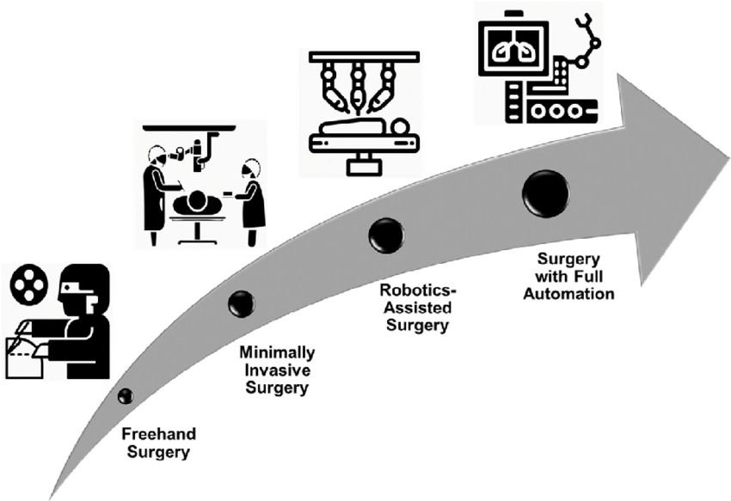

1741 Nicolas ANDRY de BOISREGARD
Orthopédie Greek "ortho" straight and "paido" child “Orthopedics or the art of prevention and correction
of body deformities in children ”
2018 …100 years

Slide 4
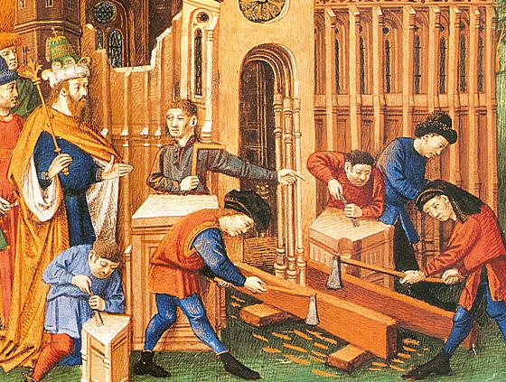
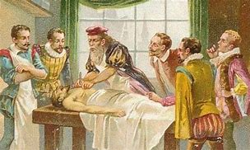
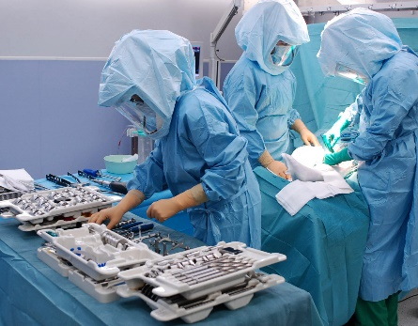
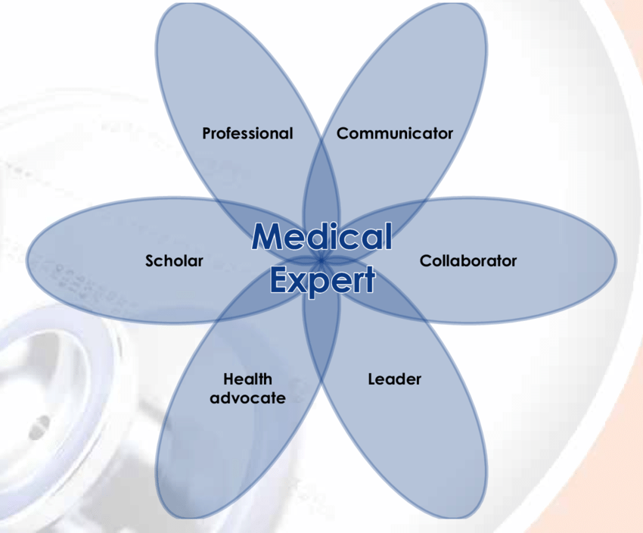
From apprentice/master or companionship type learning ….subjective , empirical
To structured , objective learning …..Competence based medical education
CBME …CanMEDS core competencies….EPA’s…ETR

Slide 5
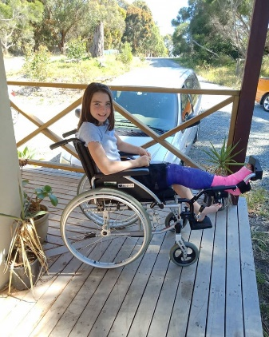
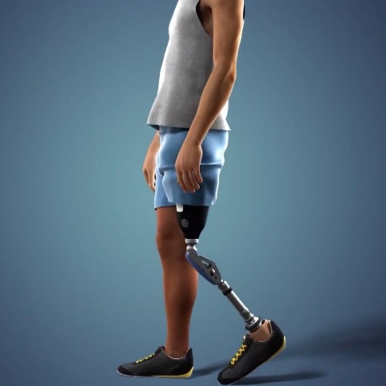
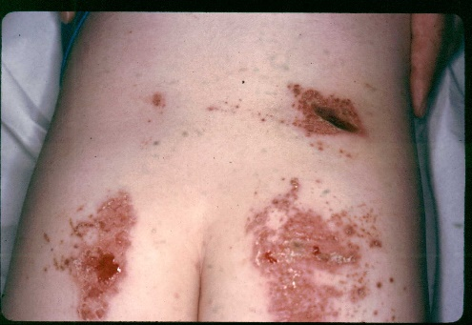
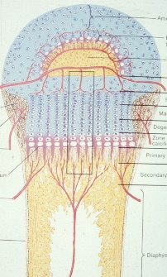
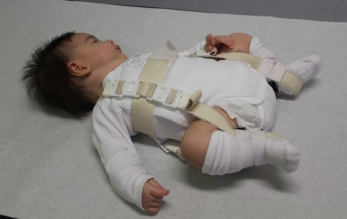
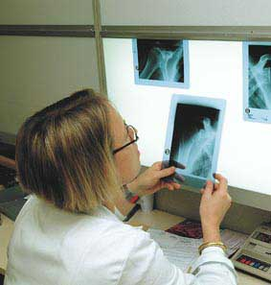
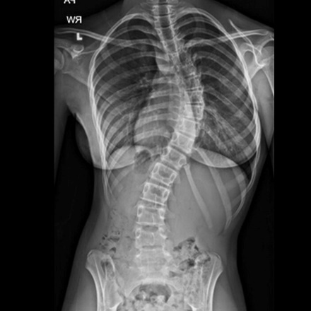
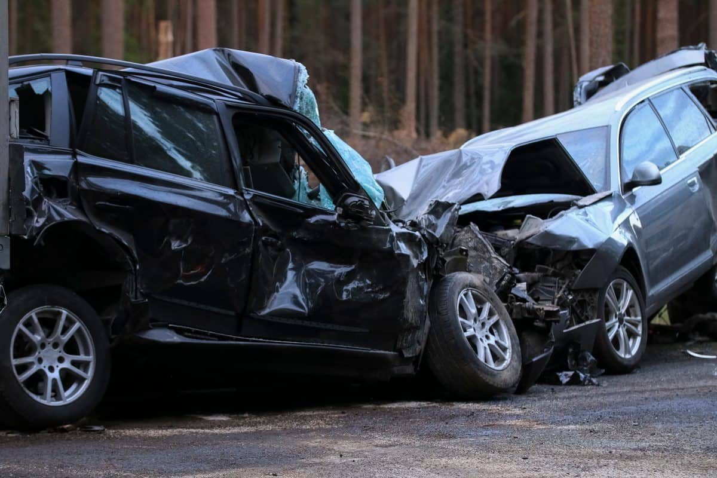
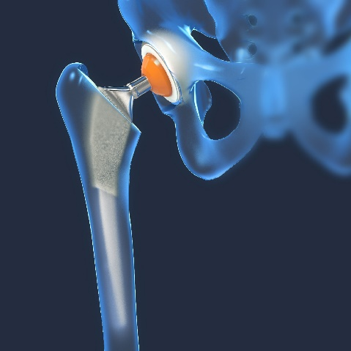
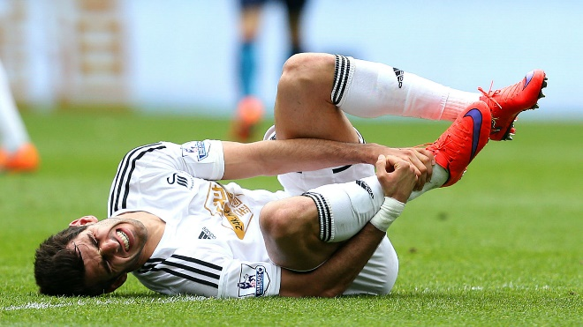
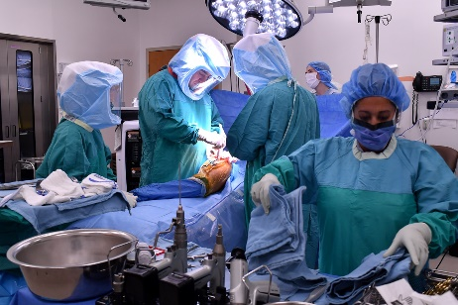

Slide 6
Huge spectrum …Overlapping
MJC Spine
MJC hand surgery
MJC adolescent medicine
MJC Pain
MJC Infection control
MJC Oncology
MJC Balneology
MJC Rare diseases
MJC Clinical skill centers
MJC Sports Medicine
EPOS
EFORT..
…..

Slide 7
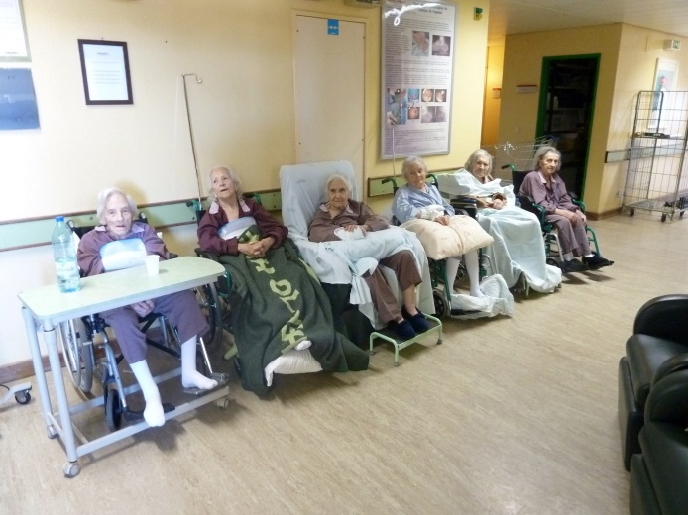
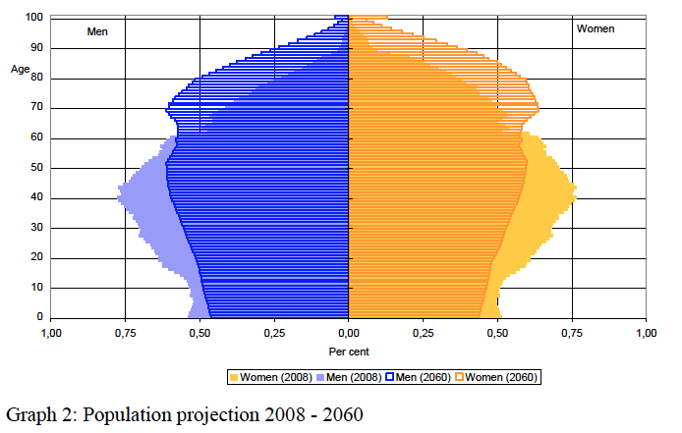
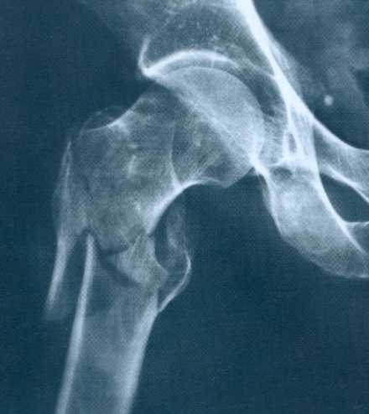
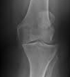
Major challenge in Orthopaedics
40% of people over the age of 70 years suffer from osteoarthritis (OA) of the knee.
80% of people with OA have some limitation of movement, and 25% cannot perform routine daily activities.
fragility fractures
Notes:
The major challenge to orthopaedics is the …

Slide 8
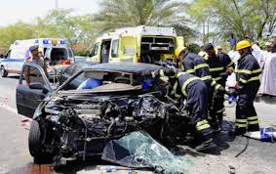
Road traffic injury is the leading cause of death for people between the ages of 15 and 29, with huge variation in incidence between EU countries.

Slide 9

In a review of 27 trauma studies, the median cost per patient for acute trauma treatment was USD $22 448 (IQR: $11 819 to $33 701). The acute treatment cost of trauma was higher than for any other disease group

Slide 10
Training Requirements in Orthopaedics & Traumatology
I. TRAINING REQUIREMENTS FOR TRAINEES
II. TRAINING REQUIREMENTS FOR TRAINERS
III. TRAINING REQUIREMENTS FOR TRAINING INSTITUTIONS
Notes:
The training requirements reflect

Slide 11
I. TRAINING REQUIREMENTS FOR TRAINEES
Content of training and learning outcome
  Competencies required of the trainee
  a. Theoretical knowledge
  b. Practical and clinical skills
  c. Competences EPA’s
Organisation of training
a. Schedule of training
b. Curriculum of training
c. Assessment and evaluation

Slide 12
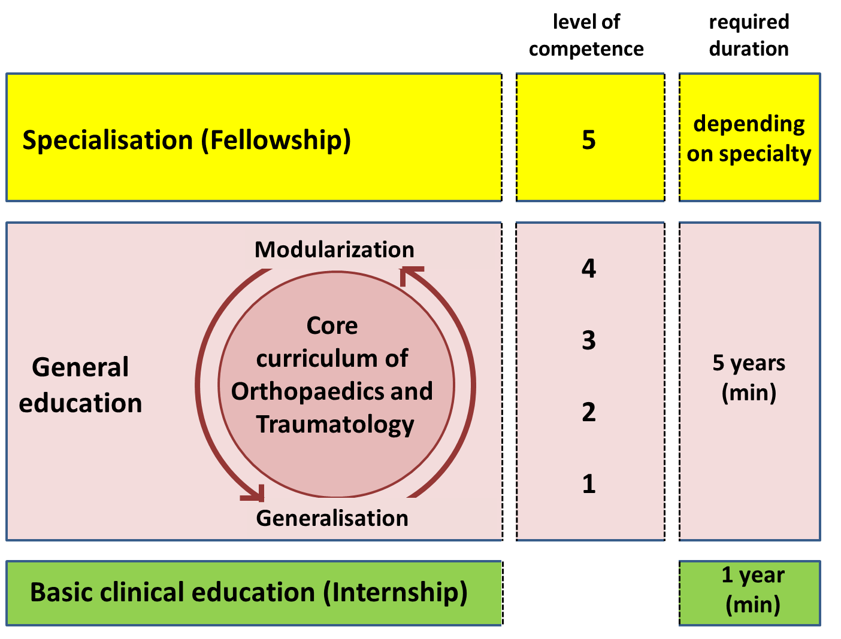
Schedule of training
Notes:
Generalisation, modularisation and competence development are a dynamic process during a training that will take at least 5 years

Slide 13


National Associations:
Austria, Belgium, Croatia, Cyprus, Denmark, Finland, France, Germany, Greece, Italy, Kosovo, Lithuania,Luxembourg,
Malta, Netherlands, Norway, Poland, Portugal, Serbia, Slovenia, Spain, Sweden, Switzerland, Turkey, United Kingdom
European Specialty Societies
European Bone and Joint Infection Society
European Federation of National
Associations of Orthopaedic Sports Traumatology
European Foot and Ankle Society
European Hip Society
European Orthopaedic Research Society
European Paediatric Orthopaedic Society
European Rheumatism and Arthritis Surgical Society
European Society of Pelvis and Acetabulum
European Society of Sports Traumatology, Knee Surgery and Arthroscopy
European Wrist Arthroscopy Society
Federation of European Societies for Surgery of the Hand
FORTE
Notes:
And this is the final document publish in March 2015

Slide 14
The Core Curriculum Orthopaedics and Traumatology
Defined in Pathologies
inherent
growth associated
caused by bone metabolism
caused by infections
caused by nervous system
caused by systematic diseases
caused by bone and soft tissue tumor
rheumatic caused
caused by sports
caused by injuries
cause by medical interventions
Defined in Areas
shoulder, elbow, upper arm
lower arm and hand
pelvis, hip and thigh
knee
lower leg and foot
cranium, body cavity
spine
Defined in Patient Groups
neonates
children and adolescents
adults
older person

Slide 15
The Core Curriculum Orthopaedics and Traumatology
Differentiated in Diagnosis
Imaging methods
Specialist laboratory medicine
Puncture and biopsy
Investigation technique
Differentiated in Conservative Therapy
Physical – medical measures, ergo therapy, manual medicine, complementary therapies
Treatment with immobilizing or corrective bandage
Orthoses, prosthetics, therapeutic products and medical aid
Pain- relief therapy
Conservative treatment (inclusive reposition) of luxation, fractures and distorsion

Slide 16
The Core Curriculum Orthopaedics and Traumatology
Differentiated in Operative Therapy
Arthroscopy
Reconstructures procedures
Osteotomies
Osteosyntheses
Resections
Endoprosthetics
Intervention in nerves, vessel and connective tissue (tendon-, muscle- and ligament repair/reconstruction)
Amputation

Slide 17
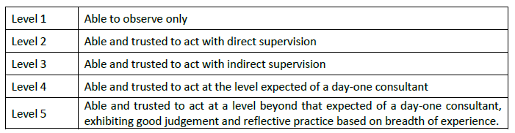
At first a general view of the wide spectrum of the specialty, followed by a modular process of developing knowledge and skills in more specific areas.
Non-operative treatment including assessment of rehabilitation needs as well as prevention are also mandatory to underpin the development of comprehensive surgical skills and excellence. This also includes the safeguarding of children with awareness of abuse/maltreatment/neglect of minors and initiating investigations when determined needed to prevent further harm.
At the end of training the trainee should have acquired a level 4 in all non-operative issues and a be entrustable in the operative procedures .The training must cover the full range of the specialty and end with the license to practice orthopaedic and traumatology surgery but not all at level 4.
The trainer will have to recognize that the trainee has become entrustable.

Slide 18
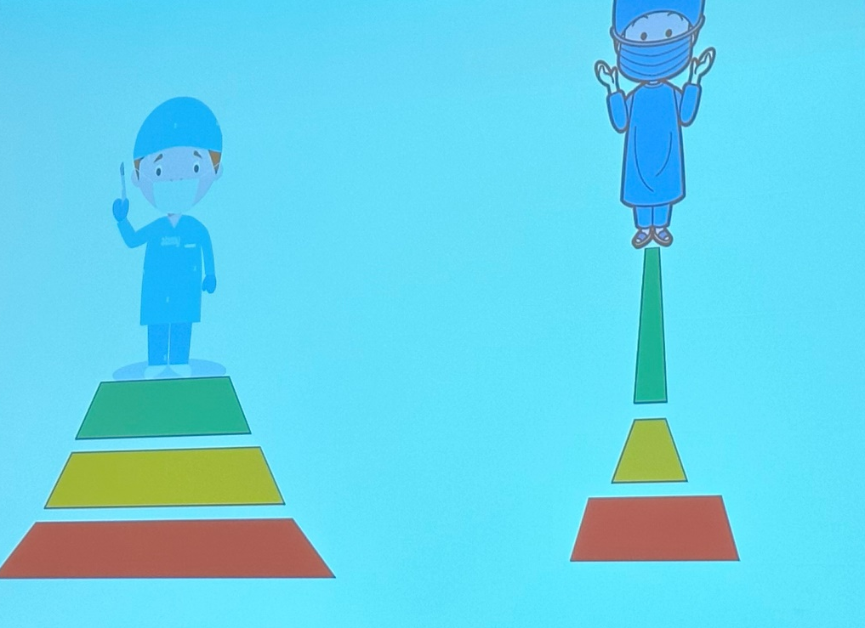
Regarding traumatology the trainee must be entrustable with basic lower limb and upper limb fracture and other trauma care (level 4).
Pelvis, spine, specialized pediatric orthopaedic surgery, and orthopaedic oncology are the next level up and will require extra training as “fellowships” or other means and thus a level 2 is sufficient.

Slide 19

Regarding traumatology the trainee must be entrustable with basic lower limb and upper limb fracture and other trauma care (level 4).
Pelvis, spine, specialized pediatric orthopaedic surgery, and orthopaedic oncology are the next level up and will require extra training as “fellowships” or other means and thus a level 2 is sufficient.

Slide 20
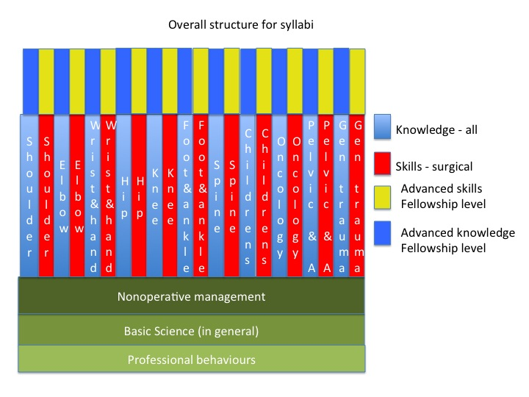
Syllabus
Notes:
A modular syllabus is proposed that is adaptable to the differing needs of member nations

Slide 21
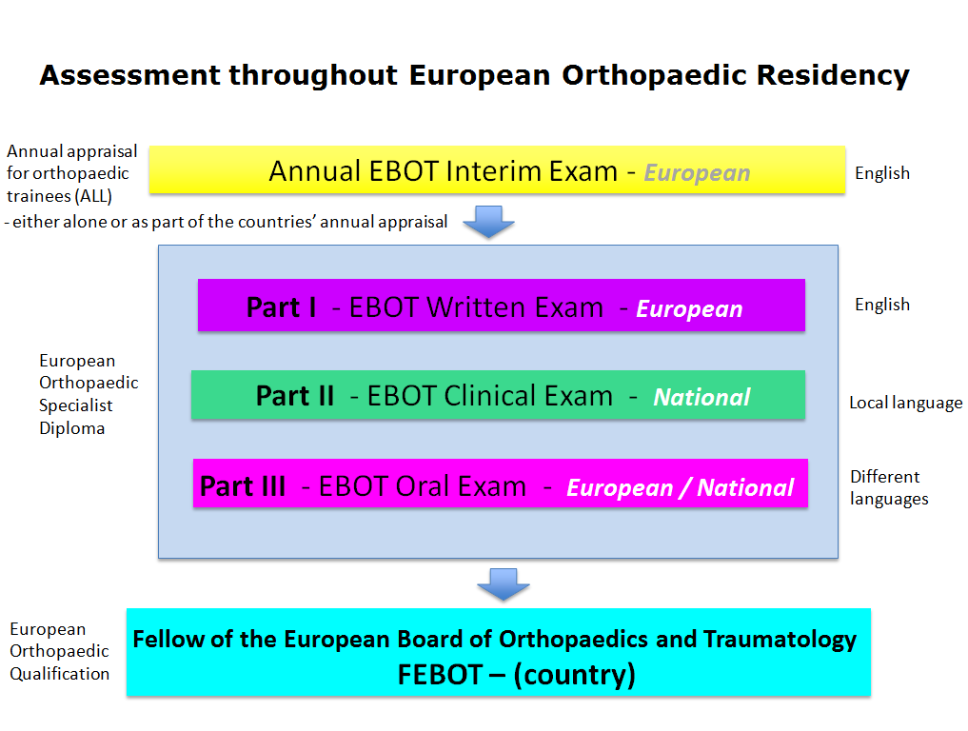

Slide 22
