Slide 1




Towards a Competency-Based Curriculum
Operationalized by EPAs
European Training Requirements in Ophthalmology
Helena Prior Filipe, Renata Ivekovic, Denise Curtin,
Wagih Aclimandos and Tristan Bourcier
with the
EBO ExCo and the UEMS Section of Ophthalmology
European
Board of Ophthalmology
UEMS Section
of Ophthalmology
UEMS Advisory Board Meeting; UEMS Council Meeting Europe, 2023-2024
Notes:
UEMS-UEMO Joint Council Meeting: October 2024 | uems.eu
https://docs.google.com/spreadsheets/d/1pm6_r1RMzol8MVbSdYkmGmQVvzTZvfgrnfpdAto8P0Y/edit?gid=0#gid=01.
https://www.uems.eu/event/uems-uemo-joint-council-meeting-october-2024-4/page/introduction-uems-uemo-joint-council-meeting-october-2024-copy
Dear Heads of Delegations of National Medical Associations, Members of the UEMS,
Dear Presidents and Secretaries of UEMS Sections & Boards, Divisions, MJCs and TFs,
Dear Representatives of UEMO,
Dear Representatives of European Medical Organisations,
Advisory Board – 18.10.2024
Council Meeting – 19.10.2024
UEMS-UEMO Joint Council Meeting: October 2024 | uems.eu
Dr Helena Prior Filipe chair of the CME/CPD committee and coordinator of the ETR in Ophthalmology will representthe EBO on both days. Could you please include Helena in future correspondences

Slide 2

1. Introduction

Slide 3
Who We Are
Harmonisation and improvement of the quality of medical specialists training, qualifications and practice in the European Union.
EACCME (CME Accreditation)
CESMA (Exam Standards)
UEMS Section of Ophthalmology
A permanent working group of UEMS Section of Ophthalmology
To guarantee the highest standards of care in the field of ophthalmology in full or associate member countries of the U.E.M.S., by ensuring that the training of the Ophthalmologist is raised to the highest possible level
EBOD Exam (FEBO)
Residency Exchange Committee
Residency Review Committee
CME Committee
European Board of Ophthalmology

Slide 4
2 . People and Methods

Slide 5

Who We Are: An International Team for ETRs
UEMS Section of Ophthalmology
+
=
Over 70 International (UEMS) Ophthalmologists
11 working Groups
European Board of Ophthalmology
This Photo by Unknown Author is licensed under CC BY-SA

Slide 6
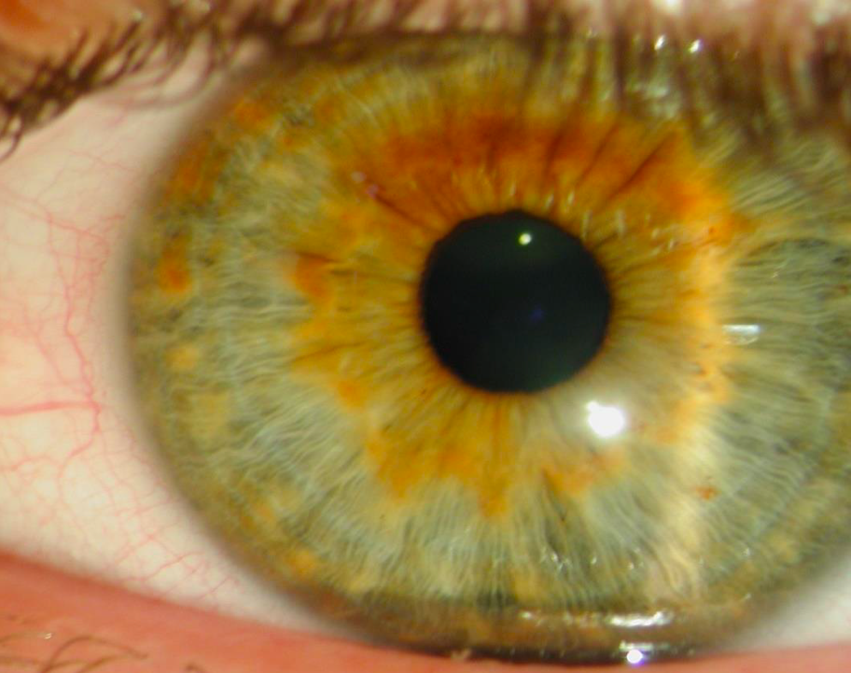
ETRs in Ophthalmology: Step by Step – 2023-2024
Designed & conducted an online survey, submitted a manuscript
Held 6 meetings
(3 online, 2 onsite, 1 hybrid)
Wrote a main document V1 + Curricula of training: highest level of performance + EPA template
Created an online resource on EPAs
Reviewed the main document +Validated 11 Subspecialty Rotations Curricula of Training Outcomes + Created 21 EPAs + Created a Surgical Logbook template
Submitted V2 - UEMS ETRs Review Co
Received feedback + Responded to the reviewers
Changed accordingly, the document (V3)
Re-submitted

Slide 7
3. Output

Slide 8

ETRs in Ophthalmology: 4 Distinct Parts
The European Training Requirements in Ophthalmology (Main Document)
The Entrustable Professional Activities
The Curricula of Training Outcomes (Subspecialty Rotations Sections)
EBO and UEMS Section of Ophthalmology Surgical Logbook

Slide 9

ETRs in Ophthalmology: A Living Document
Introduction
Pg 8
Methodology..................................................................................... 11
The Discipline ................................................................................... 12
The Specialist in Ophthalmology …….................................................. 12
The Scope of Practice......................................................................... 12
Notes:
The present document is to be considered a “living document”, ready to welcome constructive suggestions and updates and thus be revised and modified to suit national healthcare needs, and progress with growing knowledge, techniques, and technology, while consistently respecting the sovereignty of the EU member states.
The process of development included designing and implementing a self-administered online survey on ETRs in Ophthalmology. This survey was distributed to the national representatives of the EBO and UEMS Ophthalmology section, leaders of the European subspecialty societies, partners of the EBO, European University Professors of Ophthalmology, Young Ophthalmologists participating in the European Leadership Development Program organized by the European Society of Ophthalmology and Young Ophthalmologists, and former EBOD examiners. A first draft of this document was then produced by the Core Working Group with EBO and UEMS section of ophthalmology representation. The draft was further reviewed by the Executive Committee of the EBO and the UEMS section of the Ophthalmology Executive Committee. The survey showed a significant expression by the participants to be actively involved in the process of building the “ETRs in Ophthalmology”. This led the Core Working Group to design and conduct a trifold series of online meetings. The first targeted all who answered affirmatively in the survey to be contacted, and an overview of competency-based education was provided as well as the project development plan designed by the core working group. The following two online meetings were held with the eleven subspecialty rotation working group coordinators. The latter comprised at least one element of each of the organizations mentioned above. They were invited to review the overall document, validate their subspecialty rotation curriculum of training outcomes, and draft 1-2 entrustable professional activities (EPAs) themed in accordance with them. To support these eleven focus groups, a microlearning package composed of a short video clip, a working book, and an EPA template was purposely created and shared. Two more meetings, an onsite and a hybrid one, were carried out to share progress within each working group. These two meetings were respectively held as pre-events of the UEMS section of the Ophthalmology Bureau meeting in Copenhagen and of the EBO General Assembly with the UEMS Section of the Ophthalmology Plenary Section. In addition to the team review rounds, thirteen expert individuals from the above-mentioned organizations reviewed the master document, and version 2 emerged from all review rounds. Twenty one EPAs were designed. The European Junior Doctors (EJD) Representatives for the EBO contributed with a general concluding review, edits, and formatting. The EBO Advisory Committee contributed to developing the residency in ophthalmology logbook for surgical procedures.

Slide 10
ETRs in Ophthalmology: Training Requirements for…
I Trainees
II Trainers
III Training Institutions / Programs
Notes:
Training Requirements for the Specialty of …
European Standards of Postgraduate Medical Specialist Training
https://www.uems.eu/areas-of-expertise/postgraduate-training/european-standards-in-medical-training

Slide 11
ETRs in Ophthalmology: A Living Document
Section I: Training Requirements for Trainees.
Pg 14
Content of Training and Learning Outcome…..... 14
Eligibility Criteria for Being a Resident of Ophthalmology ......................................14
Competencies Required of the Trainee .................................................................. 15
Organization of Training………………………………..17
Schedule of Training .................................................................................................17
Curriculum of Training ..............................................................................................17
Entrustable Professional Activities by Subspecialty Rotation ................................20
Assessment and Evaluation .....................................................................................21
Governance ...............................................................................................................24
Notes:
Section I: Training Requirements for Trainees.................... 14
Content of training and learning outcomes
Competencies required of the trainee
Organisation of training
Governance

Slide 12
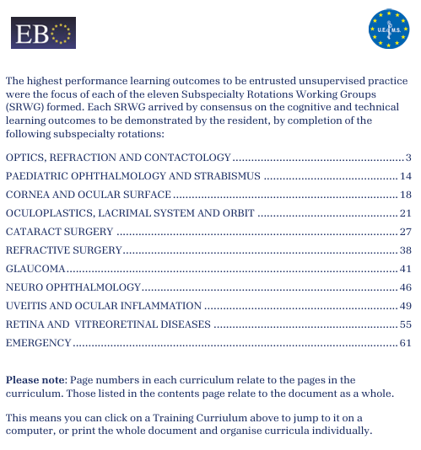
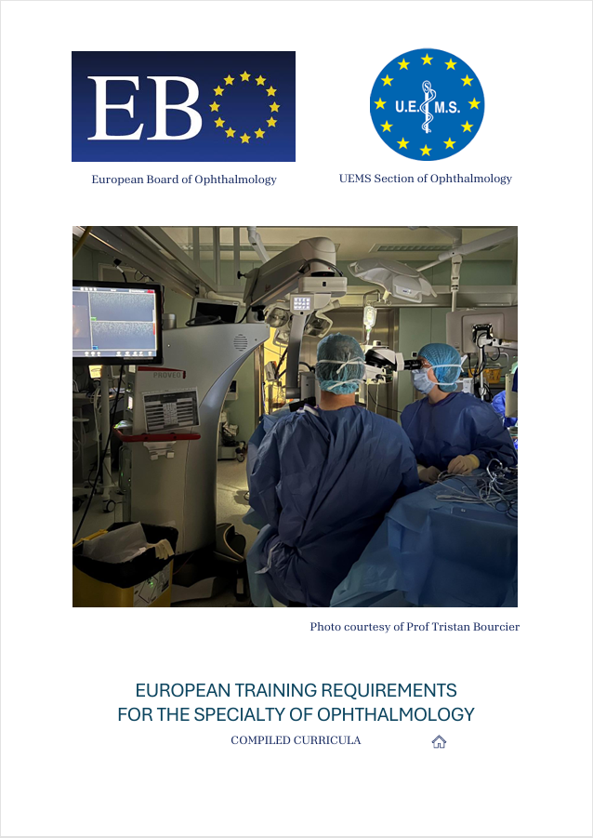
Section I: Training Requirements for Trainees.
Pg 14
Cognitive Skills
Technical/Surgical Skills
Curriculum of Training Outcomes for Subspecialty Rotations
Notes:
The EBO-UEMS European Training Requirements in Ophthalmology is composed of 4 distinct parts:
The European Training Requirements in Ophthalmology (Main Document)
The European Training Requirements Curriculum of Training for 11 Subspecialty
Sections

Slide 13

What learners show they know, do and act
on completion of a learning process.
Section I: Training Requirements for Trainees.
Pg 14
Student achievement (outcomes)
SMART
Learning
Outcomes
Notes:
Learning Outcomes are defined in terms of learners´ knowledge, skills and behaviour.
European countries have shown their ambition to harmonize education and training in ophthalmology, particularly through the creation of the European Board of Ophthalmology (EBO) by the Ophthalmology section of the European Union of Medical Specialists (UEMS) in 1992. The core mission of the EBO is to guarantee the highest standards of care in ophthalmology in EU countries by ensuring high-level training. While ophthalmology residency duration is not the same in every European Union (EU) country, and surgical training exposure may differ (Ní Dhubhghaill et al. 2023), every resident in the EU must achieve an equal level of medical knowledge, assessed by one final examination: the EBO Diploma (EBOD) examination, a similar national or international exam, or both (Mathysen et al. 2016)
Competency-based medical education (CBME) serves as the foundation for the ACGME’s accreditation model, which is also grounded in a continuous quality improvement and innovation philosophy (Nasca et al. 2012; Weiss, Bagian, and Nasca 2013).

Slide 14

Competency-Based Education
Section I: Training Requirements for Trainees.
Pg 14
The outcome of Education:
the capability to demonstrate Knowledge, Skills and Attitudes at the workplace
Frank J et al. 2015
Notes:
Competency based educations is defined by the capability to demonstrate knowledge, skills and attitudes derived from the analysis of societal and patient needs and performance in the workplace as the outcome of education
Competency based education enables an outcomes-based approach to the design, implementation, assessment, and evaluation of a medical education program using a framework of competencies
CBME de-emphasises time-based training and promises a greater accountability, flexibility, and learner-centeredness
Is defined by the capability to demonstrate Knowledge, Skills and Attitudes in the workplace as the outcome of education
Enables an outcomes-based approach to design, implement, assess, and evaluate training programs
Rather than time and content-based, professional identity can be formed supported by an outcome-based curriculum, relying on the demonstration of the performance of Entrustable Professional Activities (EPAs)(Ten Cate 2013). As discrete, observable units of professional practice, EPAs require simultaneous proficiency in several competencies, combine knowledge and skills, and define professional identity. EPAs translate competencies into practice (Ten Cate & Schumacher 2022).
Requires a workplace environment, even though preparation for it can happen before entering the workplace
The acquisition of competencies, integrating knowledge, skills and attitudes for practice (Epstein & Hundert 2002; Albanese et al. 2008; ten Cate 2014b) should be confirmed in a workplace environment.
is fundamentally oriented to graduate outcome abilities and organized around competencies derived from an analysis of societal and patient needs
de-emphasises time-based training and promises a greater accountability, flexibility, and learner-centeredness’’ (Frank et al. 2010).
Requires a workplace environment, even though preparation for it can happen before entering the workplace
The acquisition of competencies, integrating knowledge, skills and attitudes for practice (Epstein & Hundert 2002; Albanese et al. 2008; ten Cate 2014b) should be confirmed in a workplace environment.
is fundamentally oriented to graduate outcome abilities and organized around competencies derived from an analysis of societal and patient needs
de-emphasises time-based training and promises a greater accountability, flexibility, and learner-centeredness’’ (Frank et al. 2010).
an approach to preparing physicians for practice that
is fundamentally oriented to graduate outcome abilities and
organised around competencies derived from an analysis of
societal and patient needs. It de-emphasises time-based
training and promises a greater accountability, flexibility,
and learner-centeredness’’ (Frank et al. 2010).
workplace experience for trainees is
usually organised in a rotational system with fixed periods of
time, competency-based education may pose logistical challenges,
as it requires some flexibility in time. Fundamental to
competency-based education is that trainees are only certified

Slide 15

Competency Frameworks
Section I: Training Requirements for Trainees.
Pg 14
https://www.royalcollege.ca/rcsite/canmeds/canmeds-framework-e.
Notes:
These are two widely accepted models of Core Competencies frameworks to describe Roles and Milestones of performance:
The Can Meds developed by the RCPSC and
the core competencies model of the American council of graduate medical education

Slide 16


Competency-Based Curriculum
From Curriculum of
Training Outcomes
Knowledge
Skills
To EnTrustment of
Professional Activities
Attitude
Notes:
Competencies describe people’s abilities in terms of their knowledge, professional attitude, communication skill. Competencies remain theoretical if not grounded in practice.
Entrustable professional activities or EPAs are units of work: tasks or responsibilities that faculty entrust a trainee to execute, unsupervised, once he or she has obtained adequate competence.
Units of work and abilities of persons can be viewed as two dimensions
and Competencies remain theoretical if not grounded in practice.

Slide 17




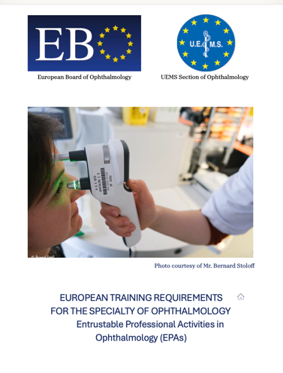
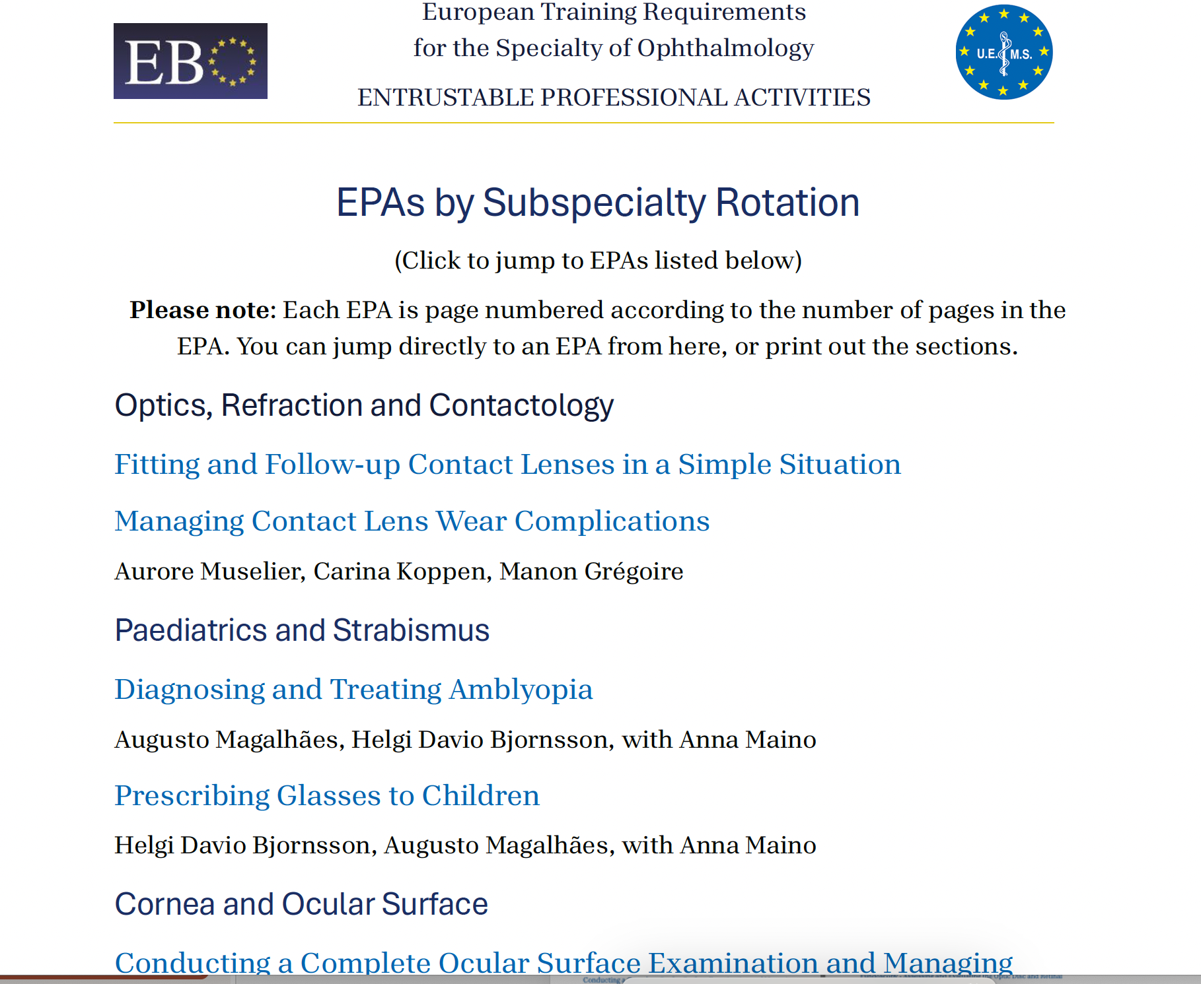
21
Entrustable Professional Activities
Notes:
Title
Description
Competencies required
Knowledge, Skills, Attitudes and Experience (qualitative and quantitative) required
Assessment Tools and Strategies (Information to assess progress)
Highest level of performance (Level 4 supervision conditions)
Levels of supervision likely to be expected across the residency program duration

Slide 18
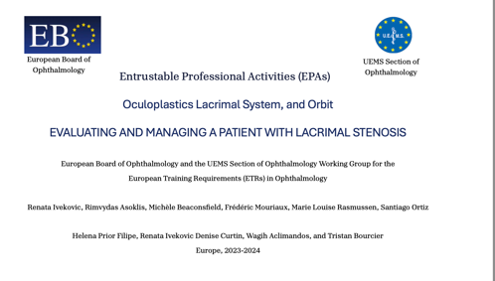
Title
Description
Competencies required
Knowledge, Skills, Attitudes and Experience
Assessment Tools and Strategies
Highest level of performance
Levels of supervision likely to be expected across the residency program duration
Entrustable Professional Activities
Notes:
Title
Description
Competencies required
Knowledge, Skills, Attitudes and Experience (qualitative and quantitative) required
Assessment Tools and Strategies (Information to assess progress)
Highest level of performance (Level 4 supervision conditions)
Levels of supervision likely to be expected across the residency program duration

Slide 19
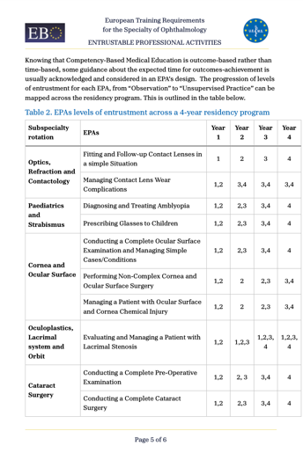
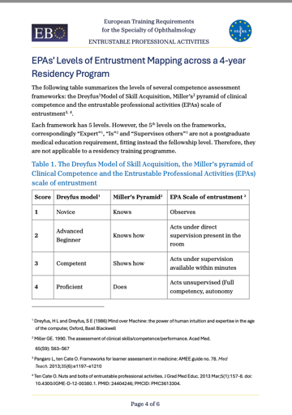
Entrustable Professional Activities
Notes:
Title
Description
Competencies required
Knowledge, Skills, Attitudes and Experience (qualitative and quantitative) required
Assessment Tools and Strategies (Information to assess progress)
Highest level of performance (Level 4 supervision conditions)
Levels of supervision likely to be expected across the residency program duration

Slide 20
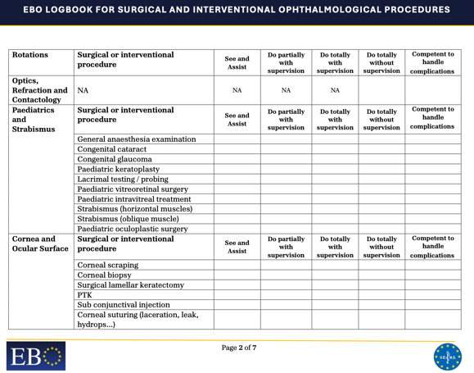
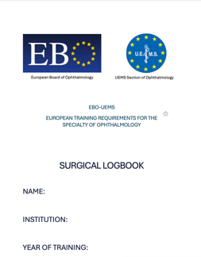
Quantitative Experience
Logbook
Notes:
Title
Description
Competencies required
Knowledge, Skills, Attitudes and Experience (qualitative and quantitative) required
Assessment Tools and Strategies (Information to assess progress)
Highest level of performance (Level 4 supervision conditions)
Levels of supervision likely to be expected across the residency program duration

Slide 21
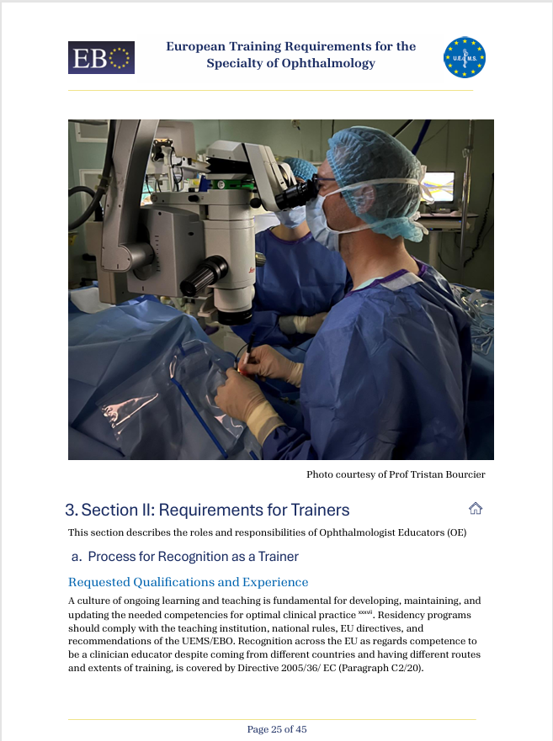
Training the Trainer
Section II: Training Requirements for Trainers.
Pg 25
Process for Recognition as a Trainer............... 25
Requested Qualifications and Experience .......25
Core Competencies for Trainers .....................27
Quality Management for Trainers ...................28
Notes:
The value of HUMAN CAPITAL
Process for recognition as trainer
Requested qualification and experience
Core competencies for trainers
Special Qualifications of the trainers when required (if not covered by EU Directive on Professional Qualifications)
Quality management for trainers

Slide 22
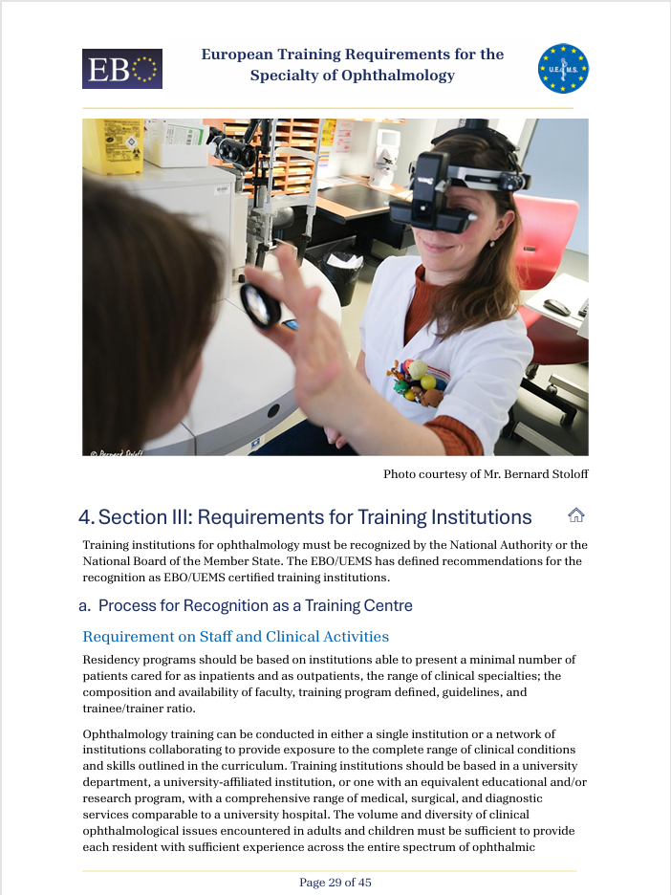
Engaging the Learning Environment
Section III: Training Requirements for Training Institutions
Pg 29
Process for Recognition as a Training Centre ........29
Requirement on Staff and Clinical Activities...........29
Requirement on Equipment, Accommodation........30
Quality Management within Training Institutions ...31
Notes:
Process for recognition as Training centre, requirements on
Staff and clinical activities
Minimal number of patients cared for as inpatients and as outpatients; Range of clinical specialties; Composition and availability of faculty, training programme defined, guidelines applies Trainee / trainer ratio; Minimal scientific activity
Equipment, accommodation
Medical-technical equipment, library, opportunities for R&D
Quality Management within the Training centre
Accreditation ; Clinical Governance, Manpower planning, Regular report, External auditing, Transparency of training programmes, Structure for coordination of training; Framework of approval
(if not covered by EU Directive on Professional QProcess for recognition as Training centre, requirements on
Staff and clinical activities : Minimal number of patients cared for as inpatients and as outpatients; Range of clinical specialties; Composition and availability of faculty, training programme defined, guidelines applies Trainee / trainer ratio; Minimal scientific activity
Equipment, accommodation : Medical-technical equipment, library, opportunities for R&D
Quality Management within the Training centre
Accreditation ; Clinical Governance, Manpower planning, Regular report, External auditing, Transparency of training programmes, Structure for coordination of training; Framework of approval
ualifications)

Slide 23

4. Next Steps

Slide 24



ETRs in Ophthalmology: A Living Document
1. Additional Topics
Climate Change &
Sustainable Eyecare
Systemic Disease, Social Impact & Ophthalmology
Global & Systems-Based Ophthalmology
Notes:
By promoting and adopting sustainable behaviors, we can minimize our impact on the environment.
The need for sustainable practices to reduce our carbon footprint

Slide 25



2. Subspecialty Rotations
ETRs in Ophthalmology: A Living Document
Plan
Implement
Pilot
Evaluate
Adjust
3. Continuous Review
4. ePortfolio
5. EPAs Validation
Notes:
as done will be beneficial to attain authentic programme harmonization
Decide about additional subspecialty rotations
Documents the personal development plan (medical and/or surgical) closely followed by his/her mentors
An important component CBME implementation
Self assessment- progress and development
Formative Assessment for all applicable EPA’s
Progress Interview/coaching session
Portfolio-based Entrustment decision-making
Time adjustment

Slide 26

In Summary
V1 ETRs Master Document -V1
V3 UEMS ETRs Review Committee
V2 Review: 3Teams; 6 Subspecialty Experts

Slide 27
ETRs in Ophthalmology
A living document that
{
Addresses the current diverse European residency programmes in ophthalmology
Acknowledges fundamental requirements to acquire the professional identity of a practicing ophthalmologist recognized in Europe as elsewhere
Welcomes continuous review for quality
Notes:
the present is a living document that given the current diverse European residency programmes in ophthalmology and the desire to acknowledge fundamental requirements to acquire the professional identity of a practicing ophthalmologist recognized in Europe as elsewhere, updates are considered and welcome.

Slide 28

Thank you!
hpriorfilipe@gmail.com
“please make sure that any training center undergoes a qualifying procedure, with onsite monitoring”

Slide 29
ETRs & Ophthalmology
ETRs should be designed to guide a curriculum for PGME- moving towards CBME
Frank et al. 2010, Orgill & Simpson 2014
Specialist training in ophthalmology should have a structured design that facilitates building knowledge and understanding of the discipline, developing clinical skills, and professional identity of an independent ophthalmologist
International Council of Ophthalmology 2006
Several frameworks of competencies exist, describing the professional abilities to develop across all medical education stages till retirement, such as the CanMEDs the ACGME framework, the Miller’s Pyramid
Frank, Snell & Sherbino 2015

Slide 30

V3: The Document We Present Today
UEMS Section of Ophthalmology
European Board of Ophthalmology
UEMS-UEMO Joint Council Meeting: October 2024 | uems.eu
Submitted 16 September 2024

Slide 31

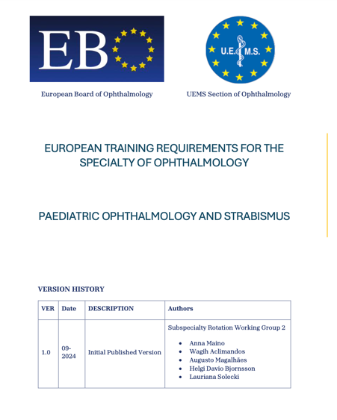
Cognitive Skills
Technical/Surgical Skills
SMART
Curriculum of Training Outcomes for 11 Subspecialty Sections
Notes:
The EBO-UEMS European Training Requirements in Ophthalmology is composed of 4 distinct parts:
The European Training Requirements in Ophthalmology (Main Document)
The European Training Requirements Curriculum of Training for 11 Subspecialty
Sections

