Slide 1

PDM for Pain Medicine for Anaesthesiologists
Prof. Oleg Sabelnikovs
President of EBA
UEMS AUTUMN COUNCIL MEETING
19 OCT 2024
Notes:
12:05 - 13:25

Slide 2
The concept of a professional development module in anesthesiology
Presented on UEMS Spring Meeting 2024

Slide 3
Training and CPD in Anaesthesiology
Continuing professional development (CPD)
Undergraduate training
Residency training (PGT)
There is a continuum from undergraduate medical education through postgraduate training (PGT) to continuing professional development (CPD).
Notes:
Professional Development Module is a way to implement more structure in CPD.

Slide 4

Training and CPD in Anaesthesiology
ETR
Continuing professional development (CPD)
Undergraduate training
Residency training (PGT)
There is a continuum from undergraduate medical education through postgraduate training (PGT) to continuing professional development (CPD).

Slide 5
Training and CPD in Anaesthesiology
ETR
Continuing professional development (CPD)
Undergraduate training
Residency training (PGT)
There is a continuum from undergraduate medical education through postgraduate training (PGT) to continuing professional development (CPD).

Slide 6
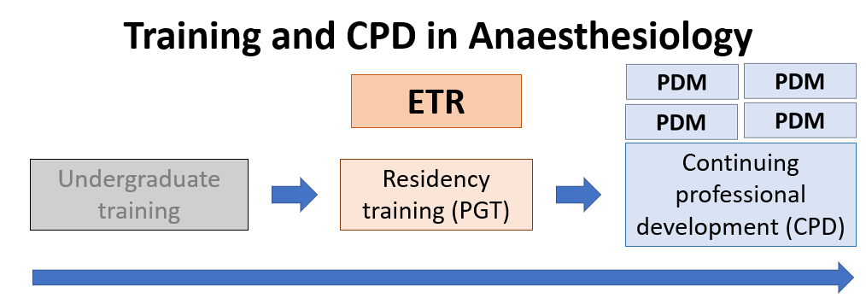
Pain Medicine in ETR

Slide 7
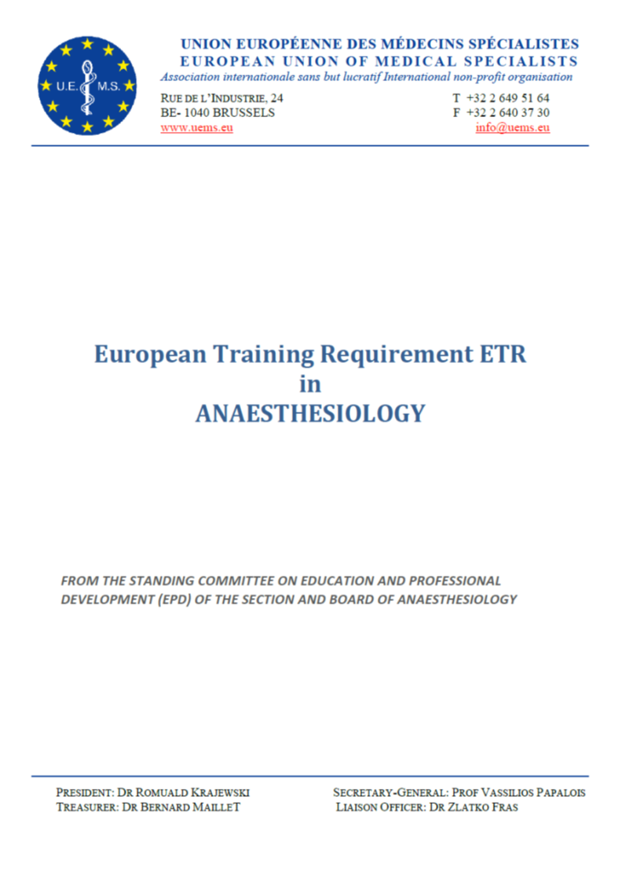
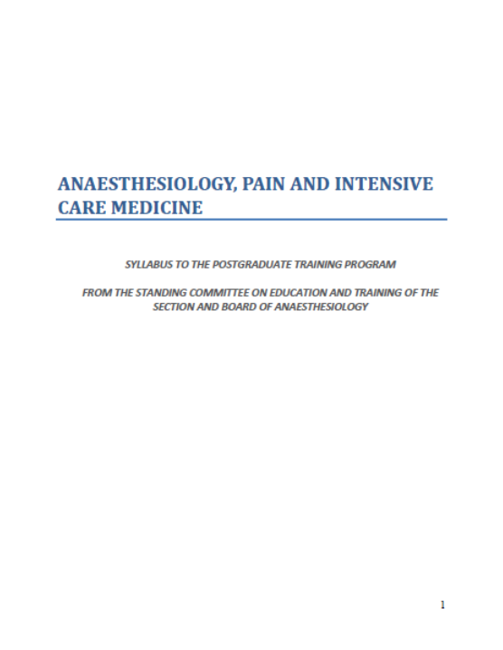
European Training Requirements
for the Specialty of Anaesthesiology
5 years
4 years
https://www.uems.eu/__data/assets/pdf_file/0003/64398/UEMS-2018.17-European-Training-Requirements-in-Anaesthesiology.pdf
https://www.uems.eu/__data/assets/pdf_file/0004/156199/UEMS-2022.12-European-Training-Requirements-in-Anaesthesiology.pdf
https://www.uems.eu/__data/assets/pdf_file/0004/44428/UEMS-2013.18-European-Training-Requirements-Anaesthesiology.pdf
UEMS 2013/18
UEMS 2018/17
UEMS 2022/12

Slide 8
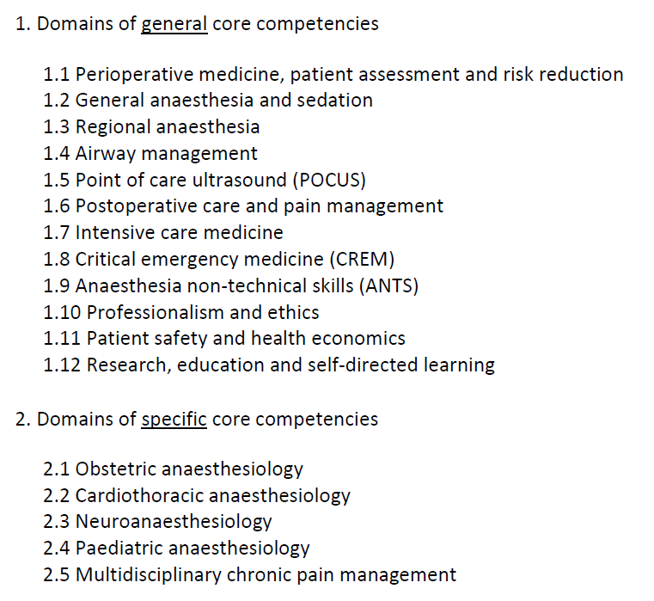
European Training Requirements
for the Specialty of Anaesthesiology
General core competencies should be achievable by most national training programmes
Specific core competencies - basic competence levels proposed
Levels of competencies
A: observer level (has knowledge of, describes)
B: performs, manages, demonstrates under direct supervision
C: performs, manages, demonstrates under distant supervision
D: performs, manages, demonstrates independently

Slide 9

General core competencies should be achievable by most national training programmes
Specific core competencies - basic competence levels proposed
Levels of competencies
A: observer level (has knowledge of, describes)
B: performs, manages, demonstrates under direct supervision
C: performs, manages, demonstrates under distant supervision
D: performs, manages, demonstrates independently

Slide 10
General core competencies should be achievable by most national training programmes
Specific core competencies - basic competence levels proposed
Many competencies related to Pain Medicine are developed during residency training
Levels of competencies
A: observer level (has knowledge of, describes)
B: performs, manages, demonstrates under direct supervision
C: performs, manages, demonstrates under distant supervision
D: performs, manages, demonstrates independently

Slide 11
Competencies required of the trainee
General core competencies should be achievable by most national training programmes
Specific core competencies - basic competence levels proposed
Not all learning objectives listed in the ETR reach level D
(perform and manage independently)
Levels of competencies
A: observer level (has knowledge of, describes)
B: performs, manages, demonstrates under direct supervision
C: performs, manages, demonstrates under distant supervision
D: performs, manages, demonstrates independently

Slide 12
PDM for Pain Medicine for Anaesthesiologists

Slide 13
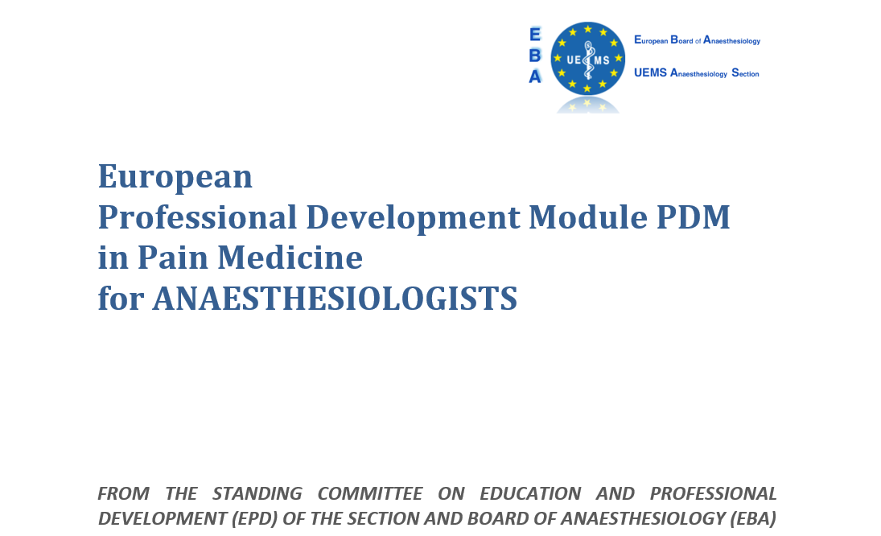
The European Professional Development Modules (PDMs) for anaesthesiologists summarise learning objectives to enrich and increase competencies raising clinical experts and professional leaders to a higher level of qualification.

Slide 14
Part 1: General Information about the European Professional Development Module (PDM) in Pain Medicine for Anaesthesiologists
Part 2: Domains and Competencies in the PDM Pain Medicine for Anaesthesiologists
Appendix I: Entrustable Professional Activities (EPAs)

Slide 15
Part 1: General Information about the European Professional Development Module (PDM) in Pain Medicine for Anaesthesiologists
The Way to Excellence: From ETR for Trainees to the PDM for Specialists
Scope of the PDM in Pain Medicine for Anaesthesiologists
PDM Pain Medicine Development
Duration and Type of Training in PDM in Pain Medicine
Candidates for PDM in Pain Medicine
Trainers for PDM in Pain Medicine
Training Institutions
Assessment of Competences in PDM in Pain Medicine
Completion of the PDM in Pain Medicine

Slide 16
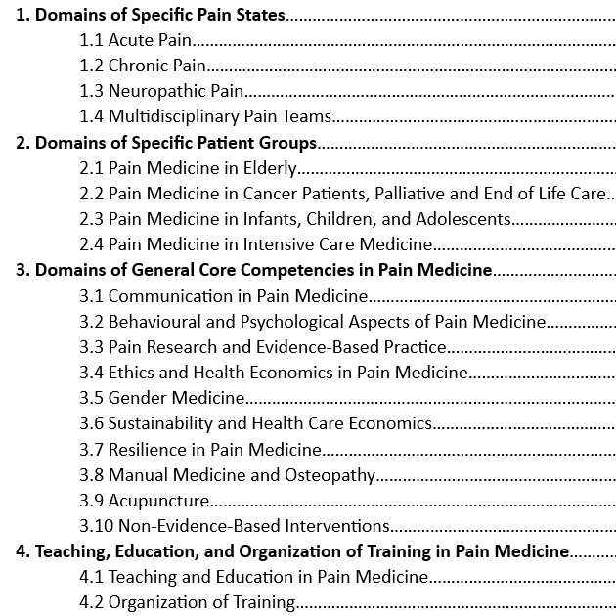
Part 2. Domains and competencies in the PDM Pain Medicine for anaesthesiologists
Descriptions of domains
Learning objectives of PDM
Content related to pain medicine from ETR in anaesthesiology

Slide 17
1. Domains of specific pain states
1.1 Acute Pain
1.2 Chronic Pain
1.3 Neuropathic Pain
1.4 Multidisciplinary Pain Teams

Slide 18
2. Domains of specific patient groups
2.1 Pain Medicine In Elderly
2.2 Pain Medicine In Cancer Patients, Palliative And End Of Life Care
2.3 Pain Medicine In Infants, Children And Adolescence
2.4 Pain Medicine In Intensive Care Medicine

Slide 19
3. Domains of general core competencies in pain medicine
3.1 Communication in Pain Medicine
3.2 Behavioural and Psychological Aspects of Pain Medicine
3.3 Pain Research and Evidence-Based Practice
3.4 Ethics and Health Economics in Pain Medicine
3.5 Gender Medicine
3.6 Sustainability And Health Care Economics
3.7 Resilience In Pain Medicine
3.8 Manual Medicine And Osteopathy
3.9 Acupuncture
3.10 Non-evidence-based Interventions

Slide 20
3.10 Non-evidence-based Interventions
Knowledge
Understand the range of non-evidence-based interventions that patients may seek, such as magnetic field therapy, herbal medicine, and other alternative practices
Recognize the importance of cultural, social, and personal beliefs in shaping patient preferences for non-evidence-based interventions
Awareness of the risks associated with non-evidence-based interventions, including the potential for harm or interference with standard treatments

Slide 21
1.1 Acute pain
a. Knowledge
  - Epidemiology, origin, assessment and treatment of various acute pain states including but not
  limited to:
    • perioperative/procedural pain
    • pain of spinal, musculoskeletal and joint origin
    • head and oro-facial pain states
    • visceral pain
    • pain related to trauma
    • inflammatory pain
  - Evidence for interventions (pharmacological and non-pharmacological) that can reduce
  the incidence of progression from acute to chronic pain
  - Concept and importance of red and yellow flags in assessing the acute pain patient
  - Role of anaesthesiologists in setting up and running hospital acute pain services
b. Clinical skills
  - Perform a thorough clinical assessment according to the bio-psycho-social model of pain E
  - Be able to recognise and manage red flags in the acute pain patient from history and physical
  examination (e.g. possible fracture, tumour, headache, infection or serious neurologic deficit) and
  initiate further investigation or specialist referral as needed E
  - Be able to recognise and manage yellow flags during the evaluation of the acute pain patient
  and to address the underlying psychosocial factors (e.g. attitudes, behaviours, social
  and work environment) as part of a multimodal/multidisciplinary treatment plan E
  - Explain and discuss risks/benefits of the treatment and obtain verbal and where
  appropriate written consent E
  - Prevention, early recognition and management of pain treatment related side-effects E
  - Documentation of treatment(s), outcomes and possible adverse events E
  - Define and implement institutional standard operating procedures for the in-hospital acute
  pain service E
  - Define and implement patient information material for post-discharge analgesia E
c. Specific attitudes
  - Recognise the principle of minimum intervention – using the simplest and safest
  treatment option(s) likely to be effective
Notes:
The structure of domains

Slide 22
4. Teaching, Education and Organization of Training in Pain Medicine
4.1 Teaching and Education in Pain Medicine
4.2 Organization of Training

Slide 23
4.2 Organization of Training
Mentoring and Teaching by Specialists
Participation in Interdisciplinary Teams
Simulation-Based Training
Participation in Balint Groups
Research Activities
Coursework and Workshops
E-learning and Distance Education
Feedback and Reflection
Curriculum Development

Slide 24
Appendix I. Entrustable Professional Activities (EPAs)
Definition and Implementation of EPAs in the Training of Medical Specialists
Proposed Entrustable Professional Activities (EPAs) for Anaesthesiologists Training in Pain Medicine
  EPA 1: Comprehensive Pain Assessment
  EPA 2: Developing and Executing a Pain Management Plan
  EPA 3: Performance of Interventional Pain Procedures
  EPA 4: Management of Acute Pain in Hospitalized Patients
  EPA 5: Coordination of Multidisciplinary Pain Management
  EPA 6: Evaluation and Management of Neuropathic Pain

Slide 25
EPA 1: Comprehensive Pain Assessment
Description:
This EPA involves the ability to perform a comprehensive assessment of patients presenting with both acute and chronic pain. This includes taking a detailed history, conducting a physical examination, and utilizing appropriate diagnostic tests to formulate a diagnosis. The focus is on accurately identifying the underlying aetiology and contributing factors of pain, whether it is acute or chronic.
Domains of Competence:
Medical Knowledge: Demonstrates comprehensive knowledge of pain mechanisms, acute and chronic pain syndromes, and differential diagnoses.
Patient Care: Provides high-quality, patient-centred care by conducting thorough pain assessments and accurately interpreting clinical findings.
Interpersonal and Communication Skills: Communicates effectively with patients and families to gather comprehensive pain histories and explain assessment processes.
Professionalism: Maintains professionalism in all interactions, showing empathy, respect, and ensuring patient confidentiality.
Systems-Based Practice: Utilizes healthcare resources efficiently, ensuring appropriate use of diagnostic tests and referral to other healthcare professionals as needed.
Practice-Based Learning and Improvement: Engages in continuous learning and improvement by reflecting on assessment practices and outcomes.

Slide 26
EPA 1: Comprehensive Pain Assessment
Specific Tasks:
Conduct a detailed patient history focused on pain characteristics, onset, duration, intensity, and impact on daily activities for both acute and chronic pain.
Perform a thorough physical examination tailored to the patient’s pain presentation, considering both acute and chronic pain contexts.
Utilize validated assessment tools/questionnaires and appropriate diagnostic tests (e.g., imaging, laboratory tests) and interpret the results to identify the underlying aetiology of both acute and chronic pain.
Assess psychological, social, and functional aspects of pain to gain a holistic understanding of the patient’s condition.
Differentiate between acute and chronic pain syndromes, understanding their unique characteristics and implications for management.
Document clinical findings accurately and comprehensively.

Slide 27
EPA 1: Comprehensive Pain Assessment
Milestones:
Novice: Observes and assists in pain assessments under close supervision.
Advanced Beginner: Conducts pain assessments with supervision, requiring guidance in interpreting complex cases.
Competent: Independently performs comprehensive pain assessments, with occasional consultation for complex cases.
Proficient: Consistently conducts thorough and accurate pain assessments independently.
Expert: Leads pain assessment practices, mentors junior trainees, and contributes to developing assessment protocols.

Slide 28
EPA 1: Comprehensive Pain Assessment
Assessment Methods:
• Direct Observation: Supervisors observe pain assessments and history-taking.
• Case Discussions: Presentation and discussion of complex pain assessment cases.
• Multi-Source Feedback: Input from patients, peers, and other healthcare team members.
• Portfolio: Documentation of clinical experiences and reflective practice.
Expected Outcome:
By the end of their training, anaesthesiologists specializing in Pain Medicine will be able to independently and comprehensively assess patients with both acute and chronic pain, accurately identifying underlying causes and contributing factors to inform effective management plans.

Slide 29
Candidates for PDM in Pain Medicine
The PDM in Pain Medicine has been developed for anaesthesiologists who have successfully completed a specialist training programme consistent with the EBA UEMS ETR in anaesthesiology and wish to attain a higher level of competency in the domain of pain medicine.

Slide 30
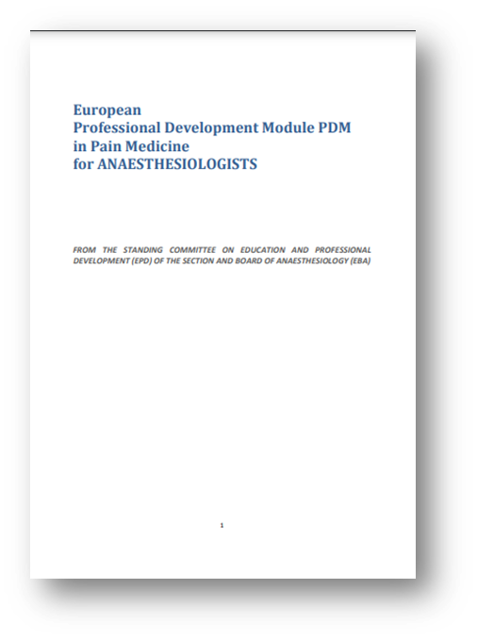
Summary
The aim of the PDM in pain medicine for anaesthesiologists is to provide a framework for harmonising the practice and teaching of advanced pain medicine across Europe by expert specialist clinicians.
The PDM in Pain Medicine for anaesthesiologists could serve as a model for advanced training in other medical disciplines involved in pain medicine (e.g. radiology, surgery, neurology etc.).

Slide 31

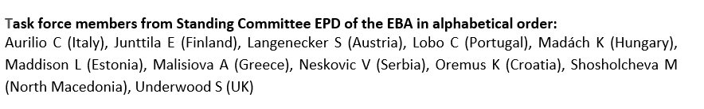
Thanks !
Special thanks – to all EBA members!!!
https://www.eba-uems.eu/

