Slide 1
Introduction of the submitted ETRs and feedback of the ETR Review Committee
Nada Cikes
Chair, European Training Requirements Review Committee
Advisory Board meeting and UEMS Council meeting
Brussels, October 2024

Slide 2
ETR review and appraisal process
Terms of Reference (ToR) for ETR Review Committee (ETR RC)
New ETR proposal to be submitted 3 months before the UEMS Council
The draft ETRs is published on the Google Drive,
All UEMS Bodies and NMAs are invited to participate in consultation
ETR Review Committee
  leads the review process
  facilitates dialogue in areas of conflicting approaches and interests
  ensures that the UEMS procedure for ETR development is followed
Advisory Board meeting (Specialty Sections & Boards, MJCs)
  ETR presentation and discussion - not resolved in the review process
UEMS Council meeting (National Medical Associations)
  ETR presentation and discussion - issues brought forward by the NMA’s

Slide 3
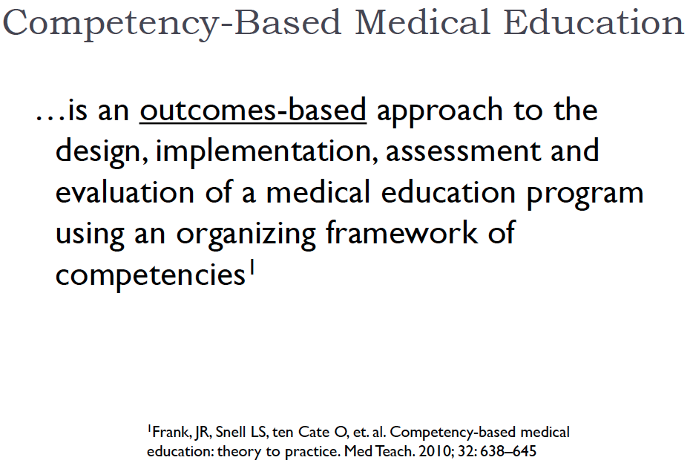
Challenges
  Implementation of Competency Based Medical Education
“…..As a new paradigm, CBME will result in a dramatic shift in the way physicians are trained
We must ensure……… that medical education and postgraduate training systems continue to meet the needs of our Patients…²
Methods of assessments
EPA – Entrustable Professional Activities
(or Entrustable Performance Assessment)
²http//canmeds.royalcollege.ca/

Slide 4
New or revised ETR documents
UEMS Council meeting, October 2024
By 16th of July 2024 proposed were ETRs:
ETR for the Specialty in Ophthalmology
European Professional Development Modules PDM in Pain Medicine for Anaesthesiologists
ETR for the Specialty of Plastic, Reconstructive and Aesthetic Surgery
ETR for Competencies in Rare Neurological Diseases
Review process ended 17th of August followed by authors’ responses and corrections of the proposed texts
ETR for the Specialty in Orthopaedics and Traumatology
was proposed for the last UEMS Council meeting and participated in the last review process. Corrections were prepared for this AB and Council meeting

Slide 5
Members of the ETR Review Committee
Professor Nada Čikeš, Rheumatology, Croatia, Chair
Professor Arthur Felice, General Surgery, Malta, Vice Chair
Professor Ute Moog, Genetics, Germany
Professor Reinold Gans, Internal Medicine, The Netherlands
Professor Monika Brodmann Maeder, ISWF, Switzerland
Dr. Marc Hermans, Psychiatry, Belgium
Professor Leila Niemi-Murola, Anaesthesiology, Finland
Professor Paolo Ricci, Radiology, Italy
Professor Felix Tanner, Cardiology, Switzerland
Dr. Andrew Brittlebank, Psychiatry, UK
Professor Pedro Lara, Radiation Oncology, Spain

Slide 6
Roles/responsibilities of ETR RC
Revise – modernise the ETR Template
Create Guidelines for writing new ETRs
  in accordance with CBME
  Based on principles of transforming education to strengthen health system
Revise the ToR for ETR RC -> roles/responsibilities of the ETR RC
To invite sections and Boards to write/revise ETRs
Prepare the 2nd UEMS-ETR conferences
  To define format (as compared to CME-CPD conference)
  To select main topics for plenaries
  To select topics for discussions/panels
  To engage NMAs
  To invite and include participants from EU institutions

Slide 7
ETR RC Working groups
Review of ETR template and Timeline
Ute Moog, MD, PhD
UEMS Section of Medical Genetics
Competence Based Education implementation in
postgraduate medical education
Leila Niemi-Murola, MD, PhD, MME
UEMS Section of Anaesthesiology
Working groups need to collaborate closely and interactively developing the content

Slide 8

Review of ETR Template and Timeline
How to proceed
How can we better support UEMS bodies writing/revising ETRs?
What have you been missing when writing/revising your ETR
What do we have?
UEMS documents
What is missing or should be amended?
Timeline WG Review of ETR template and Timeline

Slide 9

CBE implementation in postgraduate medical education
The five core components of CBME
Outcomes framework
EPA
Programmatic assessment
Progressive sequencing of competencies
Teaching tailored to competencies
Learning experiences tailored to competencies
van Melle et al Acad Med 2019

Slide 10
Are all stakeholders aware of the intended learning goals ?
Are all aware of terms and definitions ?
Language problems
- English vs. native language
- ”cut the edu-speak”
Misunderstandigs
- if people don’t grasp the idea, they will take their pick of what they understand
CanMEDs
- competence, competency
Incentives
Outcomes framework
CBE implementation in
postgraduate medical education

Slide 11
Future steps
To better present the ETR RC and its role
To revise the ETR RC Terms of Reference
To strengthen the plans of ETR RC working groups
To support the collaboration of UEMS Sections with European
scientific societies (ESS) and national societies
To revise or propose new ETRs
To invite NMAs to influence the implementation of ETRs
  to establish the Committee of all delegates - national representatives to
  UEMS S&Bs and MJCs to be strong connections to the stakeholders involved
  in the process of implementing the ETRs in their country
  to reassure they have two national representatives to all UEMS sections, one of them
  with academic engagement

