Slide 1
Report of the Officer for EU & Int’l Affairs
UEMS Council meeting 18 – 19 October 2024

Slide 2
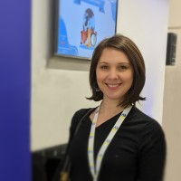
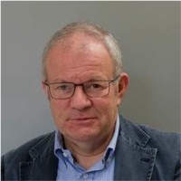
Report of the Officer for EU & Int’l Affairs
The Office now
Mrs.Isabelle DUMAINE Dr. Marc HERMANS the TASK FORCE

Slide 3
Report of the Officer for EU & Int’l Affairs
Mrs. DUMAINES’ activities
Started in 2024 on EU issues
regular meetings with the Officer for EU & Int’l Affairs
focusing on UEMS communication strategy
presented the strategy to the EEC in February
a major milestone: the launch of the new UEMS website
…

Slide 4
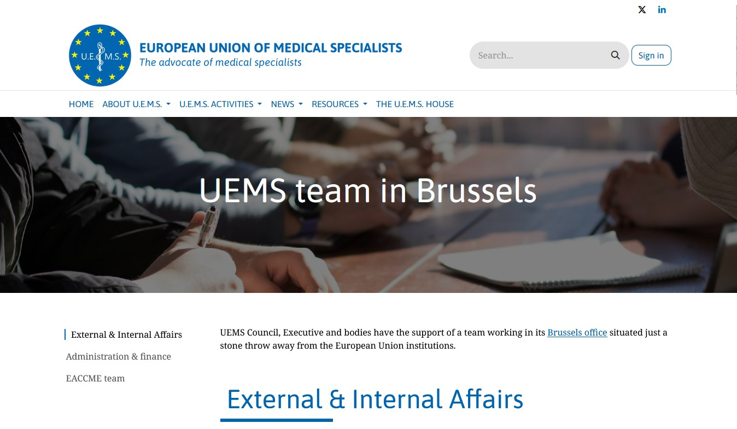
Report of the Officer for EU & Int’l Affairs
Mrs. DUMAINES’ activities
A major milestone: the launch of the new UEMS website
…
…
…
…

Slide 5
Report of the Officer for EU & Int’l Affairs
Mrs. DUMAINES’ activities
UEMS involved in 2 EU funded initiatives
KEEPCARING
addressing mental health of health care professionals
DISCERN-DSS (submitted)
improve digital health uptake in Indonesia and the wider Asian region
digital soft skills training

Slide 6
Report of the Officer for EU & Int’l Affairs
Mrs. DUMAINES’ activities
September 2024: European Commission’s mandatory survey on implementation
of the Direcive on Recognition of Professional Qualifications
After a request for input
the Section of Physical & Rehabilitation Medicine requested
to ask for a change in the title from Physiotherapy => PRM

Slide 7
Report of the Officer for EU & Int’l Affairs
Mrs. DUMAINES’ activities
Produces a monthly update on EU affairs
sent around by email
gets very positive comments from different UEMS bodies
Throughout the year attending meetings, webinars, short conferences
organised by European organisations, the EU Commission

Slide 8
Report of the Officer for EU & Int’l Affairs
The activities of the Officer for EU & Int’l Affairs
Meetings with UEMS bodies
mostly focusing on particular issues
during online meetings
Attending more live meetings in the future ?
an example: the Autumn meeting of the PRM Section

Slide 9
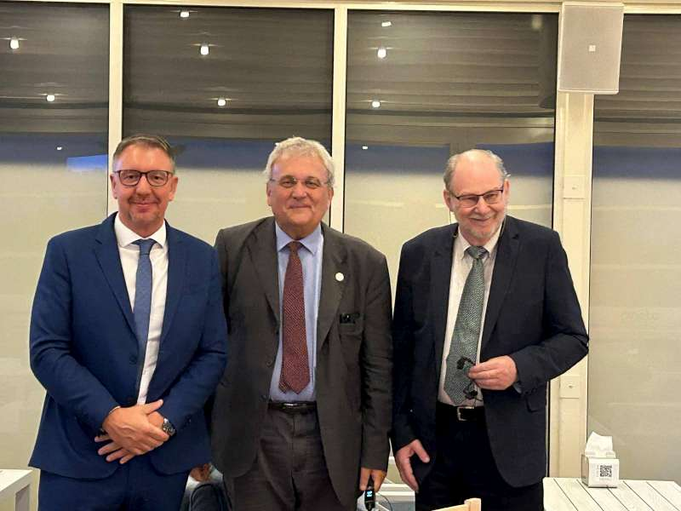
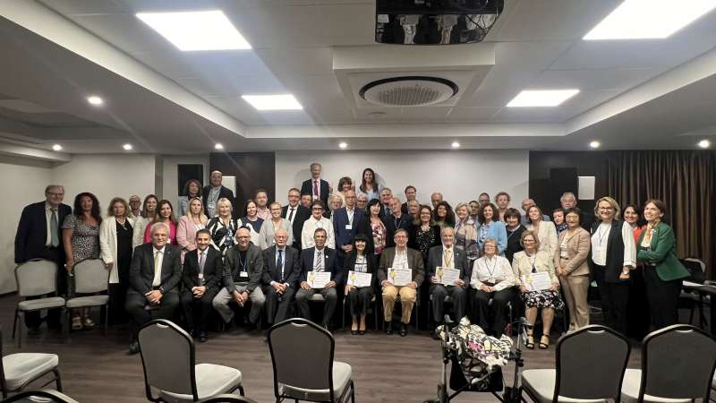
Report of the Officer for EU & Int’l Affairs
The activities of the Officer for EU & Int’l Affairs
The Autumn meeting of the PRM Section offered opportunities
to meet delegates from professional and scientific associations,
together with the Section’s colleagues
**
**

Slide 10
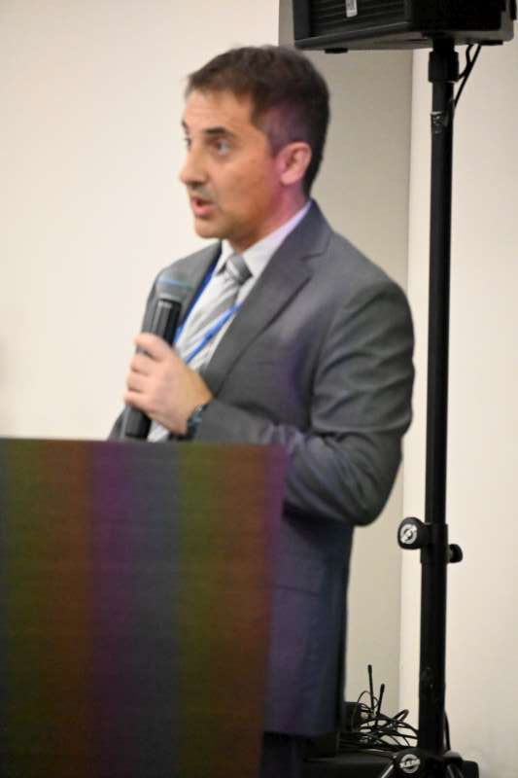
Report of the Officer for EU & Int’l Affairs
The activities of the Officer for EU & Int’l Affairs
The Autumn meeting of the PRM Section offered opportunities
to learn how the Section organises it’s EU examinations
evaluates it’s exam’s questions
finds cut-off values
in a very impressive way

Slide 11
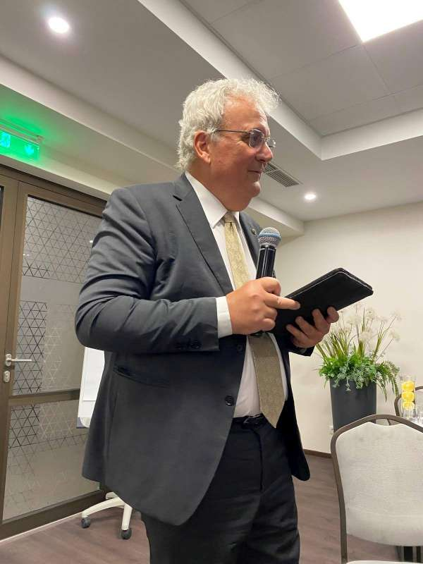
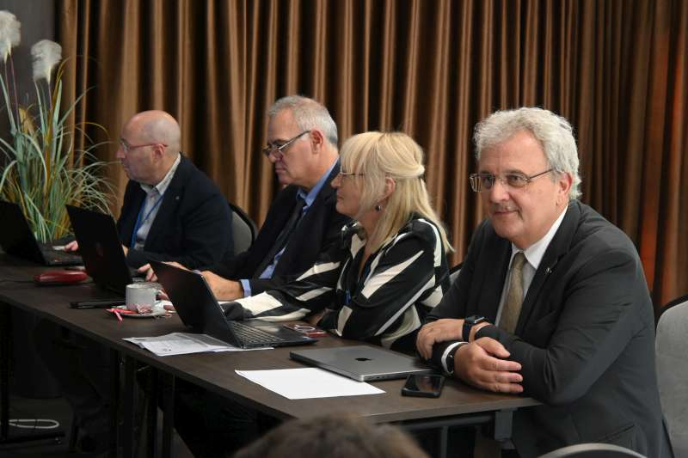
Report of the Officer for EU & Int’l Affairs
The activities of the Officer for EU & Int’l Affairs
The Autumn meeting of the PRM Section offered opportunities
to experience how the Section organises it’s meetings
**
**
*

Slide 12
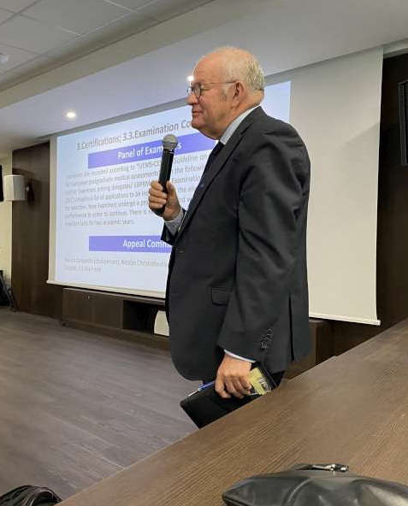
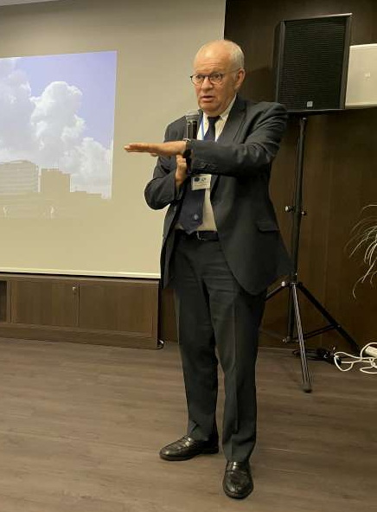
Report of the Officer for EU & Int’l Affairs
The activities of the Officer for EU & Int’l Affairs
The Autumn meeting of the PRM Section offered opportunities
to explain the rationale behind policy
clarify decision processes **

Slide 13
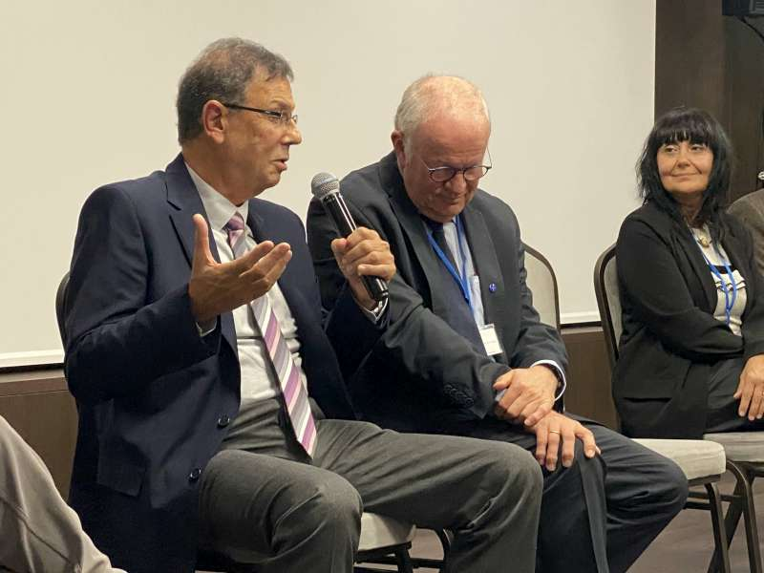
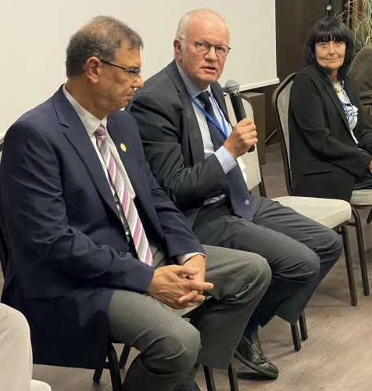
Report of the Officer for EU & Int’l Affairs
The activities of the Officer for EU & Int’l Affairs
The Autumn meeting of the PRM Section offered opportunities
to listen experienced colleagues
reflect on their words
…
or sharing one’s opinion

Slide 14
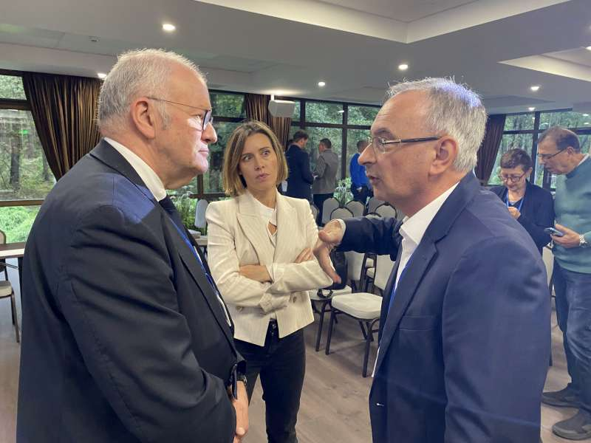
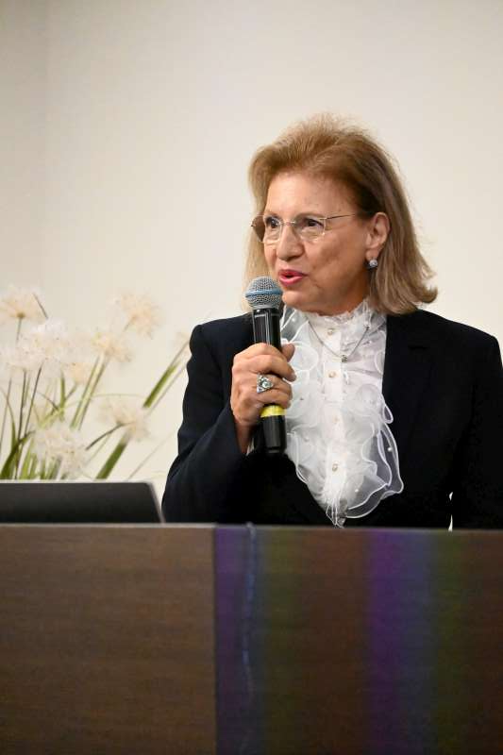
Report of the Officer for EU & Int’l Affairs
The activities of the Officer for EU & Int’l Affairs
The Autumn meeting of the PRM Section offered opportunities
to carefully listen to newly elected officers
**
of a Section’s Bureau
**

Slide 15
Report of the Officer for EU & Int’l Affairs
The activities of the Officer for EU & Int’l Affairs
Regular meetings with other European Medical Organisations
**
**
**
CEOM

Slide 16
Report of the Officer for EU & Int’l Affairs
The activities of the Officer for EU & Int’l Affairs
European Academy for Clinical Leadership - EACL
initiated by AEMH and UEMS
jury members from different EMOs
end of career applicants
early career colleagues

Slide 17
Report of the Officer for EU & Int’l Affairs
The activities of the Officer for EU & Int’l Affairs
European Academy for Clinical Leadership - EACL
leadership qualities are different from managerial qualities
1. composing a portfolio
2. presenting a project
3. obtaining a diploma

Slide 18
Report of the Officer for EU & Int’l Affairs
The activities of the Officer for EU & Int’l Affairs
European Observatory on Health Systems and Policies
attending its interesting webinars
the one on Health Care Workers Shortages
highlighted different research projects
AHEAD, OASES, ROUTE HWF, TASHI, METEOR

Slide 19
Report of the Officer for EU & Int’l Affairs
The activities of the Officer for EU & Int’l Affairs
European Observatory on Health Systems and Policies
a visit to the research team lead by Prof. Goderis (KULeuven)
UEMS can rely on their input whenever necessary
**
**

Slide 20
Report of the Officer for EU & Int’l Affairs
The activities of the Officer for EU & Int’l Affairs
High-Level Conference on the Future of the EU Health Union
conference in Brussels, organised by the Belgian EU Presidency
panels of politicians, policy makers and stakeholders of all kinds
☹
limited time slots for patients and medical professionals
frustration pushed Dr. Martin Balzan and me to initiate a document
on Health Care Workforce shortage

Slide 21
Report of the Officer for EU & Int’l Affairs
The activities of the Officer for EU & Int’l Affairs
Health Care Workforce Shortages – development of an EMOs’ statement
are numbers for necessary HC Workers available => NO
using texts produced by the METEOR project as inspiration
a reiterative process developing and finalising the text
actually in the process of approval by EMOs’ executive committees

Slide 22
Report of the Officer for EU & Int’l Affairs
The activities of the Officer for EU & Int’l Affairs
Developing a WHO Europe survey with other EMOs
Dr. Tomas Zapata (WHO Europe) asked UEMS for collaboration
involved in developing a WHO Europe survey on individual HC workers,
an EU funded project on health of doctors and nurses
the link to the online survey will be sent around to UEMS Members

Slide 23
Report of the Officer for EU & Int’l Affairs
The activities of the Officer for EU & Int’l Affairs
Symposium in Amsterdam
organised by CPME & Royal Dutch Society of Pharmacists (branch of PGEU)
on shortages of medicines, medical devices and health care workers
Dr. Mathias Wismar (European Observatory for HC Systems & Policies)
DG GROW as main obstacle for change ?!

Slide 24
Report of the Officer for EU & Int’l Affairs
The activities of the Officer for EU & Int’l Affairs
The European Patients’ Forum 16th of October 2024
first contact with Mrs. Anca TOMA during the symposium in Amsterdam
a follow-up meeting together with Mrs. Dumaine at the EPF’s secretriat
on 16th of October representing UEMS
at their meeting, further exploring

Slide 25
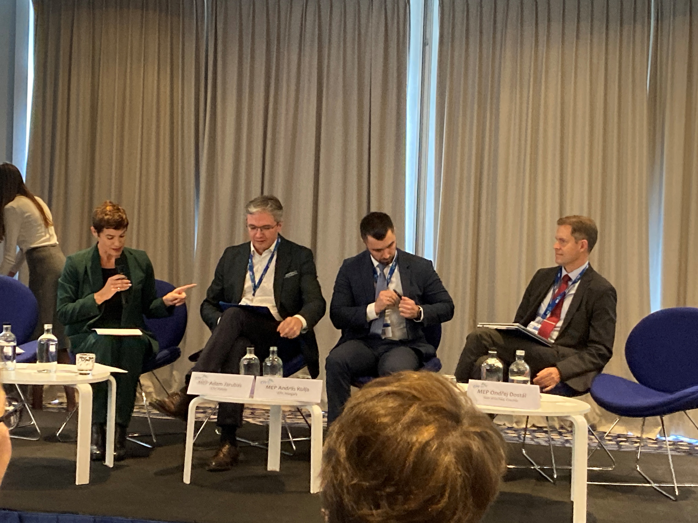
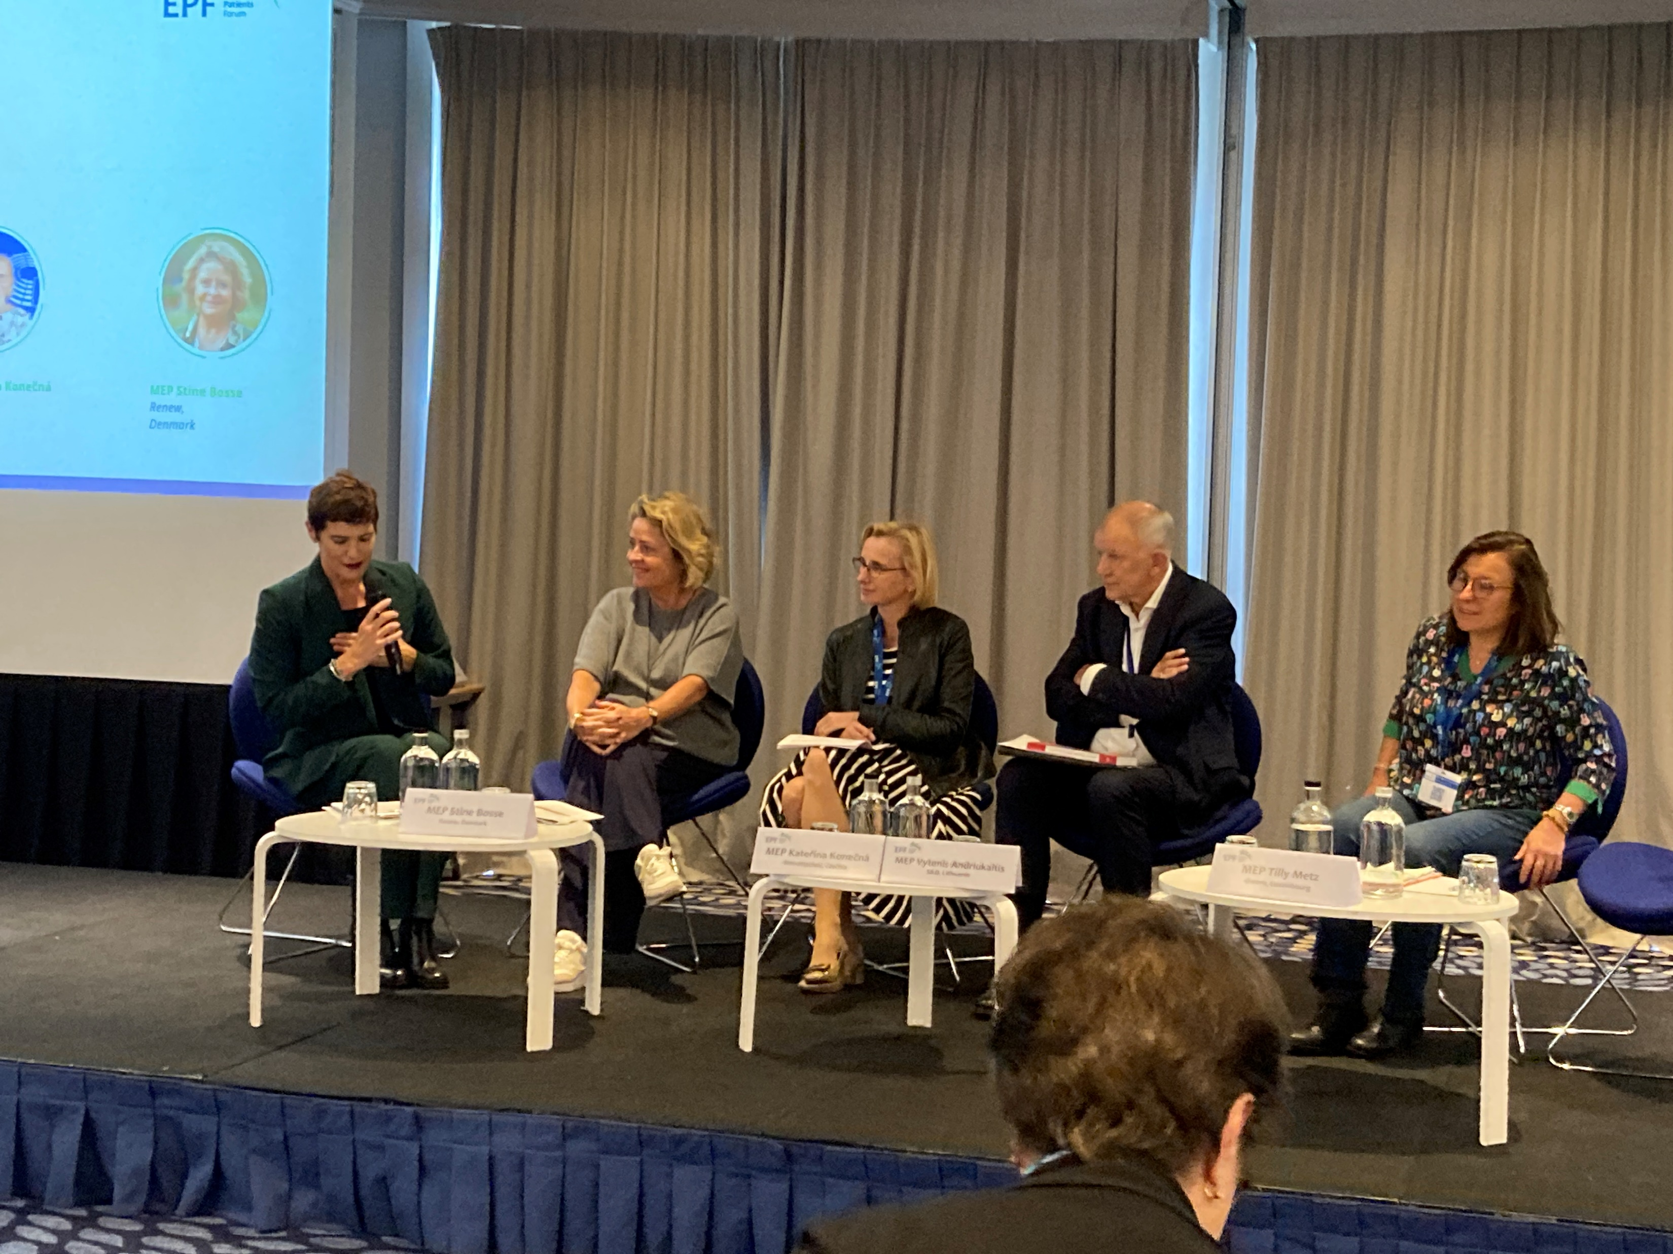
Report of the Officer for EU & Int’l Affairs
The activities of the Officer for EU & Int’l Affairs
The European Patients’ Forum

Slide 26
Report of the Officer for EU & Int’l Affairs
The activities of the Officer for EU & Int’l Affairs
4th World Summit in Competency-Based Education in HC Professions - Basel
opening plenary: “The UEMS aiming at Competency Based Education”
interest for criteria concerning ETRs, accreditation of CME&CPD initiatives
…
…

Slide 27
Report of the Officer for EU & Int’l Affairs
The activities of the Officer for EU & Int’l Affairs
4th World Summit in Competency-Based Education in HC Professions - Basel
Prof. Monika Brodmann Maeder (CH) organising committee member
Prof. Leila Niema Murola (FIN) introduced me
main focus of the event: Entrustable Professional Activities (EPAs)
very relevant for the further development of ETRs !

Slide 28
Report of the Officer for EU & Int’l Affairs
The activities of the Officer for EU & Int’l Affairs
AMEE Basel 2024 – Connect, Grow and Inspire
annual congress of the Association for Medical Education in Europe
has an impressive global impact due to an equally impressive programme
compass to new aspects of education
scientific & experiential aspects

Slide 29
Report of the Officer for EU & Int’l Affairs
The activities of the Officer for EU & Int’l Affairs
AMEE Basel 2024 – Connect, Grow and Inspire
remediation interventions for poorly performing trainees
how to use the input from medical students
offering training in L&MICountries
aspects of AI in training (e.g. ChatGPT)

Slide 30
Report of the Officer for EU & Int’l Affairs
The activities of the Officer for EU & Int’l Affairs
Care2Care - project
UEMS was invited to become a member in a new project
“Promote mental health and wellbeing among healthcare workers in Europe”
COST - European Cooperation in Science and Technology
funding organisation for research and innovation

Slide 31
Report of the Officer for EU & Int’l Affairs
The activities of the Officer for EU & Int’l Affairs
UEMS Task Force for EU & Int’l Affairs
announced during the Council’s Spring meeting
Prof. Akyol Umut Dr. Brittlebank Andy Prof. Cikes Nada Prof. Halilah Hannuh Prof. Krajewski Romuald Dr. Patil Naishad Mrs. Dumaine Isabelle
… kick-off meeting on 16th of September
…
… many thanks to its members

Slide 32
Report of the Officer for EU & Int’l Affairs
The activities of the Officer for EU & Int’l Affairs
UEMS Task Force for EU & Int’l Affairs
develop strategies to increase UEMS’ “soft power”
… more widely known ETRs => will increase their implementation
… => will promote development of EU exams
… establish working contacts with EU institutions (DG GROW?) and MEPs

Slide 33
Report of the Officer for EU & Int’l Affairs
The activities of the Officer for EU & Int’l Affairs
UEMS Task Force for EU & Int’l Affairs
expand existing contacts with other stakeholders
… WHO Europe and national politicians,
… educational institutions and their networks (Royal Colleges)
… look for common interests shared with other stakeholders

Slide 34
Report of the Officer for EU & Int’l Affairs
The activities of the Officer for EU & Int’l Affairs
My plan for the time coming:
what are our Members’ & Sections’ expectations from UEMS ?
… what would you add to these suggestions ?
… how do you look to the future ? (pandemic, conflicts, climate changes, …)

Slide 35
Report of the Officer for EU & Int’l Affairs
The activities of the Officer for EU & Int’l Affairs
…
bit.ly/ bit.ly/MHsurveyEU
…
isabelle@uems.eu
…
marc.uems@telenet.be
Thanks for your attention

