Slide 1

Presentation
Financial Report
UEMS Council • Brussels • 10.2024

Slide 2

Profit & Loss Account
2023

Slide 3

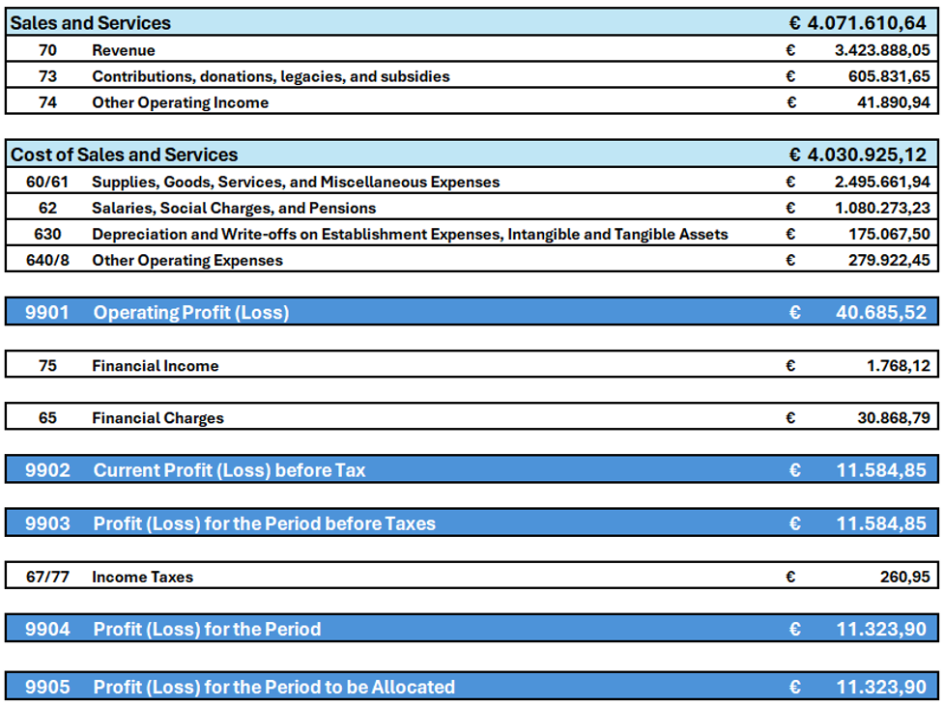

Slide 4
Balance Sheet
2023

Slide 5
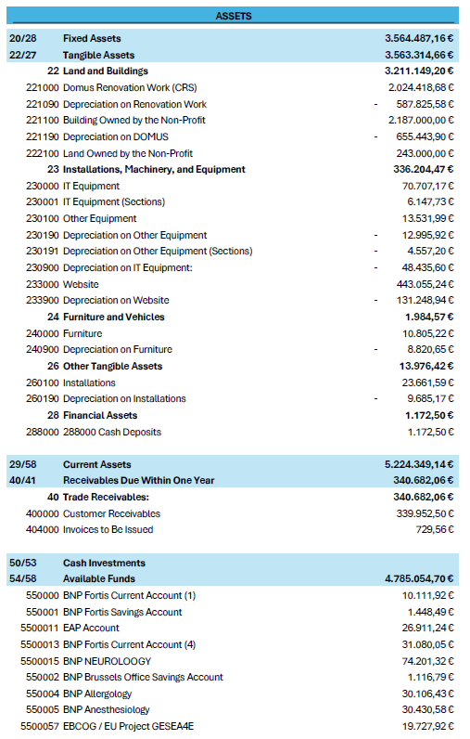
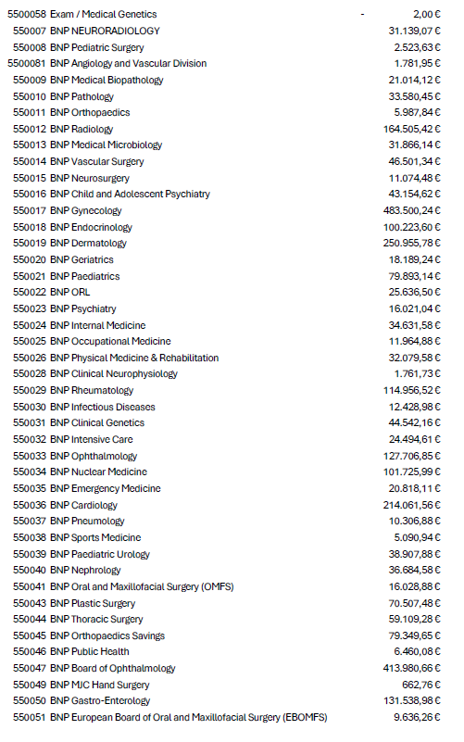

Slide 6
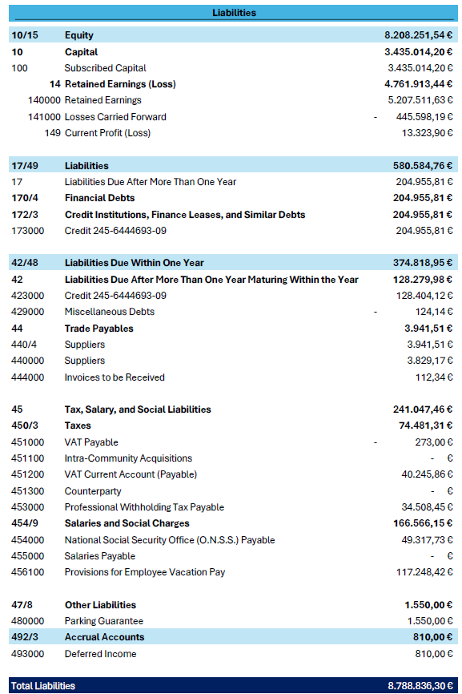
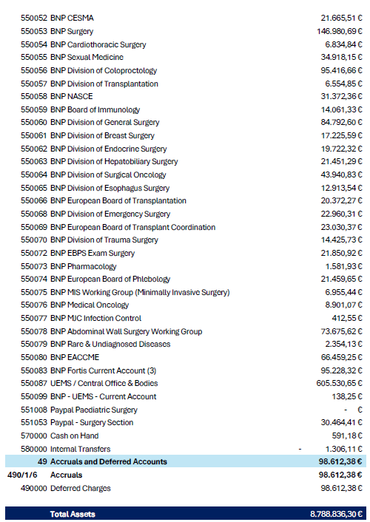

Slide 7
Profit & Loss
1st Semester 2024

Slide 8
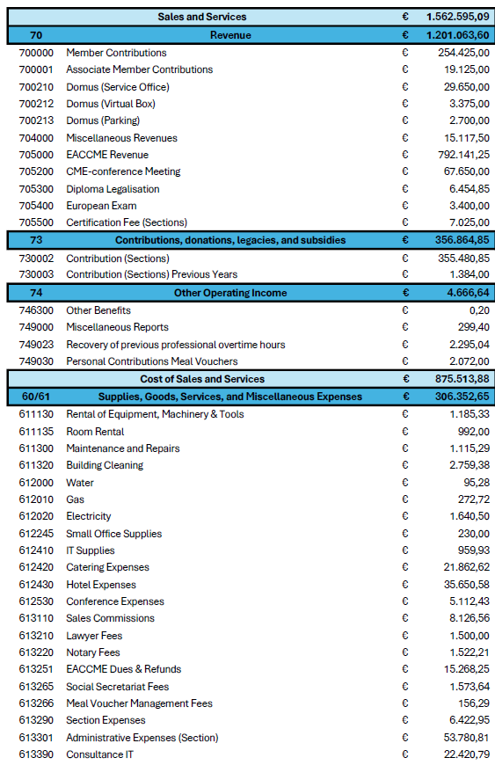
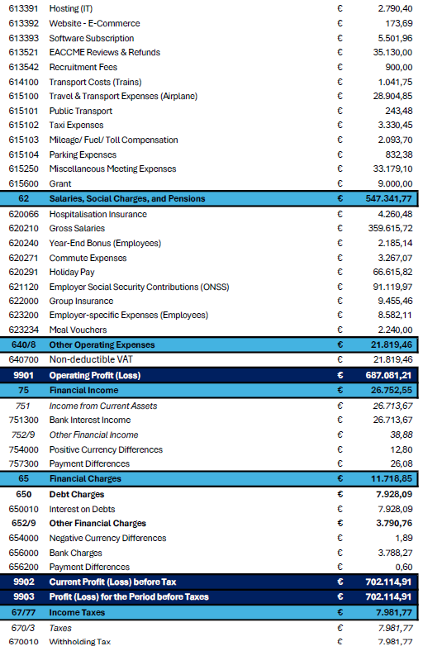


Slide 9
Profit & Loss
01.01.2024 – 30.09.2024

Slide 10
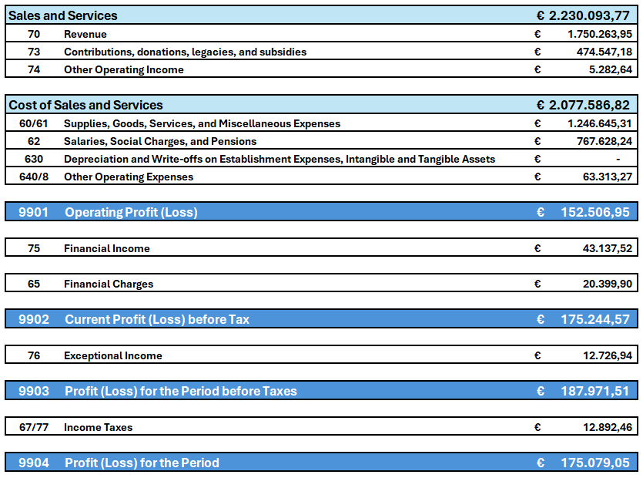

Slide 11
Budget 2025
Proposal

Slide 12
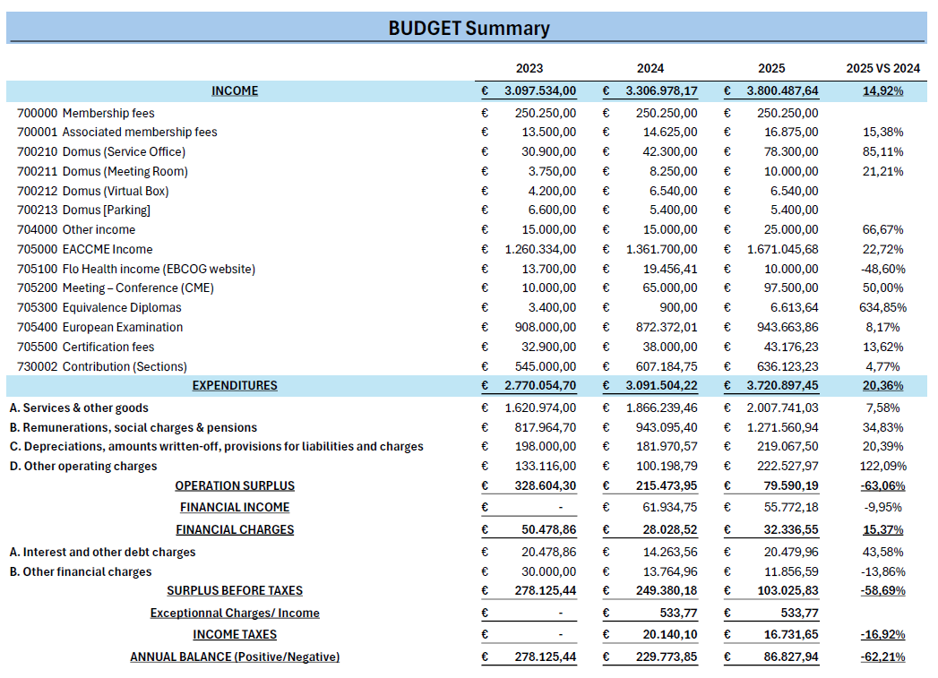

Slide 13
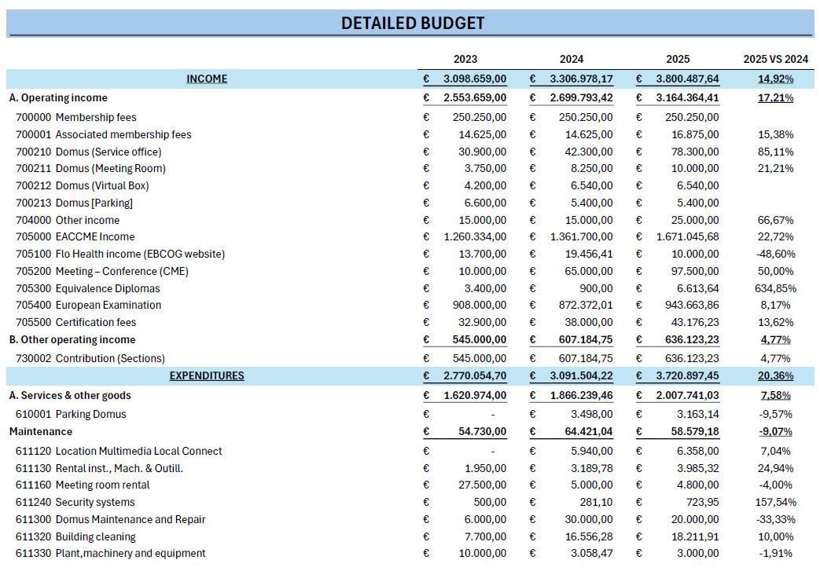

Slide 14
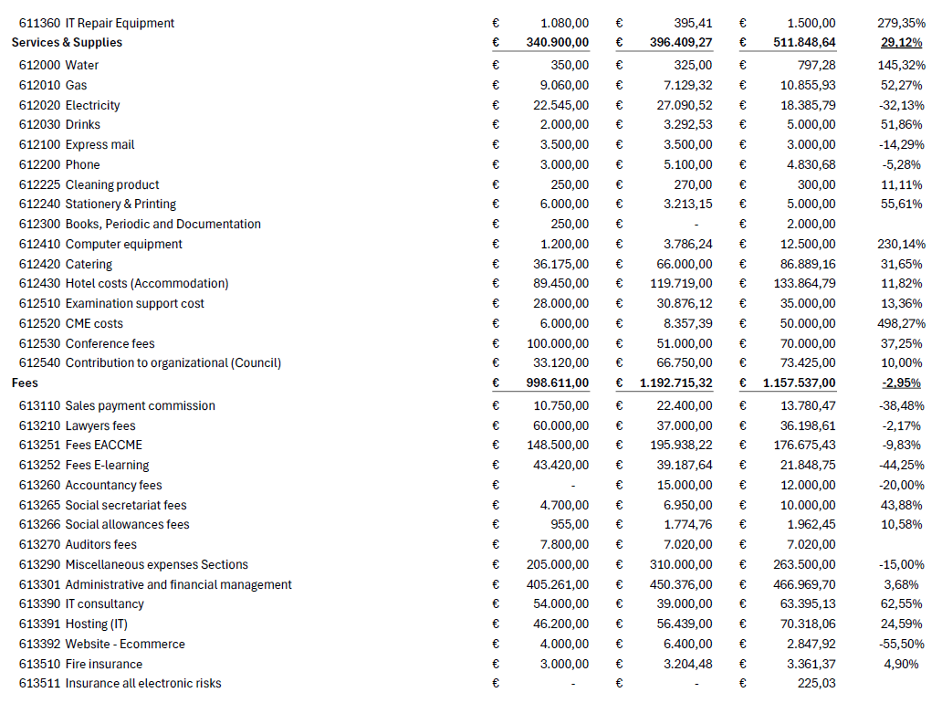

Slide 15
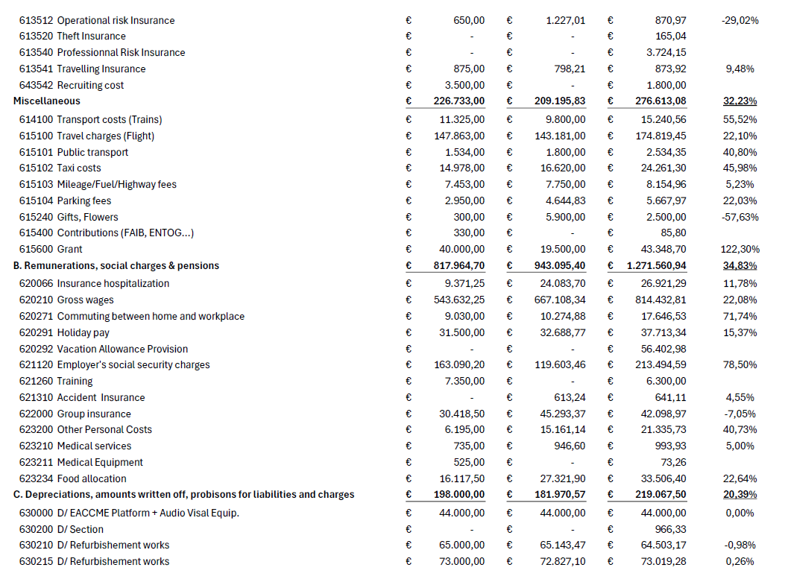

Slide 16
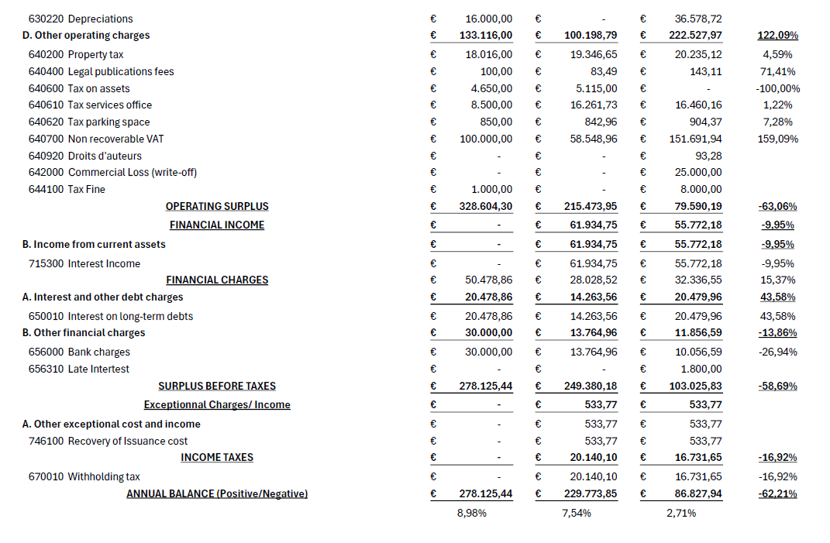

Slide 17
Loan

Slide 18
Loan 245-6444693-09 - Interest 4.924%
30/09/2011 | Capital | Interest | Annual Repayment
2011 | - 34,102.42 | 37,231.42 | 71,333.84
2012 | - 70,796.07 | 71,871.61 | 142,667.68
2013 | - 74,397.22 | 68,270.46 | 142,667.68
2014 | - 78,181.52 | 64,486.16 | 142,667.68
2015 | - 82,158.34 | 60,509.34 | 142,667.68
2016 | - 86,337.43 | 56,330.25 | 142,667.68
2017 | - 90,729.09 | 51,938.59 | 142,667.68
2018 | - 95,344.16 | 47,323.52 | 142,667.68
2019 | - 100,193.96 | 42,473.72 | 142,667.68
2020 | - 105,290.46 | 37,377.22 | 142,667.68
2021 | - 110,646.21 | 32,021.47 | 142,667.68
2022 | - 116,274.37 | 26,393.31 | 142,667.68
2023 | - 122,188.82 | 20,478.86 | 142,667.68
2024 | - 128,404.12 | 14,263.56 | 142,667.68
2025 | - 134,935.56 | 7,732.12 | 142,667.68
2026 | - 70,020.25 | 1,313.59 | 71,333.84
Total | - 1,500,000.00 | 640,015.20

Slide 19
Common Investment

Slide 20
First period: 16.02.2024 – 16.05.2024
  Invested amount: € 1,927,078.99
  Net interest: € 11,708.19
  Total amount: € 1,938,787.18
Second period: 21.05.2024 – 21.08.2024
  Invested amount: € 1,838,787.18
  Net interest: € 11,452.47
  Total amount: € 1,850,239.65
Third period: 28.08.2024 – 28.11.2024
  Invested amount: € 1,850,239.65
  Net interest: € 10,511.80
  Total amount: € 1,860,751.45
Total Net Interest: € 33,672.46

