Slide 1

UEMS Congress
27-30 May 2026, Leuven

Slide 2


Purpose
Open the UEMS to the rest of the world

Slide 3

Content
ETR Conference (1st Conference 20/04/2023)
EACCME Conference (every two years – 8-9/03/2024)
Presentation of the
UEMS’ various activities (Sections, CESMA, NASCE…)
UEMS’ partnerships

Slide 4
Format
Workshops
Rountables
Discussions
Abstracts
…

Slide 5

Expected attendance
1,000 participants
UEMS members
UEMS partners
External participants

Slide 6
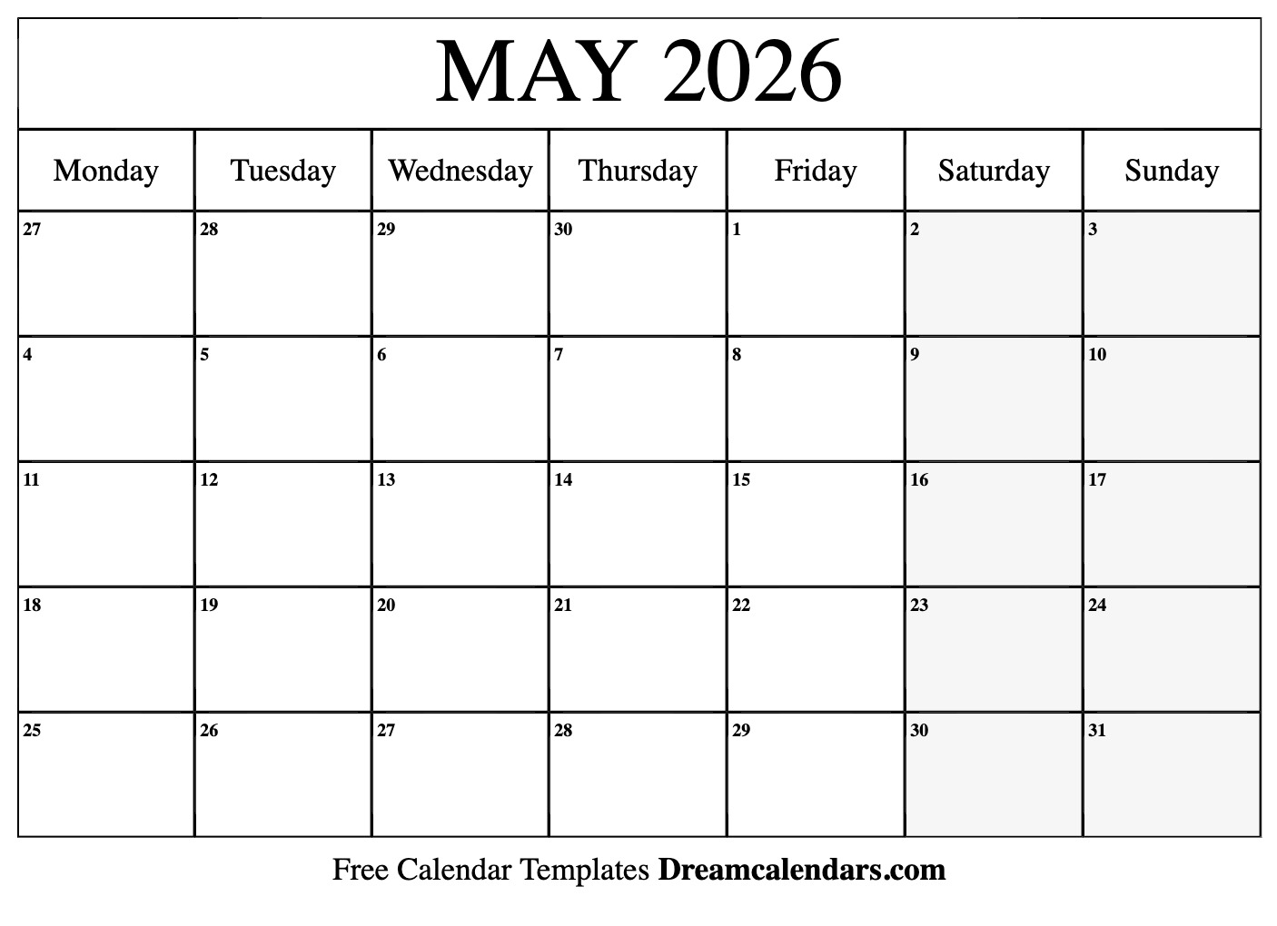

When?
27 May: late afternoon start
28 May: full day meeting
29 May: full day meeting
30 May: half-day meeting

Slide 7

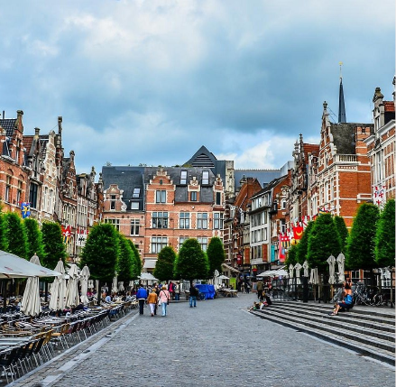
Leuven
Leuven is situated at 28 km from Brussels
Easily accessible by train from Brussels airport (15 min)
Historical city with a rich cultural heritage
Known for its high-ranking university
Dynamic international community

Slide 8
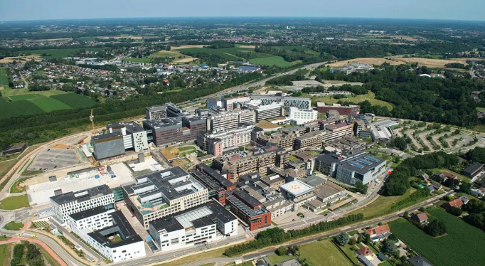
Venue
Gasthuisberg
University
Hospital
(Leuven, Belgium)

Slide 9
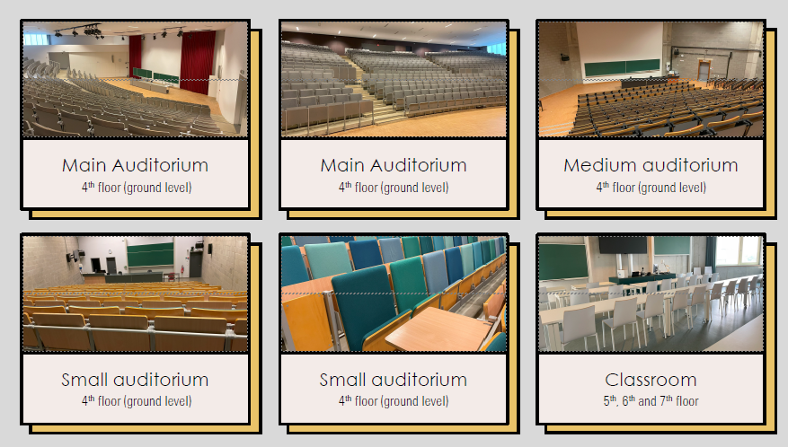
Meeting rooms

Slide 10

SAVE THE DATE

