Slide 1
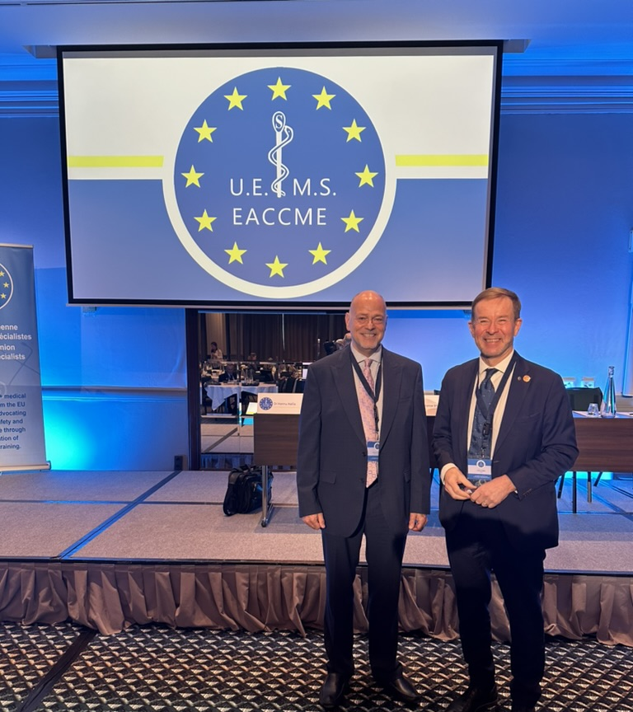
An Overview of CME/CPD Systems in Europe
AMEE 2024, Basel
Lawrence Sherman, President, Meducate Global, LLC
In collaboration with Dr. Hannu Halila, Finland
Past President of UEMS, European Union of Medical Specialist

Slide 2
Purpose of the study
Describe requirements for physicians to engage in CME/CPD in Europe
Explore perceptions of country experts of their CME/CPD systems
Descrive perceptions about interprofessional CE and independent CME/CPD
Provide recommendations to improve quality and effectiveness

Slide 3
Methods
A mixed-methods approach:
  1:1 interviews with in-country subject matter experts (15 countries)
  Electronic survey capturing qualitative and quatitative data from practising in-country physicians (270 respondents from 27 countries)
  One in a series of four assessments about CME/CPD systems in different regions of the world and complementing two previously published studies in the Asia-Pacific region

Slide 4
Countries in the study
Population range: 3,9 million (Croatia) – 84,8 million (Turkey)
Physicians per 1000 people, range: 1,8 (Turkey)– 8,0 (Italy)

Slide 5
CME/CPD Requirements for Physicians
Requirement to participate in CME/CPD as a condition of licensure: 7 countries
1 country requires specialist physicians to participate
Participation in CME/CPD encouraged and often supported but not mandatory : 7 countries

Slide 6
Credit points from CME/CPD
  Amount of credits awarded may vary depending on the perceived impact/value of the activity
Regulatory body for CME/CPD
  Usually the same as the regulatory responsible for the practice of medicine, may be delegated to a more specialized branch

Slide 7
CME/CPD Accreditation Systems
EACCME, European Accreditation Council for Continuing Medical Education, by UEMS (European Union of Medical Specialists)
  By far the largest, founded in 2000, Accrediting over 2000 events yearly
  Mutual recognition of credits with USA and Canada
  www.uems.eu www.eaccme.uems.eu
EBAC, European Board for Accreditation of Continuing Education for Health Professionals
Royal College of Physicians in the United Kingdom
UK CPD Certification Services

Slide 8
Results from the Quantitative Survey
Aware of the country CME/CPD system
  Yes 80 %
  No formal system in my country 7%
Number of hours you participated in the past 12 monts
0: 9 %
1-20 : 34 %
21-40: 20 %
41-50: 17 %
51- : 20 %

Slide 9
Participation in CME/CPD should be compulsory?
  Strongly agree 39 %
  Agree 48 %
  Disagree 12 %
  Strongly disagree 1 %
Interprofessional CE is needed
  Yes 72 %
  No 5 %
  Not sure 12 %
  (Missing 11%)

Slide 10
What are your barriers to participating in CME/CPD?
Not covered in my budget 31 %
Not offered at convenient times 20 %
Topics not relevant/clinically important 14 %
Quality not high enough 15 %
Learning objectives not clear 14 %
Formats not flexible enough 13 %
Not enough skill bilding exercise 13 %
I do not have any barriers 20 %

Slide 11
Results from the Quantitative Survey
CME/CPD free from control by pharmaceutical or other commercial interests
  Strongly agree 14%
  Agree 36%
  Disagree 29%
  Strongly disagree 6 %
  (Missing 15 %)
CME/CPD funded by pharma or other commercial interest organizations can be free from bias
  Strongly agree 6 %
  Agree 35%
  Disagree 31 %
  Strongly disagree 11%
  (Missing 17 %)

Slide 12
Key findings from 1:1 interviews
There is value in implementing mandatory system to all physicians, though data shows that most do participate regardless
In countries with mandatory systems, sanctions for failure to participate were few
Interprofessional CE endorsed and philosophically supported, wide variation in whether it is actually available for physician learners

Slide 13
Key findings from 1:1 interviews (continued)
CME/CPD systems are quite mature compared to other areas of the world
CME/CPD systems are professionally self-regulated
Almost all countries have implemened policies or laws to limit the influence of commercial interest organizations (pharma or devise) over CME/CPD content

Slide 14
Key findings from 1:1 interviews (continued)
CME/CPD is readily available in a variety of different formats
Participation is hampered by costs and time constraints
Opportunities for improvement:
  Increasing innovation
  Improving transparency
  Decreasing admimistrative burdens
  More interprofessional continuing education

Slide 15

Thank you!
Kiitos!

