Slide 1
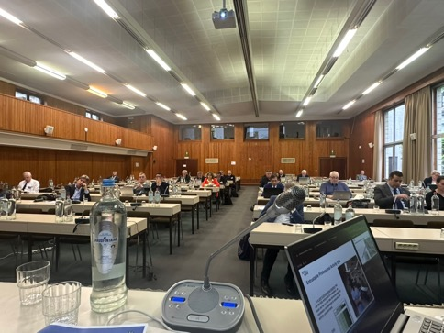
UEMS
Working Group of CME/CPD
April 26, 2024
Brussels
Dr. Hannu Halila
Chairman of the WG
UEMS Past President, Honorary Member
Gynecology, Finland

Slide 2
UEMS CME/CPD Working Group
Feedback from the 6 th UEMS Conference on CME/CPD, March 2024, Brussels
The agreement with UEMO about accreditation of educational activities for General Practitioners/Family doctors!
Became operational April 1, 2024 ; now already 5 applications to EACCME, UEMO will evaluate their content

Slide 3
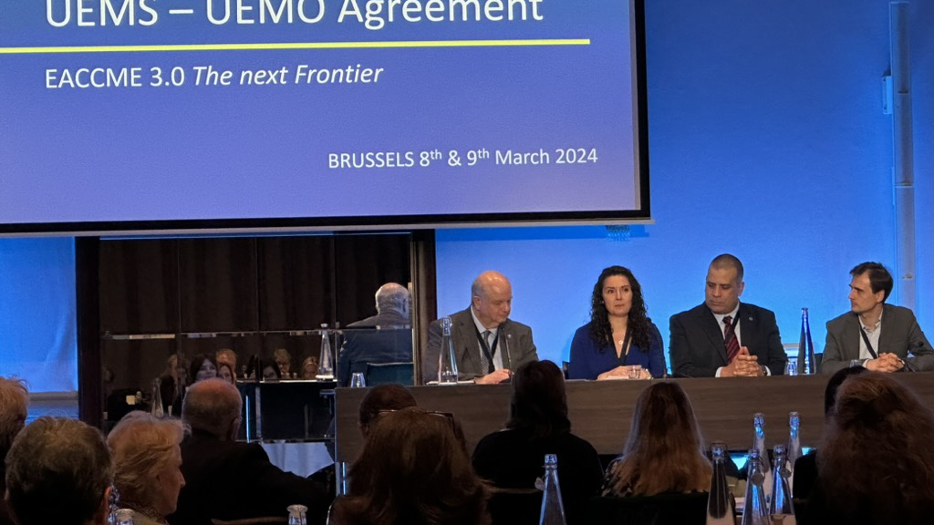

Slide 4

CBME, Competence Based Medical Education and CME/CPD
Excellent presentation by Dr. Monika Brodmann-Mäder
CBCPD
  Competence
  Based
  Continuos
  Professional Development

Slide 5
CBME + CME / CPD
Monika Brodmann Maeder, PD, MD, MME
President Swiss Institute of Medical Education SIME

Slide 6



Definition of Competence
Knowledge
Skills
Attitude
Outcome, not content

Slide 7

CBCPD: Take Home Message
CBME established in under- and postgraduate medical education
CanMEDS and EPAs can be applied to CPD
Control the physician, not the documents
Culture of life-long learning
Peer support and feedback as powerful instruments
K2 (Pakistan); 8611 m
Notes:
Because it is there
According to George Mallory,most famous for his response to the question, “why do you want to climb Mount Everest?”, to which he answered, “because it’s there”. Those 3 words sum up the mentality of mountaineers at that time: every mountain was there to be scaled, no matter the physical toll.

Slide 8


Slide 9
Revision of the UEMS CPD Policy, The Basel Declaration (2001)
Drafting of a more concise policy statement, taking into consideration new methods on CPD, new terminology, concept of Competence Based
Re: Paragraph 7. The UEMS believes strongly that CPD is part of the ethical responsibility of every doctor and recommends that all doctors should be able to verify their involvement in CPD activities. While there is considerable debate over whether CPD should be mandatory or voluntary, there is no European-level consensus on this.

Slide 10
UEMS CME/CPD Working Group, April 2024
New developments in the CME/CPD situation in the UEMS member countries
For information: AMEE (Association for Medical Education in Europe) Survey of the CME/CPD systems globally, European results were presented at the UEMS CME-CPD Conference in March, will be published in Medical Teacher (open access)
For information: Report from UEMS of analyzing over 6000 CME events by EACCME published in Ann Med Surg

Slide 11

Further work of the Working Group
Smaller Task forces to pursue the two projects
  UEMS Statement on Competence Based CPD
  Revision of the UEMS CPD Policy
  Next meeting of the entire Working
  Group, October 18, 2024, Brussels

Slide 12

Thank you!
Kiitos!
Helsinki, Finland, April 23

