Slide 1

Management Fee 2023 – Income 2022
09.2024

Slide 2

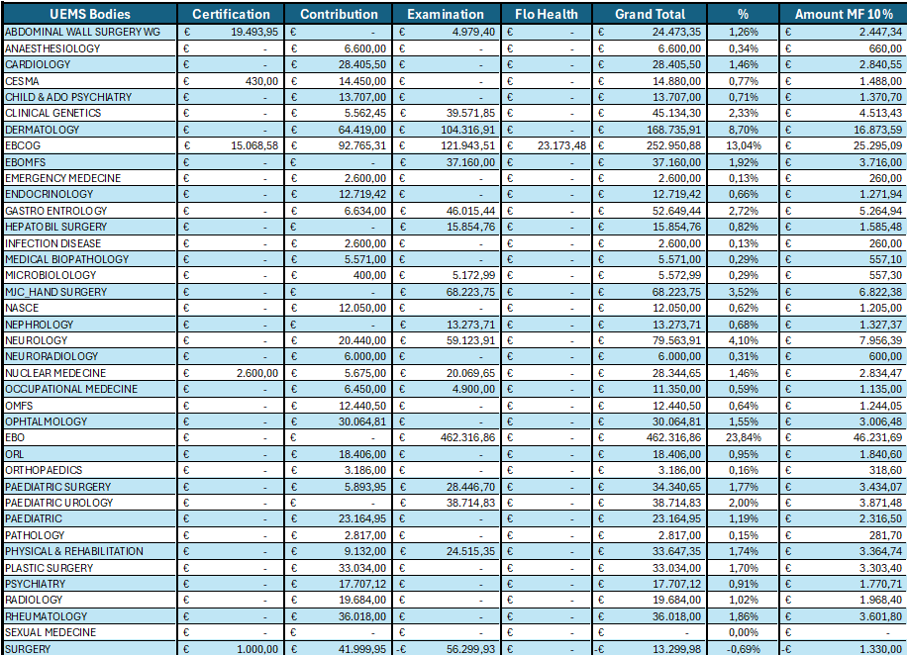

Slide 3
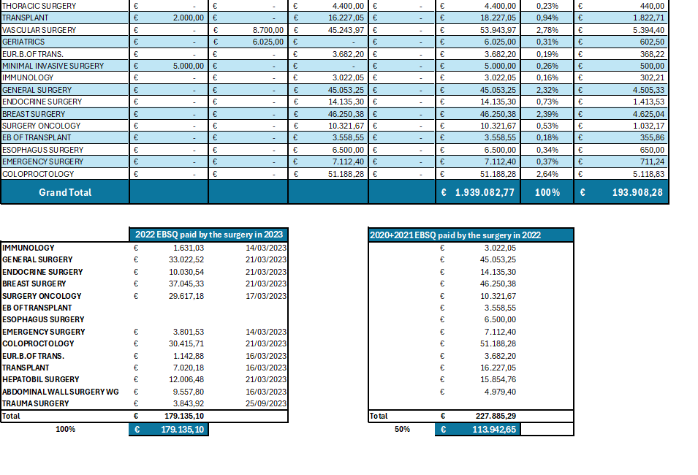

Slide 4
Comments
Total Income of the Section of Surgery from Examination Activity Only:
  236.777,82 €
Less: 100% of 2022 EBSQ paid by Surgery in 2023 to the Divisions:
  179.135,10 €
Less: 50% of 2020 + 2021 EBSQ paid by Surgery in the past to the Divisions:
  113.942,65 €
Total for Examination Activity in 2022:
  - 56.299,93 €

