Slide 1

Meeting of the
UEMS Working Group for Post Graduate Training
UEMS Autumn Council Meeting
Friday, 16 October 2026
11 :00 – 12 : 30
MAI – Maison des Associations Internationales
Rue de Washington 40, 1050 Brussels
Conference room : Brussels

Slide 2

Main points
Introductions / Presentation of newly attending members
Approval of the agenda / Previous Minutes
Discussion of the document on Accreditation of Training Centers
Beyond the Glossary – Standardisation of Terminology
Update on involving Fellows in UEMS Affairs
Future projects and scope of WG – Prof. Nash Patil
AOB

Slide 3

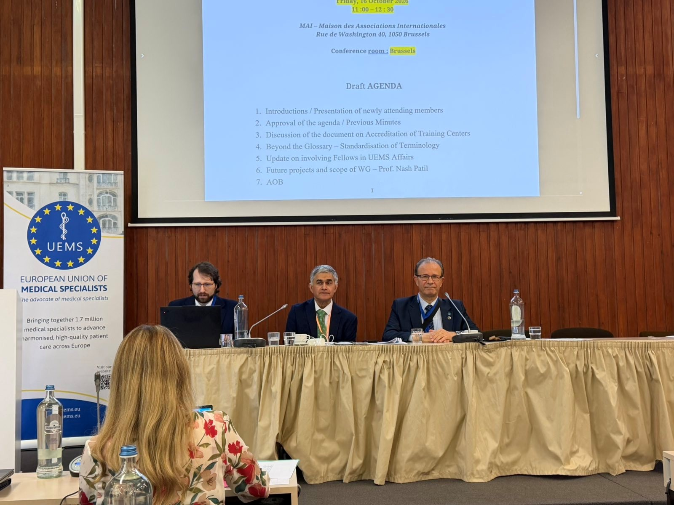
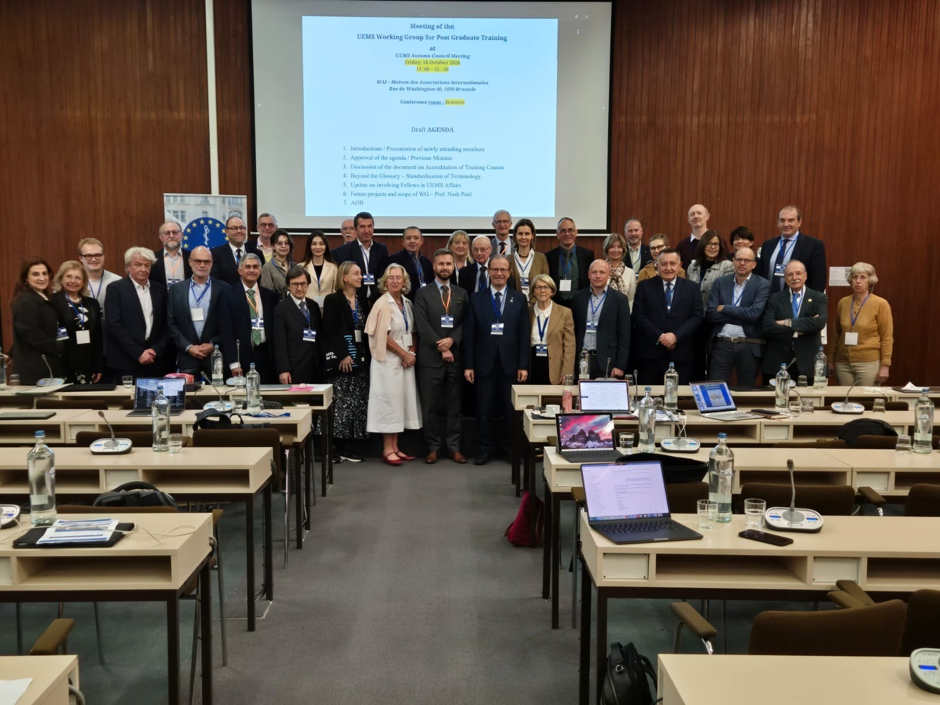
WG PGT Group

Slide 4

Thank you for your attendance!

