Slide 1
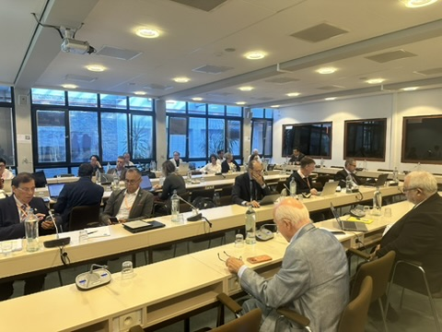

UEMS
Working Group of
CME/CPD
October 16, 2026, Brussels
Dr. Hannu Halila
Chair of the WG
UEMS Past President, UEMS Honorary Member
Gynecology, Finland

Slide 2

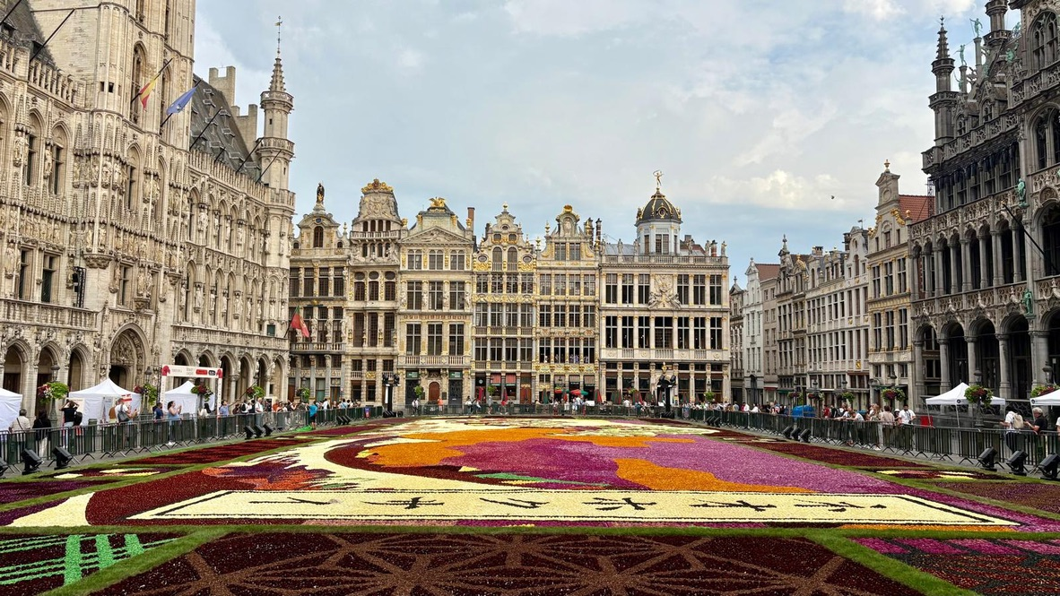
CME / CPD Working Group meeting
Meeting well attended by 33 colleagues representing widely the UEMS countries and various specialities,
lively and constructive
discussion

Slide 3
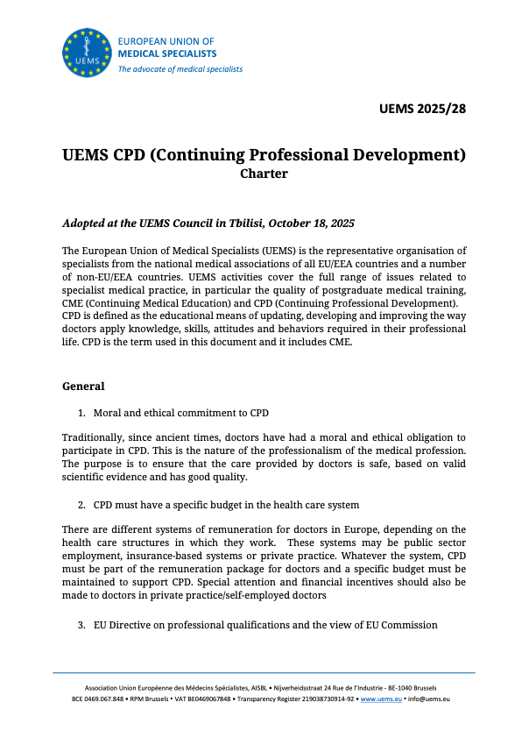
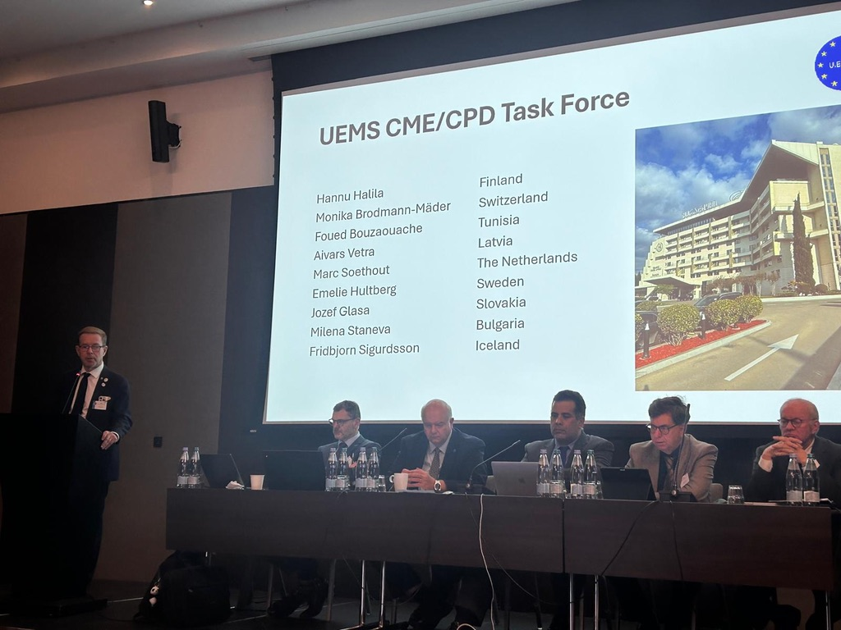
https://www.uems.eu/documents

Slide 4
UEMS CPD Charter , UEMS 2025/28
CPD Charter was accepted in October 2025 Council in Georgia. After that it has been distributed widely within the UEMS bodies, NMAs as well as outside partners and stakeholders
A short Executive summary of key points has been provided
NMAs have been asked to distribute it in their countries, at the same time make publicity of UEMS in their national medical journals
Social media important in the publicity of the Charter

Slide 5
Questionnaire about the current situation about
CME/CPD situation in the UEMS Member Countries
There is no current comprehensive information about this topic
Was sent to UEMS Members/NMAs in the beginning of August
Questionnaire had 18 questions
Thank you for all the colleagues answering !
The WG was presented preliminary results of the questionnaire and had a fruitful conversation about the information

Slide 6
Questionnaire about the current situation about
CME/CPD situation in the UEMS Member Countries
Questions covered :
  Mandatory?
  Recertification? Cycle of it. Requirements for it. Sanctions?
  Accreditation of CME activities, by which organisation
  Financing of CME/CPD
  Possibilities to participate in CME/CPD, what are the obstacles
  Suggestions for further action to EU, to UEMS
  Report of the Questionnaire to be published in 2027
  European Medical Specialist Review

Slide 7
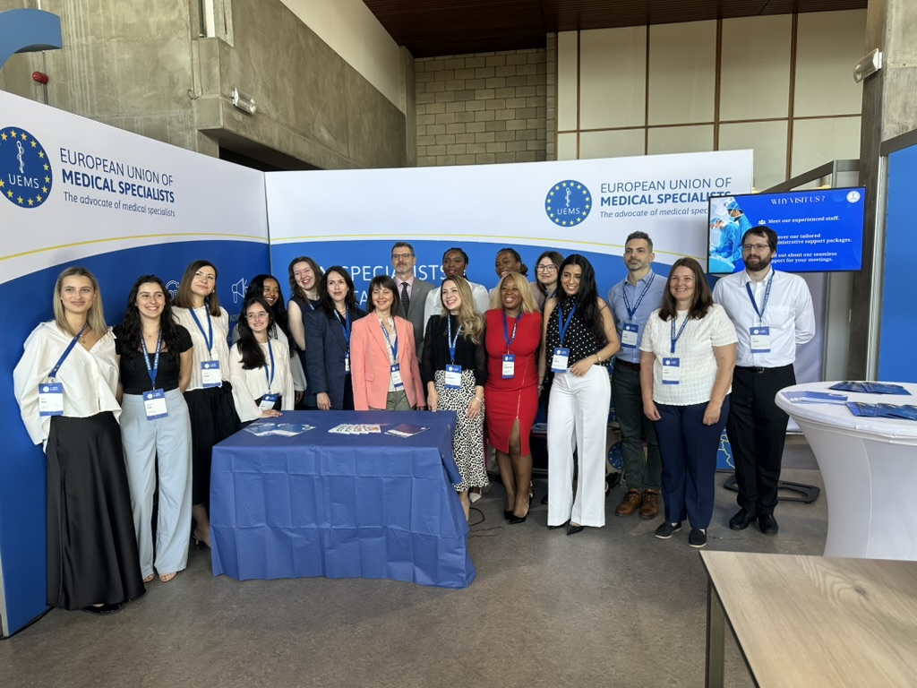
New developments within EACCME
Presentation by Secretary General Joao Grenho
Start of the the accredited provider
as a complimentary pathway, has
received great interest
Contacts with AMA and Canada, their approval of the accredited provider system

Slide 8
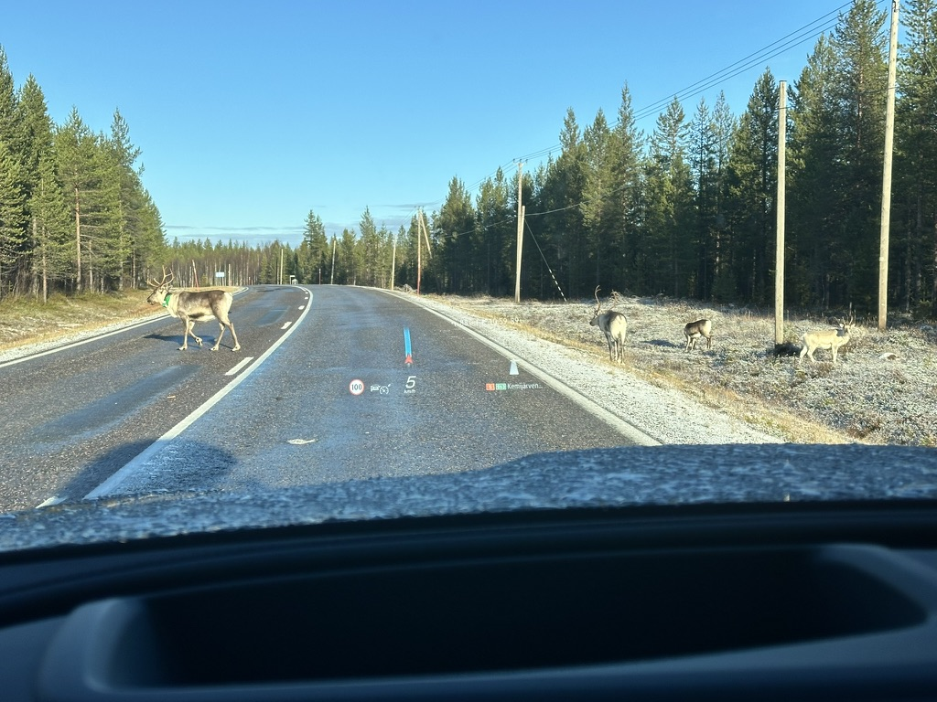
Discussion about the future of UEMS WGs in general
Clearer definition and assignment for the WGs
Lengt of term of the chairperson
(and rapporteur)
Procedure to choose chairpersons
(and rapporteurs)

Slide 9

Next meeting of the WG
April 16, 2027 in Haarlem.
Thank you ! Kiitos !

