Slide 1

MONTENGRO
New associate member of UEMS

Slide 2
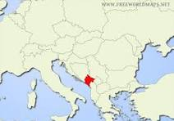
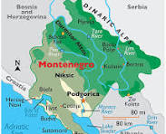
Where we are
Don’t mention size we are sensitive on it
Population 634 000 Plus 110000 foreigners mainly refugees from war, plus some others

Slide 3
Some data
Number of doctors all
2400
Number in private practice 380
Need for additional doctors
One mail KCCG link to University
2 other clinical centers north and south on the coast
8 hospitals + 2 private
13 primary care centers
Growing private sector
Medical university in Podgorica
One postgraduate program for radiology
Several postgraduate programs in preparation
Presently we have cooperation with Medical Universities from Serbia and Croatia

Slide 4
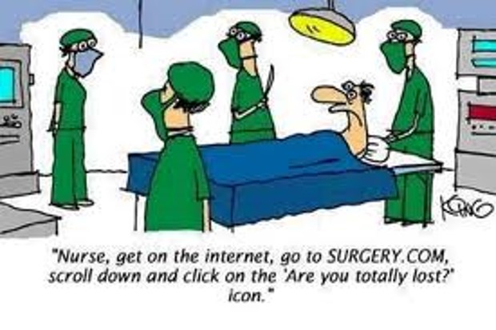
Our needs
Help in establish adjustment of programs according ETR’s
Help in accreditation process
Enforcing of CME and rules related to this – governmental or institutional finance for continuous training and education

Slide 5
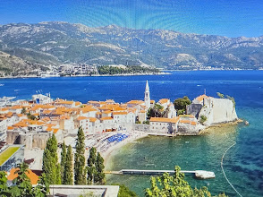
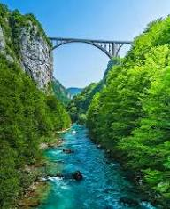


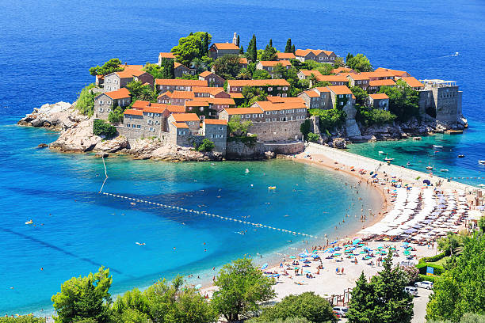

Hope to be your host
In near future

