Slide 1

UEMS 2027
Haarlem
Spring Meeting
16–17 April 2027
Prof. dr. Armand Girbes
Notes:
Welcome to the UEMS Spring Meeting in Haarlem, 16–17 April 2027. Host: Prof. dr. Armand Girbes.

Slide 2
Why Haarlem?
A personal choice
I prefer its friendly, cosy atmosphere
and quieter pace.
Notes:
Why Haarlem rather than Amsterdam? Quite simply, I prefer it. I find it friendlier, cosier and quieter, and I would like to share that experience with you.

Slide 3
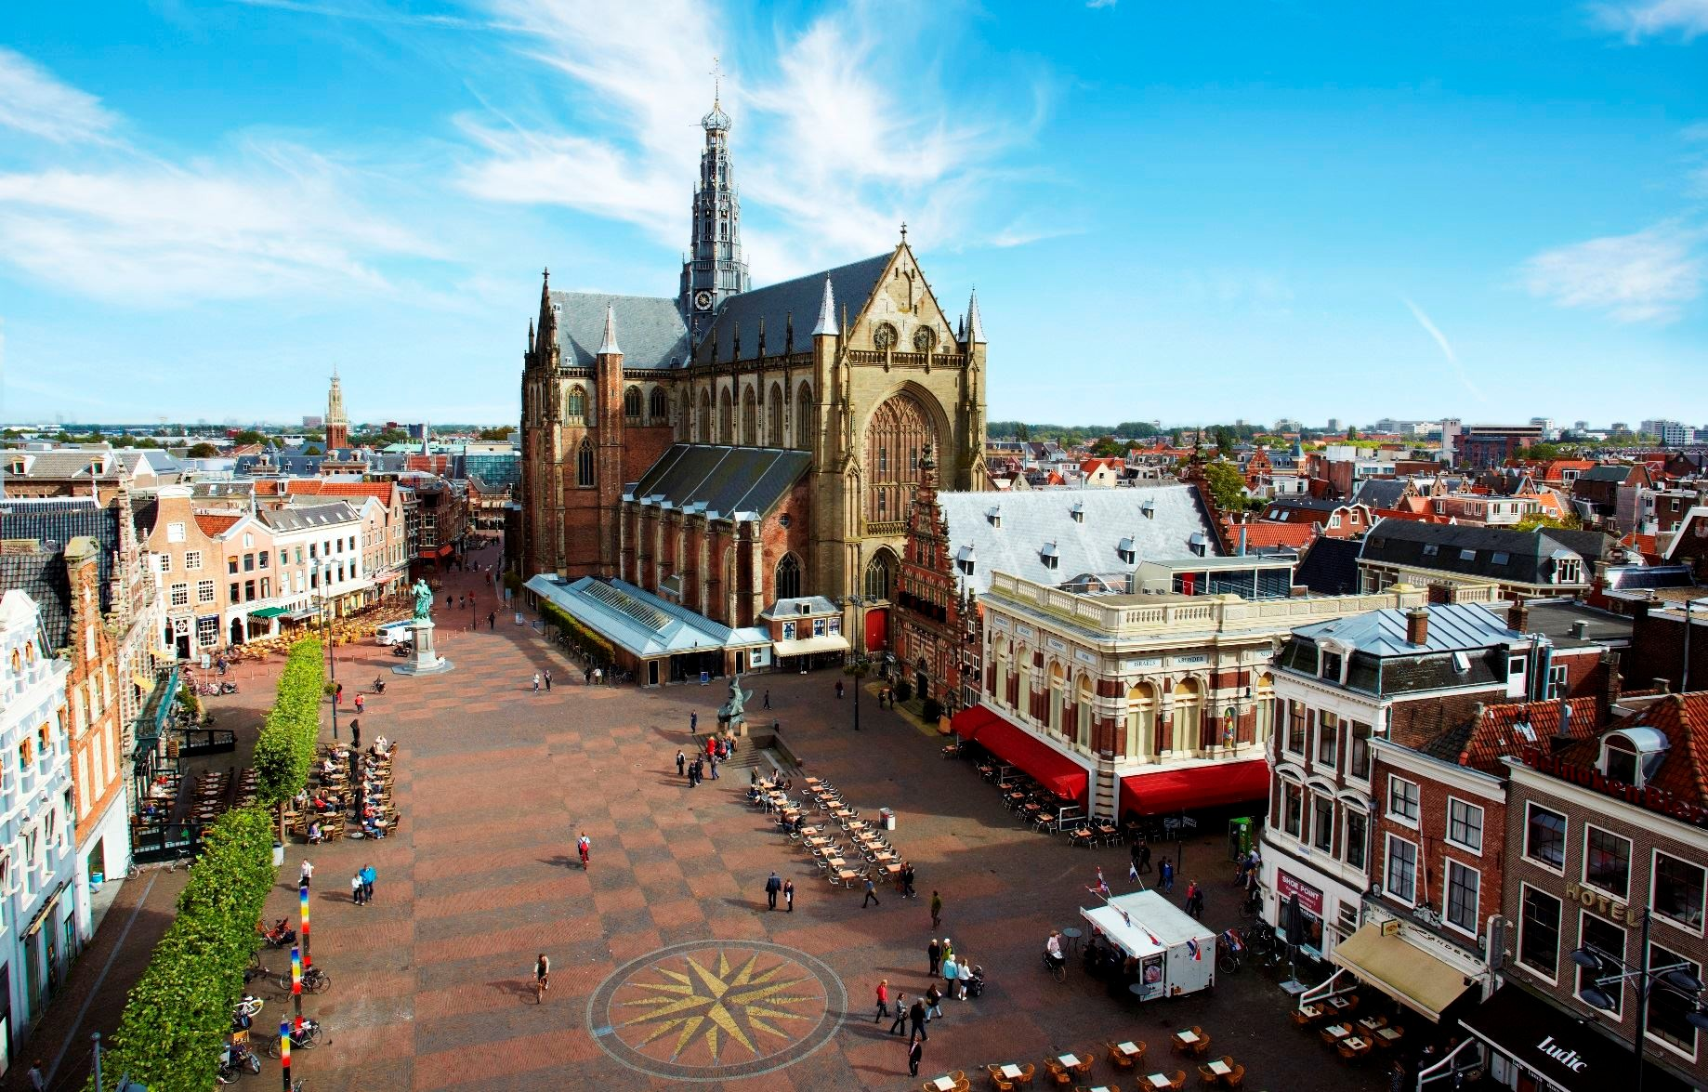

Slide 4
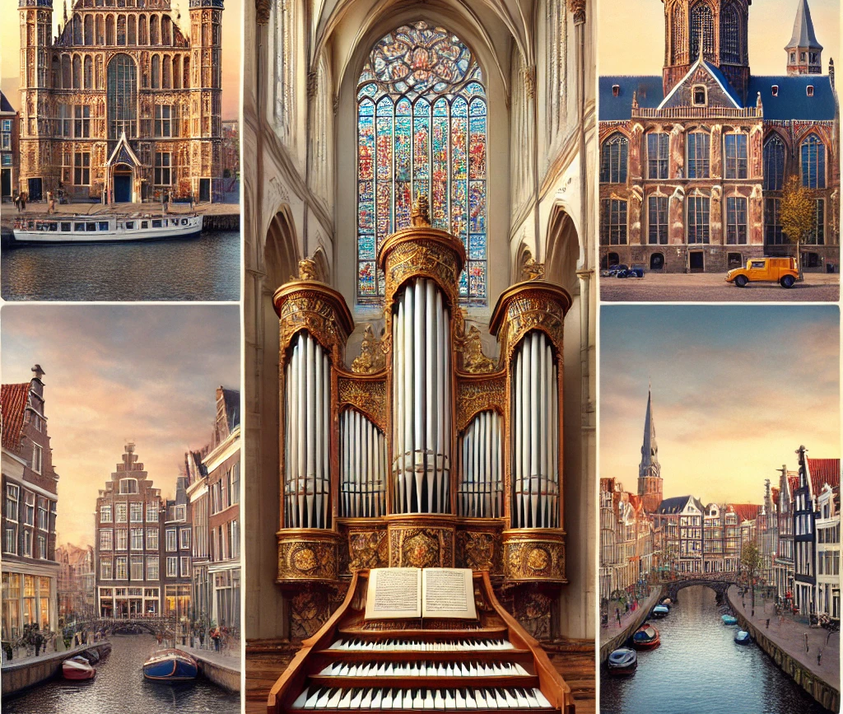
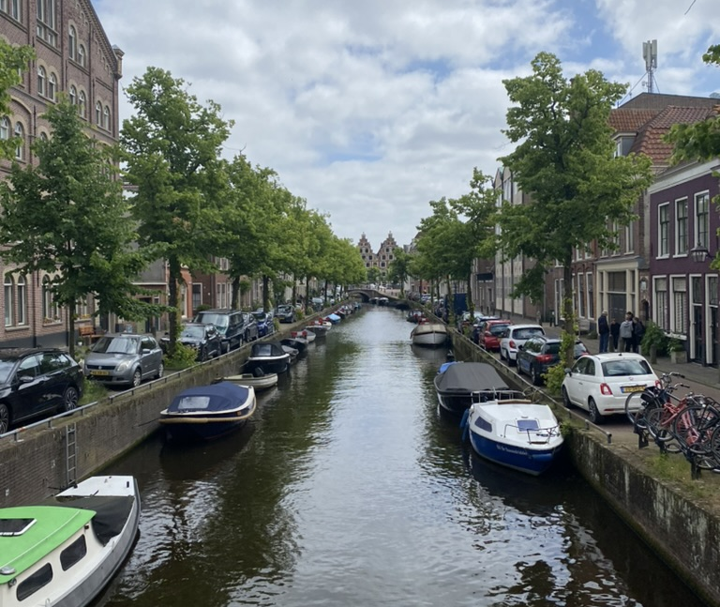
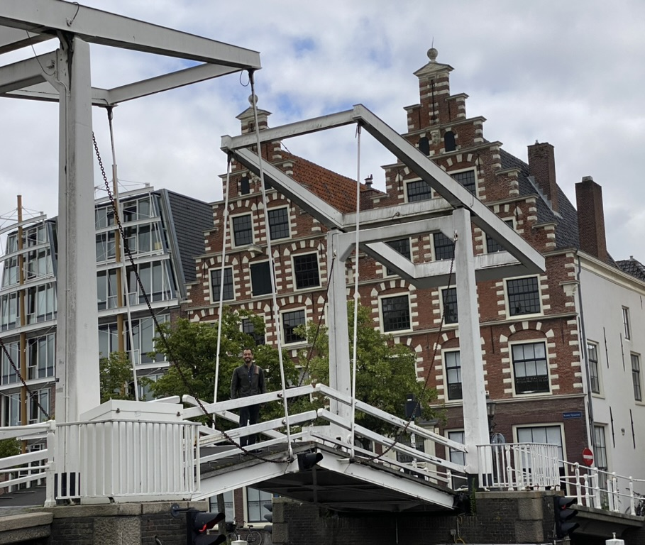
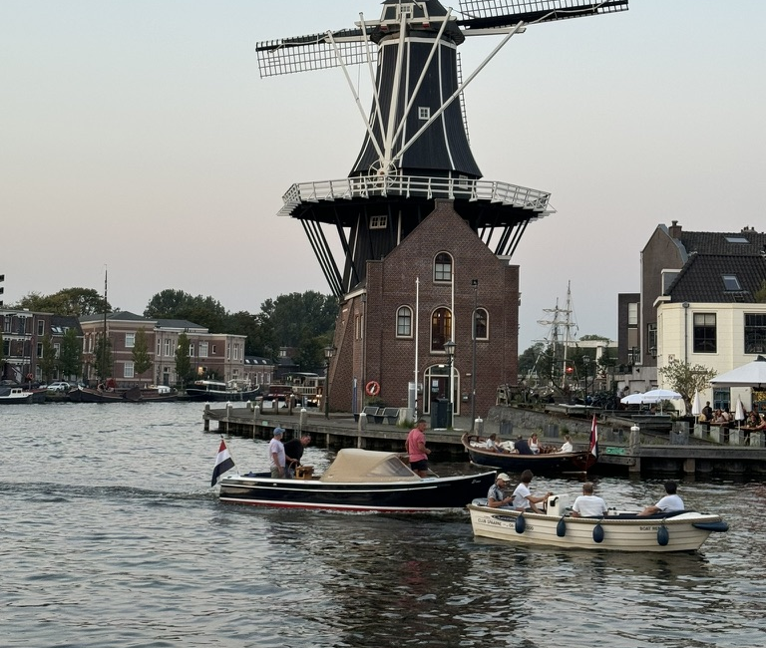
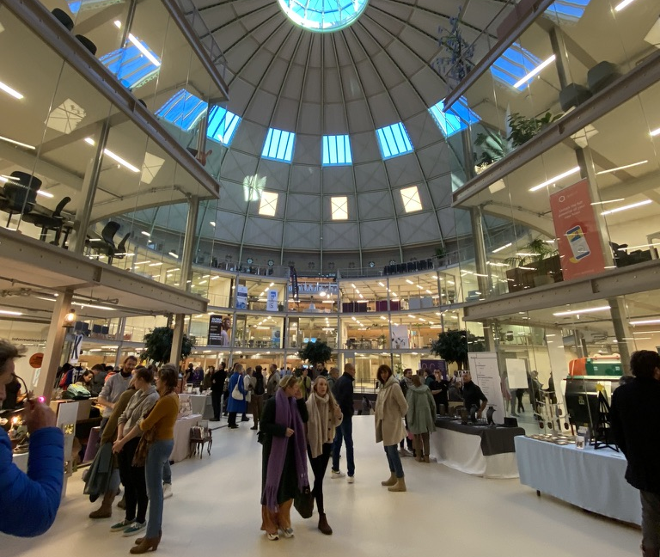
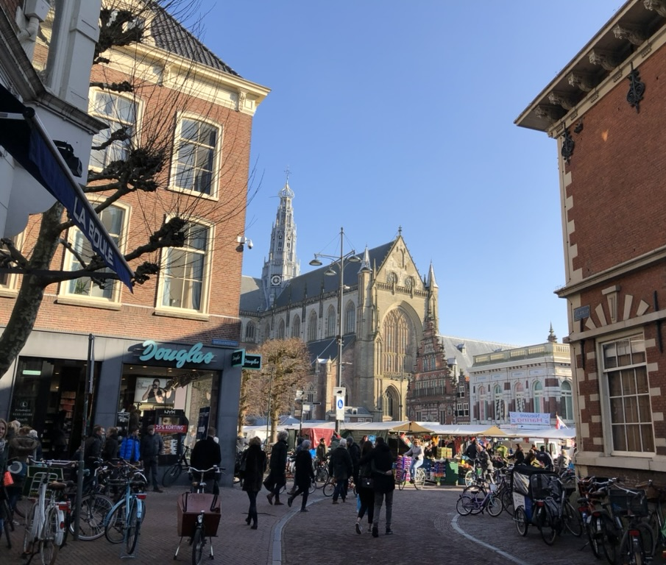

Slide 5
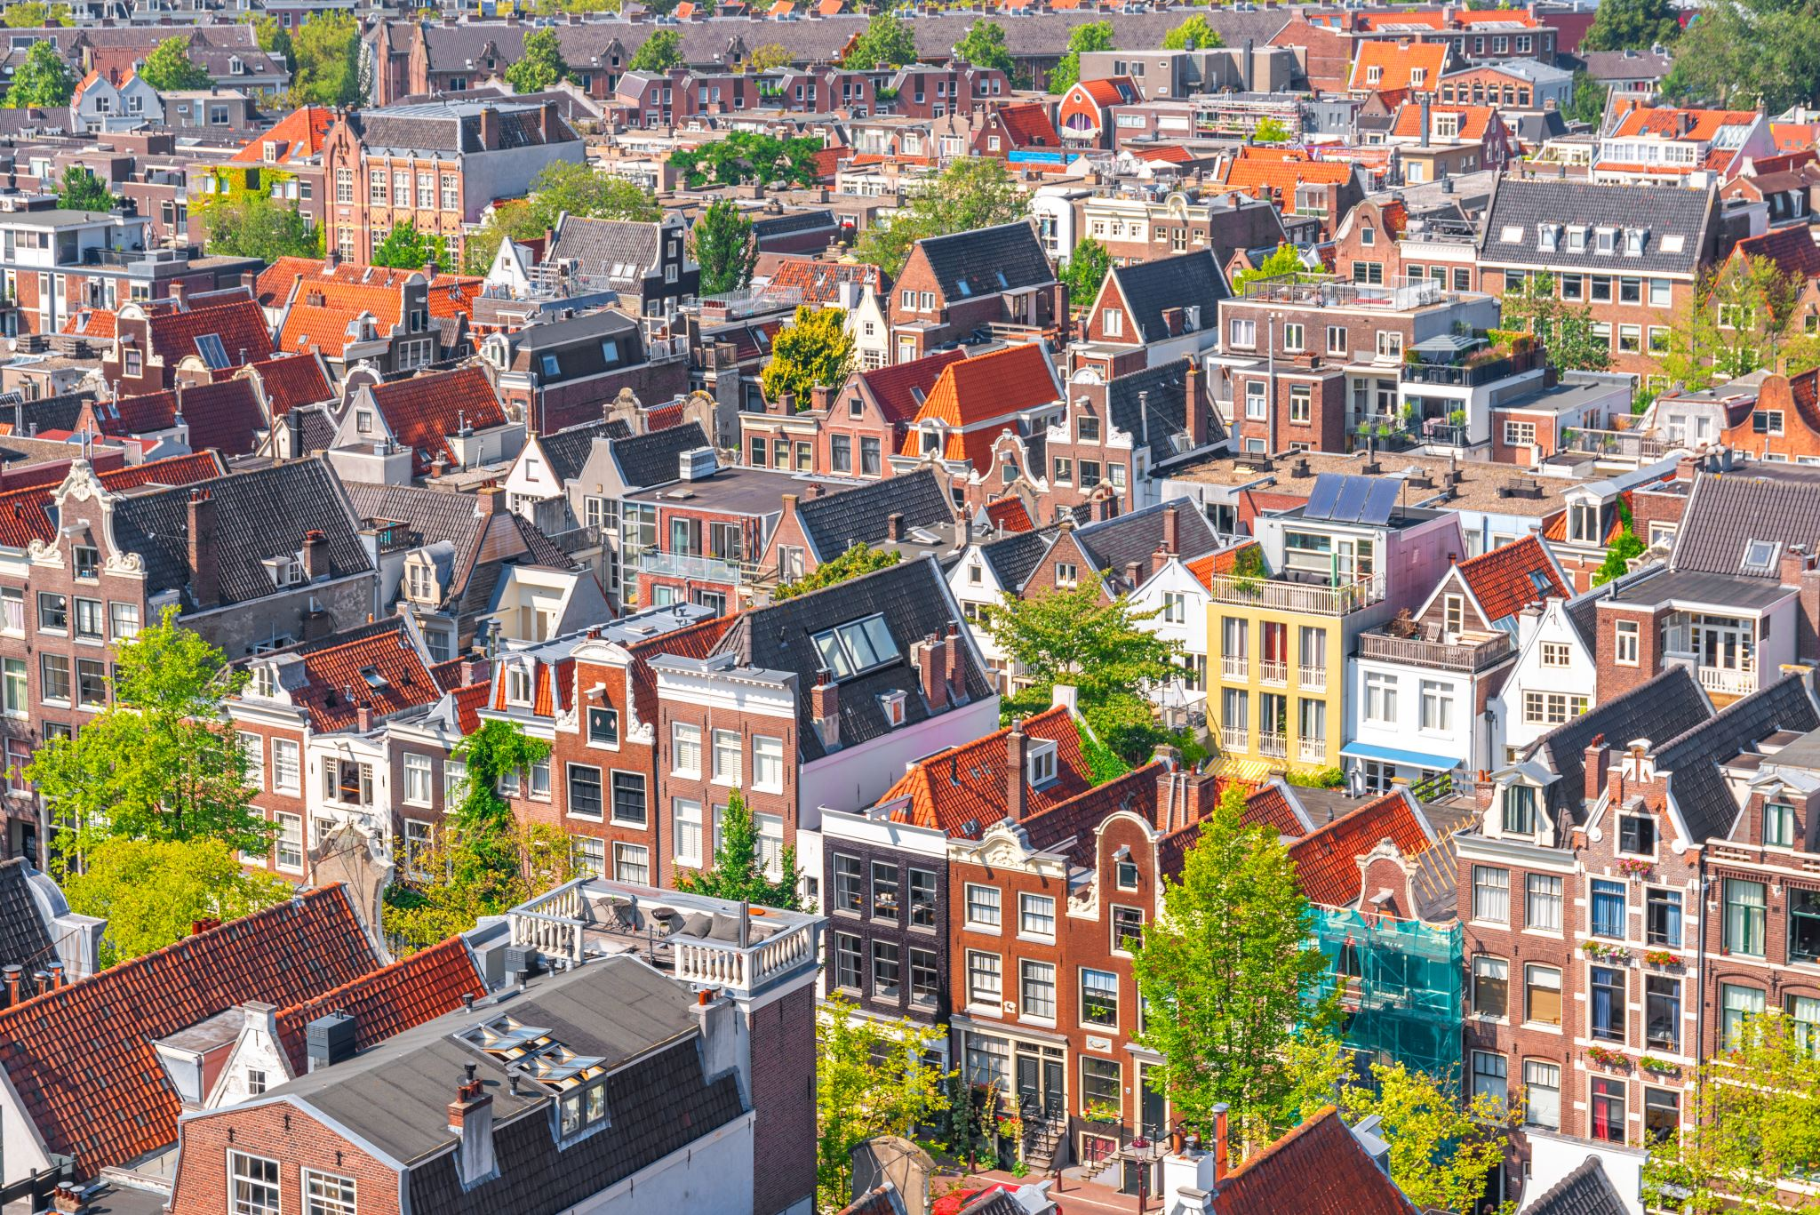
Why Haarlem?
A friendlier, cosier atmosphere
A quieter setting for our meeting
Better value than Amsterdam
A compact, historic city
Notes:
The comparison with Amsterdam reflects the organiser’s own experience and reasons for choosing Haarlem. Better value is an expectation, not a quoted or guaranteed rate for April 2027.

Slide 6
Getting to Haarlem
Haarlem is close to Amsterdam Schiphol Airport
Direct and frequent railway connections to Amsterdam and other major cities
Easy access to major highways for international visitors
Notes:
Haarlem is close to Schiphol and Amsterdam. Actual journey times depend on transport, connections and traffic. The original fixed 15-minute airport claim has been removed.

Slide 7
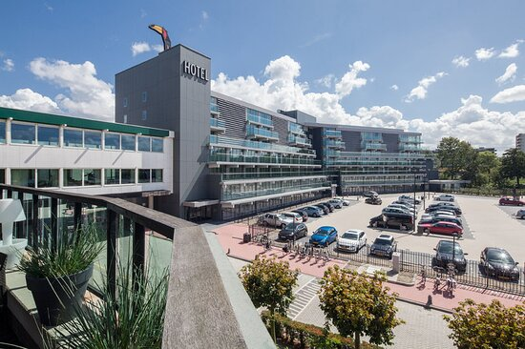
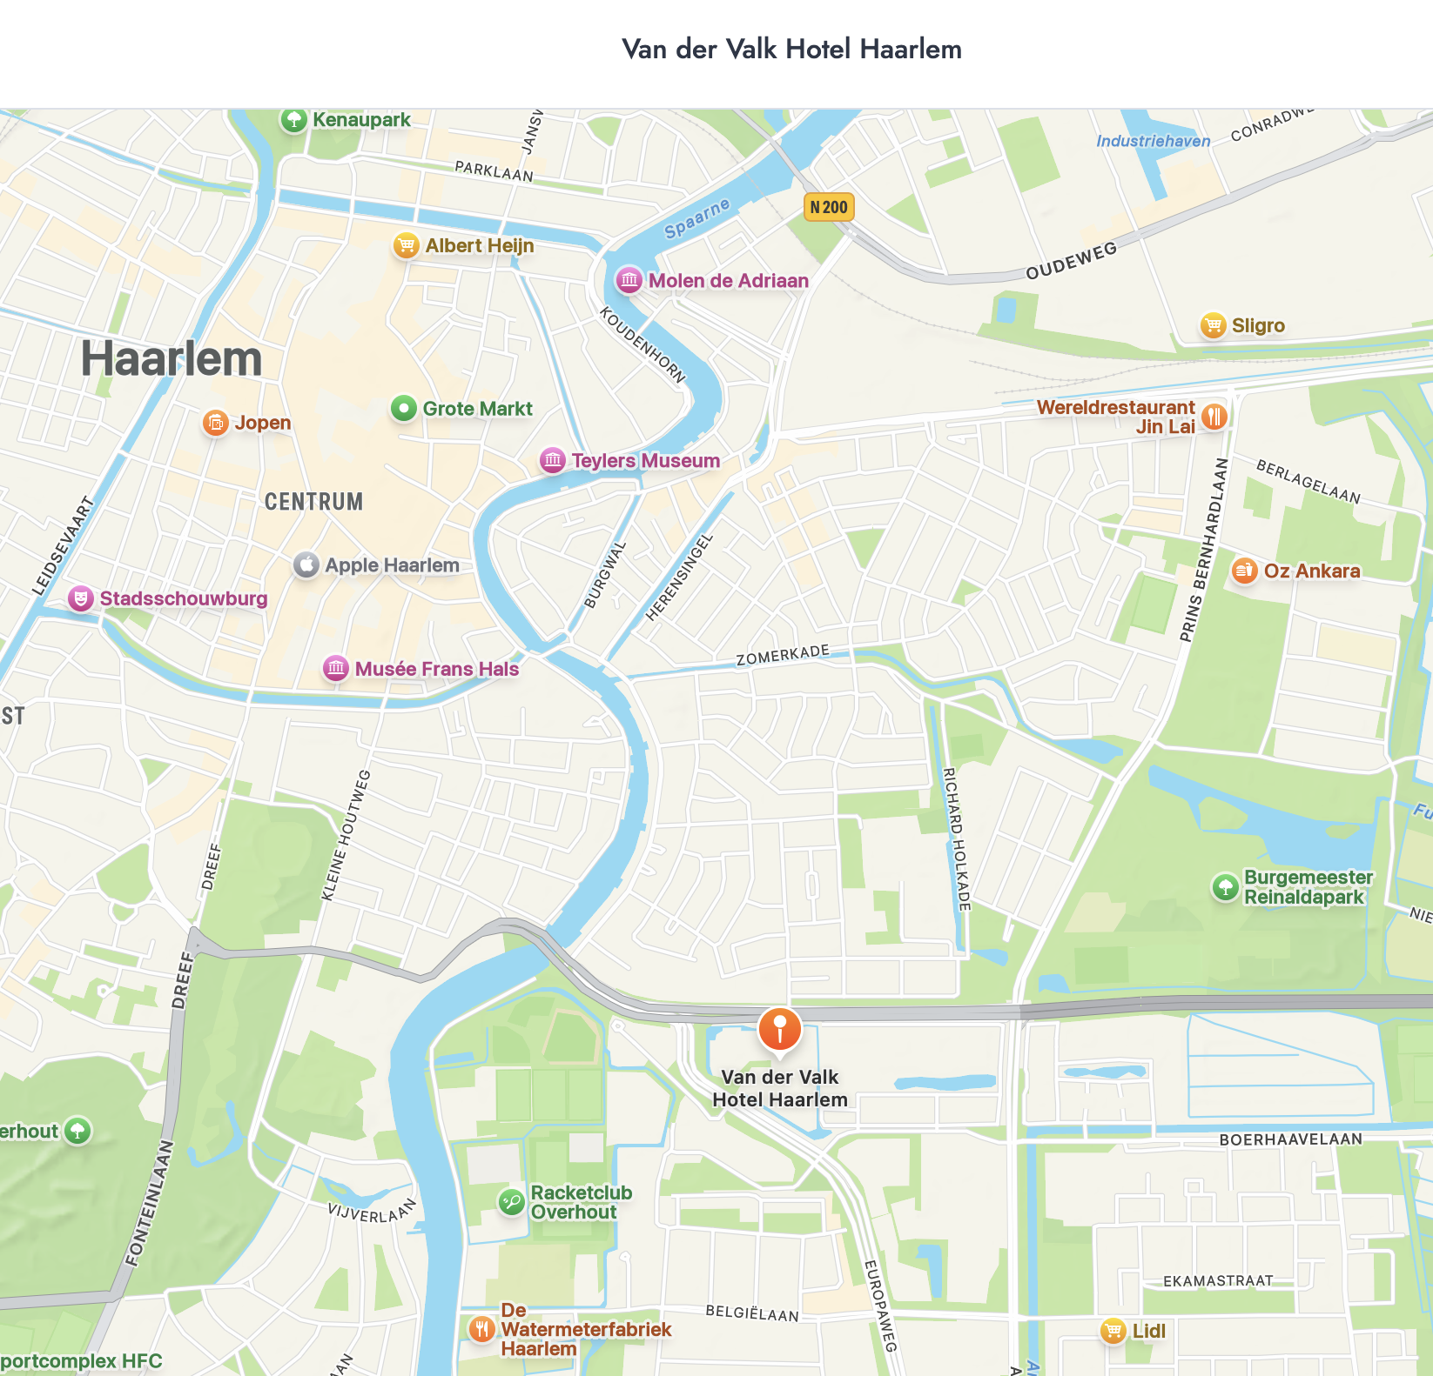

Our meeting venue
Van der Valk Hotel Haarlem
  Conference facilities &
  Accommodation in one place
Walk to city centre:
25 min
Notes:
Teylers Museum in Haarlem is the oldest museum in the Netherlands, founded in 1778. It is renowned for its unique combination of art, science, and natural history collections. Some of its special features include:
Historical Significance: The museum has remained largely unchanged since its founding, providing visitors with an authentic 18th-century museum experience.
Collection: Teylers Museum houses rare fossils, minerals, scientific instruments, books, and artworks, including pieces by Michelangelo and Rembrandt.
Oval Room: The museum's iconic Oval Room was designed as a space for scientific study and is one of the most recognisable parts of the museum.
Its blend of science, history, and art makes it a unique cultural institution in the Netherlands.

Slide 8
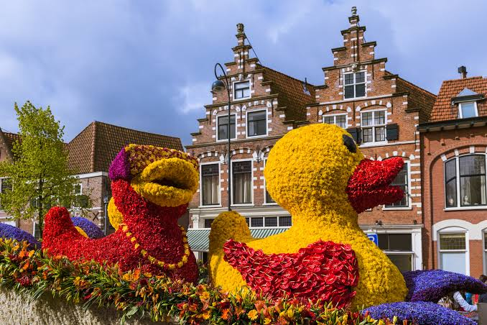
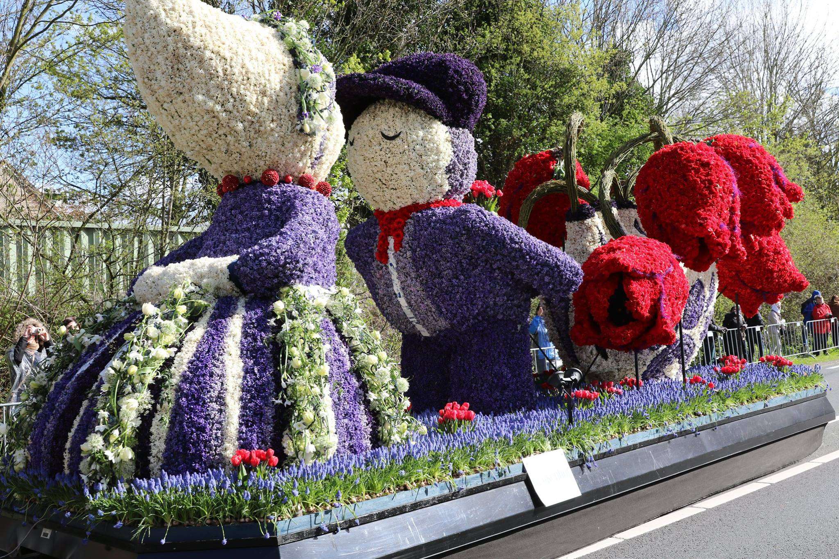
Haarlem in bloom
The Bloemencorso
Saturday 17 April
The flower parade arrives
in Haarlem in the evening.
Sunday 18 April
The floats remain on display
in the historic city centre.
A lovely reason to stay
for the weekend.
Notes:
Our meeting takes place on Friday 16 and Saturday 17 April 2027. The Bloemencorso travels from Noordwijk to Haarlem on Saturday 17 April, arriving in the evening. On Sunday 18 April the floats are on display in Haarlem. Delegates can extend their stay to enjoy them. Exact times and viewing arrangements should follow the final programme. Sources checked 15 October 2026: https://www.bloemencorso-bollenstreek.nl/bezoekersinfo/programma and https://bollenstreek.nl/bloemencorso-bollenstreek/ . Photographs from the supplied presentation illustrate earlier flower parades.

Slide 9
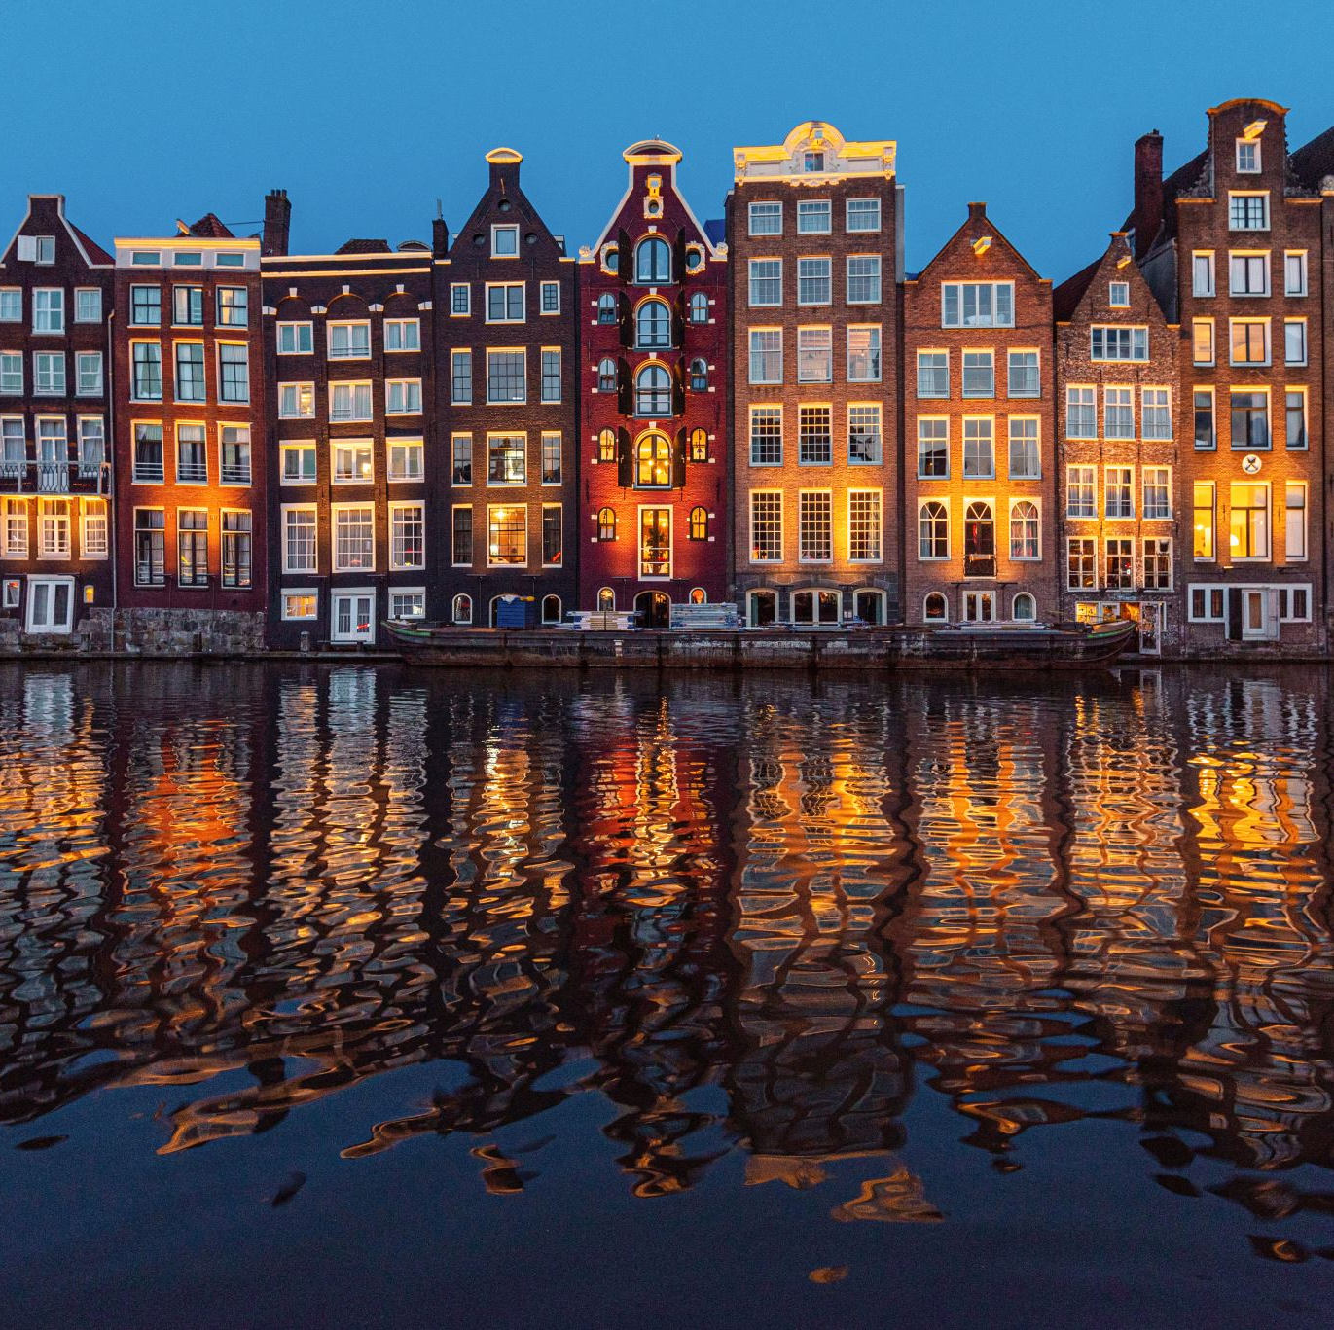
Time to enjoy
the Netherlands
Haarlem’s historic centre,
museums and canals
Cosy cafés and restaurants
for time with colleagues
Amsterdam is nearby
for those wishing to explore
Notes:
The photograph illustrates Amsterdam, an optional nearby excursion. Haarlem remains the congress destination. Photographs retained from the supplied presentation.

Slide 10
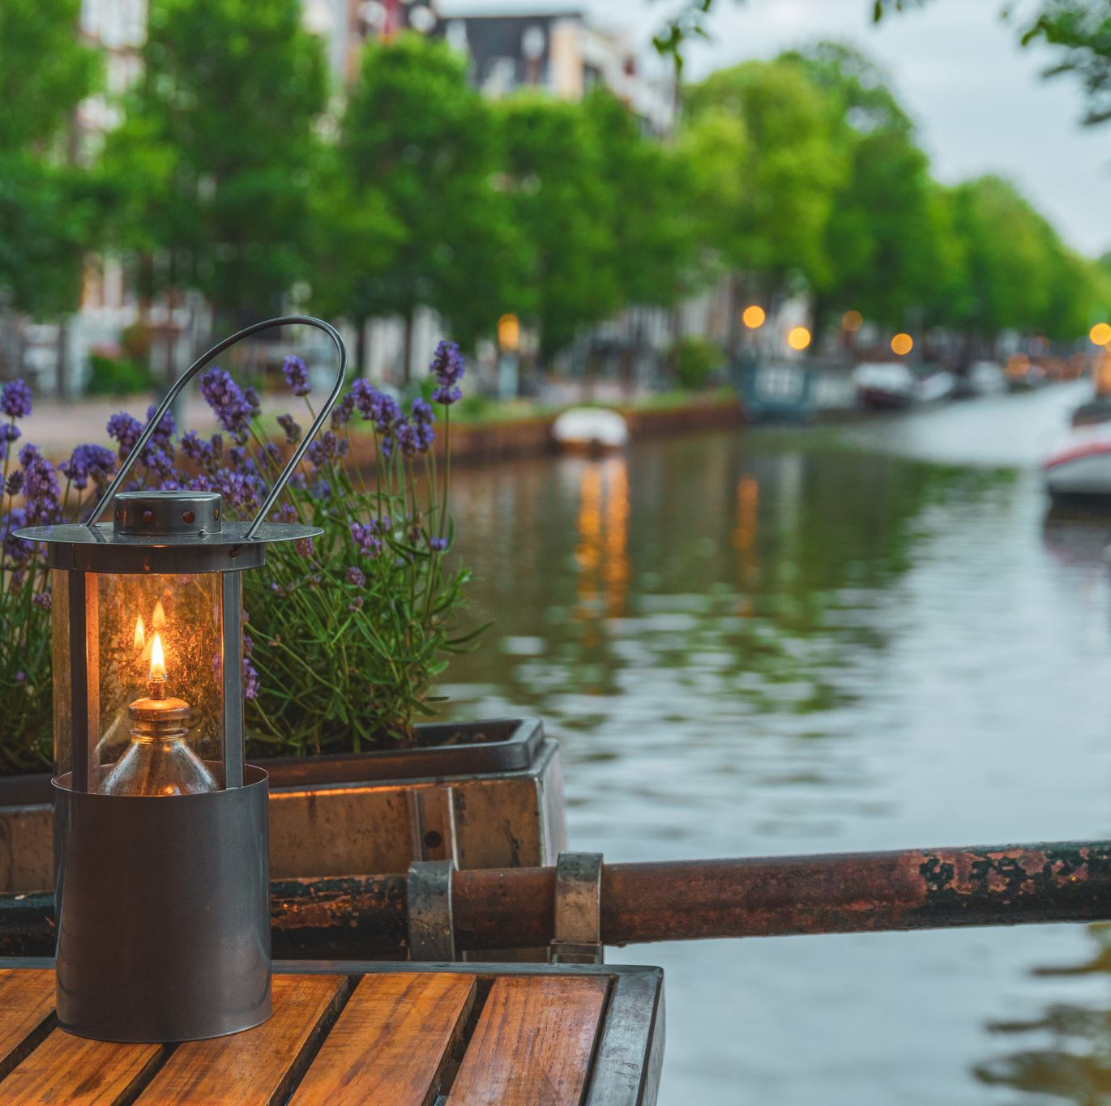
See you in Haarlem
UEMS Spring Meeting
16–17 April 2027
I look forward to welcoming
you to a city I particularly enjoy.
Armand Girbes
Notes:
I look forward to welcoming you to Haarlem for our UEMS meeting and a memorable spring weekend.

Slide 11
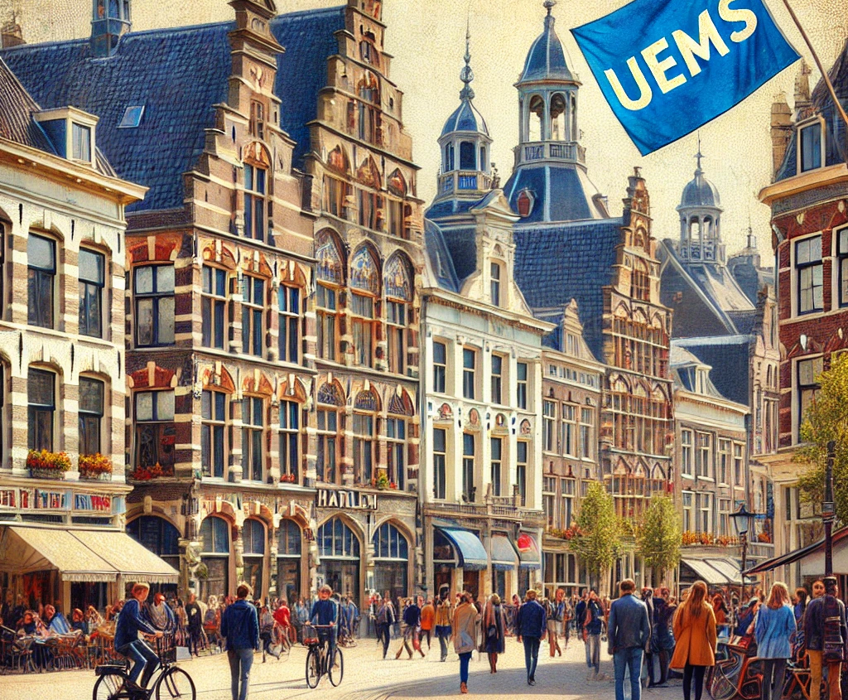

UEMS
Haarlem
2027
Notes:
Stylised illustration retained from the supplied presentation. It is not a documentary photograph of Haarlem.

