Slide 1

Overview of Submitted ETRs and
Work of the ETR RC team
Nada Čikeš
Chair, UEMS ETR Review Committee
Advisory Board and UEMS Council meetings, Brussels, October 2026
Notes:
next to editing

Slide 2
UEMS ETR Review Committee members
Prof. Nada Cikes – Chair of the ETR RC, Rheumatology Croatia.
Prof. Maryna Dolzhenko – Cardiology, Ukraine.
Prof. Arthur Felice – European Board of Surgery, Malta.
Prof. Leila Niemi-Murola – Anaesthesiology, AMEE CBME Coordinator, Finland
Prof. Roman Romero-Ortuno, European Board of Geriatric Medicine, Ireland
Dr. Valentina Pugelj – Emergency Medicine, representing EJD, PGT, Slovenia
Prof. Paolo Ricci, Radiology, Italy
Dr. Sarah Verheyen – Medical Genetics, Austria.
Prof. Lina Zabuliene – Endocrinology, MJC Adolescent Medicine and Health, Lithuania.
Prof. Rado Zic – PRAS Section, Croatia
Amelia Donighian – UEMS Coordination.
Notes:
next to editing

Slide 3
ETR documents in the UEMS approval process
October 2026
ETR for Competence in Emergency Surgery
ETR for the Specialty of Nephrology
ETR for the General Practice/Family Medicine
ETR for the the Specialty of Rheumatology
ETR for the Specialty of Thoracic Surgery
ETR for the Specialty of Paediatrics
ETR for the Competence in Paediatric Endocrinology and Diabetes
ETR for the Competence in Paediatric Infectious Diseases
ETR for the Competence in Paediatric Urology
ETR for the Competence in Paediatric Rheumatology
ETR for the Competence in Upper Gastrointestinal Surgery
Notes:
next to editing

Slide 4
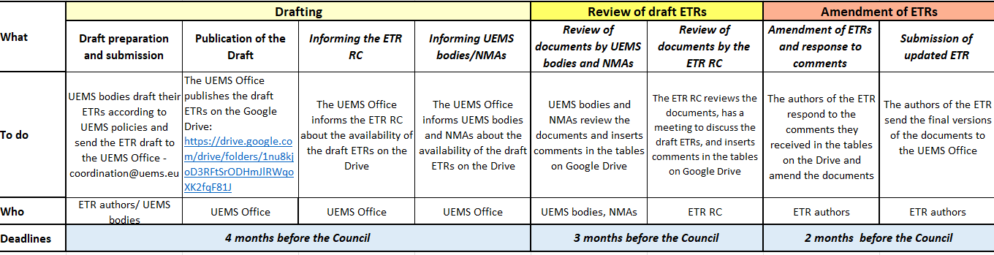
ETR Review and Approval Process Timeline
...
Whole review process, i.e. latest date submission draft ETR to UEMS Council 4 months
1st obligatory meeting ETR Review Committee (RC) in the month following submission of ETRs

Slide 5
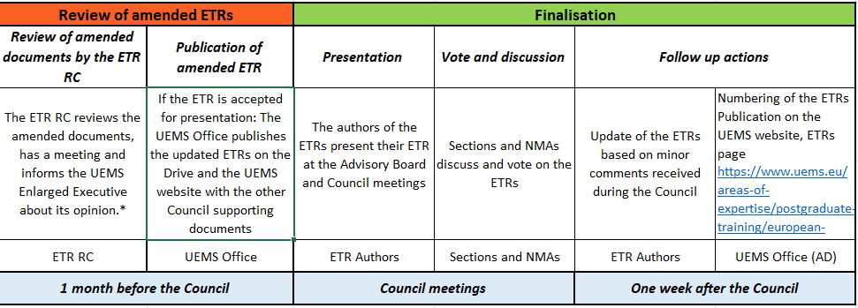
ETR Review and Approval Process Timeline
...
2nd obligatory meeting ETR RC in the month following submission of amended ETRs
* not in scheme, but has to follow: decision by UEMS EE on presentation at Council meeting

Slide 6
ETR UEMS Review and Approval process for approval at the UEMS Council meeting April 2026
June 15, 2026 -draft ETRs submitted by authors, published at Google Drive
June 23 and July 7 – meetings of the ETR RC, pairs of reviewers analyse, report and publish comments and suggestions
August 15, 2026 - reviews by ETR RC members, UEMS bodies and NMAs published
September 15, 2026 – amended versions and author’s responses are published
September 21meeting of the ETR RC, reviewers present revised versions, discussed and made conclusions
September 29 UEMS EC meeting, ETR RC conclusions presented
October 16, 2026 – Advisory Board meeting: ETRs final version presented, discussed and voted
October 17, 2026 – UEMS Council meeting: ETRs presented, discussed and voted for approval
Notes:
next to editing

Slide 7


Special remarks from the ETR RC
Congratulations to colleagues authors
for creating modern, CBME based, conceptually appropriate, comprehensive educational ETR document
Gratitude to colleagues for the great effort invested in the correction and advancement of their ETRs in respecting the reviewers' comments and especially for the very high quality cooperation with ETR RC
Special congratulation and gratitude to colleagues from GP/FM for gathering all relevant organisations
with UEMS
and to All Colleagues for brilliant collaboration in refining ETR and achieving an important position of GP/FM
Exceptional gratitude to
Ms Amélia Donighian UEMS Senior Coordinator for enormous work, understanding and respecting the UEMS institutional responsibility towards all collaborators in supporting the process of enhancing the quality of postgraduate training
🌺
Notes:
next to editing

Slide 8
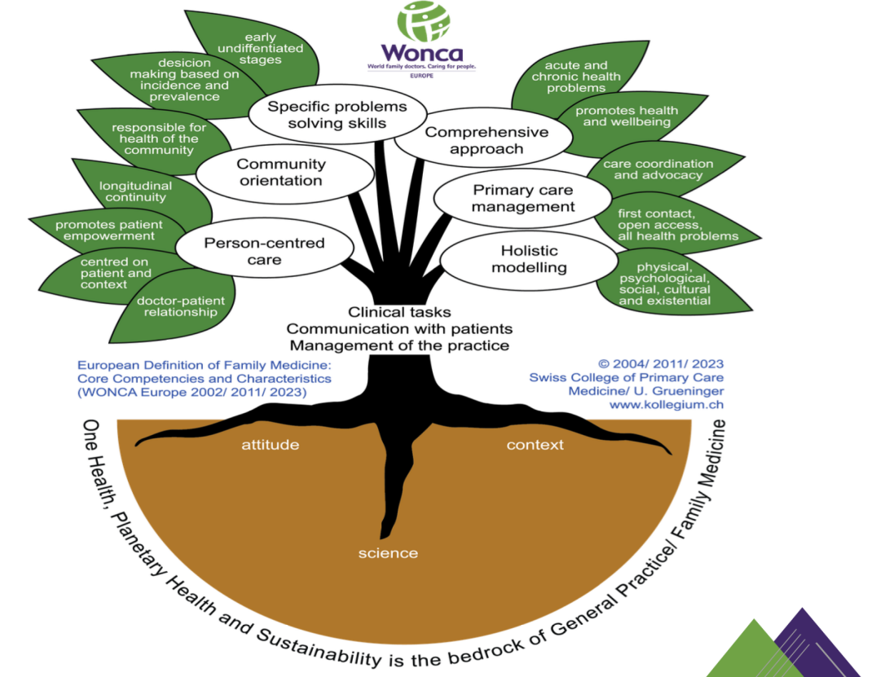
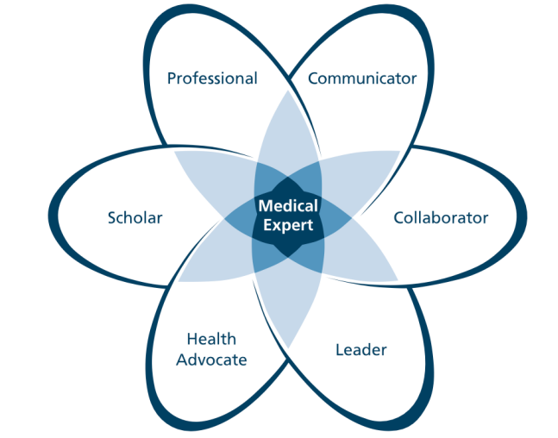
ETR RC Approach to Challenges
Alignment with the Annex V of the EU Directive 2005/36EC
Alignment with the UEMS Template Structure 2025
CBME implementation
- CanMEDS introduction
- EPAs selection, elaboration
Alignment of the two systems seen in visual mnemonics
Harmonisation of the largest systems of medical competence and learning outcomes in Europe
Capabilities in Practice (CiPs) in UK and CanMEDS
in creating ETR documents
CanMEDS framework of phyisicians competencies
Wonca tree characteristics and core competencies of Family medicine
Notes:
next to editing

