Slide 1

FINANCIAL OUTLOOK
H1 2026 and 2027 Budget Proposal
UEMS Autumn Council Meeting – October 2026 – Brussels, Belgium

Slide 2

Profit and loss account

Slide 3

H1 2026|Financial performance at a Glance
H1 2026 MAJOR FACTS
+2.21 %: Salary Indexation (January 2026)
+2.60 %: Average Inflation (June 2026, YTY basis)
+10.3 %: Energy Price Inflation (June 2026, YTY basis)
1st UEMS Congress (May 2026)
EACCME Reviews Retrocession to UEMS Bodies
UEMS has no outstanding external debt
OPERATING INCOME
€ 3.27m
+21,7 % vs H1 2025
OPERATING COSTS
€ 2.32m
+14,3 % vs H1 2025
OPERATING SURPLUS
€ 958k
+44,12 % vs H1 2025
NET RESULT
€ 924K
+43,7 % vs H1 2025

Slide 4
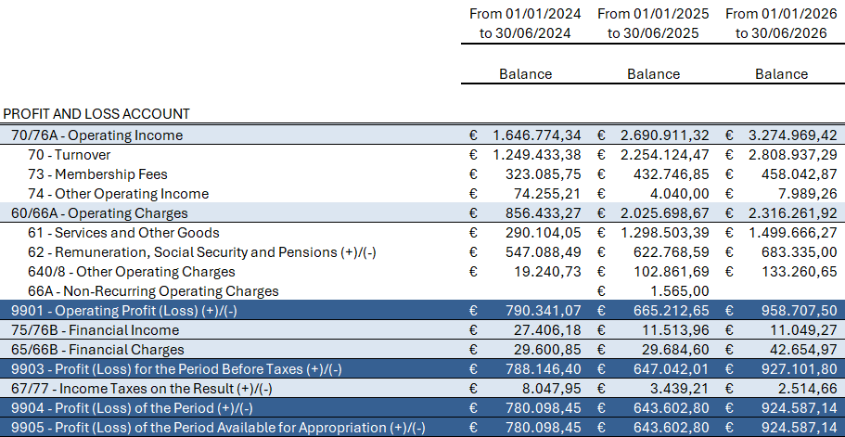
H1 2026|Simplified Profit and Loss Account

Slide 5
H1 2026 | What drove our income
EACCME INCOME
30,26 %
EXAMINATION
26,95 %
UEMS BODIES MF
13,99 %
TOP 3

Slide 6
H1 2026 |Where did our money go
STAFF COSTS
29,50 %
EXTERNAL ADMIN
14,39 %
EACCME RETROCESSION
7,03 %
TOP 3

Slide 7
H1 2026 | Cash Position and Common Saving
CONSOLIDATED CASH AT BANK
€ 5.77m
+3,46 % vs H1 2025 (15.10.2026 = € 5.29m)
COMMON SAVING ACCOUNT
€ 1.845m
Included in Consolidated Cash (ended 07.26)
CASH DIRECTLY AVAILABLE
€ 3.797m
EU Grant + Common investment excluded

Slide 8
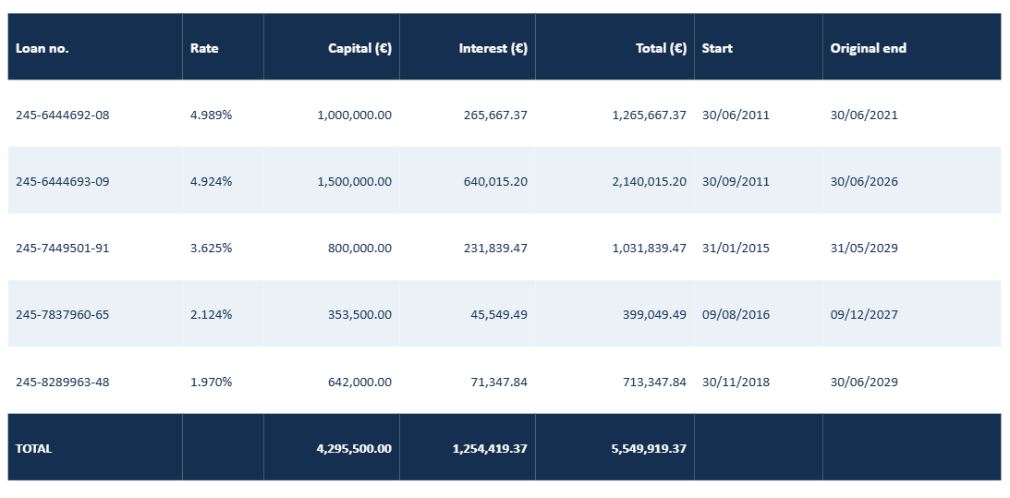
H1 2026 | A Milestone Worth Celebrating!
UEMS IS FREE OF EXTERNAL DEBT AS OF 30 JUNE 2026 - OUTSTANDING BALANCE € 0
A MAJOR STEP FORWARD IN UEMS'S FINANCIAL INDEPENDENCE

Slide 9
Management fee 2026

Slide 10
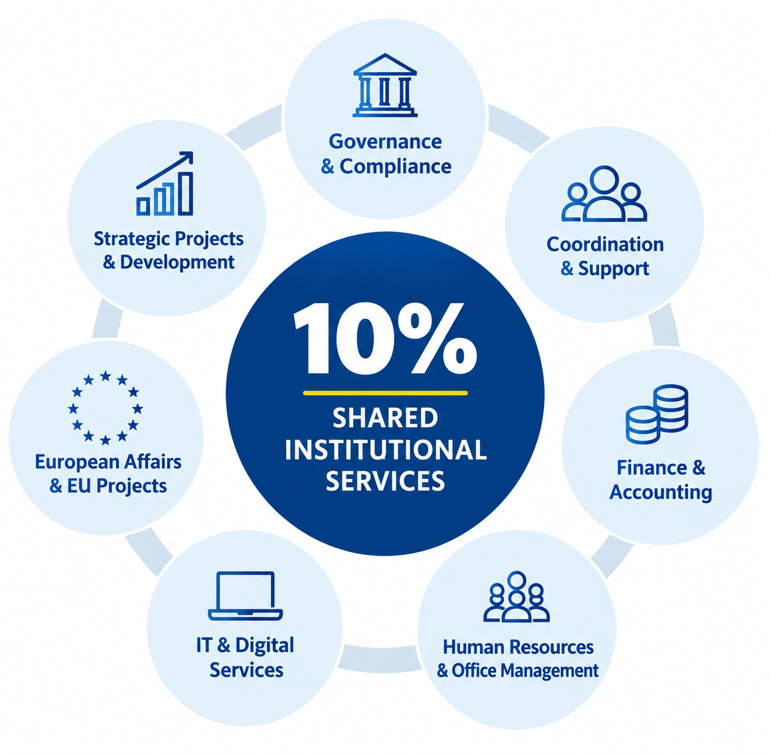
2026 | Management Fee Proposal
BASED ON ELIGIBLE INCOME 2025
€ 2,262,246.03
PERCENTAGE
10%
TO BE APPROVED
€ 226,224.60
Collection by 31/12/2026
Illustrative, non-exhaustive overview of shared institutional services.

Slide 11
BUDGET PROPOSAL 2027

Slide 12
2027 Budget |Assumptions and Key figures
MAIN ASSUMPTIONS
GENERAL PURCHASE INFLATION
+2.5 %
INDEXATION GROSS SALARIES
+4,06 %
EACCME FEE INCREASE
+3,75 %
RESULTS
OPERATING INCOME
€ 4.65m
OPERATING COSTS
€ 4.54m
BUDGETED NET RESULT
€ 58k

Slide 13
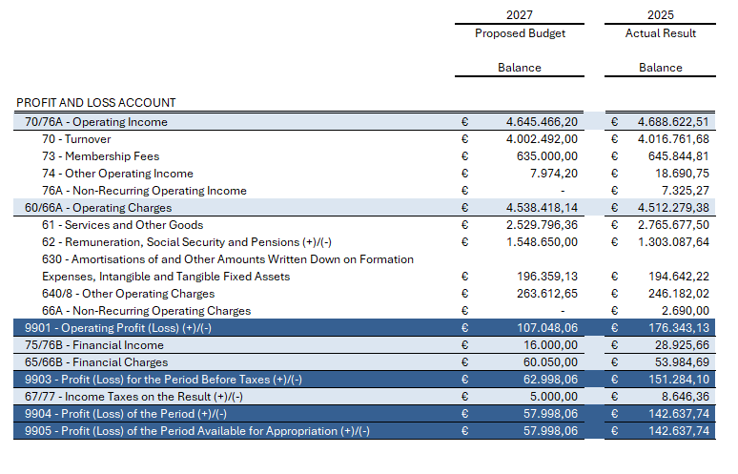
2027 Budget |Simplified Profit and Loss Account

Slide 14
2027 Budget |What will drive our income
TOP 3
EACCME INCOME
42,36 %
EXAMINATION
29,06 %
UEMS BODIES MF
13,67 %

Slide 15
2027 Budget |Where will our money go
TOP 3
STAFF COSTS
34,12 %
EXTERNAL ADMIN
15,42 %
UEMS BODIES HOTEL
6,28 %

Slide 16
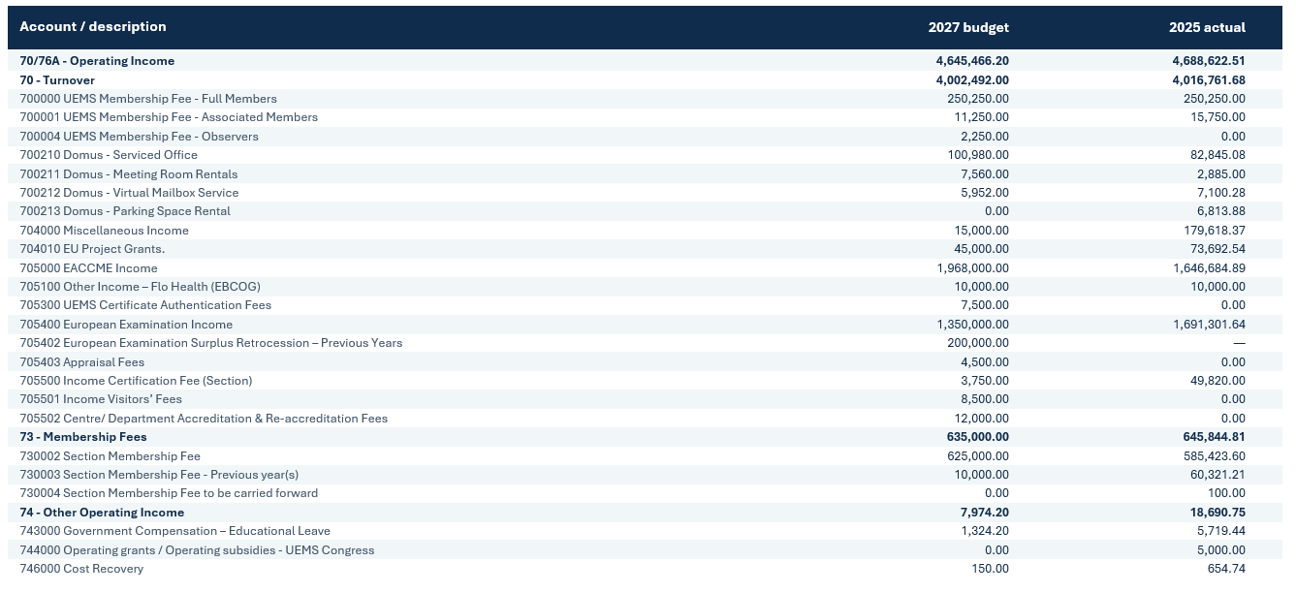
2027 Budget | Detailed Profit and Loss Account

Slide 17
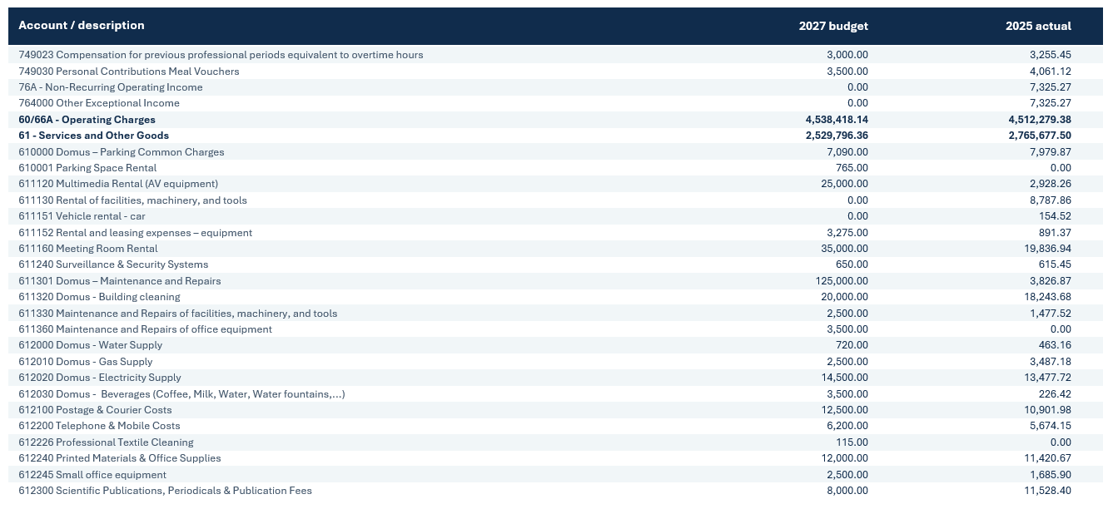
2027 Budget | Detailed Profit and Loss Account

Slide 18
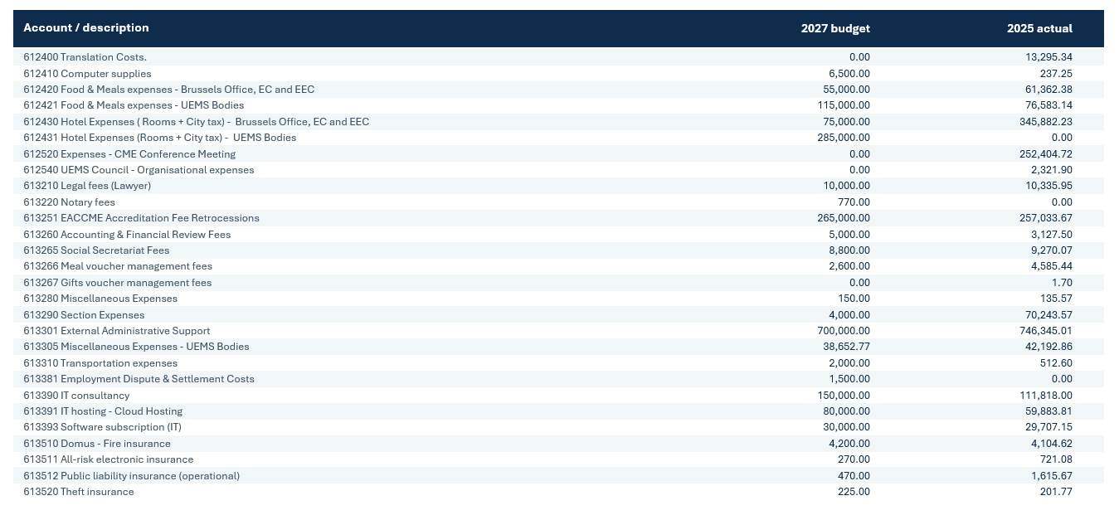
2027 Budget | Detailed Profit and Loss Account

Slide 19
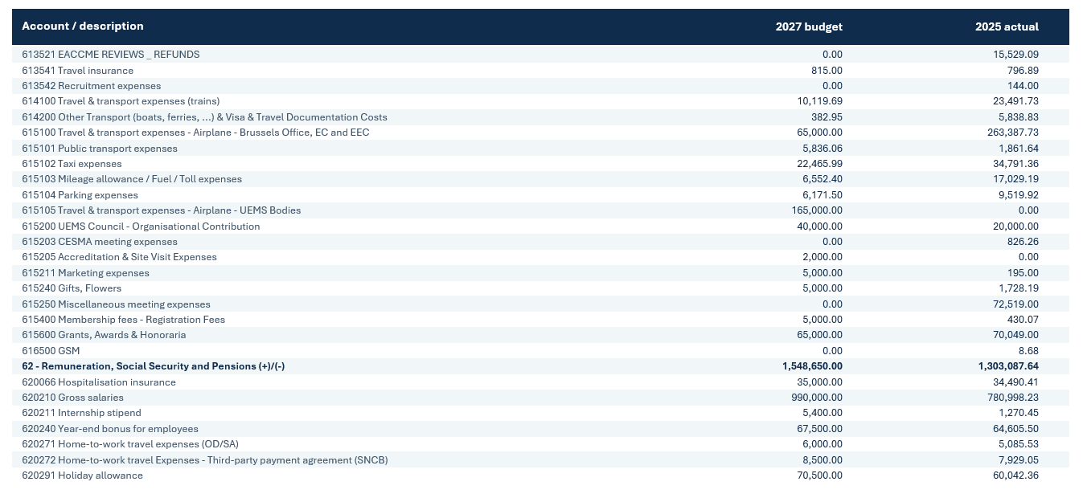
2027 Budget | Detailed Profit and Loss Account

Slide 20
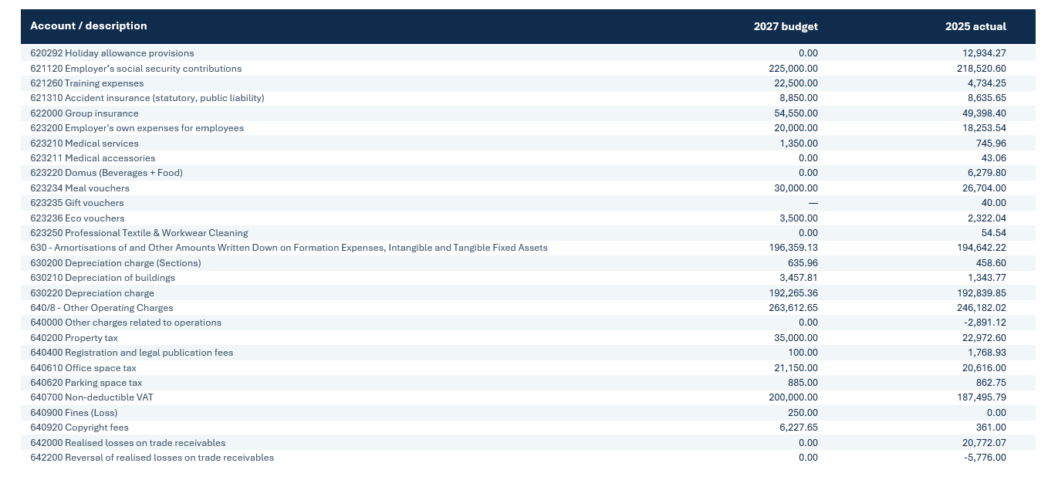
2027 Budget | Detailed Profit and Loss Account

Slide 21
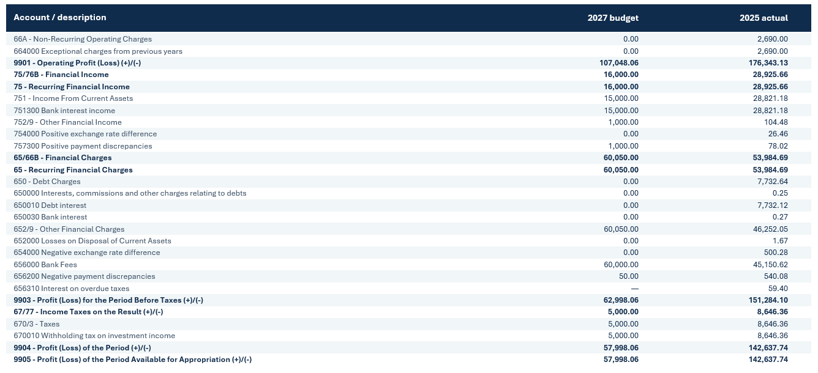
2027 Budget | Detailed Profit and Loss Account

Slide 22
Financial OBJECTIVES 2027

Slide 23
2027 |Objectives
1
COMMON INVESTMENT Continue the common investment scheme.
UEMS BODIES BUDGETS Ensure annual budgets are submitted to the Brussels Office.
EACCME RETROCESSION Continue reimbursing UEMS Bodies for EACCME reviews activities.
6-YEAR BOND Maintain reserve for the Bond repayment due in mid-2028.
FINANCIAL AUTOMATION Automate invoicing, expense management and financial reporting.
INACTIVE UEMS BODIES Contact Bodies with no reported activities to assess their situation.
2
3
4
5
6

