Slide 1

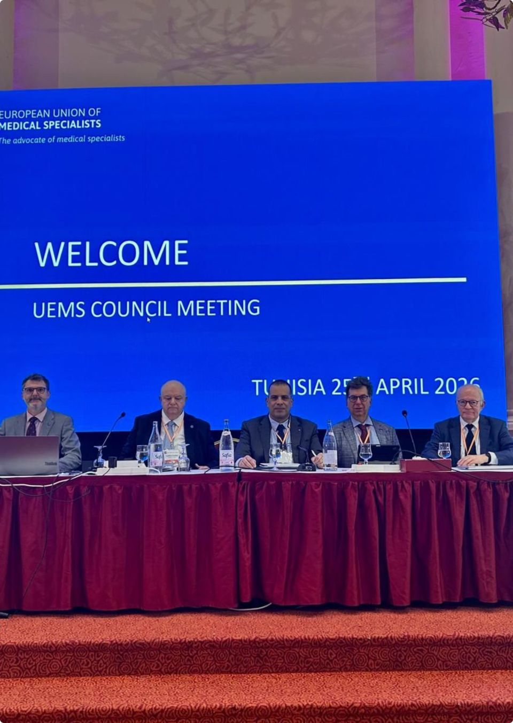
From Consolidation to Impact
SECRETARY GENERAL'S REPORT
UEMS Autumn Council Meeting
Brussels | October 2026
João Miguel Grenho
UEMS Secretary General
Notes:
1. From Consolidation to Impact
0:45 · Elapsed 0:00–0:45
Welcome colleagues and Members.
Report on progress since our Spring Council in Tunis.
Central theme: from consolidation to impact.
Strong foundations already in place.
Today’s focus: what this work means for Members, specialist training and our contribution in Europe.
Collective effort across the UEMS community.

Slide 2
Six Months That Made a Difference
EACCME Accredited Provider Status
1st UEMS Congress
A new platform for the European specialist community
From development to implementation
European Training Requirements
European Engagement
Continued development and broader cooperation
Stronger cooperation with WHO/Europe and European partners
Institutional Development
Financial independence and closer relations with Members
Notes:
2. Six Months That Made a Difference
1:15 · Elapsed 0:45–2:00
Brief overview of the past six months.
EACCME Accredited Provider Status moving into implementation.
First Congress creating a shared platform for our community.
Continued development of European Training Requirements.
Stronger European cooperation and closer relations with Members.
Connecting these developments: greater value for the people and organisations we represent.
Use this slide as the roadmap; details follow.

Slide 3

EACCME: A New Chapter in Accreditation
ACCREDITED PROVIDER STATUS
From concept to implementation
October 2026
January 2027
First application cycle
First eligible activities under the new model
A complementary pathway
Provider-level recognition alongside individual activity accreditation
The objective:
Greater efficiency without compromising quality, independence or transparency.
Notes:
3. EACCME: A New Chapter in Accreditation
1:45 · Elapsed 2:00–3:45
Accredited Provider Status: a significant development in the EACCME model.
First application cycle: October 2026.
First eligible activities: January 2027.
Provider recognition alongside individual activity accreditation.
Complementary pathways, with a shared commitment to quality.
Greater efficiency while protecting independence and transparency.
Implementation priorities: clear guidance, consistent assessment and support for applicants.
Judge success through the experience of providers and the quality of accredited education.

Slide 4
EACCME: Sustaining Activity and Quality
1,779
+1.1%
€1.47M
LEE applications | January–August 2026
Compared with January–August 2025
EACCME income | 2026 reporting period
A system operating at historically high levels
The challenge is sustainability, not simply further growth.
Notes:
4. EACCME: Sustaining Activity and Quality
1:15 · Elapsed 3:45–5:00
1,779 LEE applications, January–August 2026.
1.1% increase against the same period in 2025.
€1.47 million income in the reporting period shown.
Activity remaining at historically high levels.
Strong demand brings responsibility: assessment capacity, consistency and service quality.
Sustainability as the central challenge.
Maintain confidence in the system while managing the workload responsibly.

Slide 5
European Training Requirements: From Standards to Impact
European Training Requirements: From Standards to Impact
EUROPEAN TRAINING REQUIREMENTS
8 ETRs / 1 PDMs
9 ETRs
Adopted in Tunis | April 2026
Submitted for approval | October 2026
PDM for Disaster Medicine for Anaesthesiologists
ETR for Competence in Abdominal Wall Surgery
ETR for the Specialty of Endocrinology
ETR for Competence in Hand Surgery
ETR for the Specialty of Obstetrics and Gynaecology
ETR for Competence in Paediatric Allergology
ETR for Competence in Paediatric Emergency Medicine
ETR for Competence in Paediatric Gastroenterology, Hepatology and Nutrition
ETR for the Specialty of Urology
ETR for Competence in Paediatric Rheumatology
ETR for Competence in Emergency Surgery
ETR for the Specialty of Nephrology
ETR for the Specialty of Rheumatology
ETR for the Specialty of Thoracic Surgery
ETR for the Specialty of Paediatrics
ETR for Competence in Paediatric Endocrinology and Diabetes
ETR for Competence in Paediatric Infectious Diseases
ETR for Competence in Upper Gastrointestinal Surgery
The next challenge
From developing standards to understanding their impact.
How are European Training Requirements influencing specialist medical training across Europe?
Notes:
5. European Training Requirements: From Standards to Impact
2:30 · Elapsed 5:00–7:30
Recognise the sustained work of Sections, Boards and contributing experts.
Tunis: eight ETRs and one PDM adopted.
October Council: nine ETRs submitted for approval.
Distinguish clearly between adopted documents and proposals awaiting Council approval.
Breadth of work across specialties and specific competences.
Avoid reading the full lists; draw attention to their range.
Main question: how are these standards influencing specialist training across Europe?
Adoption provides the foundation; implementation determines their practical value.
Questions for Members:
Where do national training bodies use ETRs?
How do they inform curricula and training requirements?
What supports their use, and what creates difficulties?
Need for feedback from national organisations and training communities.
Evaluation should help identify useful changes and remaining gaps.
Impact must be demonstrated through evidence from training and practice.
Members as essential partners in understanding that impact.

Slide 6
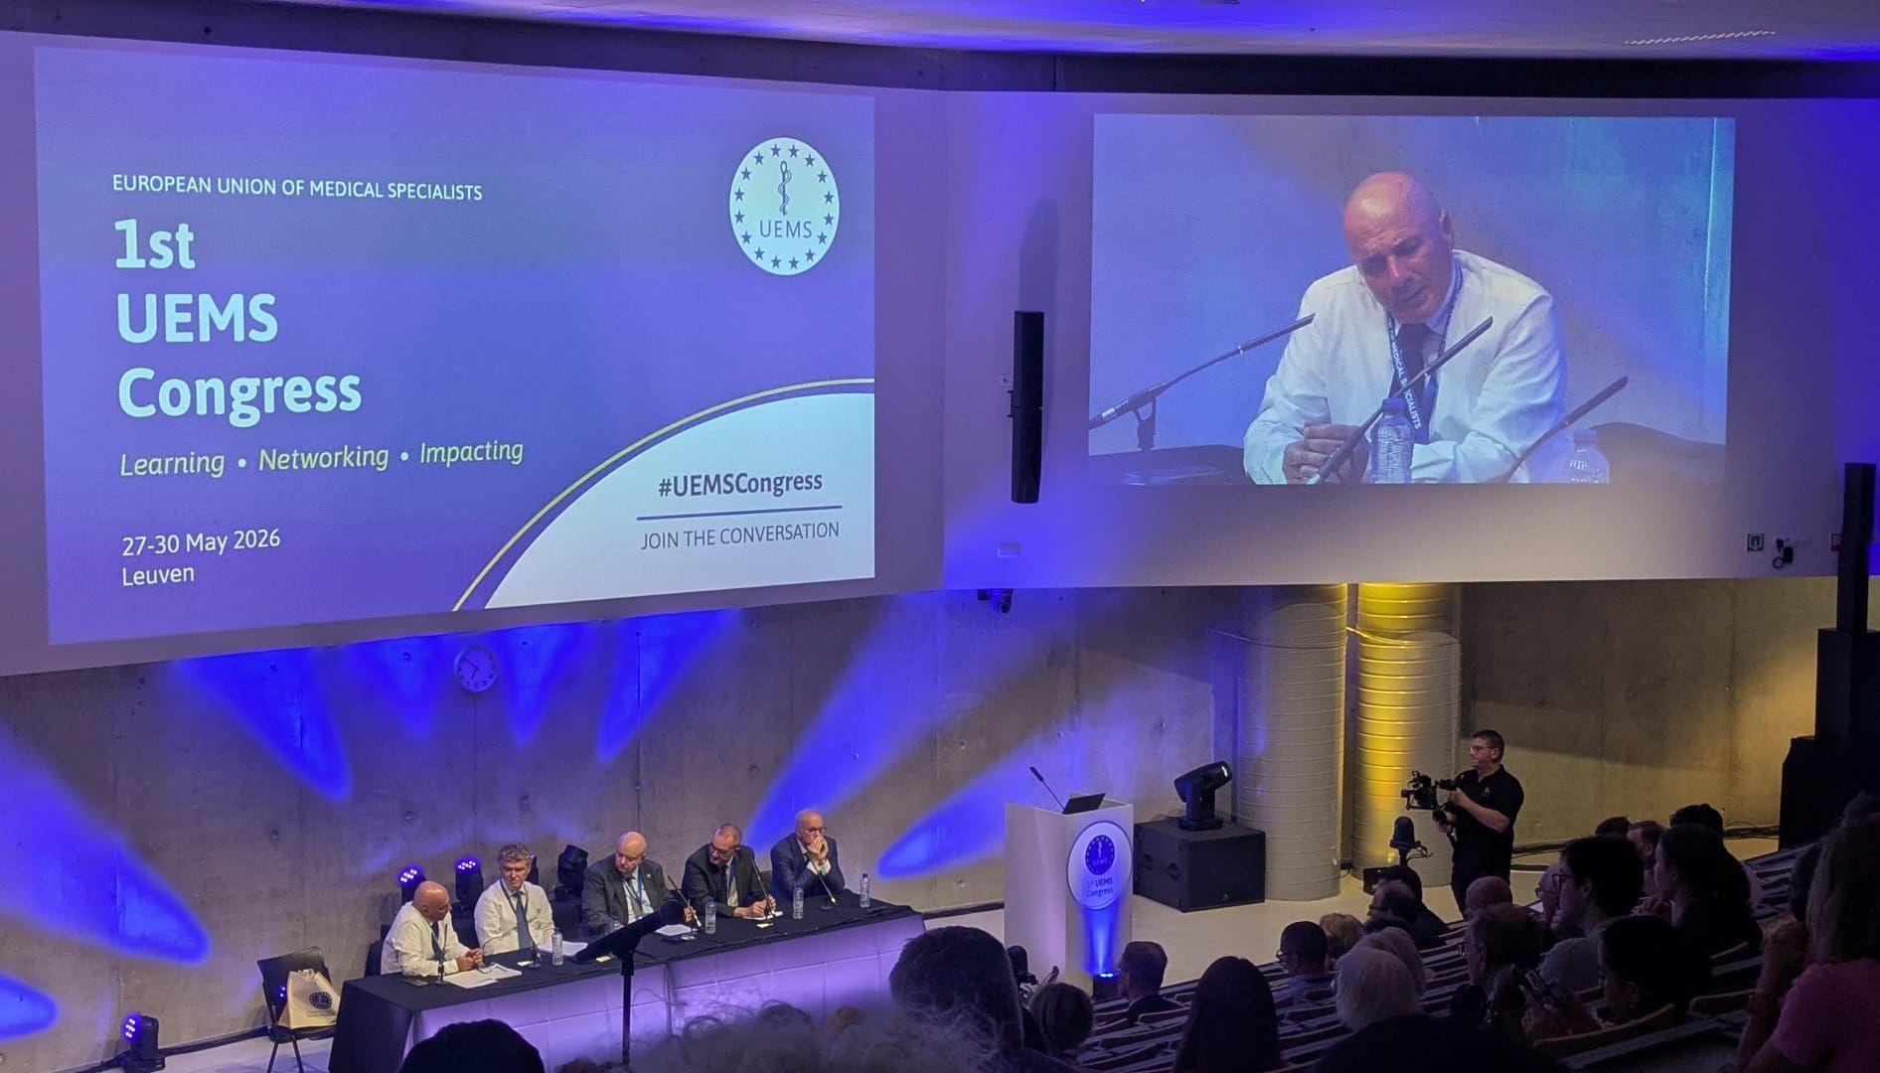
The 1st UEMS Congress: Bringing Our Community Together
LEUVEN | 27–30 MAY 2026
439
53
Registrations
Countries represented
64
194
55
Scientific sessions
Speakers
UEMS bodies represented
A new platform for the European specialist medical community.
Bringing together expertise, institutions and perspectives.
Notes:
6. The 1st UEMS Congress: Bringing Our Community Together
1:30 · Elapsed 7:30–9:00
Leuven, 27–30 May 2026.
439 registrations from 53 countries.
64 scientific sessions and 194 speakers.
55 UEMS bodies represented.
Acknowledge organisers, contributors and participants.
Beyond attendance figures: opportunities for colleagues across specialties and countries to meet.
A shared platform for exchanging expertise and discussing common challenges.
Value for Members through stronger connections within the UEMS community.

Slide 7

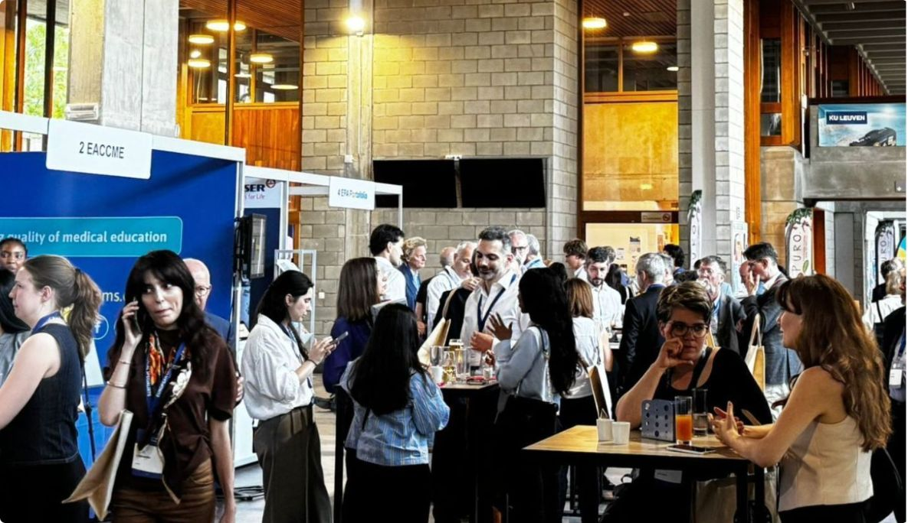
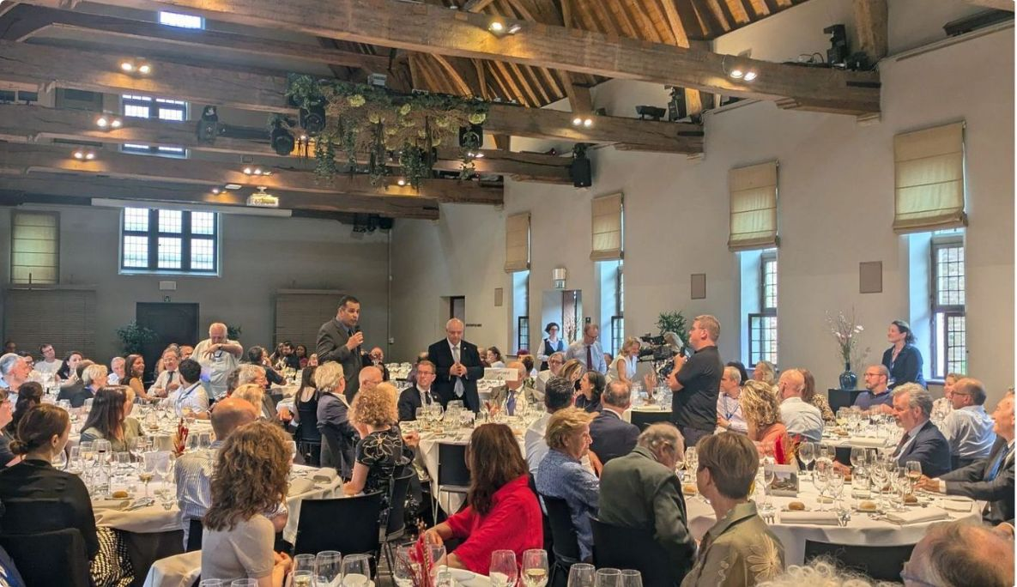
The Congress: Building on Experience
The Congress: Building on Experience
A SUCCESSFUL FIRST EDITION
Strong participation
Positive feedback
Broad representation across the UEMS community
A very favourable overall assessment from participants
Lessons for 2028
A more concentrated scientific programme
Fewer parallel sessions
Greater opportunities for interaction and networking
Earlier and more sustained communication
From a successful first edition to a stronger second Congress.
Building on what worked. Improving what can work better.
Notes:
7. The Congress: Building on Experience
1:15 · Elapsed 9:00–10:15
Strong first edition, with very favourable participant feedback.
Recognise the achievement while taking the lessons seriously.
For 2028:
More concentrated scientific programme.
Fewer competing parallel sessions.
More space for interaction and networking.
Earlier, sustained communication.
Make participation easier and more useful.
Build the second Congress around the experience of those who attended.

Slide 8
Closer to Our Members
Closer to Our Members
STRENGTHENING OUR RELATIONSHIP WITH MEMBERS
Regular bilateral meetings
Understanding national priorities
A two-way relationship
A new opportunity for direct dialogue
Recognising different realities across European healthcare systems
Listening, exchanging perspectives and identifying opportunities for cooperation
Continuing in 2027
A stronger UEMS begins with stronger relationships with its Members.
Our relevance depends on the value we bring to those we represent.
Notes:
8. Closer to Our Members
1:45 · Elapsed 10:15–12:00
Members at the centre of the UEMS’s purpose.
Regular bilateral meetings creating space for direct dialogue.
Understand national priorities and the different realities of healthcare systems.
Two-way exchange: listening, sharing experience and identifying useful cooperation.
Follow-through matters: reflect what we hear in our work.
Continue these conversations in 2027.
Stronger Member relationships also strengthen our European representation.
Our relevance depends on the value we bring to those we represent.

Slide 9
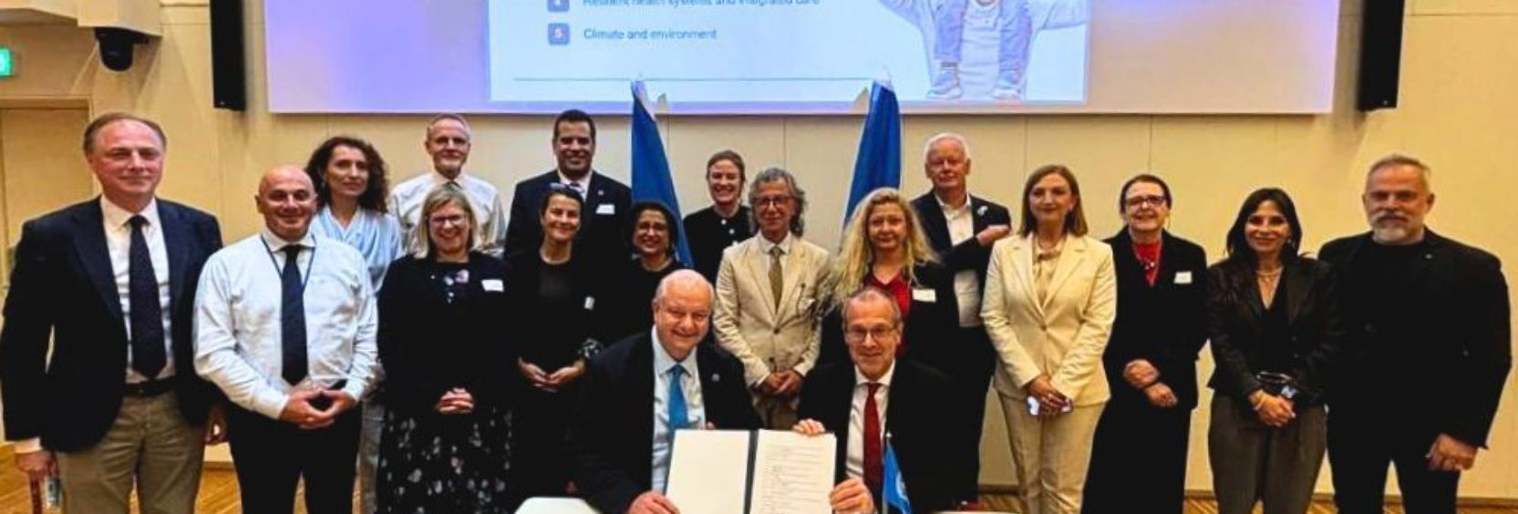
Strengthening Our European Voice
Strengthening Our European Voice
EUROPEAN AND INTERNATIONAL ENGAGEMENT
10 June 2026
European Medical Organisations
European Projects
Joint Statement with WHO Regional Office for Europe
Strengthening cooperation and common positions
KEEPCARING | DISCERN DSS | UM HEART VR
The next challenge
Transforming specialist medical expertise into greater influence at European level.
The UEMS should be a recognised voice in decisions affecting European healthcare.
Notes:
9. Strengthening Our European Voice
1:45 · Elapsed 12:00–13:45
Joint Statement with WHO Regional Office for Europe, 10 June 2026.
Cooperation with European Medical Organisations and work on common positions.
Participation in KEEPCARING, DISCERN DSS and UM HEART VR.
Different channels through which specialist expertise can contribute.
Main challenge: bring that expertise into decisions affecting European healthcare.
A credible, independent European voice for specialist medicine.
Independence supported by professional expertise and a clear connection to Members.
Cooperation with partners while retaining our own professional judgement.
Greater influence requires clear positions and sustained engagement.

Slide 10
Financial Stability and Institutional Independence
A STRONG FINANCIAL POSITION
€176,343
€934,209
€17,378
Positive financial result | 2025
Net result | First half of 2026
Projected positive result | Budget 2027
DOMUS MEDICA EUROPAEA
Bank loan fully repaid in 2026
The UEMS is now free of external debt.
Financial stability provides the independence and capacity to invest in our future.
Notes:
10. Financial Stability and Institutional Independence
1:30 · Elapsed 13:45–15:15
Keep the three financial periods distinct:
€176,343 positive result for 2025.
€934,209 net result for the first half of 2026.
€17,378 projected positive result in the 2027 budget.
Different reporting periods and statuses; avoid direct like-for-like comparisons.
Domus Medica Europaea bank loan fully repaid in 2026.
UEMS now free of external debt.
Financial stability supports institutional independence.
Capacity to invest responsibly in services, expertise and future priorities.
Continued discipline in matching commitments with resources.

Slide 11
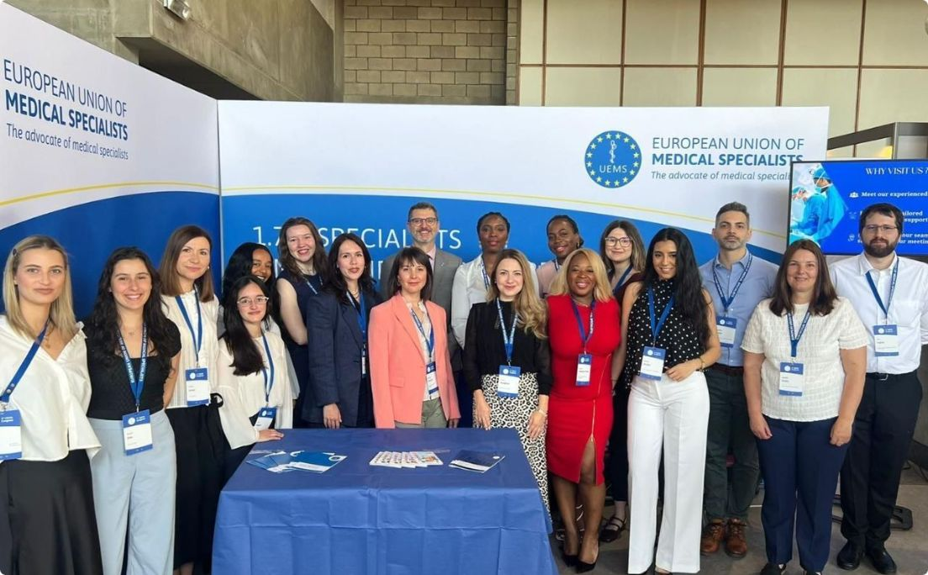
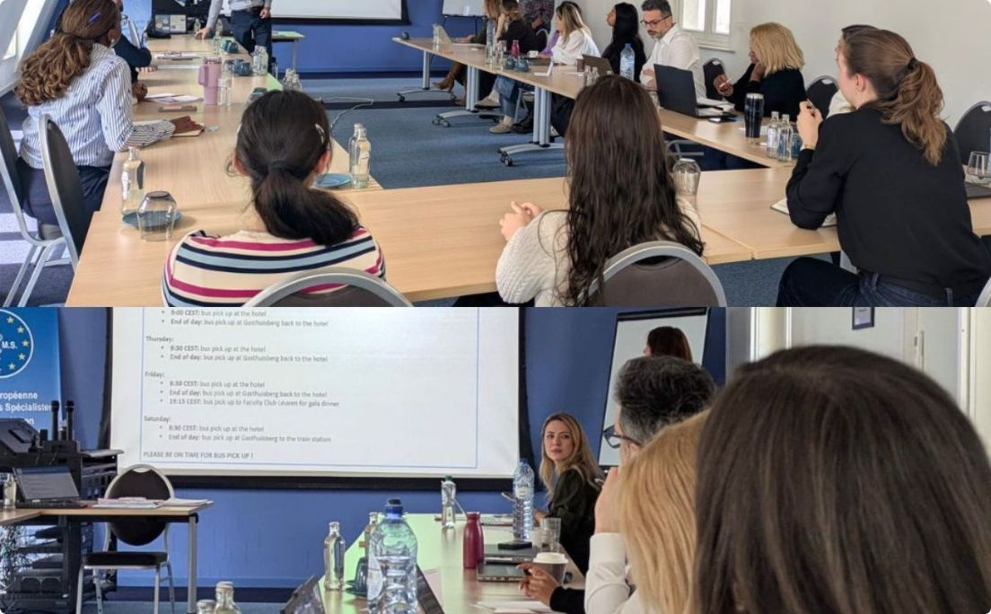
The Brussels Office: Supporting a Growing Organisation
The Brussels Office: Supporting a Growing Organisation
20.3 FTEs
Current operational capacity
EACCME Development
Digital Transformation
Implementation of Accredited Provider Status
Transition to Nalios and migration to Odoo v.19
Institutional Projects
European Medical Specialist Review
Member Zone and UEMS Fellowship
Consolidating the UEMS scientific publication platform
A stronger Office supporting an increasingly active organisation.
Growth must be accompanied by efficiency, expertise and appropriate resources.
Notes:
11. The Brussels Office: Supporting a Growing Organisation
1:30 · Elapsed 15:15–16:45
Recognise the Office’s contribution to the work presented today.
20.3 full-time equivalents of current operational capacity.
Accredited Provider Status adding implementation responsibilities.
Digital transition: Nalios and migration to Odoo v.19.
Member Zone and UEMS Fellowship.
Consolidation of the European Medical Specialist Review.
Growing activity requires appropriate expertise and efficient processes.
Practical objective: reliable support for Members and UEMS bodies.
Thank the team for managing this expanding range of responsibilities.

Slide 12
Looking Towards 2027
FIVE PRIORITIES FOR THE NEXT STAGE
Closer to Our Members
Strengthening dialogue and understanding national priorities
1.
Greater Impact of European Standards
Moving beyond approval towards implementation and evaluation
2.
A Sustainable EACCME
Innovation, quality and operational efficiency
3.
A Stronger European Voice
Making specialist expertise more visible and influential
4.
A More Connected UEMS Community
Bringing together the expertise of our Members, Sections and Boards
5.
The next stage is not simply about doing more.
It is about making better use of what we have built.
Notes:
12. Looking Towards 2027
2:00 · Elapsed 16:45–18:45
Five priorities emerging from the work already presented.
Closer to our Members
Continue direct dialogue.
Use national priorities to inform our work.
Greater impact of European standards
Understand implementation.
Gather evidence of their influence on training.
A sustainable EACCME
Deliver innovation with quality and operational efficiency.
A stronger European voice
Bring independent specialist expertise into relevant discussions.
A more connected UEMS community
Make better use of expertise across Members, Sections and Boards.
Shared priorities requiring contributions across the organisation.
Continuity of purpose, with clearer attention to results.
Make better use of what we have built.

Slide 13
A More Relevant and Influential UEMS
FROM CONSOLIDATION TO IMPACT
Closer to our
Members
Stronger in
Europe
Greater impact in Specialist
Medical Training and Practice
Stronger relationships and dialogue
A more influential European voice
Turning standards into meaningful change
OUR NEXT CHALLENGE
Not simply to do more, but to make a greater difference.
Thank you to our Members, Sections, Boards, Committees and the entire UEMS team
for their continued commitment.
Notes:
13. A More Relevant and Influential UEMS
1:15 · Elapsed 18:45–20:00
Return to the opening theme: from consolidation to impact.
Brief pause between the three messages:
Closer to our Members.
Stronger in Europe.
Greater impact in specialist medical training and practice.
Collective achievement and shared responsibility for the next stage.
Measure progress through the value our work brings to Members and specialist medicine.
Closing line, slowly:
“Not simply to do more, but to make a greater difference.”
Pause.
“Thank you to our Members, Sections, Boards, Committees and the entire UEMS team for their continued commitment.”

Slide 14
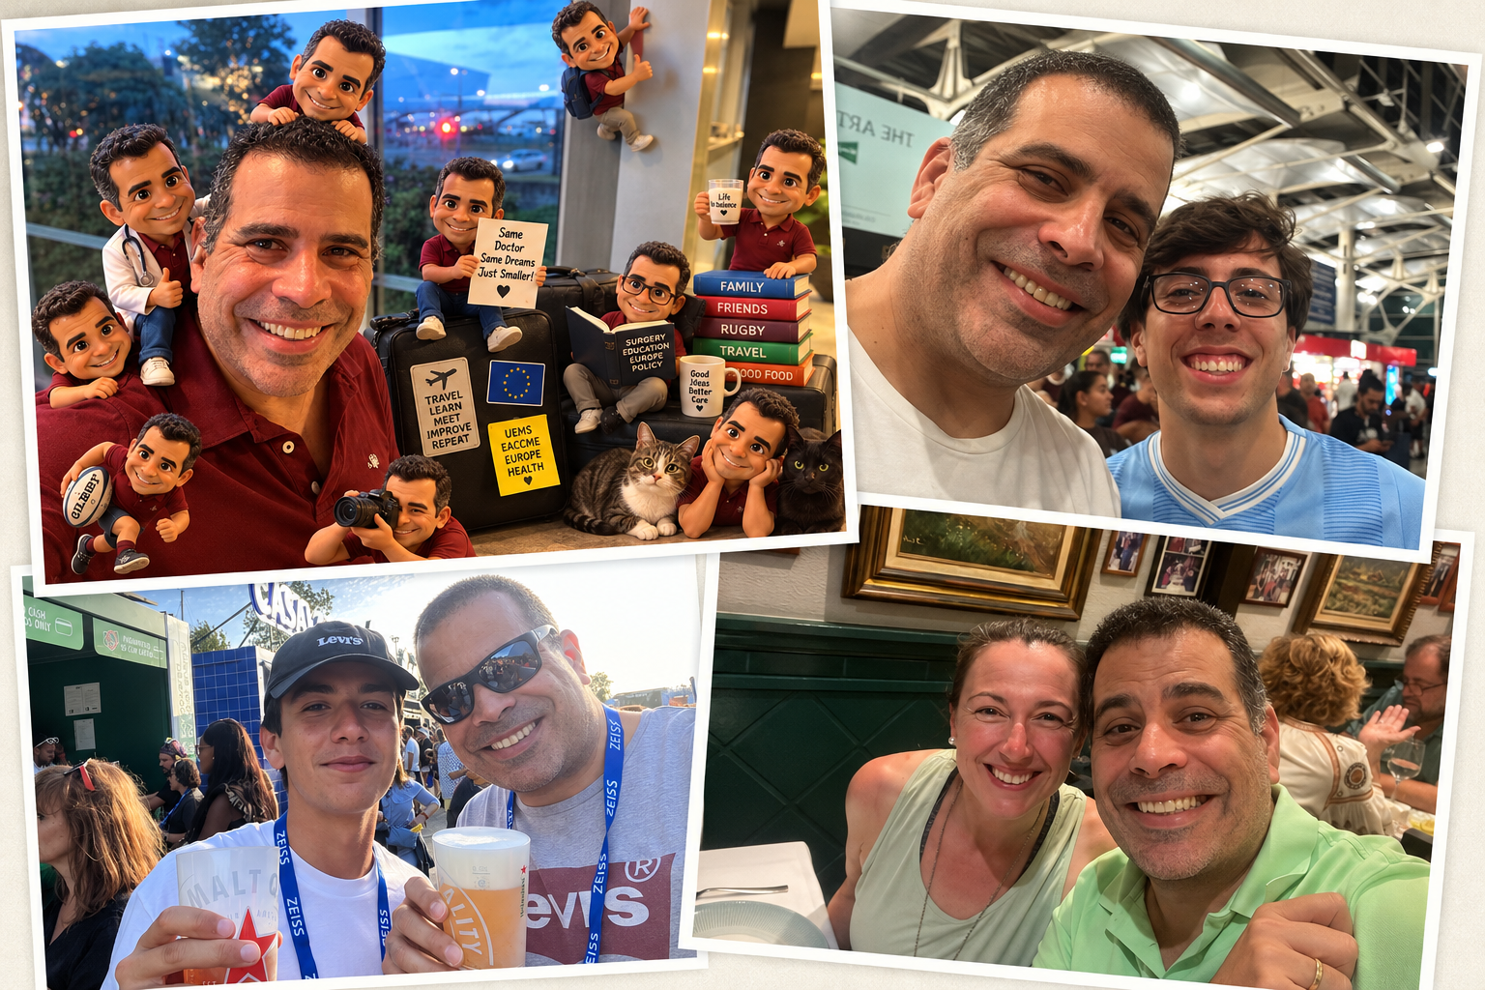
A More Relevant and Influential UEMS
Thank you for your attention
Notes:
13. A More Relevant and Influential UEMS
1:15 · Elapsed 18:45–20:00
Return to the opening theme: from consolidation to impact.
Brief pause between the three messages:
Closer to our Members.
Stronger in Europe.
Greater impact in specialist medical training and practice.
Collective achievement and shared responsibility for the next stage.
Measure progress through the value our work brings to Members and specialist medicine.
Closing line, slowly:
“Not simply to do more, but to make a greater difference.”
Pause.
“Thank you to our Members, Sections, Boards, Committees and the entire UEMS team for their continued commitment.”

