Slide 1
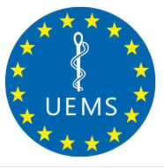
PROPOSAL –
CHANGE OF SECTION NAME
LABORATORY MEDICINE / MEDICAL BIOPATHOLOGY
LABORATORY MEDICINE

Slide 2
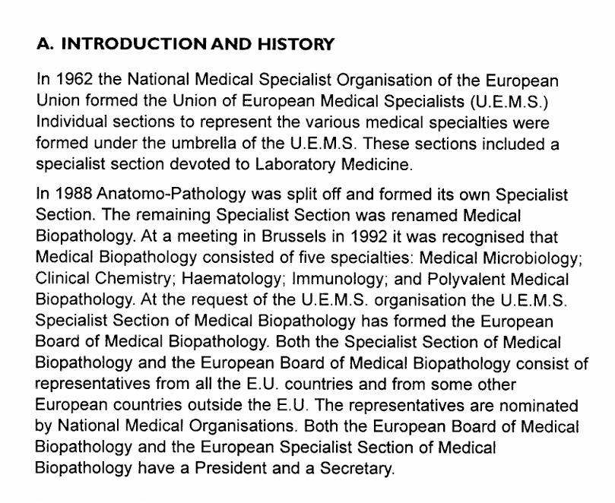








Historical origin of Section name ???
Blue Book version 1999:
Indicates content of the specialty as Laboratory Medicine
(Anatomical) Pathology becomes separate Section
New name „Medical Biopathology”

Slide 3
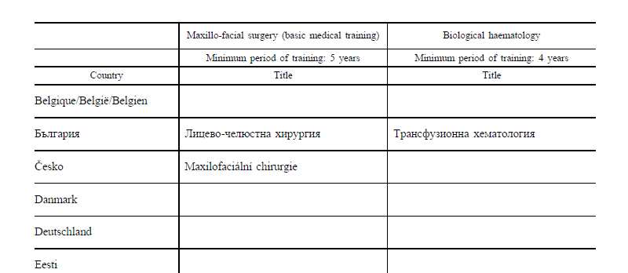
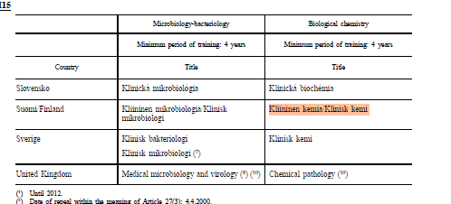
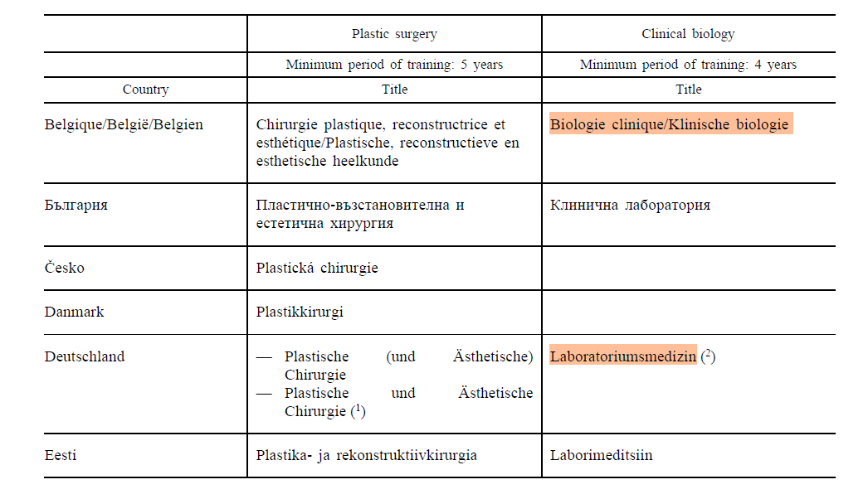
UEMS SPECIALTY TERMINOLOGY | ANNEX V EU Directive 36/05 TERMINOLOGY
Laboratory Medicine / Medical Biopathology | Clinical Biology Biological Chemistry Biological Haematology

Slide 4
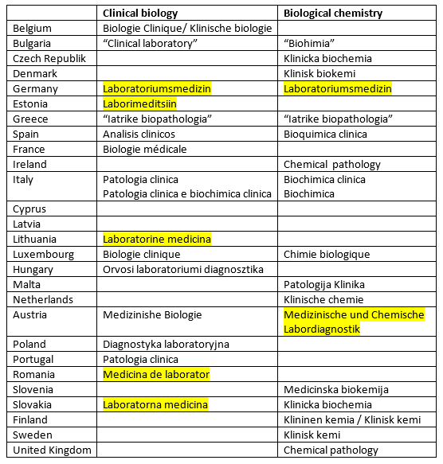
Annex V
There is only 1 profession
in each country despite the
2/3 columns and the fact
that some counties have 2
names.
Laboratory Medicine is a
service and thus is very
heterogeneous in Europe

Slide 5
Annex V
Shorter term aim – simplify name to Laboratory Medicine
  Many non-medics are now starting to use the term “Laboratory Medicine” – so we use it or lose it
Longer term aim – to reduce from 2 to 1 column with the column name “Laboratory Medicine”
  We have liaised on a few occasions with Isabelle Dumaine
  We would value the Advisory Board/Council support going forward

Slide 6
Annex V
55 Different column headings but only 45 UEMS Sections
In general, the Section names should match Annex V
But not always as there are several anomalies in Annex V
I would say that the UEMS is more up to date and more reflective of reality/contemporary than the Annex V

Slide 7
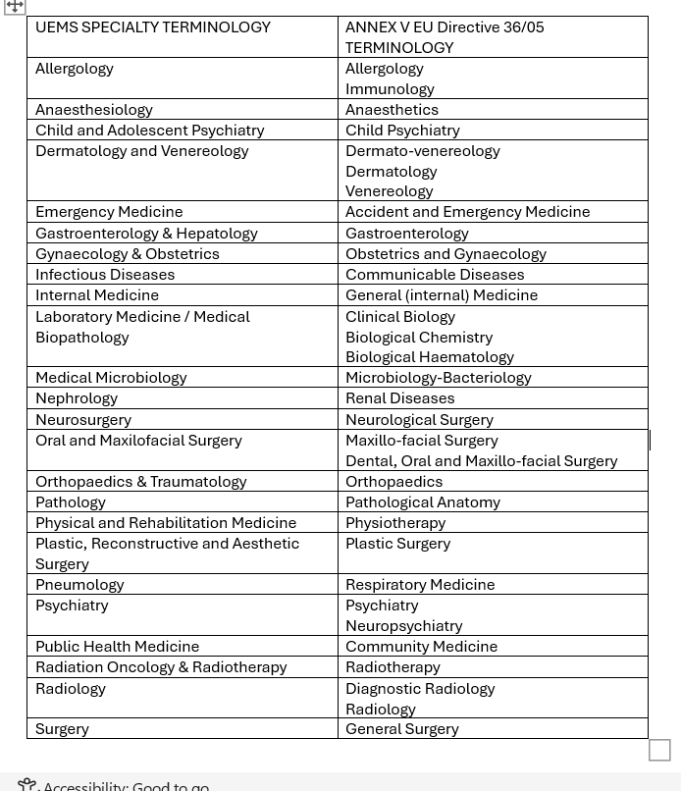

Slide 8

