Slide 1



Thematic Federation
for Medical Ethics
A shared syllabus for sound clinical judgment, professional integrity and future-ready care on medical ethics
ADVISORY BOARD MEETING • BRUSSELS • 15–16 OCTOBER

Slide 2
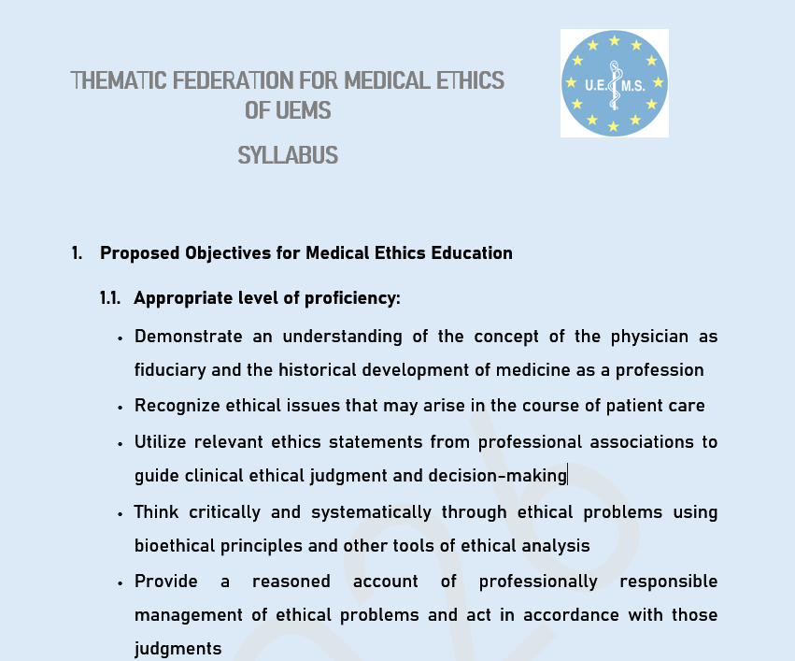

Slide 3
TOPICS
Ethical Theories
Contemporary Approaches to Medical Ethics
Doctor/Patient Relationship
Confidentiality
Truth-telling / Bad news
Autonomy, Paternalism, Informed Consent
Beginning of life/ Abortion
Ethics on infants
End of life/Euthanasia/Assisted Suicide
Medical research
Justice, Equity and sustainability of the Health Care System
Biotechnology
Artificial Intelligence
Patient Safety
Green Medical Ethics
Sustainable Healthcare Systems
Social media in medicine
Artificial intelligence in medicine
Big health databases

Slide 4
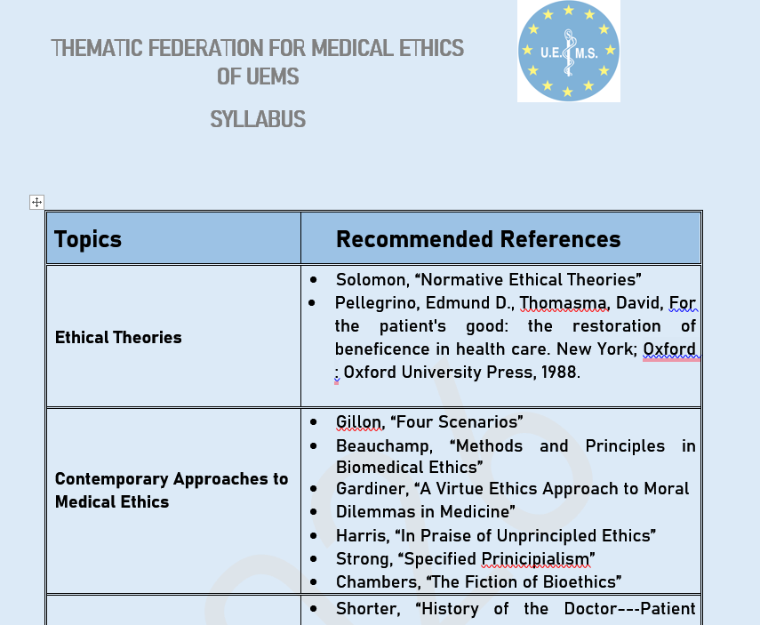

Slide 5














UEMS ADVISORY BOARD • MEDICAL ETHICS EDUCATION
Why a medical ethics syllabus
Recurring ethical challenges
Cross-border reality
Medical practice is increasingly complex, cross-border and technology-enabled.
European specialists increasingly practise across borders, with diverse legal and cultural settings. Ethical challenges — from consent to end-of-life care — are shared, yet responses vary.
Ethical challenges recur across specialties even when legal systems differ.
A common professional vocabulary
Specialists need a shared vocabulary for responsible judgment, communication and professional action.
Strengthening, not replacing
A shared framework strengthens, rather than replaces, national and specialty traditions.
The syllabus translates the values of medicine into teachable competencies.
From values to teachable skills
This syllabus provides a common baseline that each specialty and country can adapt — preserving local values while enabling mutual understanding.
Ethical reasoning becomes a structured, learnable proficiency.
Clinicians gain practical tools for everyday decision-making.
A shared ethical language is an investment in trust, patient safety and the future of European medicine.

Slide 6
UEMS ADVISORY BOARD • MEDICAL ETHICS EDUCATION
What proficiency should look like
1
Physician as fiduciary
Understand the physician as a fiduciary and the historical development of medicine as a profession.
2
Recognize ethical issues
Identify ethical issues in patient care, from everyday dilemmas to complex value conflicts.
3
Professional statements guide judgment
Use professional ethics statements and codes to guide reasoning and clinical decisions.
4
Critical thinking with bioethical tools
Think critically and systematically using bioethical principles, case analysis and ethical frameworks.
5
Act and articulate responsibly
Give a reasoned account, act responsibly, and articulate ethical reasoning respectfully in team and patient settings.

Slide 7











UEMS ADVISORY BOARD • MEDICAL ETHICS EDUCATION
The clinical core: decisions with patients
Voice and trust
Care across the life course
Agency and vulnerability
Privacy and confidentiality underpin the therapeutic relationship and the patient’s willingness to disclose.
Decision-making capacity assessment protects patients who cannot weigh risks and benefits for themselves.
Maternal–fetal medicine and reproductive technologies raise questions of risk, benefit and moral status.
Truth-telling, medical errors and bad news demand honest, compassionate communication even when outcomes are uncertain.
Surrogate decisions and shared decision-making respect autonomy while acknowledging interdependence.
Paediatric and neonatal medicine require balancing parental authority with the child’s best interests.
Informed consent and refusal, together with advance directives, safeguard patient wishes across changing circumstances.
Cross-cultural communication and attention to religion and spirituality shape how values and preferences are expressed.
End-of-life care, withholding/withdrawing treatment and determination of death test the limits of beneficence and respect.
Ethics is present wherever clinicians interpret, communicate and decide.

Slide 8








UEMS ADVISORY BOARD • MEDICAL ETHICS EDUCATION
Professionalism in real clinical systems
Professionalism is shaped by the interplay of team dynamics, individual clinician integrity, and institutional structures. The syllabus addresses each layer to prepare specialists for the real ethical pressures of everyday practice.
Team
Clinician
Institution
Working within the medical team and handling interprofessional interactions
Personal values and the right of conscience: extent and limits
Conflicts of interest and conflicts of obligation in education, practice and research
Medical trainee issues, hidden curriculum and moral distress
Concerns about colleagues: impairment, incompetence and mistakes
Institutional policies that shape ethical climate and accountability
Self-awareness, professional identity and self-care
Managing challenging patients and families, including the clinician’s contribution to difficulty
Structural support for ethical practice and reporting concerns
Ethical professionalism emerges when team culture, clinician integrity and institutional accountability work in concert.

Slide 9





UEMS ADVISORY BOARD • MEDICAL ETHICS EDUCATION
Justice, safety, and the public mission of medicine
Linking bedside duties to system responsibilities
Public mission and professional integrity
Public trust: Physicians hold a fiduciary role that extends beyond individual patients to the communities they serve.
Access and equity: Addressing healthcare disparities and the fair allocation of scarce resources as core ethical obligations.
Gifts and philanthropy: Navigating grateful patient philanthropy and gift acceptance with transparency and ethical boundaries.
Patient safety as ethical duty: Framing safety as a moral imperative for clinicians, not merely a quality metric.
Research ethics: Upholding the Declaration of Helsinki, institutional review boards, and the protection of human subjects.
System stewardship: Clinicians contribute to the conditions that make safe, fair care possible across the healthcare landscape.
Equitable system design: Integrating justice and equity into the ethical architecture of healthcare institutions.
The syllabus links bedside duties to the conditions that make safe, fair care possible.

Slide 10








UEMS ADVISORY BOARD • MEDICAL ETHICS EDUCATION
New frontiers are already in practice
Contemporary challenges that shape ethical judgment today and set the agenda for tomorrow.
Social media in medicine
Artificial intelligence
Professionalism, boundaries, privacy and public trust. Clinicians must navigate digital spaces without compromising patient confidentiality or the reputation of the profession.
Accountability, bias, explainability, regulation and the human–machine relationship. AI tools must serve clinical judgment without eroding the physician's fiduciary duty.
Big health databases
Biotechnology
Governance, privacy, secondary use, data quality and responsible inference. Ethical stewardship of health data is essential for research, public health and patient trust.
Enhancement, stem-cell research, human cloning and the moral limits of innovation. Scientific progress must be guided by ethical reflection and societal values.

Slide 11







UEMS ADVISORY BOARD • MEDICAL ETHICS EDUCATION
Green medical ethics and sustainable healthcare
Clinicians hold an ethical responsibility to minimize environmental harm. Equipment use, waste management, and climate-sensitive decisions connect individual care with planetary health. Sustainable systems must balance efficiency, equity, and ecological responsibility.
The clinician’s ethical duties
Minimize environmental harm: reducing waste, choosing sustainable equipment, and considering the carbon footprint of clinical choices.
CASE PROMPT
How should a service protect today’s patient while preserving tomorrow’s capacity to care?
Balance individual care and planetary health: climate-sensitive decisions should not compromise the well-being of the present patient.
Sustainable healthcare systems: efficiency, equity, and ecological responsibility must be weighed together in clinical governance.
A question for every clinical team and institutional policy.
Resource-limited settings make these trade-offs especially visible, demanding transparent ethical reasoning.
Ethical responsibility extends beyond the bedside: green medical ethics links individual clinical decisions to the health of communities and the planet.

Slide 12








UEMS ADVISORY BOARD • MEDICAL ETHICS EDUCATION
Why is this syllabus adoptable
Balanced intellectual foundation
Ready for implementation
Common core, adaptable delivery
Clinically anchored references
A shared European baseline that specialties and countries can contextualize without erasing local traditions. Designed as a flexible framework for diverse national systems.
Ethical theories, principlism, virtue ethics, professionalism, justice and contemporary approaches are integrated to support rigorous reasoning and reflective practice.
AMA ethics opinions, WMA materials, major bioethics scholarship and current literature on AI, data and sustainability provide a robust starting library.
Clear proficiencies, teachable topics and a reference library that can support local curricula in every European specialty and national context.
Coherent
Relevant
Future-facing
Approval test
Usable

Slide 13







UEMS ADVISORY BOARD • MEDICAL ETHICS EDUCATION
Supporting European Training Requirements (ETRs)
The syllabus provides a practical ethical foundation that can strengthen ETRs across specialties while remaining adaptable to the clinical realities of each discipline.
Embed ethics where it already belongs
Add elements when a gap is identified
Support implementation and review
Map the syllabus competencies onto existing ETRs so that ethical reasoning, communication and professional responsibility are visible within clinical requirements.
Where an ETR has limited or no ethics content, introduce proportionate elements: learning outcomes, case discussions, assessment prompts or recommended resources.
Use a common reference point when ETRs are updated, helping specialties compare approaches and keep pace with emerging issues such as AI, data and sustainability.
Result: ethics becomes visible, teachable and comparable across European specialist training.

Slide 14






UEMS ADVISORY BOARD • MEDICAL ETHICS EDUCATION
Complementing the Boards — specifically in ethics
The syllabus is designed to complement the Boards’ work, not to duplicate or replace it: it offers a shared ethical framework that Boards can use when shaping standards, training and review.
The Boards
The syllabus
Define specialty standards, oversee training quality and respond to the practical needs of their disciplines and national contexts.
Provides common ethical concepts, proficiencies, cases and references that can inform Board discussions and make ethical expectations more explicit.
Complementarity in practice
Supports Boards when ethical questions arise in ETR development or revision.
Offers a common language for dialogue across specialties and countries.
Helps translate ethical commitments into teachable and reviewable expectations.
Shared aim: stronger specialty standards, better prepared specialists and greater public trust.

Slide 15











UEMS ADVISORY BOARD • MEDICAL ETHICS EDUCATION
Recommendation to the Advisory Board
Proposed next steps toward implementation
1
Endorse the syllabus and its proficiency-based structure.
2
Invite specialty and national representatives to map local implementation.
RESOLUTION
3
Develop teaching resources and a light-touch review cycle for emerging topics.
FORMAL REQUEST
Approve the Medical Ethics Education Syllabus as the common framework of the Thematic Federation for Medical Ethics.
APPROVAL TEST
Coherent
Relevant
Future-facing
Usable
A common ethical language is an investment in trust, patient safety and the future of European medicine.

