Slide 1
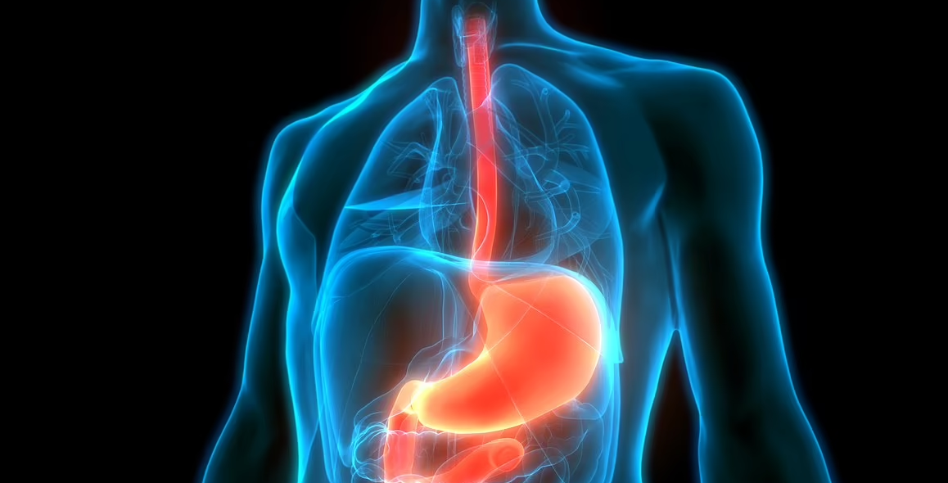

European Training Requirements in the Specialty of Upper GI Surgery
On behalf of the UEMS MJC Upper GI Surgery
Octobre 16th, 2026
Philippe Nafteux, MD PhD

Slide 2

Composition MJC Upper GI surgery
Executive committee:
Lars Bo Svendsen
Toni Lerut
Philippe Nafteux
European Board of Upper GI Surgery
Philippe Nafteux (chair board and examination committee), Ass professor, Belgium
Lars Bo Svendsen (chair executive committee); Professor Emir., Denmark
Toni Lerut (co-chair executive committee) ; Professor Emir., Belgium
Jakob Hedberg, Ass Professor, Sweden
Mette Siemsen, Ass. Professor, Denmark
Wolfgang Schröder, Professor,, Germany
Jesper Durup, Ass. Professor Surgery, Denmark
Grard Nieuwenhuijzen, Professor The Netherlands
Eligibility committee = UGI board of UGIS

Slide 3
ETR’s for high quality training
Quality of care is directly linked to quality of training
Surgery training is different across Europe but trainees should have same core competences: harmonization.
Define the knowledge, skills and competences that a specialist must acquire during training (European Training requirements or ETR’s)
  Wide area of knowledge (clinical knowledge, technical and communication skills, ethics,…)

Slide 4
The 2016 evaluation of Upper GI Surgery situation in Europe
Variation was the driver for European harmonisation
Different specialties involved
General/visceral vs Thoracic surgeons
Practices
Benign vs oncologic
Specific training program
Slightly developped to largely inexistant
CCST issued by different authorities: professional body, university, ministries
Harmonization was critically needed

Slide 5
From working group to UEMS MJC Upper GI Surgery
2012 → 2016 → 2018 → 2021 → 2025
2012 — Working group Upper GI Surgery (Esophagus, cardia and stomach) within UEMS Section of Surgery.
Purpose: common high standards and mutual recognition across Europe.
2016 — Esophagogastric Surgery within UEMS Section of Surgery
2018 — Upper GI Surgery within UEMS Section of Surgery
in collaboration with UEMS Section of Thoracic Surgery
2021 — UEMS council approved the creation of a Multidisciplinary Joint Committee Upper GI Surgery.
2025 — Development of ETR’s

Slide 6
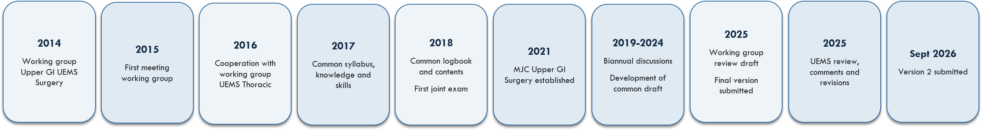
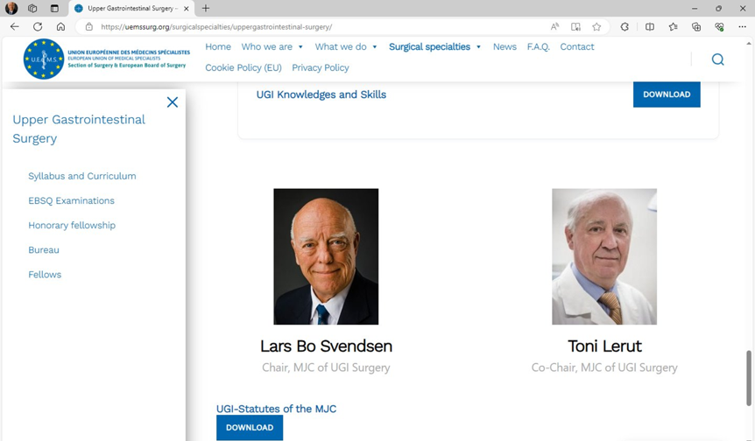
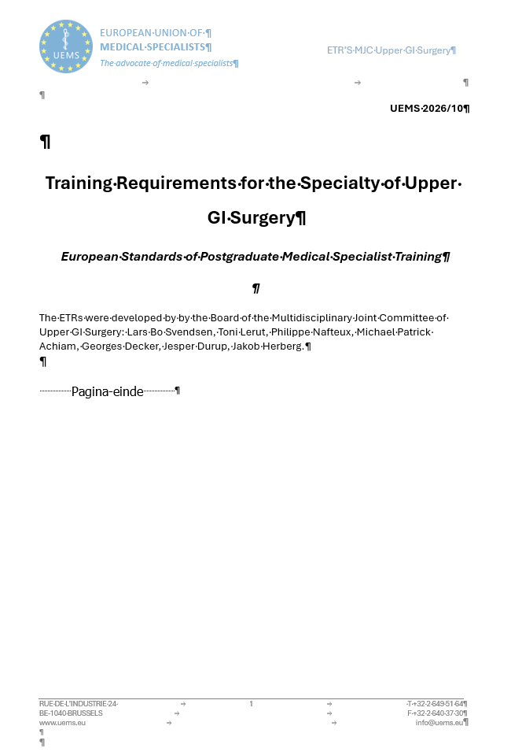
How the 2026 ETR was developed?

Slide 7
The ETR changes the emphasis: from time to competence
European reference, implemented alongside national requirements
Competency-based rather than time-based alone
Knowledge + technical skills + professional attitudes + workplace performance
Assessment is linked to progressive entrustment
National regulatory requirements remain applicable
The ETR is a living document: regular review, at least every five years

Slide 8
I - Training requirements for trainees: the architecture
From knowledge and skills to independent practice
Knowledge
Syllabus
Skills
Practical & clinical
procedures
Professionalism
CanMEDS
7 roles
Entrustment
EPAs + assessment
+ portfolio
(20 esophagectomies for cancer)

Slide 9

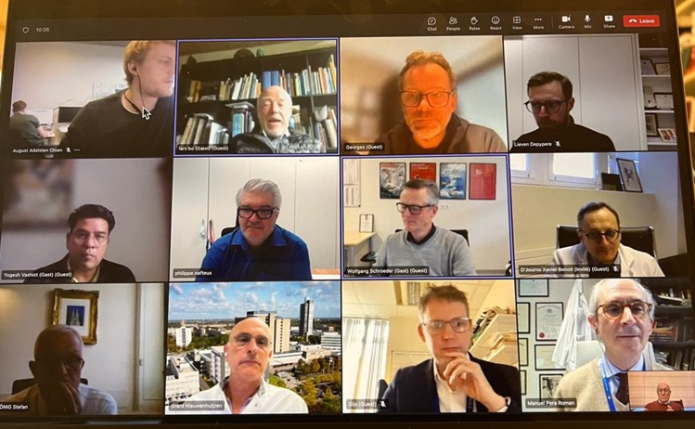
Syllabus: defining the European knowledge base
A harmonised core, with specialised areas depending on training opportunities
The syllabus describes theoretical knowledge plus practical and clinical skills for Upper GI training training.
Built through a Delphi process involving UEMS Sections General Surgery and Thoracic Surgery.
Has been endorsed by ESDE

Slide 10
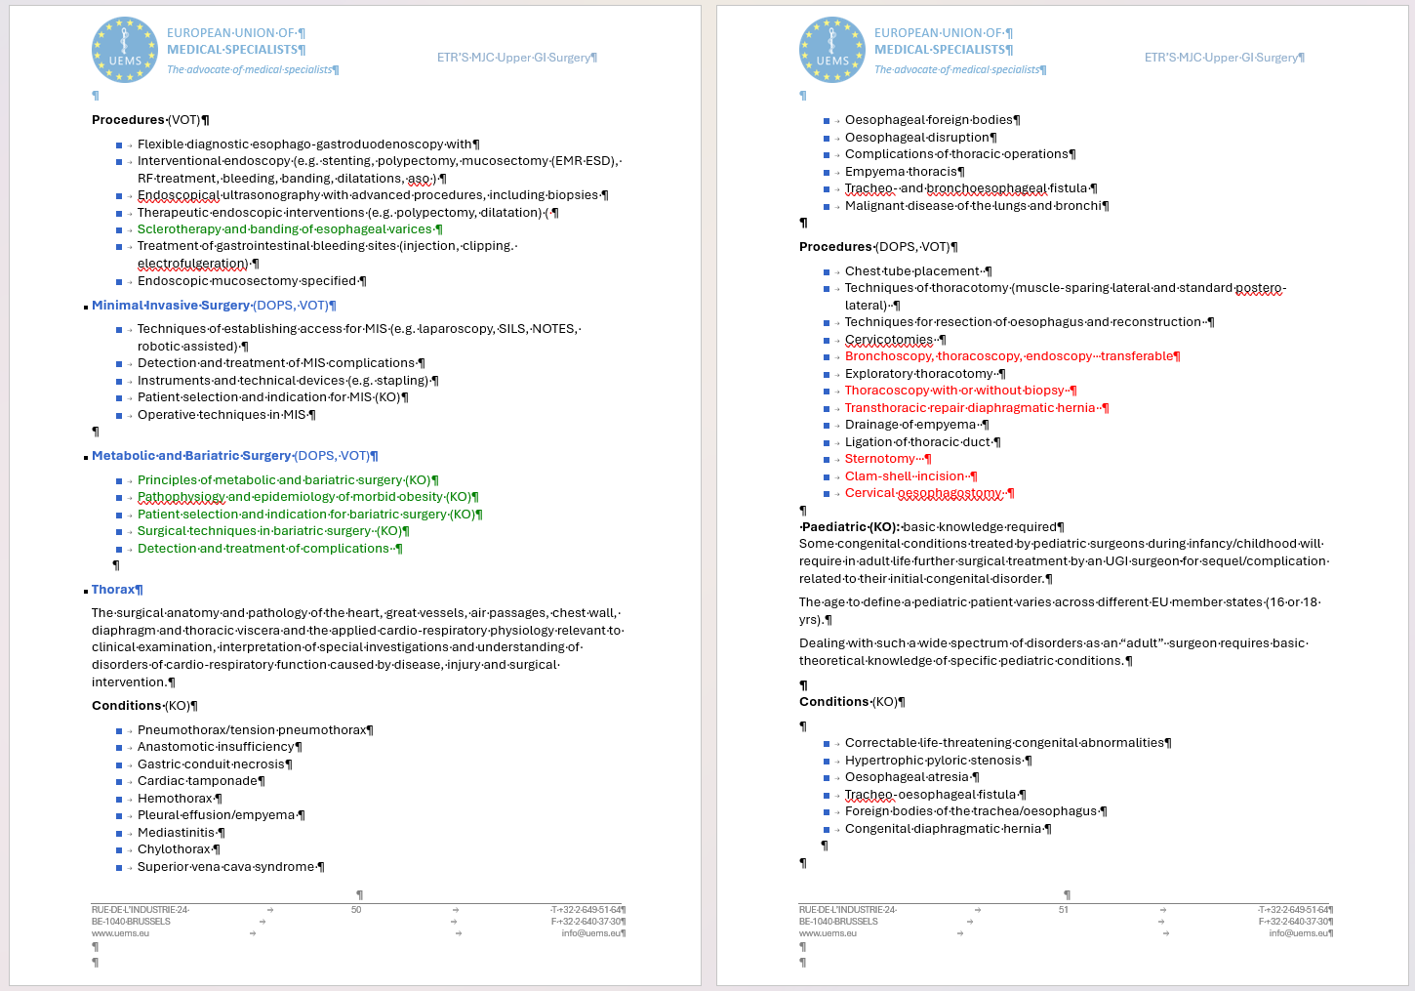
Syllabus for Upper GI Surgery
15 modules
  Supplementary knowledge for Thoracic vs General/visceral surgeons
Pediatric surgery, endoscopy and bariatric surgery
Basic knowledge expected
Collaboration with other specialties is key
  Radiology, Gastroenterology, Pediatric Surgery, ENT,…

Slide 11
Curriculum: translating the syllabus into training
Structured progression and increasing responsibility
The curriculum should describe contents and aims of training.
Rotations should cover all the main areas of Upper GI Surgery.
Responsibility should increase progressively with clinical and surgical experience.
Protected time for study and tuition is required.
Ongoing scholarly activity: teaching, journal clubs, research conferences and morbidity & mortality discussion.
Exposure
Supervised practice
Increasing responsibility
Independent practice

Slide 12
CanMEDS: the non-technical dimension
Seven overlapping roles around the Medical Expert
Leader
Collaborator
Medical
Expert
Communicator
Health Advocate
Professional
Scholar

Slide 13
EPAs: making competence observable in practice
Four EPAs — Fith is transferable competency
Core:
EPA 1 — Upper Gastrointestinal Trauma
EPA 2 — Benign Esophageal, gastric Duodenal Disease
EPA 3 — Malignant Esophageal, gastric Duodenal Disease
EPA 4 — Diaphragmatic and hiatal Pathology
Optional:
EPA 5 — Upper Gastrointestinal Endoscopy
Entrustment levels
1 Observe / assist
2 Direct supervision
3 Distant supervision
4 Independent

Slide 14
Assessment: evidence, not just case numbers
Portfolio + logbook + workplace-based assessment + board examination
Training Portfolio: CV, operative logbook, previous posts, publications, presentations and courses.
Logbook entries are regularly inspected and signed by the trainer (min 800 points).
EPAs are supported by repeated workplace observations across patients and clinical contexts.
The ETR requires at least 20 esophagectomies and 20 transthoracic Resections as first operating surgeon, including open,video-assisted or robotic-assisted procedures.
Recommandation letters from 2 independent mentors
European Board examination complements training assessment.

Slide 15

Assessment
Log Book: min 800 Points for A+B+C
Categories A,B or C (assistant: 1point)
Categorie C (principal surgeon: 2 points)
At least 50% points as principal surgeon
Eligibility
CAVE: provisional arrangement

Slide 16
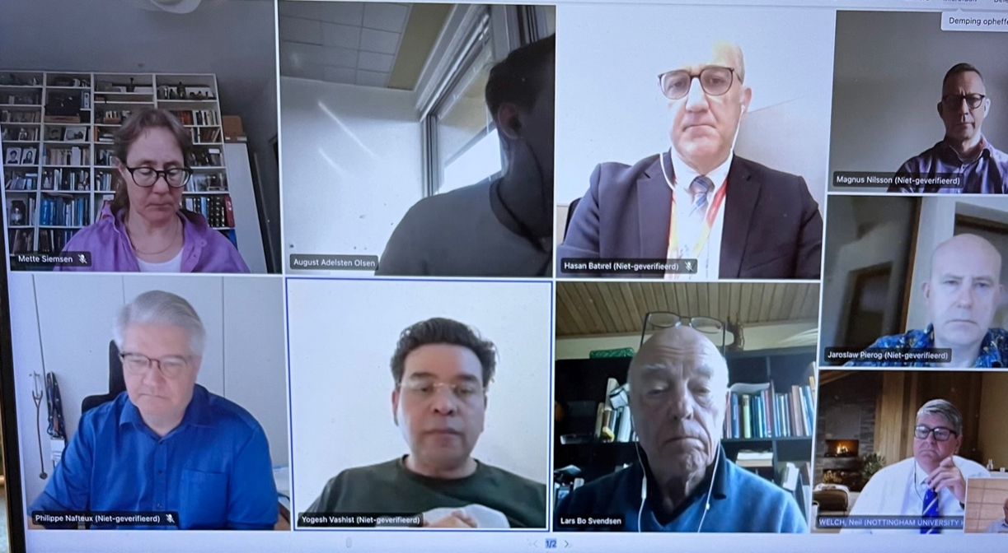
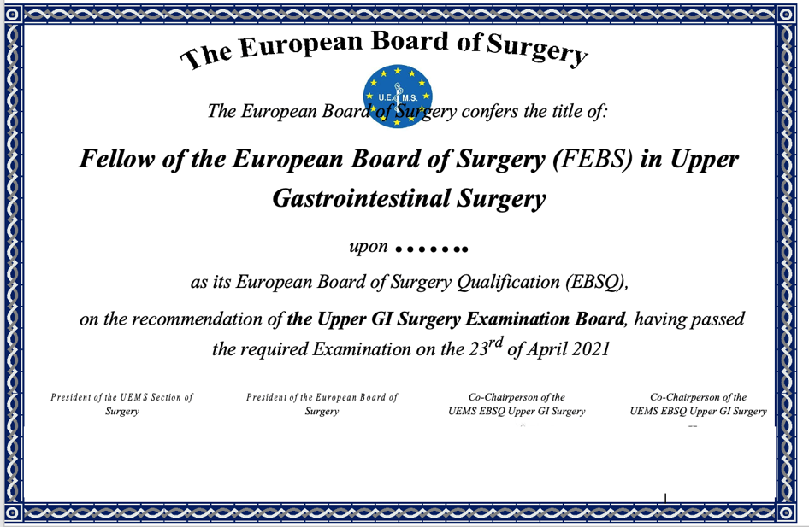
UEMS MJC Upper GI Board Exam
MCQ’s
OSCE
120 MCQ’s
6 stations
On-Line or physical meeting

Slide 17
II - Training requirements for trainers
A trainer is a clinician, educator and assessor
Certified Upper GI Surgeon — preferably EB UGIS or equivalent UEMS-recognised certification.
Continuing professional development plus clinical, teaching and administrative skills.
Commitmentto conduct the teaching program.
Training in educational methods: learning needs, teaching objectives and trainee assessment.
Evidence of scholarly activity: research, publications and scientific meetings.
Set realistic objectives, supervise day-to-day work and document progress at the end of rotations.
Faculty should have protected educational capacity and be large enough for clinical, educational and research supervision.
Notes:
The ETR makes clear that a trainer needs more than clinical expertise. Trainers should be appropriately certified, maintain professional development, understand teaching and assessment, demonstrate scholarly activity and formally supervise and document trainee progress.
Source for all slide content: UEMS Section of Thoracic Surgery, 'Training Requirements for the Specialty of Thoracic Surgery', version submitted 15 September 2026, uploaded by the user.

Slide 18
III - Training institutions: the environment must support training
Case mix, staff, infrastructure, education and quality management
High-specialisation units: university affiliation or equivalent multidisciplinary level; qualified head with ≥5 years as a UEMS Upper GI Surgeon.
Full-length high-specialisation program: sufficient case variety and mentors; minimum 100 major procedures/year is specified.
Dedicated staff (min 2 full-time staff surgeons) and institutional resources.
Access to open, endoscopic and minimally invasive surgery, ICU and relevant diagnostic/support services.
Educational infrastructure: research facilities, simulation; high-specialisation units must have simulation lab facilities.
Quality management: defined educational responsibilities, evaluation and mechanisms for continuous improvement.
Notes:
The institution is the third part of the training system. The ETR distinguishes high-specialisation and standard units. For a full-length high-specialisation programme, it specifies at least 300 major procedures per year, sufficient mentors and broad case exposure. Educational and research infrastructure, including simulation at high-specialisation level, is also addressed.
Source for all slide content: UEMS Section of Thoracic Surgery, 'Training Requirements for the Specialty of Thoracic Surgery', version submitted 15 September 2026, uploaded by the user.

Slide 19
The ETR in one framework
A coherent system from European standards to patient care
European
harmonisation
Syllabus &
Curriculum
CanMEDS &
Competencies
EPAs &
Assessment
Qualified
Trainers
Accredited
Institutions
Safe, competent
Upper GI Surgeons

Slide 21



Collaboration
Honorary/ Examinators members: > 30 experts (examinators/ proctors) - nordic countries, Belgium, the Netherlands, Spain, Greece, Italy, GB, Germany, France, Turkey, Poland, Luxembourgh, Switzerland, Estonia
Fellows examined: > 49 fellows
Austria, Spain, GB, Denmark, Sweden, Norway, Italy, Germany, Belgium, the Netherlands, Egypt, Pakistan, Japan, Ireland
Memorandum of understanding should be established with scientific societies

