Slide 1

UEMS COUNCIL MEETING · SATURDAY 17 OCTOBER 2026
Creation of the first two Divisions of Paediatrics
Prof. Dr. Ann De Guchtenaere
President, European Board of Paediatrics
UEMS Section of Paediatrics
Notes:
Welcome and introduction. Thank the Council for the opportunity to present the proposal for the creation of the first two Divisions of Paediatrics.

Slide 2




Paediatrics has grown into many subdisciplines — our Paediatric section should structurally reflect that
WHY NOW
Children with complex, chronic and rare conditions are increasingly cared for by paediatric subspecialists.
~70%
Equal
Subdiscipline
of rare diseases begin in childhood — care that demands subspecialty expertise
Not ‘just’ a competence, requires knowledge, skills and competences
Training =2-3y! ETR’s already exsist
in UEMS not visible
Active cfr societies!
Notes:
(~60 seconds)
Dear colleagues, paediatrics today is no longer one discipline — it is many. Children with complex, chronic and rare conditions are increasingly looked after by paediatric subspecialists: neonatologists, paediatric cardiologists, nephrologists, oncologists and many more.
Around seven in ten rare diseases begin in childhood, and these children need highly specialised expertise.
Yet across Europe, the way we train and recognise these subspecialists still differs enormously from one country to the next.
Every child in Europe deserves the same standard of specialist care, wherever they live. That is why I am proposing that our Section formally recognise subdivisions in paediatrics.

Slide 3





First paediatrics, then recognised divisions
THE PROPOSAL
Neonatology
Cardiology
Gastroenterology, hepatology & nutrition
Nephrology
Neurology
Pulmonology
Paediatrics (revised ETR)
General paediatrics= core training — the shared foundation for every paediatrician
Haematology & oncology
Endocrinology & diabetes
Infectious diseases
Rheumatology
Allergy & immunology
Intensive & emergency care
Each subdivision has:
European Training Requirements
Shared curriculum
Common assessment standards
(A partnership with their) subspecialty society
Notes:
(~60 seconds)
What exactly are we proposing? A simple, transparent model.
Every paediatrician starts with the same common trunk in general paediatrics — that stays our shared foundation and our identity.
On top of that, the Section formally recognises subdivisions: neonatology, cardiology, gastroenterology, nephrology, neurology, pulmonology, oncology and the others you see here. The final list would of course be agreed together with the subspecialty societies.
Each subdivision would have its own European Training Requirements, a shared curriculum and logbook, common assessment standards, and a formal partnership with its European subspecialty society. In short: one specialty, with clearly defined branches.

Slide 4
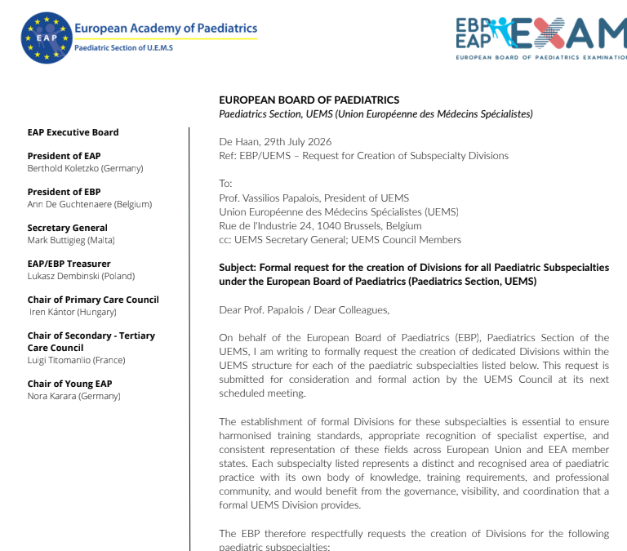

Slide 5
Reply EC UEMS
For this reason, the Executive Committee would favour a gradual approach. As a first step, we would invite the
Paediatric Section / EBP to identify two priority areas among the 13 proposed Divisions. We would suggest selecting the most established areas, preferably those for which UEMS European Training Requirements (ETRs) have already been developed and approved. For these two priority areas, it would also be useful to provide some supporting information regarding:
the approximate number of specialists practising in the field and
the extent of their representation across European countries
This would allow the Executive and, subsequently, the UEMS Council to assess the
proposed model on a sound basis.

Slide 6
TODAY….
THE PROPOSAL
Neonatology
Cardiology
Gastroenterology, hepatology & nutrition
Nephrology
Neurology
Pulmonology
Paediatrics (revised ETR)
General paediatrics= core training — the shared foundation for every paediatrician
Haematology & oncology
Endocrinology & diabetes
Infectious diseases
Rheumatology
Allergy & immunology
Intensive & emergency care
Each subdivision has:
European Training Requirements
Shared curriculum
Common assessment standards
(A partnership with their) subspecialty society
Notes:
(~60 seconds)
What exactly are we proposing? A simple, transparent model.
Every paediatrician starts with the same common trunk in general paediatrics — that stays our shared foundation and our identity.
On top of that, the Section formally recognises subdivisions: neonatology, cardiology, gastroenterology, nephrology, neurology, pulmonology, oncology and the others you see here. The final list would of course be agreed together with the subspecialty societies.
Each subdivision would have its own European Training Requirements, a shared curriculum and logbook, common assessment standards, and a formal partnership with its European subspecialty society. In short: one specialty, with clearly defined branches.

Slide 7
ETRs across the paediatric subspecialties
ETR STATUS
Subspecialty | Society | UEMS adopted | Update due | Status | Contact
Paediatric endocrinology & diabetes | ESPE | 2021 | 2027 | Approved EBP spring 2026; at UEMS ETR review committee — for approval UEMS 16–17 Oct 2026
Neonatology | ESPR | 2021 | 2027
Paediatric nephrology | ESPN | 2020 | 2025 | Update in preparation by the society | Elena Levtchenko
Paediatric gastroenterology, hepatology & nutrition | ESPGHAN | 2026 | 2031 | Proposed Division A | Ilse Broekaert
Paediatric emergency medicine | EUSEM | 2026 | 2031 |  | Ruud Nijman
Paediatric infectious diseases & immunology | ESPID | 2019 | 2024 | Approved EBP spring 2026; at UEMS ETR review committee — for approval UEMS 16–17 Oct 2026 | Adilia Warris
Paediatric allergology | EAACI | 2026 | 2031 |  | Ana Neves
Paediatric rheumatology | PRES | 2018 | 2023 | Postponed; to be discussed UEMS Oct 2026 | Marija Jelusic
Metabolic disorders | SSIEM | 2014 | 2019 |  | Risto Lapatto
Paediatric haematology & oncology | SIOPE | 2025 | 2030 | Proposed Division B | Miguel Vieira Martins
ETR adopted / updated in 2025-2026 and largest number of specialists
Notes:
(~60 seconds)
This overview shows the European Training Requirements of the paediatric subspecialties, the European society responsible, when UEMS adopted them and when an update is due.
Three ETRs were adopted or updated in 2026: gastroenterology, hepatology and nutrition; emergency medicine; and allergology. Endocrinology and infectious diseases are on the agenda for approval at this Council meeting, and rheumatology will be discussed.
Our two proposed Divisions are both in the strongest position: gastroenterology with an ETR updated in 2026, and haematology-oncology with an ETR adopted in 2025.
Two important fields are still missing from the list: paediatric cardiology and paediatric pneumology.

Slide 8

Paediatric Gastroenterology, Hepatology & Nutrition
DIVISION
2026/15
42
Why a Division
UEMS European Training Requirements adopted by Council [1]
European countries represented in ESPGHAN membership [2]
Centres without recognition less often have a written curriculum, a training lead or an integrated endoscopy suite [3]
Significant gaps in infrastructure, training leadership, assessment and certification across Europe [3]
91% of ESPGHAN members are European: a strong pan-European community [2]
≥100
12 / 19
training centres in 19 countries (ESPGHAN survey 2016–19) [3]
surveyed countries with formal national recognition [3]
Number of practising specialists: being compiled with ESPGHAN
[1] UEMS, list of adopted European Training Requirements, uems.eu/european-training-requirements [2] ESPGHAN Membership Statistics, espghan.org
[3] Papadopoulou A et al. Training standards in PGHN in European training centers with formal national recognition: ESPGHAN National Societies Network survey 2016–2019. Ann Gastroenterol 2022;35(3):317–24
Notes:
(~75 seconds)
Our first proposed Division is paediatric gastroenterology, hepatology and nutrition.
It fully meets the Executive Committee's preferred criterion: UEMS Council adopted its European Training Requirements in 2019.
It is a truly European field: ESPGHAN's membership spans 42 European countries, and 91% of its members are European. An ESPGHAN survey reached at least 100 training centres in 19 countries; note that this is a minimum, as not all centres responded.
In 12 of those 19 countries, the subspecialty is formally recognised. And recognition matters: centres in countries without recognition were less likely to have a written curriculum, a training lead or an integrated endoscopy suite. The authors concluded that there are significant gaps across Europe and called for recognition and standardisation — exactly what a UEMS Division can deliver.
The number of practising specialists is being compiled with ESPGHAN.

Slide 9
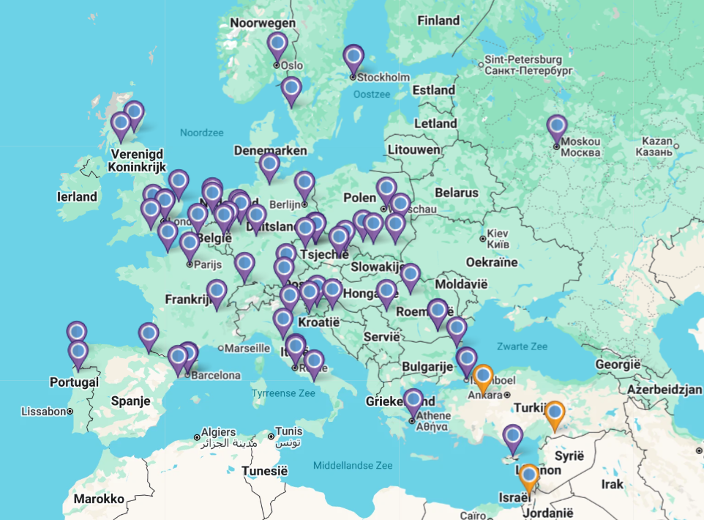
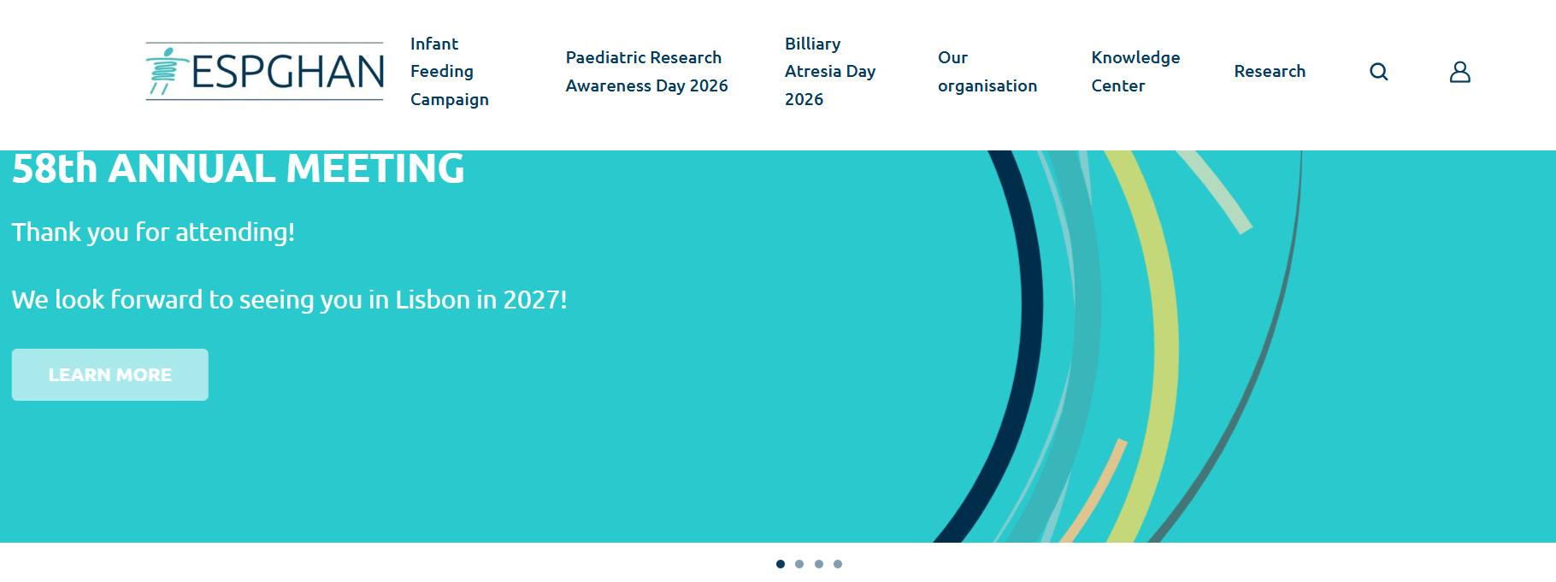
ESPGHAN Research Network Map
Paediatric Division Paediatric Gastro-enterology, Hepatology and Nutrition
58th ESPGHAN Annual Meeting Lille, 2026
6000 participants

Slide 10

Paediatric Haematology & Oncology
DIVISION
2025/16
>2,700
Why a Division
UEMS European Training Requirements adopted by Council [1]
SIOP Europe members across 36 European countries [2]
The training path to become a paediatric haemato-oncologist differs widely across Europe [4]
Already organised through national paediatric haemato-oncology societies across Europe [2]
A European syllabus (SIOPE with EHA) already exists to build on [5]
90
28
ERN PaedCan centres: 79 full members + 11 affiliated partners [3]
countries in ERN PaedCan: all 27 EU Member States + Norway [3]
Number of practising specialists: being compiled with SIOP Europe
[1] UEMS, list of adopted European Training Requirements, uems.eu/european-training-requirements [2] SIOP Europe, About SIOPE & Members, siope.eu [3] EMA network catalogue: ERN PaedCan (2025)
[4] Jelic M et al. Young paediatric oncologists and haematologists in Europe. EJC Paediatric Oncology 2024;4:100192 [5] SIOP Europe, European Training Programme (Syllabus), siope.eu
Notes:
(~75 seconds)
Our second proposed Division is paediatric haematology and oncology.
Here too, UEMS Council has already adopted European Training Requirements, most recently in 2025.
The field is organised across the whole continent: SIOP Europe has more than 2,700 members in 36 European countries, built on the national paediatric haemato-oncology societies. The European Reference Network PaedCan covers all 27 EU Member States plus Norway, with 90 centres.
Yet the training path to become a paediatric haemato-oncologist still differs widely between countries. A European syllabus, developed by SIOP Europe with the European Haematology Association, already exists — a Division would give it a formal home within UEMS.
Note that SIOP Europe membership is multidisciplinary; the number of practising physicians is being compiled with SIOP Europe.

Slide 11
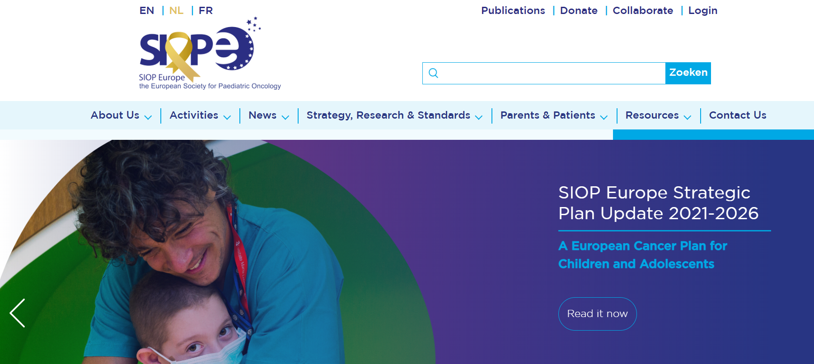
SIOP Europe
Paediatric Division Paediatric Hemato-Oncology
SIOP Europe (SIOPE) Congres 2026 Glasgow
1.310 participants

Slide 12



Subdivisions strengthen care, training and our Section: visibility for
WHY IT MATTERS
Children & families
Consistent, high-quality specialist care across Europe
Our ask today
Trainees
Clear pathways, recognised qualifications, easier mobility
1
Endorse the principle of subdivisions within the Section of Paediatrics
2
Approve the creation of Subdivision Paediatric Gastro-enterology, Hepatology and Nutrition
Member states
A European benchmark for national training programmes
3
Approve the creation of Subdivision Paediatric Hemato-oncology
Our Section
Paediatrics speaks with one voice — generalists and subspecialists together
Notes:
(~60 seconds)
Why does this matter?
For children and families, it means consistent, high-quality specialist care, wherever they live in Europe.
For trainees, it means clear pathways, qualifications that are recognised, and easier mobility between countries.
For member states, it offers a European benchmark to build their national programmes on.
And for our Section, it means paediatrics speaks with one voice — generalists and subspecialists together, rather than drifting apart.
So my ask today is concrete: first, endorse the principle of subdivisions within our Section. Second, set up a working group together with the European subspecialty societies. And third, bring draft governance and training requirements back to the next plenary.
Thank you — I would be glad to take your questions.

