Slide 1
The Office for EU & International Affairs
Brussels 17th October 2026
House of the International Associations

Slide 2
The Office for EU & International Affairs
Mrs. Isabelle DUMAINE isabelle@uems.eu
EU Policy & Public Affairs Manager
takes care of the follow-up in EU legislation & of UEMS communication
getting UEMS involved in EU projects
prepares & sends around the newsletter EU Insight

Slide 3
The Office for EU & International Affairs
Dr. Marc H.M. Hermans marc.uems@telenet.be
ambassador for the UEMS
Contacts with the EMOs
AEMH, CEOM, CPME, FEMS, EJDs, UEMO, EAHP
online events e.g. European Observatory
WHO survey on Mental Health of Doctors and Nurses
in the EU, Norway & Iceland

Slide 4
The Office for EU & International Affairs
Regular meetings
Weekly online meetings with the Executive Committee
and regular meetings with the Enlarged Executive
European Medical Associations’ Presidents meetings
rescheduled: twice a year live, twice online
UEMS and CPME remain the main hosts
EMOs can host meetings during their general assemblies
Live attendance
was limited during the last half year due to family and
profession related difficulties

Slide 5
The Office for EU & International Affairs
Mental Health of Doctors and Nurses
in the EU, Norway & Iceland
logistics: WHO Europe + finances: the EU
extensive report: (first author Roberto Mediavilla)
https://www.who.int/europe/publications/i/item/WHO-EURO-2025-12709-52483-81031
Lancet paper:
https://www.thelancet.com/action/showPdf?pii=S2666-7762%2826%2900221-8

Slide 6
External contacts
European Academy for Clinical Leadership
EACL was initiated by AEMH and
further supported and inspired by UEMS
UEMS delegates: Prof. Hannu Hallila & Dr. Marc Hermans
a changing concept => proposal to 3 UEMS Sections
Sections of Surgery, Endocrinology & Adult Psychiatry
  a pilot: combining UEMS examination and EACL assessment

Slide 7
External contacts
Working Group on Ukraine
Meetings with Dr. Olena Lukashevych
Kyiv Public Health Service
The Palliative Care project:
developing palliative care is a priority in Ukraine
request for guidance on developing training
  on developing care models

Slide 8
External contacts
Working Group on Ukraine
Meetings with Dr. Olena Lukashevych
Kyiv Public Health Service
The Palliative Care project:
several contacts with Dr. Gert Huysmans
European Association for Palliative Care
  Memorandum of Understanding

Slide 9
External contacts
Working Group on Ukraine
Meetings with Dr. Olena Lukashevych
Kyiv Public Health Service
Prof. Anton Volosovets
psychotrauma care under difficult conditions
a 5-days course, preferably live
  Kyiv => Lviv needs further exploration

Slide 10
External contacts
Working Group on Ukraine
Meetings with Dr. Olena Lukashevych
Kyiv Public Health Service
Med Col Dr. Roman Kuziv
recent developments in war medicine
proposed exchange programs
  work in progress

Slide 11
External contacts
MJC on Disaster Medicine
Bureau:
chair: Prof. Michael Malloy
    secretary: Georg Teo Voicescu
treasurer:Prof. Aivars Vetra
delegate from the EC: Dr. Marc Hermans
  next to 50 members from different UEMS bodies

Slide 12
External contacts
MJC on Disaster Medicine
Activities:
online meetings to discuss the strategy
    survey on the actual status of training programs
first goal is developing an ETR
meeting with EC confirmed needed support
  some bottlenecks

Slide 13
External contacts
MJC on Disaster Medicine
Full scale Russian invasion inspired this initiative
broadening scope military medicine => disasters
    no members with a military background
the kind of injuries very different from the past
skull, burns, shock wave injuries
  civil population much more involved

Slide 14
External contacts
MJC on Disaster Medicine
A personal initiative: UEMS – FMS shared initiative
Belgian military doctors Med Gen An Van Rompay
    International Committee on Military Medicine
www.cimm-icmm.org
from local & international background to EU level
  what have EU countries already done

Slide 15
EU-funded projects
DISCERN DSS • ERASMUS +
DISCERN-DSS: DIgitally enhanced SCenario basEd leaRNing for Digital Soft Skills, Project number: 101179391, is a project co-funded by the Erasmus+ programme of the European Union, Key Action 2 – Cooperation for innovation and the exchange of good practices – Capacity-Building projects in the field of Higher Education,
Funded by the European Union. Views and opinions expressed are however those of the author(s) only and do not necessarily reflect those of the European Union or European Education and Culture Executive Agency (EACEA). Neither the European Union nor the granting authority can be held responsible for them.

Slide 16








Project overview
PROJECT GOAL
6 PARTNERS
Developing modules of training
on telemedicine, & digital soft skills
using digital tools of teaching,
i.e. scenario-based learning
TIMELINE
Ends on 31st December 2027

Slide 17
Where we stand as of now
WP4 Co-design of D-SBL content
15 scenarios have been developed for training on digital soft skills with participation of educators and students
WP5 Technical development of D-SBL resources & piloting
The 15 D-SBL resources are being piloted with students
Equipments to produce the digital materials of the D-SBL are being purchased

Slide 18
EU-funded projects
UM-HEART-VR • ERASMUS +
Upskilling Malaysian Healthcare for empathy and communication through Virtual Reality, Project number: 101237216, is a Project co-funded by the Erasmus+ programme of the European Union, Key Action 2 – Cooperation for innovation and the exchange of good practices – Capacity-Building in the field of Higher Education.
Funded by the European Union. Views and opinions expressed are however those of the author(s) only and do not necessarily reflect those of the European Union or European Education and Culture Executive Agency (EACEA). Neither the European Union nor the granting authority can be held responsible for them.

Slide 19





Project overview
PROJECT GOAL
6 PARTNERS
Developing training on communication & empathy
using VR-based problem-based learning educational activities
TIMELINE
Ends on 31st December 2028

Slide 20
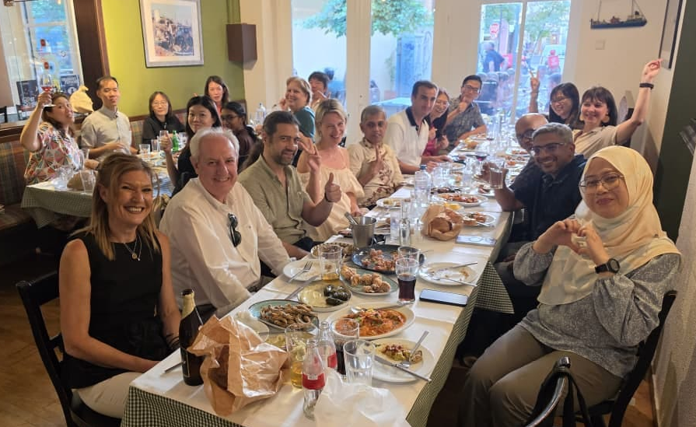
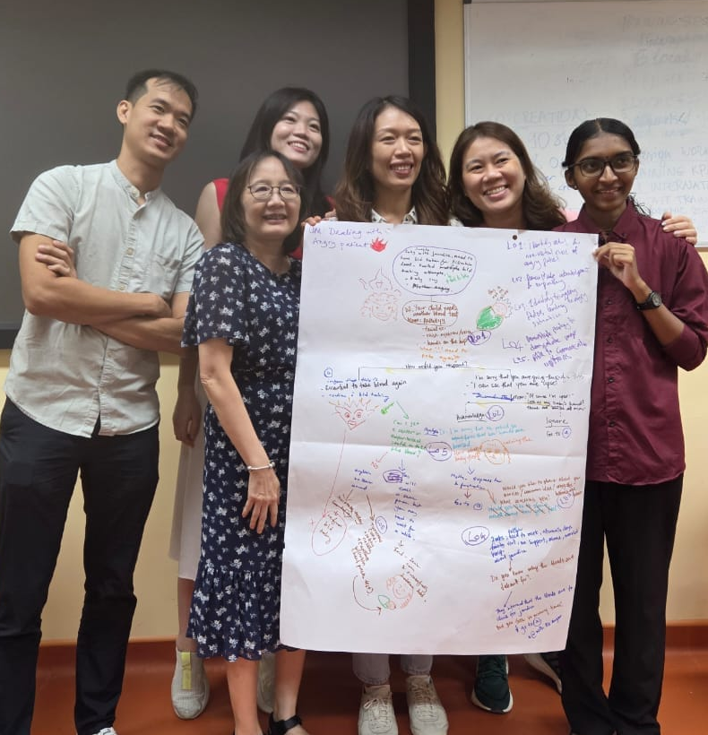
Where we stand as of now
WP2 Specification, design & implementation of VR-based training resources
15 scenarios are being developed on empathy and patient-doctor communication and interprofessional communication
WP3 Train the trainers
International workshop on 11, 13 & 14 July in Thessaloniki, and then followed by local workshops

Slide 21
EU-funded projects
KEEPCARING • HORIZON EUROPE
The KEEPCARING project is funded by the European Union’s Horizon Europe research and innovation programme under grant agreement No. 101137244.
Funded by the European Union. Views and opinions expressed are however those of the author(s) only and do not necessarily reflect those of the European Union or the European Health and Digital Executive Agency (HADEA). Neither the European Union nor the granting authority can be held responsible for them.

Slide 22


















Project overview
PROJECT GOAL
Reducing stress and preventing burnout among healthcare workers
by developing innovative, co-created solutions combining non-digital, digital, and AI-driven approaches
19 PARTNERS
TIMELINE
Ends on 31st July 2028

Slide 23
Where we stand as of now
Clinical studies
On stress, burn-out and resilience notably using biomarkers with hexoskin (WP2)
On interactions in the OR through postoperative team debriefing using audio and video recordings (WP3)
On effects of nature-based VR environment to reduce stress levels at the wards and in the OR (WP3)
On nurses’ mental wellbeing using daily diary, and evaluating the impact of breathing exercises on compassion, of job crafting to reduce stress (WP4)
Change Management Platform (WP5)
Development of the online portal which will aim to provide support to individuals, teams and organisations using profiling approach with AI

Slide 24

Where we stand as of now
Clinical studies
On stress, burn-out and resilience notably using biomarkers with hexoskin (WP2)
On interactions in the OR through postoperative team debriefing using audio and video recordings (WP3)
On effects of nature based VR environment to reduce stress levels at the wards and in the OR (WP3)
On nurses’ mental wellbeing using daily diary, and evaluating the impact of breathing exercises on compassion, of job crafting to reduce stress (WP4)
Change Management Platform (WP5)
Development of the online portal which will aim to provide support to individuals, teams and organisations using profiling approach
CMP
Presentation

Slide 25
Thanks for your attention
  Marc H.M. Hermans
  Officer for European & International Affairs
  marc.uems@telenet.be

