Slide 1


Challenges of OSCE delivery
(European Exit Exam nodal point)
Paul Ridgway

Slide 2
Challenges of EBSQ delivery
(European Exit Exam nodal point)
Paul Ridgway

Slide 3







Disclosures

Slide 4

Competence Assessment

Slide 5
Technical: Logbook, reference, operative judgement (discussion), simulation?
Non-technical: Clinical decision making, anatomy, data analysis, MDT simulation, Communication
Knowledge base: the above & MCQ
Clinical competence Surrogates

Slide 6

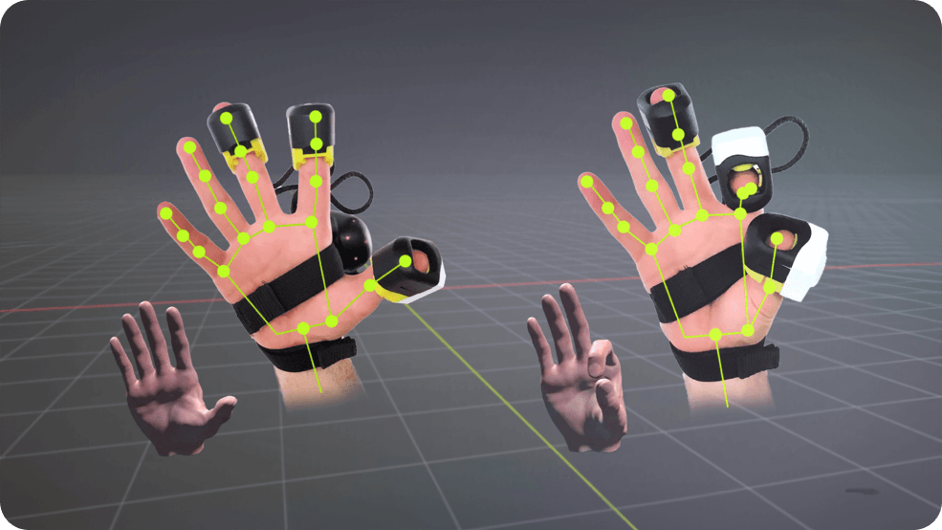
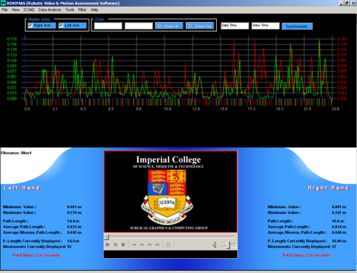
Assessing Nodal Points: Transitioning into Practice
*Ridgway et al, BJS (2003) 90 (10) 1294-9

Slide 7


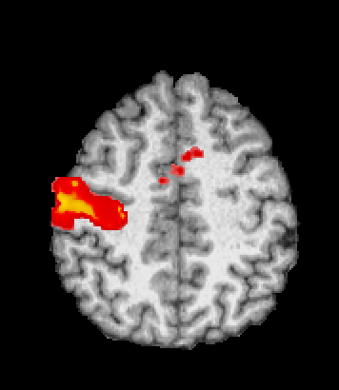
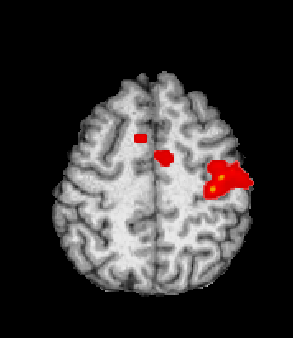

Assessing technical skill in the MRI
Right Thumb Left Thumb
*Morris M, Gillis A et al, 2013; ASGBI 2014

Slide 8

Assessing at exit of training nodal point
Domains
Technical?
Non technical?
Knowledge base?
All?
Some?

Slide 9




Slide 10
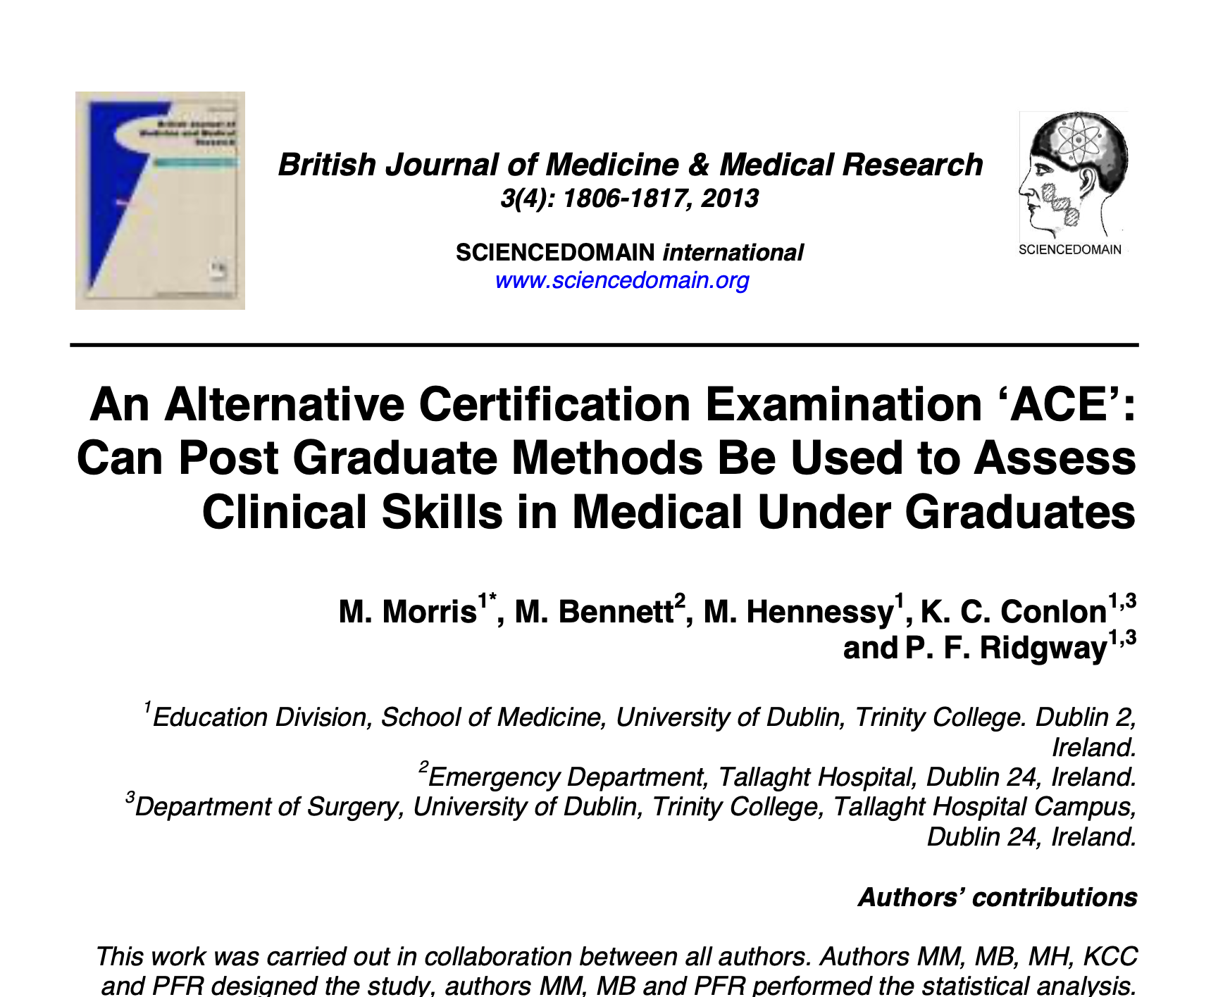

Slide 11
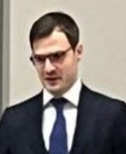

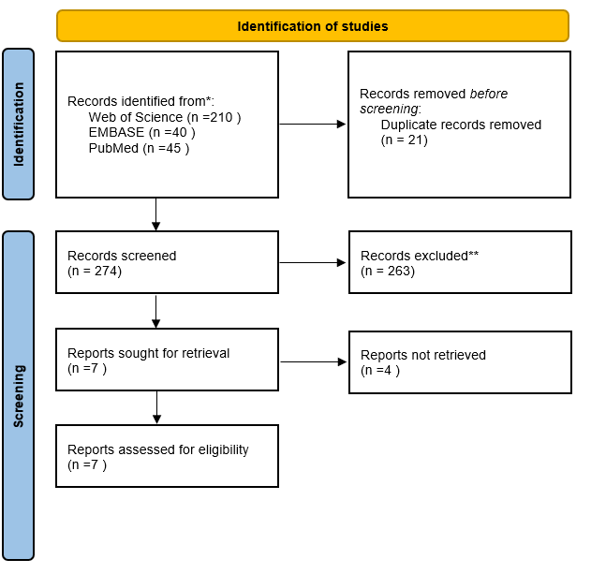


European Standard Exit Criteria
High variability
  National/Fellowship exams (UK, Ireland, Italy, France, Austria, Greece)
  Decentralised (Germany, Switzerland)
  Hospital-driven (Sweden)
  No exam (Denmark, Netherlands, Spain)
Duration: 5–8 years
Key Themes
  Fragmented landscape – No unified European standard
  Exams inconsistency
  Logbooks/procedure minimums: often indicative, not mandatory
  Future Needs: European Harmonisation, Competency-based Assessments, Standardisation, and Transparent Model
Currently completing data – Formats of Exit examinations

Slide 12



Slide 13


Our Exam- Minimum Elements:
Eligibility
MCQ
Clinical Assessment
  Clinical
  Critical Appraisal
  Data analysis
  High stakes Human Factors
  Operative skills
  MDT (if appropriate)

Slide 14
Challenges with OSCE
Not an OSCE
Standardised short form structured exam
Clinical heavy
90 minutes
Validity of Context of Exit exams

Slide 15

Admiring the problems….

Slide 16
Clinical Exam
Governance
Cost
Authenticity vs. Standardisation
SP versus ACE versus Patients
Blueprint mapping (board domains)
Time constraints versus depth
Procedural stations and fidelity?

Slide 17
Candidates
Cost
Station Predictability (candidate sharing)
Candidate Variability Across Circuits
Equity and cultural bias
Candidate cognitive load

Slide 18
Examiners
Cost
Periodicity
Court of Examiners variability
Checklists versus global raters
Time constraints versus depth

Slide 19
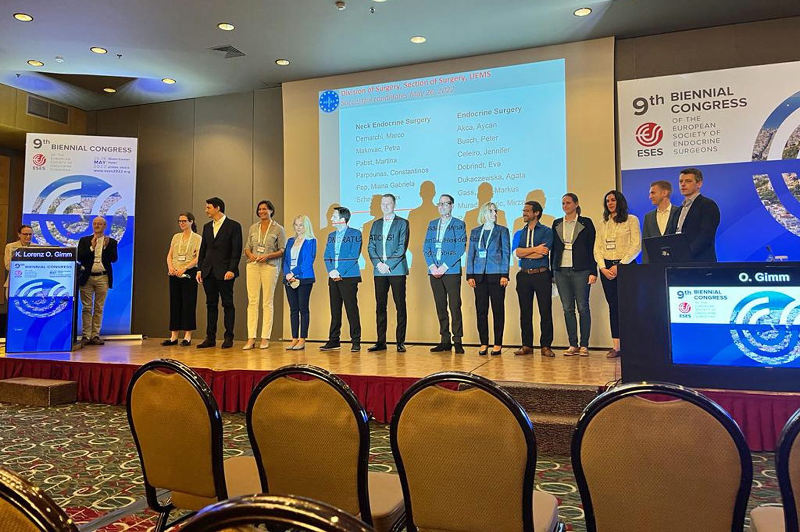
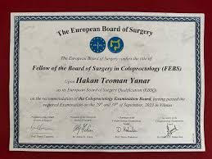
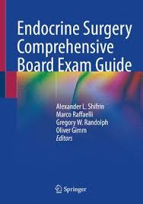






Slide 20
Minimum Standardised criteriae?
Weighted Blueprint to the competency framework and case-mix at agreed nodal point (Eligibility)
Robust exam governance
Ensure sufficient sampling time
Defensible standard setting
Extra Control on Examiner effects
Combine multiple modalities of assessment

Slide 21
Challenges of EBSQ delivery
(European Exit Exam nodal point)
Paul Ridgway

Slide 22




@UEMSf

