Slide 1


UEMS CESMA
2025 12 06
MULTIPLE CHOICE QUESTIONs:
QUALITY and VALIDITY
Ambrogio Fassina

Slide 2
The UEMS represents & supports medical specialists
The UEMS is a European non-profit organisation representing more than 1.6 million specialist doctors, from all EU countries and beyond.
UEMS members are the most representative associations of medical specialists in their respective countries.
The UEMS objective is to improve patient care across Europe by developing and supporting excellence in specialist medical practice.

Slide 3
2015 04 10
A GUIDE TO SUCCESSFULLY WRITING MCQS: EXECUTIVE SUMMARY
Alfred Tenore, Danny G.P. Mathysen, Peter Mills, Mark Westwood, Jean-Baptiste Rouffet, Vassilios Papalois, Owen Sparrow, Zeev Goldik https://drive.google.com/file/d/1a17KFLcpNn7loJMho39KFB1BlsS3s-Fe/view
High level harmonised postgraduate ETR
Organisation of European examinations
Accreditation of training centres

Slide 4
The role of knowledge-based assessment (KBA) in postgraduate training
The characteristics of a safe and caring doctor include not only knowledge, which we recommend is assessed by MCQs, but also skills and professional behaviours.
In an age of rapid electronic access to knowledge, the ability of the doctor to use knowledge in an appropriate way is as important as the possession of that knowledge.
The role of the KBA, or examination, is by definition limited to an assessment of factual knowledge.
A KBA may be deemed necessary to demonstrate competence, but is unlikely to be sufficient to define a good doctor.
CESMA
A GUIDE TO SUCCESSFULLY WRITING MCQs (2015)

Slide 5
PATHOLOGY ETRS
Knowledge MCQs
Skills EPAs
Professional Behaviour CanMeds
UEMS GENERAL COUNCIL MEETING
Tbilisi, Georgia
2025 10 18

Slide 6
The contents of MCQs must always relate back to a published curriculum.
The MCQs should be seen as a mechanism for ensuring that the candidate possesses knowledge across the breadth of the published curriculum.
An important responsibility of the exam-setting group is to select from the question bank an appropriate numbers of questions reflecting the relative
importance of the different topics within the curriculum.
Similarly, question writers generating MCQs for the bank should therefore be guided to generate questions based on the strategic needs of the bank.
A GUIDE TO SUCCESSFULLY WRITING MCQs (2015)

Slide 7
Post-hoc analysis of performance
A good question is determined by post-hoc analysis of its performance (reliable post-hoc analysis results will only become available if the number of candidates participating at the assessment is sufficiently large).
1. In a post-hoc analysis a good question is considered to be one that discriminates between good and poor candidates.
2. Bad questions have a tendency to correlate negatively with the overall performance: e.g. poorly performing candidates answer the question correctly, while the best performing candidates tend to give the incorrect answer.
A GUIDE TO SUCCESSFULLY WRITING MCQs (2015)

Slide 8
Constructing the question bank
For a fair summative assessment it is important that the whole breadth of the published curriculum is covered.
In addition, different parts of the curriculum will be weighted in terms of importance. Hence the structure of each exam should be linked to the curriculum with appropriate weighting (“blueprinted”).
It follows that the number of available questions in the Question Bank relating to each part of the curriculum should be proportional to this predetermined weighting.
A GUIDE TO SUCCESSFULLY WRITING MCQs (2015)

Slide 9
A ’’GOOD MCQ’’ MUST BE ’’VALID’’ and ‘’RELIABLE’’
GOOD: please carefully refer our Treasur: GUIDE TO SUCCESSFULLY WRITING MCQS: EXECUTIVE SUMMARY
VALID:
based on truth or reason; able to be accepted; having legal force; (CED)
RELIABLE:
can be trusted or believed because it works or behaves well in the way you expect;
deserving trust;
the overall consistency of a measure (high reliability if it produces similar results under consistent conditions)
Inter-rater reliability Test-retest reliability
Internal consistency Inter-method reliability
CESMA

Slide 10
The Data Base will itself validate the MCQ
if it will be constructed to that purpose
Number of the MCQ (generated by the Server)
Name of the AUTHOR
Date of Creation
Organ and System
Sub-System (Malformations, Inflammatory, Degenerative, Neoplastic)
Immuno Markers for Sub-typing
Special Techniques Requested

Slide 11
Level of Difficulty (Easy, Medium, Difficult)
Name of Reviewer
Date of Review
Number of times the MCQ has been emplyed
Number of reported SUCCESSES
Number of reported FAILURES
Number of NO- RESPONSE
THE GOOD QUESTION

Slide 12
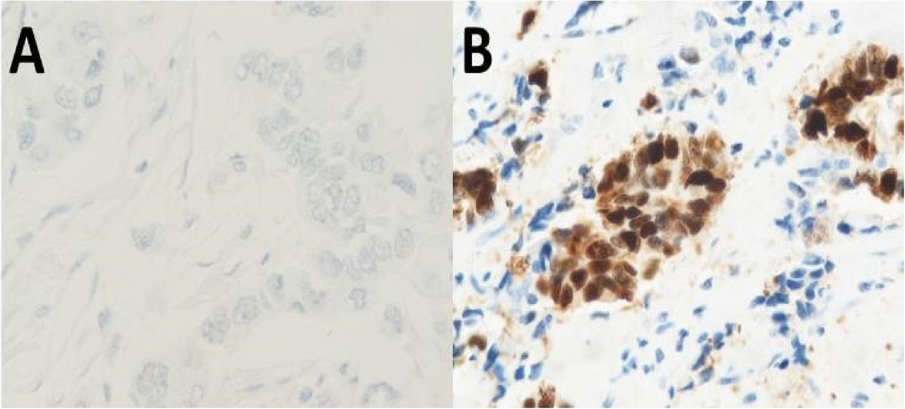
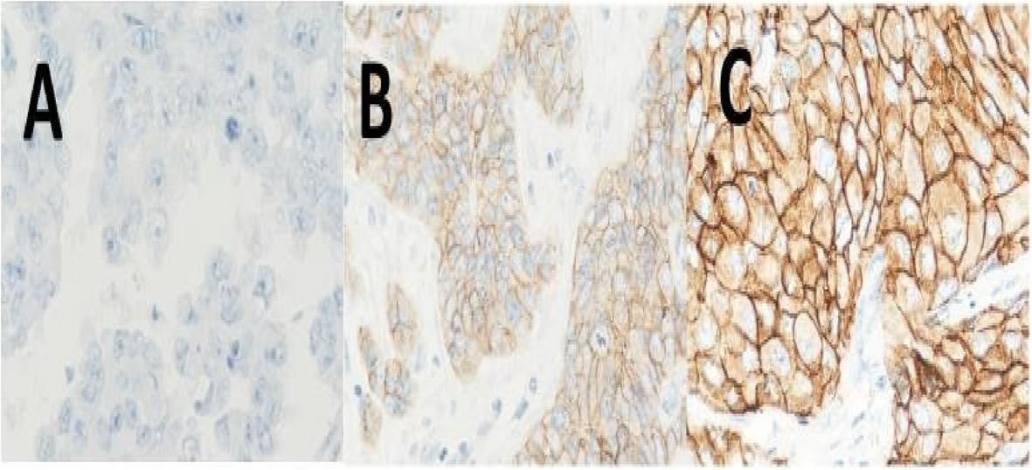
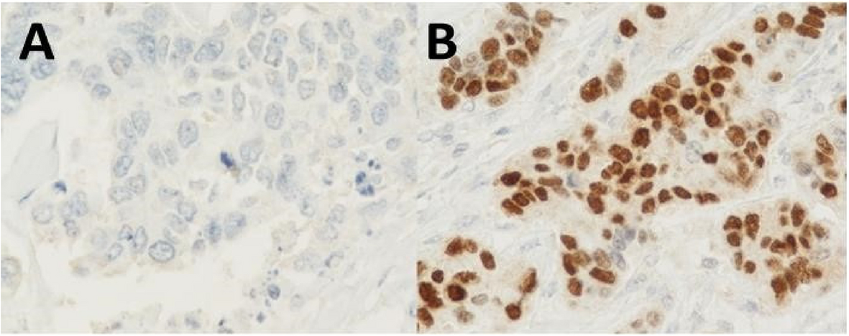
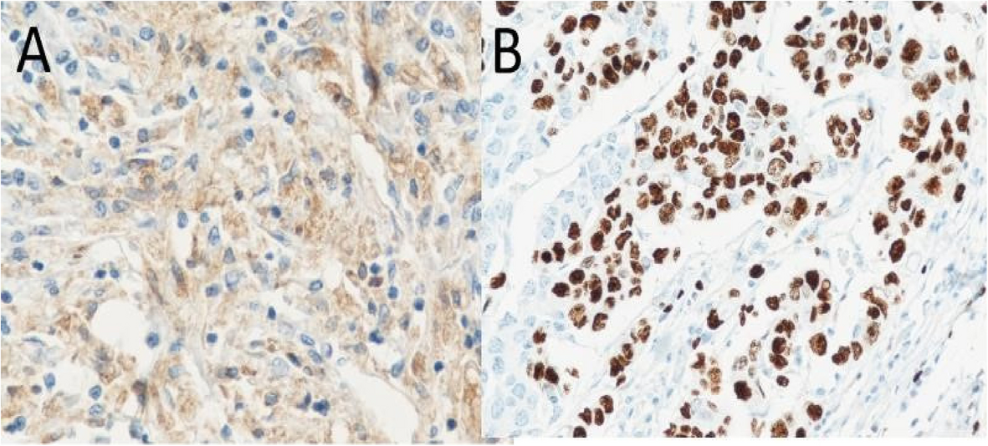
ER
PR
Her-2
KI-67
KI-67 control
F, 74 1.7 cm nodule, left upper quadrant. Which is your diagnosis
1. Invasive Ductal Carcinoma, NOS
2. Luminal A
3. Luminal B
4. Triple Negative
5. Luminal A/B

Slide 13
Morphologic type (n = 125)
Invasive ductal carcinoma-NOS
Invasive mucinous carcinoma
Invasive papillary carcinoma
Micropapillary carcinoma
Oncocytic carcinoma
Signet ring
Cribriform
Invasive lobular carcinoma
Metaplastic carcinoma
Medullary
Neuroendocrine
Tubular

Slide 14
E.G.
3856
AF
2025 12 06
Breast
Neoplastic
ER, PR, HER2, Ki-67, p53, BRCA1, BRCA2, CK5, CK7, CK20, COX-2, Cyclin D1, E CAD, SMA
Immunofluoresence, Molecular

Slide 15
Level of Difficulty (Easy, Medium, Difficult)
Name of Reviewer Marszalek
Date of Review 2025 12 31
Number of times of USE of the MCQ 5
Number of SUCCESSES 2
Number of FAILURES 2
Number of NO- RESPONSE 1

Slide 16
In a newborn male infant the right testis is palpable, no left testis in the scrotal sac. The infant has no other abnormalities. Which of the following is the most likely abnormality involving the gonads of this infant?
A Agenesis
B Fusion
C Hypopituitarism
D Incomplete descent
E Leydig cell aplasia

Slide 17
E.G.
3857
AF
2025 12 06
Embryology
Malformative
CESMA

Slide 18
The Data Base will itself validate the MCQ if it will be constructed to that purpose
Level of Difficulty (Easy)
Name of Reviewer Marszalek
Date of Review 2025 12 31
Number of times of USE of the MCQ 5
Number of SUCCESSES 2
Number of FAILURES 2
Number of NO- RESPONSE 1

Slide 19
A 56-year-old man reports reduced exercise tolerance over the past 5 years. Recently, he has noted chest pain after ascending a flight of stairs. He smokes 2 packs of cigarettes per day.
Blood pressure of 155/95 mm Hg, body mass index is 30 kg/m².
Total serum cholesterol of 245 mg/dL with HDL cholesterol of 22 mg/dL.
Which of the following vascular abnormalities is he most likely to have?
A Hyperplastic arteriolosclerosis
B Lymphedema
C Medial calcific sclerosis
D Atherosclerosis
E Deep venous thrombosis
F Plexiform arteriopathy

Slide 20
A 31-year-old woman, who has two healthy children, notes that she has had no menstrual periods for the past 6 months, but she is not pregnant and takes no medications. Within the past week, she has noted some milk production from her breasts. She has been bothered by headaches for the past 3 months. After nearly hitting a bus while changing lanes driving her vehicle, she is concerned with her vision. An optometrist finds her lateral vision to be reduced. On physical examination she is afebrile and normotensive.
Which of the following laboratory test findings is most likely to be present in this woman?
A Increased serum cortisol
B Lack of growth hormone suppression
C Increased serum alkaline phosphatase
D Hyperprolactinemia
E Hyponatremia
F Abnormal glucose tolerance test
G Decreased serum TSH

Slide 21
A 50-year-old man has episodic headaches for 3 months. On physical examination his blood pressure is 185/110 mm Hg, with no other remarkable findings. Laboratory studies show sodium 145 mmol/L, potassium 4.3 mmol/L, chloride 103 mmol/L, C02 26 mmol/L, glucose 91 mg/dL, and creatinine 1.3 mg/dL. An abdominal CT scan shows a 7 cm left adrenal mass.
During surgery, as the left adrenal gland is removed, there a marked rise in blood pressure.
Which of the following laboratory test findings most likely explains his findings?
A Decreased serum cortisol
B Decreased urinary homovanillic acid
C Increased serum ACTH
D Increased urinary free catecholamines
E Elevated serum ANCA

Slide 22
ADVANTAGES OF USING MCQ-BASED ASSESSMENT
Marking of the assessment can be undertaken electronically, which will reduce measurement errors.
As over the years the MCQ bank will be progressively built up, the costs of assessment of knowledge will become predictable and contained.
The “correct” answers of the MCQs are predetermined, and therefore do not involve the subjective judgements required in e.g. marking narrative or essay-type assessments.
The potential lack of dependence on paper-based questions permits substantial flexibility in both the location and the timing of the exam.
It is easy to vary the order in which questions are presented to the candidates electronically, as a security measure.
A GUIDE TO SUCCESSFULLY WRITING MCQs (2015)

Slide 23
Involvement of Scientific Societies
Creation of large data base of MCQs UEMS ETRs based
Uniformity of structures, Hard and Soft-ware
UEMS or other Institutions Server
Monitor friendly access for MCQ creation, revision and qualificaiton
Use of DB for NMA, academic or any other educational activity.

